Slide 1
Constraint Satisfaction
CSD 15-780: Graduate Artificial Intelligence
Instructors: Zico Kolter and Zack Rubinstein
TA: Vittorio Perera

Slide 2
Constraint satisfaction problems
A constraint satisfaction problem (CSP): A set of variables X₁…X_{n}, and a set of constraints C₁…C_{m}. Each variable X_{i} has a domain D_{i} of possible values.
A solution to a CSP: a complete assignment to all variables that satisfies all the constraints.
Representation of constraints as predicates.
Visualizing a CSP as a constraint graph.

Slide 3
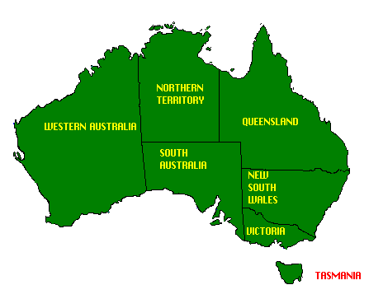
Example: Map coloring
NT
Q
WA
SA
NSW
V
T

Slide 4
Finite vs. infinite domains
Finite domains: 8-queens, matching, cryptarithmetic, job assignment
Infinite domains: job scheduling
  Cannot enumerate all possibilities
  Need a constraint language: StartJob₁ + 5 ≤ StartJob₃

Slide 5
Solving CSPs using search
Initial state: the empty assignment
Successor function: a value can be assigned to any variable as long as no constraint is violated.
Goal test: the current assignment is complete.
Path cost: a constant cost for every step.

Slide 6
High-order constraints
T W O
+ T W O
F O U R
F
T
U
W
R
O
O + O = R + 10•X1
X₁ + W + W = U + 10•X₂
X₂ + T + T = O + 10•X₃
X₃ = F
alldiff(F,T,U,W,R,O)
X₃
X₂
X₁

Slide 7
Constraint optimization
Representing preferences versus absolute constraints.
Constraint optimization is generally more complicated.
Can be solved using local search techniques.
Hard to find optimal solutions.

Slide 8
Commutativity
Naïve application of search to CSPs:
  Branching factor is n•d at the top level, then (n-1)d, and so on for n levels.
  The tree has n!•d^{n} leaves, even though there are only d^{n} possible complete assignments!
Naïve formulation ignores commutativity of all CSPs. Solution: consider a single variable at each depth of the tree.

Slide 9
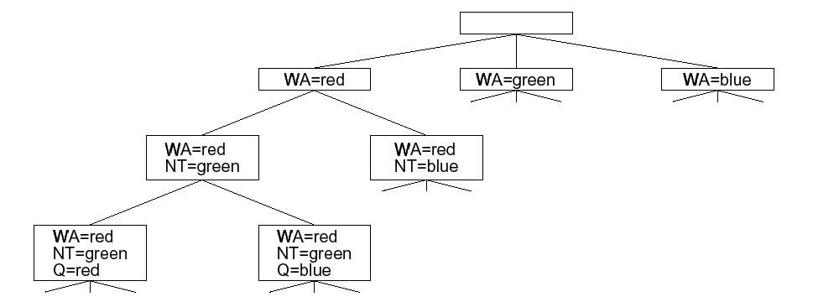
Part of the map-coloring search tree

Slide 10
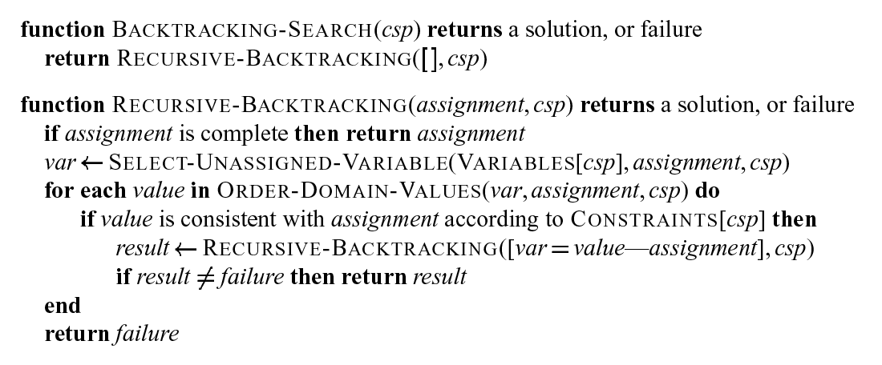
Simple backtracking

Slide 11
Heuristics that can help
Key questions:
Which variable should be assigned next and in what order should the values be tried?
What are the implications of the current variable assignments for the other unassigned variables?
When a path fails, can the search avoid repeating this failure in subsequent paths?

Slide 12
Variable and value ordering
Variable ordering
The most-constrained-variable heuristic (has the fewest “legal” values)
The most-constraining-variable heuristic (involved in largest number of constraints)
Value ordering
The least-constraining-value heuristic (rules out the fewest choices for neighboring vars)

Slide 13
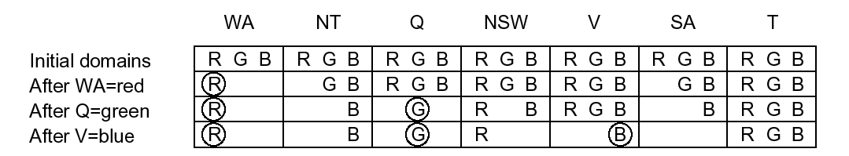
Constraint propagation
Reduce the branching factor by deleting values that are not consistent with the values of the assigned variables.
Forward checking: a simple kind of propagation

Slide 14
Arc consistency
An arc from X to Y in the constraint graph is consistent if, for every value of X, there is some value of Y that is consistent with X.
Can detect more inconsistencies than forward checking.
Can be applied as a preprocessing step before search or as a propagation step after each assignment during search.
Process must be applied repeatedly until no more inconsistencies remain. Why?

Slide 15
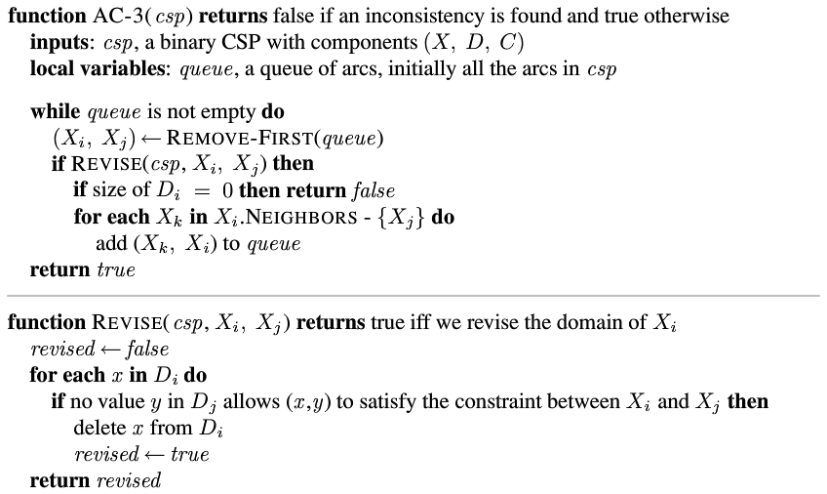
AC-3 Arc Consistency Algorithm

Slide 16
Complexity of arc consistency
A binary CSP has at most O(n²) arcs
Each arc (X→Y) can only be inserted on the agenda d times because at most d values of Y can be deleted.
Checking consistency of an arc can be done in O(d²) time.
Worst case time complexity is: O(n²d³).

Slide 17
K-consistency
A graph is k-consistent if, for any set of k variables, there is always a consistent value for the kth variable given any consistent partial assignment for the other k-1 variables.
A graph is strongly k-consistent if it is i-consistent for i = 1..k.
Higher forms of consistency offer stronger forms of constraint propagation.
Specialized algorithms for resource constraints, bounds constraints, etc.

Slide 18
Intelligent backtracking
Chronological backtracking: always backtrack to most recent assignment. Not efficient!
Conflict set: A set of variables that caused the failure.
Backjumping: backtrack to the most recent variable assignment in the conflict set.
Simple modification of BACKTRACKING-SEARCH.
Every branch pruned by backjumping is also pruned by forward checking!
Conflict-directed backjumping: better definition of conflict sets leads to better performance.

Slide 19
Local search for CSPs
Start state is some assignment of values to variables that may violate some constraints.
Successor state: change value of one variable.
Use heuristic repair methods to reduce the number of conflicts (iterative improvement).
The min-conflicts heuristic: choose a value for a variable that minimizes the number of remaining conflicts.
Can solve the million-queens problem in an average of 50 steps!

Slide 20
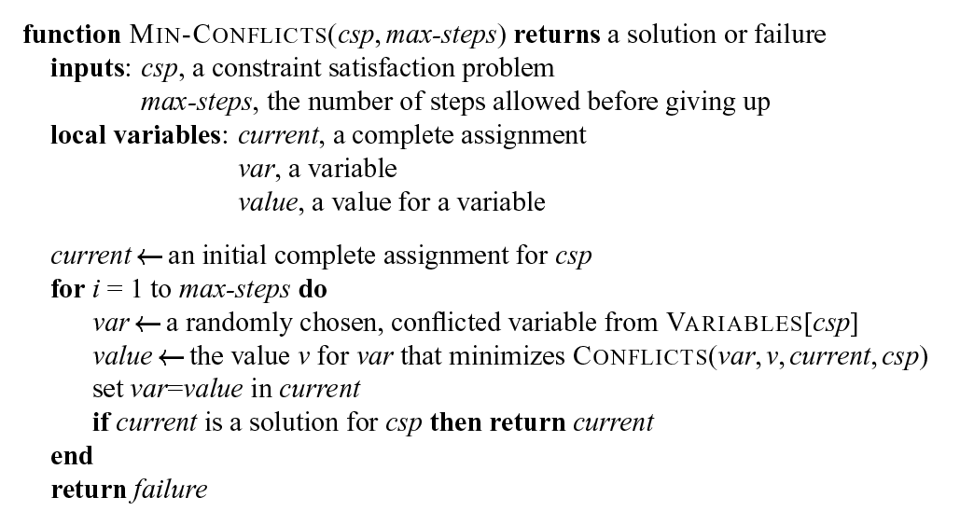

Slide 21
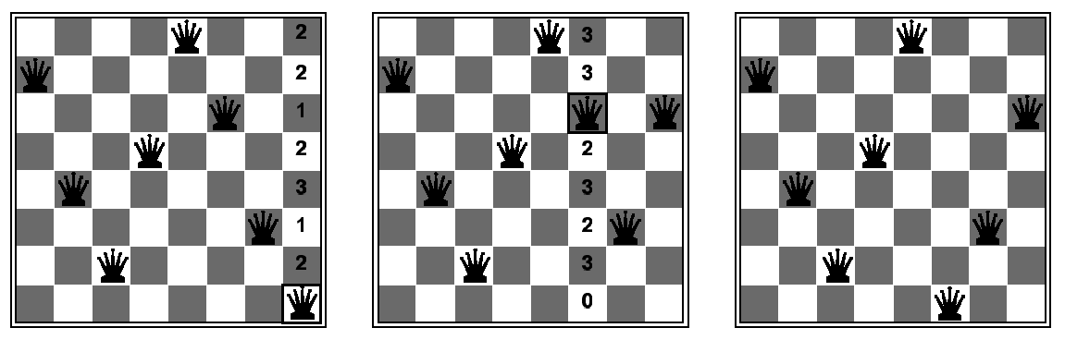
Example of min-conflicts
A two-step solution of an 8-queens problem. The number of remaining conflicts for each new position of the selected queen is shown. Algorithm moves the queen to the min-conflict square, breaking ties randomly.

Slide 22
Scheduling Example
A process consists of a set of tasks that are constrained into a partial order by temporal precedence constraints.
Each task can be accomplished using a set of resources. There may be multiple sets of resources that can satisfy the task.
The problem is to schedule the tasks in such a way as to limit the amount of delay caused by the lack of resource availability.

Slide 23
Scheduling Example (cont.)
Variables: tasks
Values: resource assignments
General algorithm:
  Do critical path analysis
  Choose task to schedule using variable-ordering heuristic.
  Generate possible reservation assignments
    This step is needed to account for the domain being so large (not quite continuous but close).
  Select reservation assignment using value-ordering heuristic

Slide 24
Scheduling Example (cont.)
In general, different heuristics result in different schedules.
  Still, cannot not guarantee quality in schedule. It depends on the individual problem.
Not all solutions are possible – what do you do?
  Backtrack
Relax termination condition by allowing delay to be introduced.

Slide 25

Blackboard Systems
Based on a “brainstorming experts” analogy
  Experts work as a team to “brainstorm” a solution to a problem, using a large blackboard as the workplace for cooperatively developing the solution
  Problem specifications are written onto the blackboard
  Experts all watch the blackboard, contributing their expertise (on the blackboard) when possible

Slide 26
AI Systems Using BB
Hearsay II and III – Speech understanding
HASP – Interpretation of sonar signals
AGE – Generalized HASP architecture
OPM – Opportunistic Planner
BB1- Generalized OPM
GBBOpen – BB Framework

Slide 27
Blackboard Applications
Some blackboard and blackboard-like systems include
  GEST (Georgia Tech Research Institute)
    really a hierarchical rule-based shell
  HCVM (FMC & Cimflex Teknowledge)
    BB1-like architecture with control-flow short cuts to avoid some of BB1’s overhead
  RT-1 (FMC)
    another BB1-like architecture with short cuts
  Erasmus (Boeing)
    a meta-architecture built on top of BBB (Boeing’s BB1-like architecture), UMass GBB, or GBB
  ATOME (CRIN/INRIA-Lorraine, Franc)
    another BB1-like architecture with control extensions

Slide 28
Blackboard Applications
DVMT (UMass, UMass GBB)
  Vehicle monitoring task used to model issues in DAI
Protean (Stanford, BB1)
  Identify family of solution-borne 3D protein structures from NMR data
PBA (FMC/Teknowledge, RT-1)
  Real-time monitoring and control of phosphorus manufacturing
Pilot’s Associate (various, UMass GBB, GBB, home-brew)
  Enhance situational awareness and decision-making support for pilots in advanced fighter aircraft

Slide 29
Early Blackboard Applications
CIM EX (Boeing, UMass GBB)
  Pilot’s-associate-like domain with emphasis on smart interface management (PVI)
Macro (Rockwell & Stanford, UMass GBB)
  Control of carbon-carbon-composite pyrolysis
SARGE (TI, UMass GBB, GBB)
  Develop, evaluate, and refine tactical decision aids
Guardian (Stanford, BB1)
  Intensive-care patient monitoring
Intelligent Tutor (FMC, BB1)
  Dynamic planning of instructional-material presentation

Slide 30
Blackboard Applications
Address-block recognition (SUNY Buffalo)
On-line network maintenance and diagnosis (Framentec, France)
Model-based diagnostic reasoning (MIT, Tektronix)
Pseike robot-control architecture (Purdue)
Weather prediction (Toronto)
Telecommunications-network management (Neher Labs, The Netherlands)
Human-interface tool suite (MCC)

Slide 31
Blackboard-System Application Areas
Sensory interpretation
Design and layout
Process control
Planning and scheduling
Computer vision
Knowledge-based simulation
Command and control
Symbolic learning
Case-based reasoning
Data fusion
Knowledge-based instruction

Slide 32
What is a Blackboard System?
A simple problem-solving concept
  Knowledge modules interacting via a shared database
Extremely subtle and open-ended in realization
  Will detail these issues
  Begin by contrasting with rule-based systems
  Many similarities
    both approaches were conceived about the same time
    both have notion of anonymous invocation
E=mc2
Eat at Joe’s
`(first ,b)
Module A
Module B
Module C
Module D
Module E

Slide 33
Rule-Based Systems
Characteristics
  Control implicit in rule ordering
  Strong dependency between inference engine and knowledge base
  Unstructured working memory
  Lots of rules
  Fine-grained control
  Most working-memory changes are significant
Inference
Engine
Knowledge Base
(Rules)
Working
Memory

Slide 34
Blackboard Systems
Characteristics
  Explicit flexible control
    separate from KB
  Multiple inference engines and KB representations
  Structured working memory (blackboard)
  A few knowledge sources
  Large-grained control
  Many blackboard changes are not immediately significant
WM (internal)
Inference
Engine
Knowledge Base
Control Shell
Blackboard

Slide 35
Blackboard System Components
Knowledge Sources (KSs)
  software specialists; each providing expertise needed by the application
The Blackboard
  shared repository of problems, partial solutions, suggestions, recommendations, and contributed information
Control Shell
  controls the flow of problem-solving activity in the application
Knowledge
Sources
Knowledge
Sources
Knowledge
Sources
Knowledge
Sources
Control
Shell
Blackboard

Slide 36
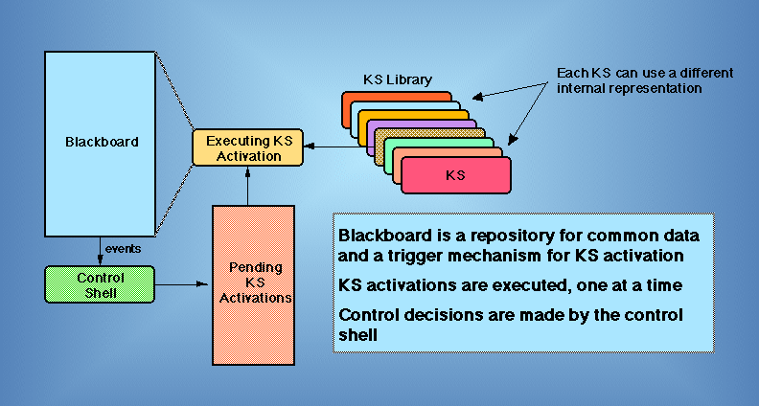
Blackboard-System Operation

Slide 37
Characteristics of a Blackboard System
Large-grained cooperating knowledge source (KS) problem-solving model
  KSs can use diverse internal problem-solving representations and implementations
KSs interact anonymously using shared global database called the blackboard
  Blackboard serves as communication medium and buffer
  Blackboard serves as community memory of data, results, and control information
  Blackboard serves as KS trigger mechanism
Opportunistic problem solving directed by explicit control component
  Separate from individual “domain” KSs
  Large-grained control of KS executions

Slide 38
Additional Characteristics
No consensus, but often present!
  Solution is generated incrementally
  Multiple levels of abstraction
  Structured blackboard
    beyond level partitioning
  Competing hypotheses problem-solving representation
  Blackboard used for control information
  Reflexive control implemented using blackboard system
  Multiple KS representations
    many classic “blackboard systems” support only a single KS representation
      actually partitioned rule-based systems
    we won’t consider them as true blackboard systems

Slide 39
Communicating Modules
Data-flow-systems design
  identify functional modules
  connect them according to communication paths
Advantages
  simple, predictable organization
Disadvantages
  static processing paths
  direct interaction (changes in functional modules requires redesign)
  leads to “private” interaction protocols that make interoperability difficult

Slide 40
Blackboard Systems
Blackboard-systems design
  identify functional modules, blackboard structure, and objects
  add control strategies as needed
Advantages
  dynamic processing paths
    adapt to situation
  indirect interaction
    allows transparent reorganization
  “public” representation
    allows other modules, development/monitoring tools, and control components to access communications
  blackboard serves as repository
Disadvantages
  more complex system infrastructure is needed

Slide 41
Advantages of Blackboard Systems
Modularity
  KSs can be developed independently
  KSs can have been developed long before the blackboard-system application itself
Integration
  KSs can use widely differing approaches, representations, programming languages
  KSs can use diverse hardware--locally or remotely
Extensibility
  New KSs can be added easily
  Existing KSs can be upgraded to new versions

Slide 42
Advantages of Blackboard Systems
Reusability
  KSs that provide expertise to one application can be redeployed in new applications
Strategic control
  Determines where the application expends its resources
  Important when
    The number of KSs grows
    KSs have overlapping capabilities

Slide 43
Why Use a Blackboard System?
When multilevel reasoning or flexible, dynamic control is required
  The original AI focus
When heterogeneous problem-solving representations and expertise must be integrated
  Including integration of legacy applications
When many developers are involved
  Large-grained anonymous modularity is important for design, implementation and maintenance
    “metaprogramming”

Slide 44
Development Strategy Overview
Initial design
  Determine blackboard structure
  Determine blackboard objects and their attributes
    The interaction “ontology” for the system
  Identify KSs
    Legacy and to be written
Sanity check
  Match KS interactions with blackboard structure and objects
Prototyping
  Prototype new KSs
  Interface legacy KSs
  Combine KSs to test interactions

Slide 45
Development Strategy Overview
Adding control
  Develop control knowledge and appropriate control strategies
Test the application
Perform performance tuning

Slide 46
Hearsay-II: The original BB system
Overview
  Who: Carnegie Mellon University
  When: 1975-1977
  Domain: Connected speech recognition
    database retrieval
  Goals:
    1000 word vocabulary, speaker trained, silent environment
    90% functionally accurate interpretations
    1/10th real time with a single processor
      hoped to use multiprocessing to achieve real-time performance
  Characteristics:
    15 KSs (C1 configuration), 12-13 (C2 configuration)

Slide 47
Hearsay-II: Architectural Requirements
Reduce search combinatorics using abstraction
Opportunistic application of diverse knowledge
Compensate for unreliable sensor data by incremental application of constraints
Apply diverse knowledge intelligently, without a known problem-solving algorithm
Support multiple system builders via modularization
Support system experimentation and evolution
  based on experience using the system
Support high-performance problem solving
  using procedural knowledge
Support parallelism

Slide 48
Hearsay-II: Levels and KSs
Database Interface
SEMANT
PREDICT
STOP
Phrase
PARSE
CONCAT
WORD-SEQ-CTL
Word-sequence
WORD-SEQ
WORD-CTL
Word
VERIFY
MOW
RPOL
Syllable
POM
Segment
SEG
Parameter
time

Slide 49
Hearsay-II: KSs
SEG: digitizes the signal
POM: synthesizes syllable-class hypotheses
MOW: synthesizes word hypotheses
WORD-SEQ: synthesizes word-sequence hypotheses
PARSE: synthesizes a phrase
PREDICT: predicts all possible words before or after a phrase
VERIFY: checks the consistency between segments and paired words in a phrase
CONCAT: creates a phrase from verified phrase predictions

Slide 50
Hearsay-II: KSs
WORD-CTL: controls the behavior of MOW
WORD-SEQ-CTL: controls the behavior of WORD-SEQ
RPOL: rates the credibility of new or modified hypotheses
STOP: decides when to halt processing and attempt an answer
SEMANT: generates the answer when STOP gives the go ahead

Slide 51
Hearsay-II: Synthesis Actions
Output context
Output context
New hypothesis
Existing hypothesis
Input context
Stimulus unit
Input context

Slide 52
Hearsay-II: Precondition-Action Model
KSs had two components
  Precondition procedure
    determines activation status
    estimates behavior of action procedure
  Action procedure
    did the real work
Stimulus/response frame
  Held state computed by precondition procedure for use by action procedure
  Could be invalidated if stimulus context changed
Precondition
Procedure
S/R
Frame
Action
Procedure

Slide 53
Hearsay-II: Scheduling Criteria
Attempted a linear combination of scheduling criteria:
  quality of KS input data
  importance of KS input data
  estimated quality of KS output data
  estimated importance of KS output data
  quality of KS knowledge
  KS performance
  estimated global benefit of KS output data
Linear combination approach (with manual learning) failed
  scheduling needed to be context sensitive

Slide 54
Hearsay-II: Summary
Main contributions
  The original blackboard system
  The cooperating KS problem-solving model
  The competing hypotheses representation
  The precondition/action KS model
  Identification of important scheduling criteria
  Development of numerous programming “tricks” that were precursors to later advances in blackboard architectures
Weaknesses
  Complex and ill structured
    due to numerous changes and advancements during its development
    many important aspects buried in code and literature

Slide 55
Designing the Blackboard and Units
Blackboard structure
  What blackboards and spaces are appropriate?
  How should the blackboards and spaces be organized?
  An issue of representational convenience and personal style
    similar to choosing a directory structure for files
Blackboard objects
  What information needs to be represented on the blackboard?
  What is an appropriate “shared” language among KSs?
  Does the application have natural objects associated with it?
  Can use standard object-oriented design methodologies

Slide 56
Identifying KSs
What processing activities need to be performed?
  Functional modularity
Are there obvious partitions of the activities based on diverse types of processing?
  Processing modularity
Are there obvious partitions based on representation choices?
  Representational modularity
Are there choices in what processing should be applied?
  Control modularity

Slide 57
Identifying KSs
Are there specific hardware requirements for any of the processing?
  Implementational modularity
What input/output data is needed?
  Data modularity

Slide 58
Defining KSs
What will trigger each KS?
On what spaces will each KS look for input objects?
  What attributes will it use?
  What assumptions are made about those attributes?
What criteria are required for KS activation?
  How complete must the input be?
Where will the KS create/modify objects?
  What attributes will be initialized/modified?

Slide 59
Analyzing KS Interactions
Review the KS specifications to insure that
  Some KS or other activity will trigger each KS
  All important events trigger at least one KS
    make certain all created/modified objects have the potential to be used by some KS
  Make certain something starts processing
    an initial KS or event
  Make certain something will stop the processing when appropriate
    continuous versus “once-only” applications
Use the KS specifications to begin coding KSs

Slide 60
Coding
Assign coding of
  Each KS
  Blackboard structure and unit definitions (infrastructure support)
  Control strategies (when needed)
KS modularity is advantageous for concurrent, team coding
  Assign domain experts to develop KSs
    unless KSs already exist
  Develop each KS according to the specifications
    any changes affecting the interface specifications must be relayed to the other KS writers and infrastructure builders
  Test each KS in isolation using test data

Slide 61
Coding
KS modularity is advantageous for evolutionary prototyping and development
  Use developers to simulate KSs via simple interactive stub
  Use canned solution to simple testbed problem
  Use simple (less complete, lower quality) approach until full KS can be developed

Slide 62
Bringing It All Together
Combine all the KSs in order to get the system to “turn over”
Be alert for
  Lack of progress due to missing triggers or activation decisions
  Cycles without progress (or with trivial progress)
  Missed stop conditions
  KS errors or poor output decisions
At this point, there is little strategic control
Watch for
  Poor choice of what to do next
    it would have been better to be working elsewhere
  Poor choice of KS to work next
    work is fine, but a better KS exists to do it

Slide 63
Adding Control
Consider what control knowledge exists for the application
Consider what control problems (lack of focus) have been encountered
Separate KS-specific control knowledge from generic and application-wide control knowledge
  KS-specific control knowledge should be bundled with the KS
Choose a control approach (control shell)
Implement and test the control approach and knowledge

Slide 64
Adding Control
Two levels of control
  Sufficient control to get the job done
    generally easy
  Optimized control to get the job done most effectively
    potentially much harder
Recommendation
  Use the simplest control approach and knowledge that will get the job done
  There is a tendency to over-complicate control activities without evidence of need

Slide 65
Performance Tuning
Performance can be significantly improved by
  Measuring what is occurring
  Analyzing how performance can be improved
  Implementing the improvements
    need a flexible blackboard framework to easily implement the improvements
    GBBOpen provides metering an mechanisms to easily tune an application
Concentrate on individual KSs
  Majority of execution time is spent in KSs
  GBBOpen metering indicates which KSs have the biggest impact on performance
Don’t neglect the blackboard
  Retrieval patterns and performance easily monitored and changed in GBBOpen.

