Slide 1
Sequential imperfect-information games
Case study: Poker
Tuomas Sandholm
Carnegie Mellon University
Computer Science Department

Slide 2
Sequential imperfect information games
Players face uncertainty about the state of the world
  Sequential (and simultaneous) moves
Most real-world games are like this
  A robot facing adversaries in an uncertain, stochastic environment
  Almost any card game in which the other players’ cards are hidden
  Almost any economic situation in which the other participants possess private information (e.g. valuations, quality information)
    Negotiation
    Multi-stage auctions (e.g., English, FCC ascending, combinatorial ascending, …)
    Sequential auctions of multiple items
    Military games (don’t know what opponents have or their preferences)
  …
This class of games presents several challenges for AI
  Imperfect information
  Risk assessment and management
  Speculation and counter-speculation (interpreting signals and avoiding signaling too much)
Techniques for solving complete-information games (like chess) don’t apply
Techniques discussed here are domain-independent

Slide 3
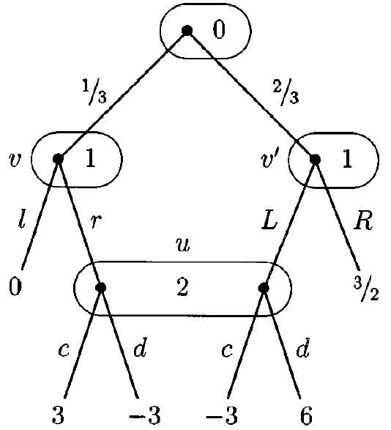
Extensive form representation
Players I = {0, 1, …, n}
Tree (V,E)
  Terminals Z  V
Controlling player P: V \ Z H
Information sets H={H₀,…, H_{n}}
Actions A = {A₀, …, A_{n}}
Payoffs u : Z R^{n}
Chance probabilities p
Perfect recall assumption: Players never forget information
Game from: Bernhard von Stengel. Efficient Computation of Behavior
Strategies. In Games and Economic Behavior 14:220-246, 1996.

Slide 4
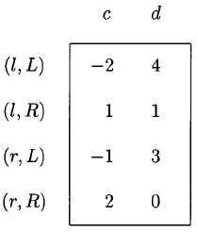
Computing equilibria via normal form
Normal form exponential, in worst case and in practice (e.g. poker)

Slide 5
Sequence form
[Romanovskii 62, re-invented in English-speaking literature: Koller & Megiddo 92, von Stengel 96]
Instead of a move for every information set, consider choices necessary to reach each information set and each leaf
These choices are sequences and constitute the pure strategies in the sequence form
S₁ = {{}, l, r, L, R}
S₂ = {{}, c, d}

Slide 6
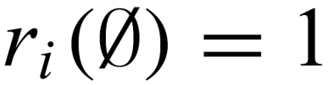
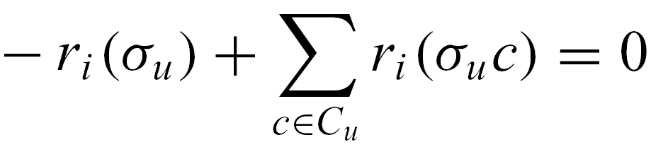
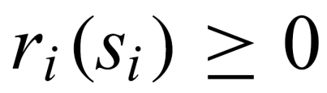
Realization plans
Players strategies are specified as realization plans over sequences:
Prop. Realization plans are equivalent to behavior strategies.

Slide 7
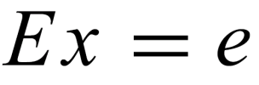
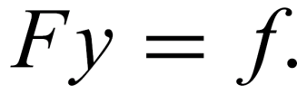

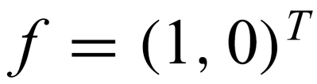
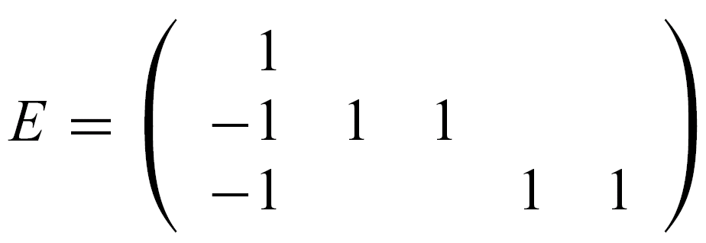
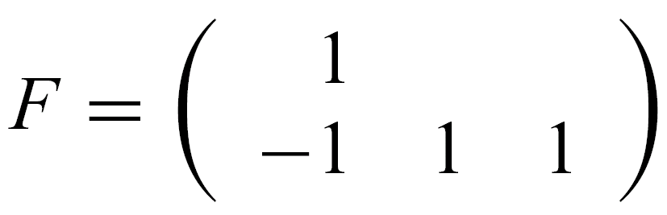
Computing equilibria via sequence form
Players 1 and 2 have realization plans x and y
Realization constraint matrices E and F specify constraints on realizations
{} l r L R
{}
v
v’
{} c d
{}
u

Slide 8
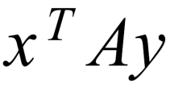
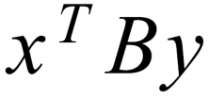
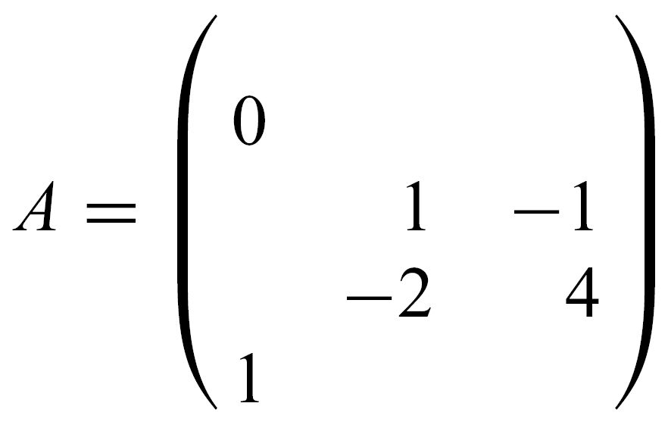
Computing equilibria via sequence form
Payoffs for player 1 and 2 are: and
for suitable matrices A and B
Creating payoff matrix:
  Initialize each entry to 0
  For each leaf, there is a (unique) pair of sequences corresponding to an entry in the payoff matrix
  Weight the entry by the product of chance probabilities along the path from the root to the leaf
{} c d
{}
l
r
L
R

Slide 9
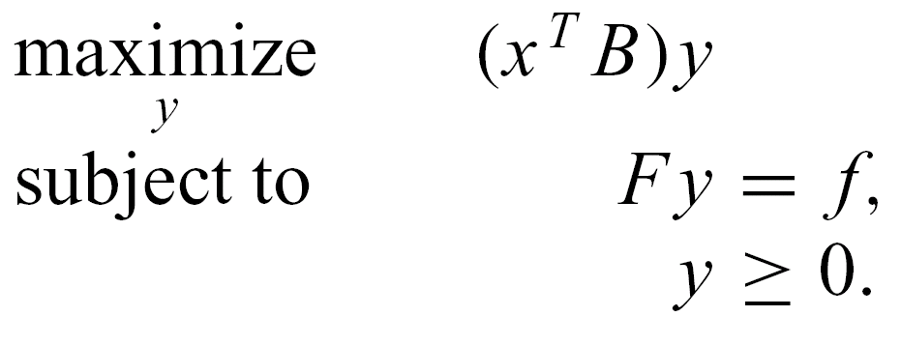
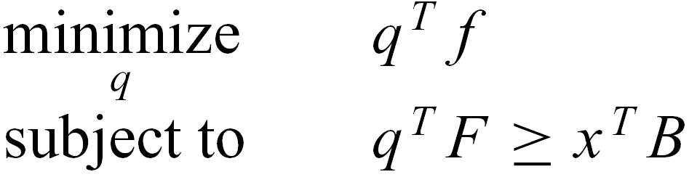
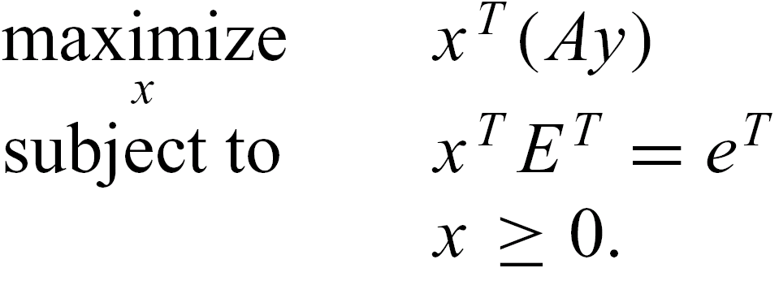
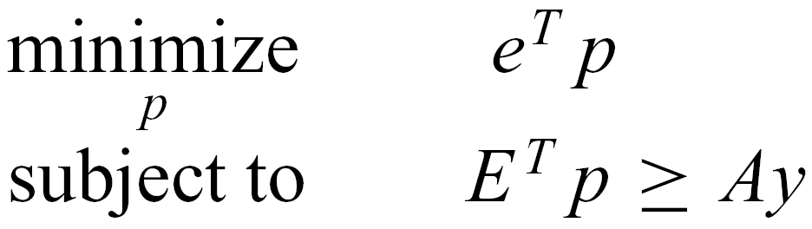
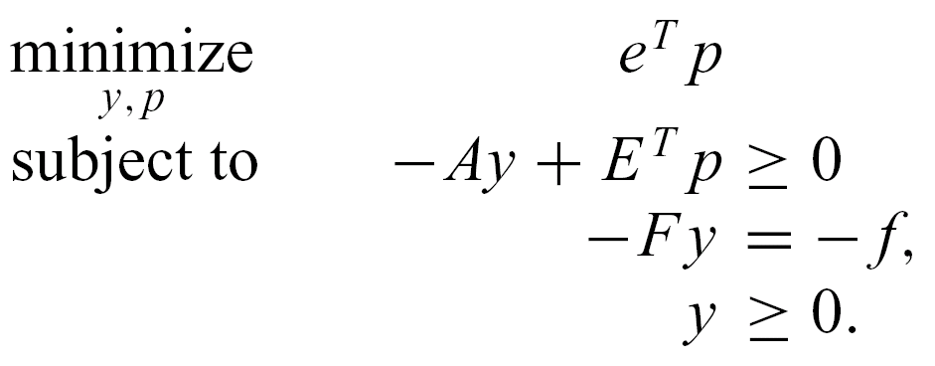
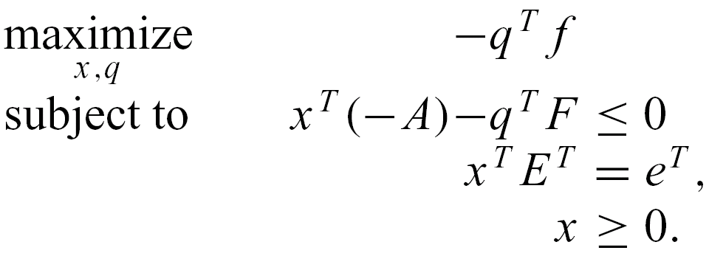
Computing equilibria via sequence form
Primal
Dual
Holding x fixed,
compute best response
Holding y fixed,
compute best response
Primal
Dual

Slide 10



Computing equilibria via sequence form:
An example
min p1
subject to
x1: p1 - p2 - p3 >= 0
x2: 0y1 + p2 >= 0
x3: -y2 + y3 + p2 >= 0
x4: 2y2 - 4y3 + p3 >= 0
x5: -y1 + p3 >= 0
q1: -y1 = -1
q2: y1 - y2 - y3 = 0
bounds
y1 >= 0 y2 >= 0 y3 >= 0
p1 Free p2 Free p3 Free

Slide 11
Sequence form summary
Polytime algorithm for finding a Nash equilibrium in 2-player zero-sum games
Polysize linear complementarity problem (LCP) for computing Nash equilibria in 2-player general-sum games
Major shortcomings:
  Not well understood when more than two players
  Sometimes, polynomial is still slow and or large (e.g. poker)…

Slide 12
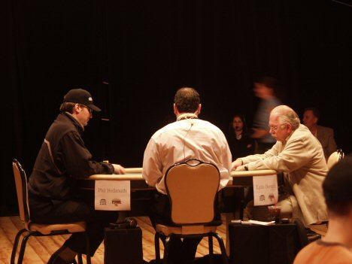
Poker
Recognized challenge problem in AI
  Hidden information (other players’ cards)
  Uncertainty about future events
  Deceptive strategies needed in a good player
Very large game trees
Texas Hold’em: most popular variant
On NBC:
Notes:
Heads-Up is highly complex & difficult to play well.
Picture is a Heads-Up competition televised by NBC.

Slide 13
Finding equilibria
In 2-person 0-sum games,
  Nash equilibria are minimax equilibria => no equilibrium selection problem
  If opponent plays a non-equilibrium strategy, that only helps me
Sequence form too big to solve in many games:
  Rhode Island Hold’em (3.1 billion nodes)
  2-player (aka Heads-Up) Limit Texas Hold’em (10¹⁸ nodes)
  2-player No-Limit Texas Hold’e, (Doyle’s game has 10⁷³ nodes)

Slide 14
Our approach [Gilpin & Sandholm EC’06, JACM’07]
Now used by all competitive Texas Hold’em programs
Original game
Abstracted game
Automated abstraction
Compute Nash
Nash equilibrium
Reverse model
Nash equilibrium
Notes:
Reverse model is straightforward if only signals are abstracted, but an interesting problem if also actions are abstracted, as in No-Limit Texas Hold’em.

Slide 15
Outline
Abstraction
Equilibrium finding in 2-person 0-sum games
Strategy purification
Opponent exploitation
Multiplayer stochastic games
Leveraging qualitative models
Papers on my web site.
Review article:
The State of Solving Large Incomplete-Information Games, and Application to Poker. Sandholm, T.
AI Magazine, special issue on Algorithmic Game Theory

Slide 16
Lossless abstraction
[Gilpin & Sandholm EC’06, JACM’07]

Slide 17
Information filters
Observation: We can make games smaller by filtering the information a player receives
Instead of observing a specific signal exactly, a player instead observes a filtered set of signals
  E.g. receiving signal {A♠,A♣,A♥,A♦} instead of A♥
Notes:
Information filters isolate signal history from action history

Slide 18
Signal tree
Each edge corresponds to the revelation of some signal by nature to at least one player
Our abstraction algorithms operate on it
  Don’t load full game into memory

Slide 19
Isomorphic relation
Captures the notion of strategic symmetry between nodes
Defined recursively:
  Two leaves in signal tree are isomorphic if for each action history in the game, the payoff vectors (one payoff per player) are the same
  Two internal nodes in signal tree are isomorphic if they are siblings and there is a bijection between their children such that only ordered game isomorphic nodes are matched
We compute this relationship for all nodes using a DP plus custom perfect matching in a bipartite graph
  Answer is stored

Slide 20
Abstraction transformation
Merges two isomorphic nodes
Theorem. If a strategy profile is a Nash equilibrium in the abstracted (smaller) game, then its interpretation in the original game is a Nash equilibrium
Assumptions
  Observable player actions
  Players’ utility functions rank the signals in the same order
Notes:
Interpretation into the original game is straightforward.

Slide 21
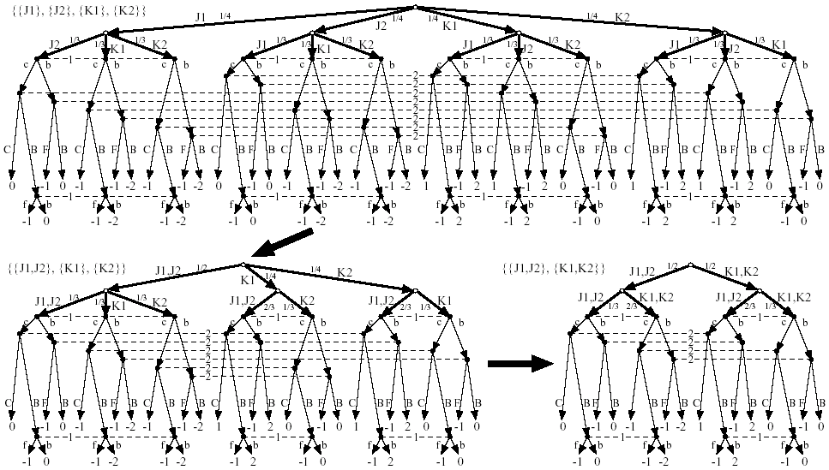

Slide 24
GameShrink algorithm
Bottom-up pass: Run DP to mark isomorphic pairs of nodes in signal tree
Top-down pass: Starting from top of signal tree, perform the transformation where applicable
Theorem. Conducts all these transformations
  Õ(n²), where n is #nodes in signal tree
  Usually highly sublinear in game tree size
One approximation algorithm: instead of requiring perfect matching, require a matching with a penalty below threshold

Slide 25
Algorithmic techniques for making GameShrink faster
Union-Find data structure for efficient representation of the information filter (unioning finer signals into coarser signals)
  Linear memory and almost linear time
Eliminate some perfect matching computations using easy-to-check necessary conditions
  Compact histogram databases for storing win/loss frequencies to speed up the checks
Notes:
E.g., unioning ace of spades and ace of clubs into{ace of spades or ace of clubs.

Slide 26
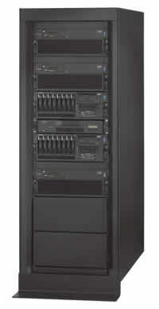
Solving Rhode Island Hold’em poker
AI challenge problem [Shi & Littman 01]
  3.1 billion nodes in game tree
Without abstraction, LP has 91,224,226 rows and columns => unsolvable
GameShrink runs in one second
After that, LP has 1,237,238 rows and columns
Solved the LP
  CPLEX barrier method took 8 days & 25 GB RAM
Exact Nash equilibrium
Largest incomplete-info (poker) game solved to date by over 4 orders of magnitude

Slide 27
Lossy abstraction

Slide 28
Texas Hold’em poker
2-player Limit Texas Hold’em has ~10¹⁸ leaves in game tree
Losslessly abstracted game too big to solve => abstract more => lossy
Nature deals 2 cards to each player
Round of betting
Nature deals 3 shared cards
Round of betting
Nature deals 1 shared card
Round of betting
Nature deals 1 shared card
Round of betting

Slide 29
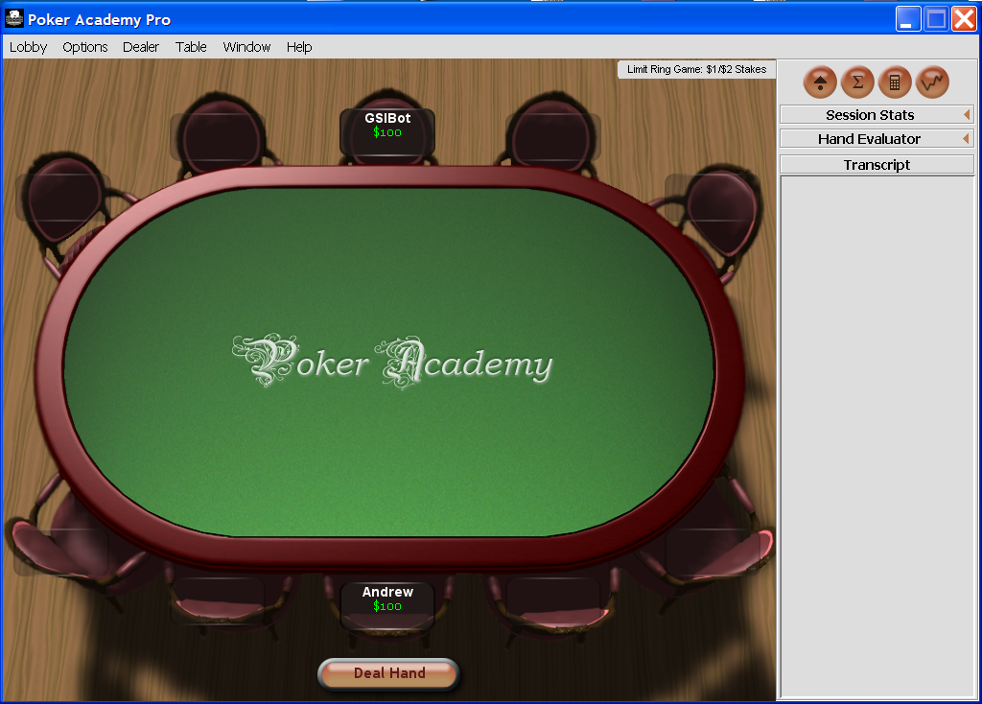

Slide 30
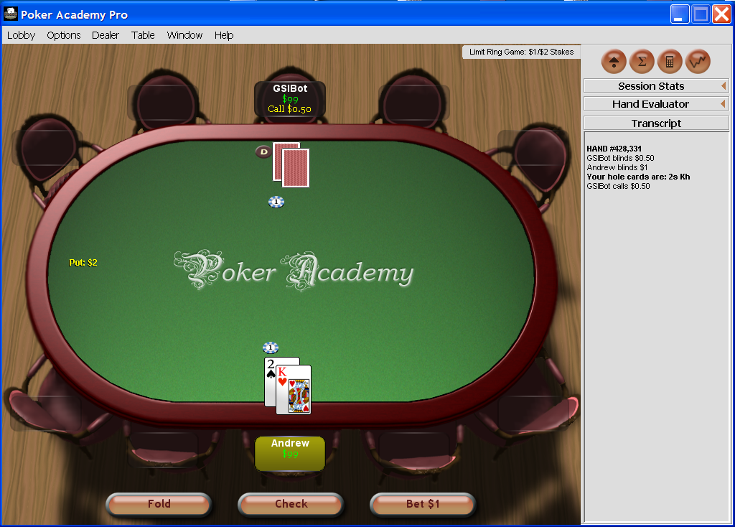

Slide 31
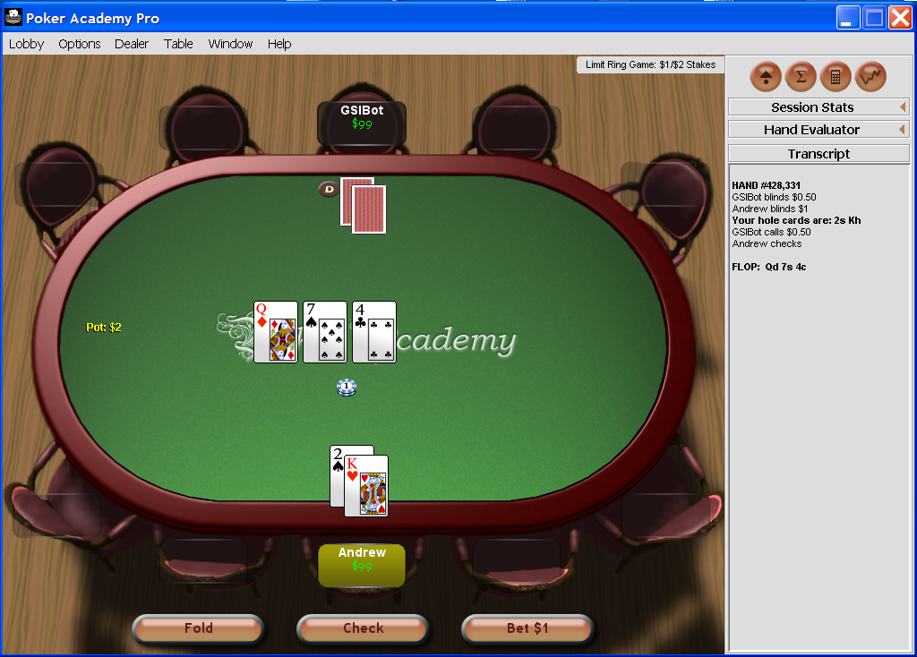

Slide 32
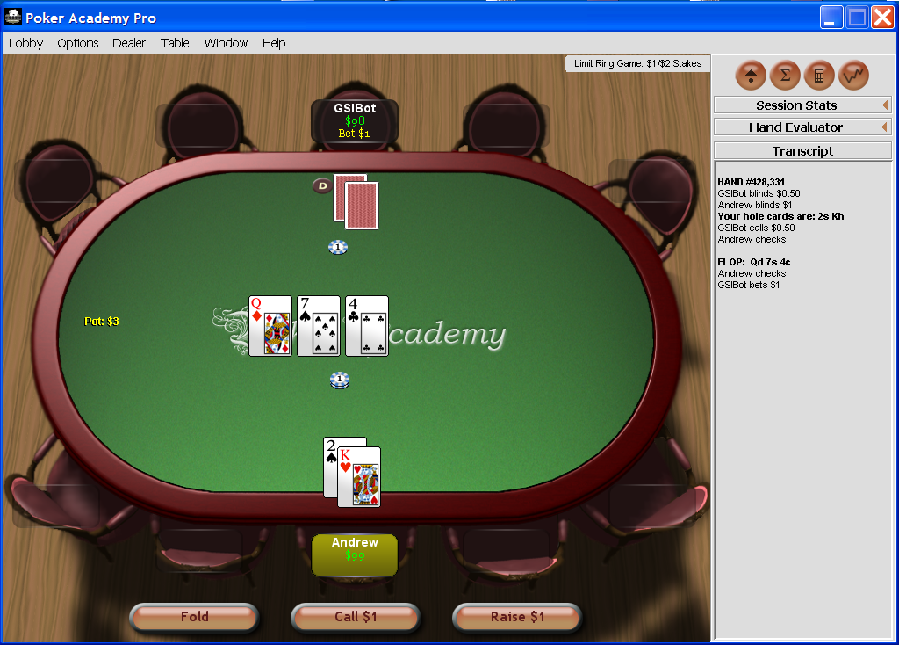

Slide 33
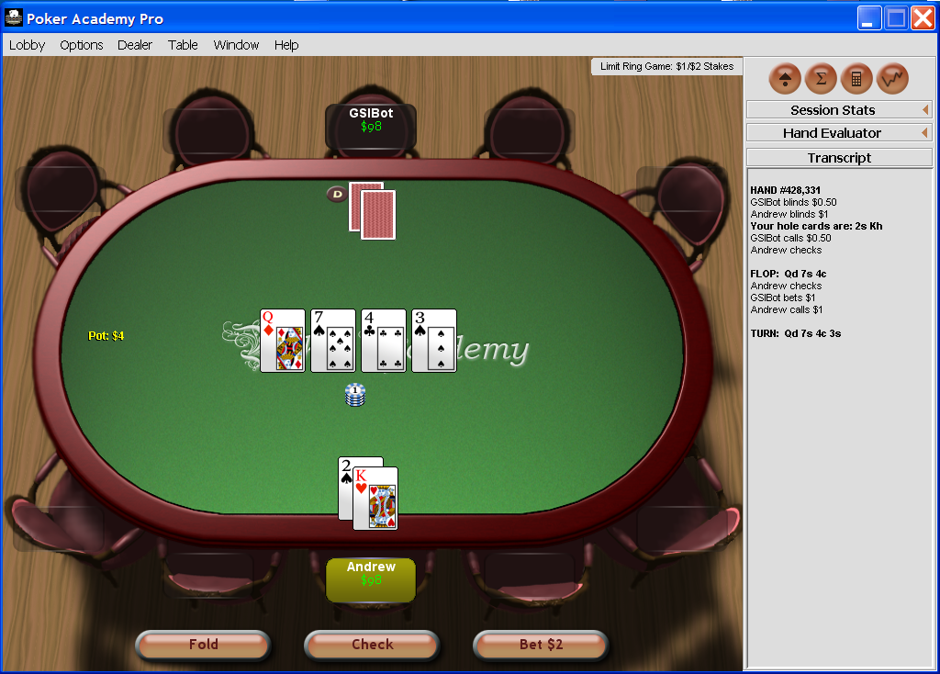

Slide 34
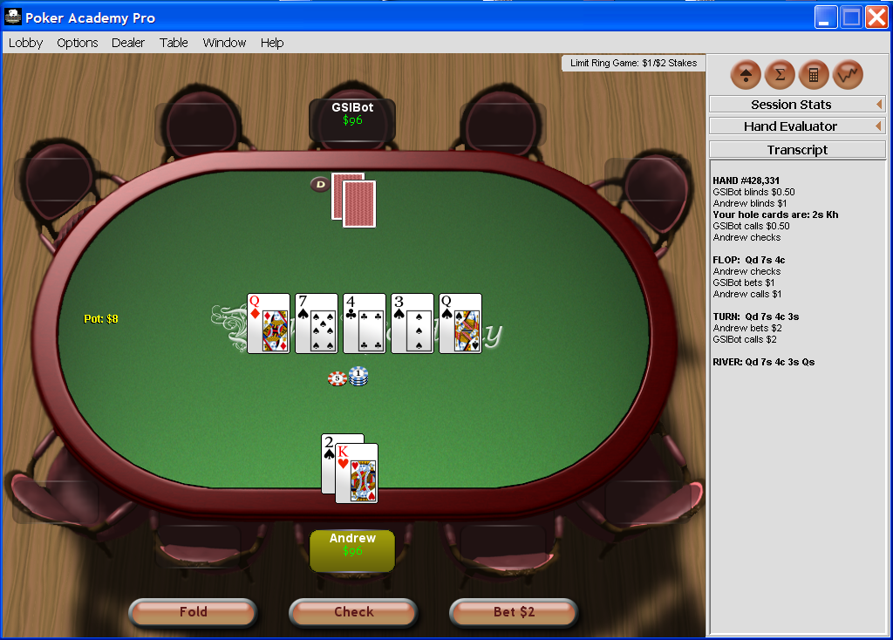

Slide 35
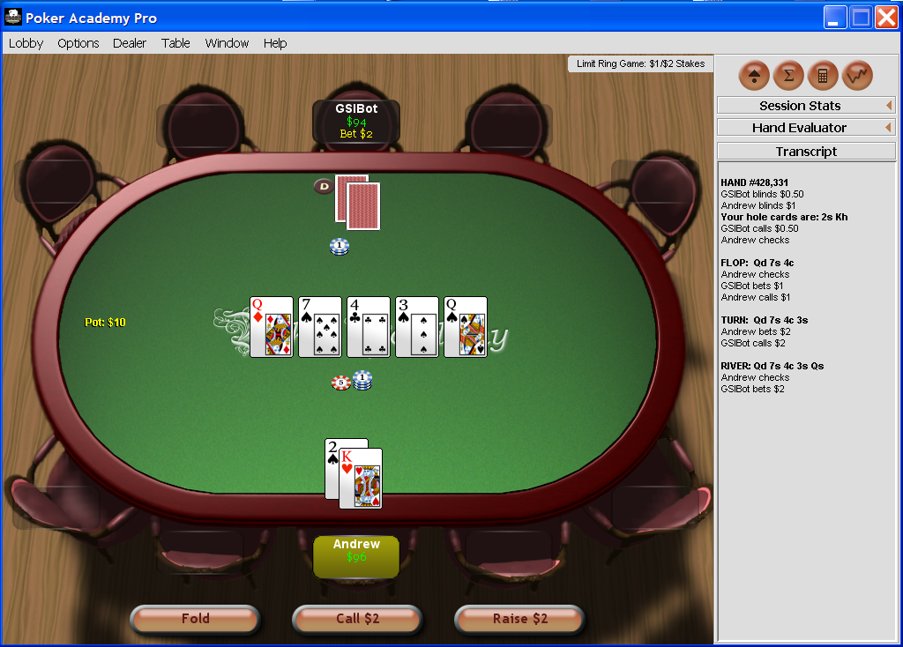

Slide 36
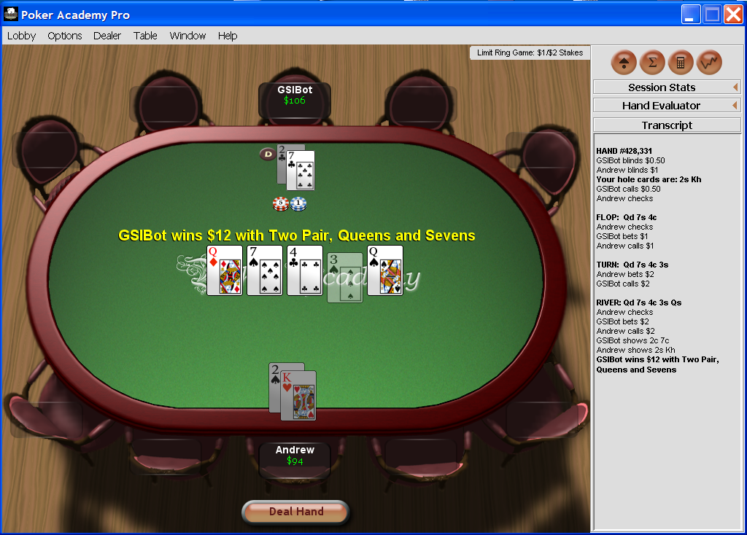

Slide 37
GS1
1/2005 - 1/2006

Slide 38
GS1 [Gilpin & Sandholm AAAI’06]
Our first program for 2-person Limit Texas Hold’em
1/2005 - 1/2006
First Texas Hold’em program to use automated abstraction
  Lossy version of Gameshrink
Abstracted game’s LP solved by CPLEX
Phase I (rounds 1 & 2) LP solved offline
  Assuming rollout for the rest of the game
Phase II (rounds 3 & 4) LP solved in real time
  Starting with hand probabilities that are updated using Bayes rule based on Phase I equilibrium and observations

Slide 39
GS1 [Gilpin & Sandholm AAAI’06]
Our first program for 2-person Limit Texas Hold’em
1/2005 - 1/2006
First Texas Hold’em program to use automated abstraction
  Lossy version of Gameshrink

Slide 40
GS1
We split the 4 betting rounds into two phases
  Phase I (first 2 rounds) solved offline using approximate version of GameShrink followed by LP
    Assuming rollout
  Phase II (last 2 rounds):
    abstractions computed offline
      betting history doesn’t matter & suit isomorphisms
    real-time equilibrium computation using anytime LP
      updated hand probabilities from Phase I equilibrium (using betting histories and community card history):
      s_{i} is player i’s strategy, h is an information set

Slide 41
Some additional techniques used
Precompute several databases
Conditional choice of primal vs. dual simplex for real-time equilibrium computation
  Achieve anytime capability for the player that is us
Dealing with running off the equilibrium path

Slide 42
GS1 results
Sparbot: Game-theory-based player, manual abstraction
Vexbot: Opponent modeling, miximax search with statistical sampling
GS1 performs well, despite using very little domain-knowledge and no adaptive techniques
  No statistical significance

Slide 43
GS2 [Gilpin & Sandholm AAMAS’07]
2/2006-7/2006
Original version of GameShrink is “greedy” when used as an approximation algorithm => lopsided abstractions
GS2 instead finds abstraction via clustering & IP
  Round by round starting from round 1
Other ideas in GS2:
  Overlapping phases so Phase I would be less myopic
    Phase I = round 1, 2, and 3; Phase II = rounds 3 and 4
  Instead of assuming rollout at leaves of Phase I (as was done in SparBot and GS1), use statistics to get a more accurate estimate of how play will go
    Statistics from 100,000’s hands of SparBot in self-play

Slide 44
GS2
2/2006 – 7/2006
[Gilpin & Sandholm AAMAS’07]

Slide 45
Optimized approximate abstractions
Original version of GameShrink is “greedy” when used as an approximation algorithm => lopsided abstractions
GS2 instead finds an abstraction via clustering & IP
    Operates in signal tree of one player’s & common signals at a time
For round 1 in signal tree, use 1D k-means clustering
  Similarity metric is win probability (ties count as half a win)
For each round 2..3 of signal tree:
  For each group i of hands (children of a parent at round – 1):
    use 1D k-means clustering to split group i into k_{i} abstract “states”
    for each value of k_{i}, compute expected error (considering hand probs)
  IP decides how many children different parents (from round – 1) may have: Decide k_{i}’s to minimize total expected error, subject to ∑_{i} k_{i} ≤ K_{round}
    K_{round} is set based on acceptable size of abstracted game
    Solving this IP is fast in practice (less than a second)
Notes:
Solves generalized knapsack problem, though computationally difficult it is solved quickly in practice

Slide 46
Phase I (first three rounds)
Optimized abstraction
  Round 1
    There are 1,326 hands, of which 169 are strategically different
    We allowed 15 abstract states
  Round 2
    There are 25,989,600 distinct possible hands
      GameShrink (in lossless mode for Phase I) determined there are ~10⁶ strategically different hands
    Allowed 225 abstract states
  Round 3
    There are 1,221,511,200 distinct possible hands
    Allowed 900 abstract states
Optimizing the approximate abstraction took 3 days on 4 CPUs
LP took 7 days and 80 GB using CPLEX’s barrier method

Slide 47
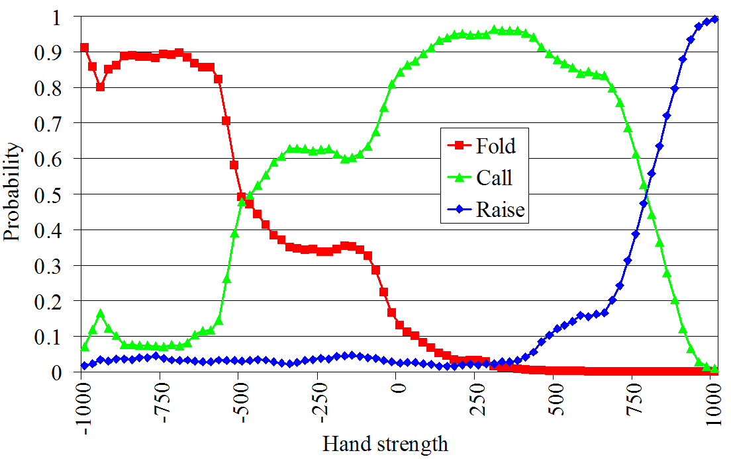
Mitigating effect of round-based abstraction (i.e., having 2 phases)
For leaves of Phase I, GS1 & SparBot assumed rollout
Can do better by estimating the actions from later in the game (betting) using statistics
For each possible hand strength and in each possible betting situation, we stored the probability of each possible action
  Mine history of how betting has gone in later rounds from 100,000’s of hands that SparBot played
  E.g. of betting in 4th round
    Player 1 has bet. Player 2’s turn

Slide 48
Phase II (rounds 3 and 4)
Note: overlapping phases
Abstraction for Phase II computed using the same optimized abstraction algorithm as in Phase I
Equilibrium for Phase II solved in real time (as in GS1)

Slide 49
Precompute several databases
db5: possible wins and losses (for a single player) for every combination of two hole cards and three community cards (25,989,600 entries)
  Used by GameShrink for quickly comparing the similarity of two hands
db223: possible wins and losses (for both players) for every combination of pairs of two hole cards and three community cards based on a roll-out of the remaining cards (14,047,378,800 entries)
  Used for computing payoffs of the Phase I game to speed up the LP creation
handval: concise encoding of a 7-card hand rank used for fast comparisons of hands (133,784,560 entries)
  Used in several places, including in the construction of db5 and db223
Colexicographical ordering used to compute indices into the databases allowing for very fast lookups

Slide 50
GS2 experiments
Opponent | Series won by GS2 | Win rate (small bets per hand)
GS1 | 38 of 50 p=.00031 | +0.031
Sparbot | 28 of 50 p=.48 | +0.0043
Vexbot | 32 of 50 p=.065 | -0.0062

Slide 51
GS3
8/2006 – 3/2007
[Gilpin, Sandholm & Sørensen AAAI’07]
Our later bots were generated with same abstraction algorithm

Slide 52
Entire game solved holistically
We no longer break game into phases
  Because our new equilibrium-finding algorithms can solve games of the size that stem from reasonably fine-grained abstractions of the entire game
=> better strategies & real-time end-game computation optional

Slide 53
Potential-aware automated abstraction
All prior abstraction algorithms (including ours) had myopic probability of winning as the similarity metric
  Does not address potential, e.g., hands like flush draws where although the probability of winning is small, the payoff could be high
Potential not only positive or negative, but also “multidimensional”
GS3’s abstraction algorithm takes potential into account…

Slide 54
Idea: similarity metric between hands at round R should be based on the vector of probabilities of transitions to abstracted states at round R+1
  E.g., L₁ norm
In the last round, the similarity metric is simply probability of winning (assuming rollout)
This enables a bottom

Slide 55
Bottom-up pass to determine abstraction for round 1
Round r-1
.3
.2
0
.5
Round r
Clustering using L₁ norm
  Predetermined number of clusters, depending on size of abstraction we are shooting for
In the last (4th) round, there is no more potential => we use probability of winning (assuming rollout) as similarity metric

Slide 56
Determining abstraction for round 2
For each 1st-round bucket i:
  Make a bottom-up pass to determine 3rd-round buckets, considering only hands compatible with i
  For k_{i}  {1, 2, …, max}
    Cluster the 2nd-round hands into k_{i} clusters
      based on each hand’s histogram over 3rd-round buckets
IP to decide how many children each 1st-round bucket may have, subject to ∑_{i} k_{i} ≤ K₂
  Error metric for each bucket is the sum of L₂ distances of the hands from the bucket’s centroid
  Total error to minimize is the sum of the buckets’ errors
    weighted by the probability of reaching the bucket

Slide 57
Determining abstraction for round 3
Done analogously to how we did round 2

Slide 58
Determining abstraction for round 4
Done analogously, except that now there is no potential left, so clustering is done based on probability of winning (assuming rollout)
Now we have finished the abstraction!

Slide 59
Potential-aware vs win-probability-based abstraction
[Gilpin & Sandholm AAAI-08]
Both use clustering and IP
Experiment conducted on Heads-Up Rhode Island Hold’em
  Abstracted game solved exactly
Finer-grained
abstraction
13 buckets in first round is lossless
Potential-aware becomes lossless,
win-probability-based is as good as it gets, never lossless

Slide 60
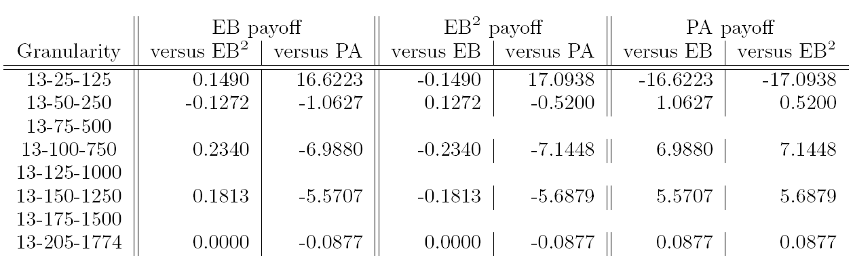
Potential-aware vs win-probability-based abstraction
[Gilpin & Sandholm AAAI-08 & new]
Both use clustering and IP
Experiment conducted on Heads-Up Rhode Island Hold’em
  Abstracted game solved exactly
13 buckets in first round is lossless
Potential-aware becomes lossless,
win-probability-based is as good as it gets, never lossless

Slide 61
Other forms of lossy abstraction
Phase-based abstraction
  Uses observations and equilibrium strategies to infer priors for next phase
  Uses some (good) fixed strategies to estimate leaf payouts at non-last phases [Gilpin & Sandholm AAMAS-07]
  Supports real-time equilibrium finding [Gilpin & Sandholm AAMAS-07]
    Grafting [Waugh et al. 2009] as an extension
Action abstraction
  What if opponents play outside the abstraction?
  Multiplicative action similarity and probabilistic reverse model [Gilpin, Sandholm, & Sørensen AAMAS-08, Risk & Szafron AAMAS-10]

Slide 62
Strategy-based abstraction [unpublished]
Abstraction
Equilibrium finding
Good abstraction as hard as equilibrium finding?

Slide 63
Outline
Abstraction
Equilibrium finding in 2-person 0-sum games
Strategy purification
Opponent exploitation
Multiplayer stochastic games
Leveraging qualitative models

Slide 64
Scalability of (near-)equilibrium finding in 2-person 0-sum games
Manual approaches can only solve games with a handful of nodes
AAAI poker competition announced
Gilpin, Sandholm
& Sørensen
Scalable EGT
Zinkevich et al.
Counterfactual regret
Gilpin, Hoda,
Peña & Sandholm
Scalable EGT
Koller & Pfeffer
Using sequence form
& LP (simplex)
Billings et al.
LP (CPLEX interior point method)
Gilpin & Sandholm
LP (CPLEX interior point method)

Slide 65
(Un)scalability of LP solvers
Rhode Island Hold’em LP
  91,000,000 rows and columns
  After GameShrink,1,200,000 rows and columns, and 50,000,000 non-zeros
  CPLEX’s barrier method uses 25 GB RAM and 8 days
Texas Hold’em poker much larger
  => would need to use extremely coarse abstraction
Instead of LP, can we solve the equilibrium-finding problem in some other way?

Slide 66
Excessive gap technique (EGT)
Best general LP solvers only scale to10⁷..10⁸ nodes. Can we do better?
Usually, gradient-based algorithms have poor O(1/ ε²) convergence, but…
Theorem [Nesterov 05]. Gradient-based algorithm, EGT (for a class of minmax problems) that finds an ε-equilibrium in O(1/ ε) iterations
In general, work per iteration is as hard as solving the original problem, but…
Can make each iteration faster by considering problem structure:
Theorem [Hoda, Gilpin, Pena & Sandholm, Mathematics of Operations Research 2010]. Nice prox functions can be constructed for sequence form games

Slide 67
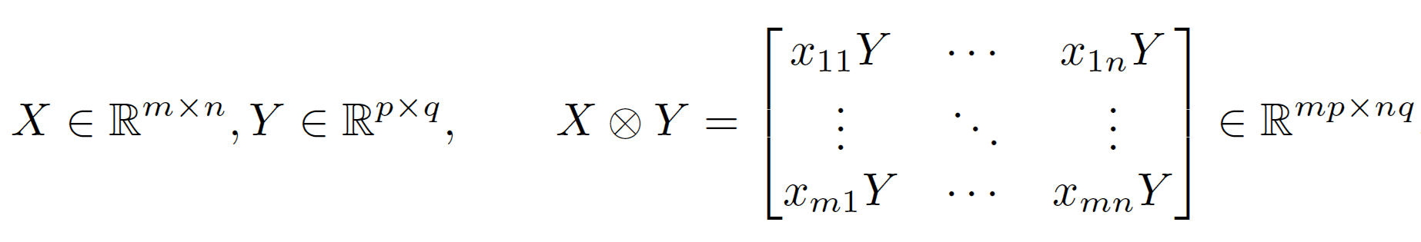
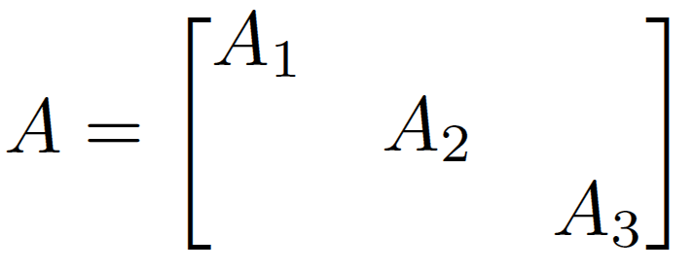
Scalable EGT [Gilpin, Hoda, Peña, Sandholm WINE’07, Math. Of OR 2010]
Memory saving in poker & many other games
Main space bottleneck is storing the game’s payoff matrix A
Definition. Kronecker product
In Rhode Island Hold’em:
Using independence of card deals and betting options, can represent this as A₁ = F₁  B₁ A₂ = F₂  B₂ A₃ = F₃  B₃ + S  W
F_{r} corresponds to sequences of moves in round r that end in a fold
S corresponds to sequences of moves in round 3 that end in a showdown
B_{r} encodes card buckets in round r
W encodes win/loss/draw probabilities of the buckets

Slide 68
Memory usage
Instance | CPLEX barrier | CPLEX simplex | Our method
Losslessly abstracted Rhode Island Hold’em | 25.2 GB | >3.45 GB | 0.15 GB
Lossily abstracted Texas Hold’em | >458 GB | >458 GB | 2.49 GB
Notes:
Space usage drops to about a square root of the original space use.

Slide 69
Memory usage
Instance | CPLEX barrier | CPLEX simplex | Our method
10k | 0.082 GB | >0.051 GB | 0.012 GB
160k | 2.25 GB | >0.664 GB | 0.035 GB
Losslessly abstracted RI Hold’em | 25.2 GB | >3.45 GB | 0.15 GB
Lossily abstracted TX Hold’em | >458 GB | >458 GB | 2.49 GB
Notes:
Space usage drops to about a square root of the original space use.

Slide 70
Scalable EGT [Gilpin, Hoda, Peña, Sandholm WINE’07, Math. Of OR 2010]
Speed
Fewer iterations
  With Euclidean prox fn, gap was reduced by an order of magnitude more (at given time allocation) compared to entropy-based prox fn
  Heuristics that speed things up in practice while preserving theoretical guarantees
    Less conservative shrinking of ₁ and ₂
      Sometimes need to reduce (halve) t
    Balancing ₁ and ₂ periodically
      Often allows reduction in the values
    Gap was reduced by an order of magnitude (for given time allocation)
Faster iterations
  Parallelization in each of the 3 matrix-vector products in each iteration => near-linear speedup

Slide 71
Solving GS3’s four-round model
[Gilpin, Sandholm & Sørensen AAAI’07]
Computed abstraction with
  20 buckets in round 1
  800 buckets in round 2
  4,800 buckets in round 3
  28,800 buckets in round 4
Our version of excessive gap technique used 30 GB RAM
  (Simply representing as an LP would require 32 TB)
  Outputs new, improved solution every 2.5 days
  4 1.65GHz CPUs: 6 months to gap 0.028 small bets per hand

Slide 72
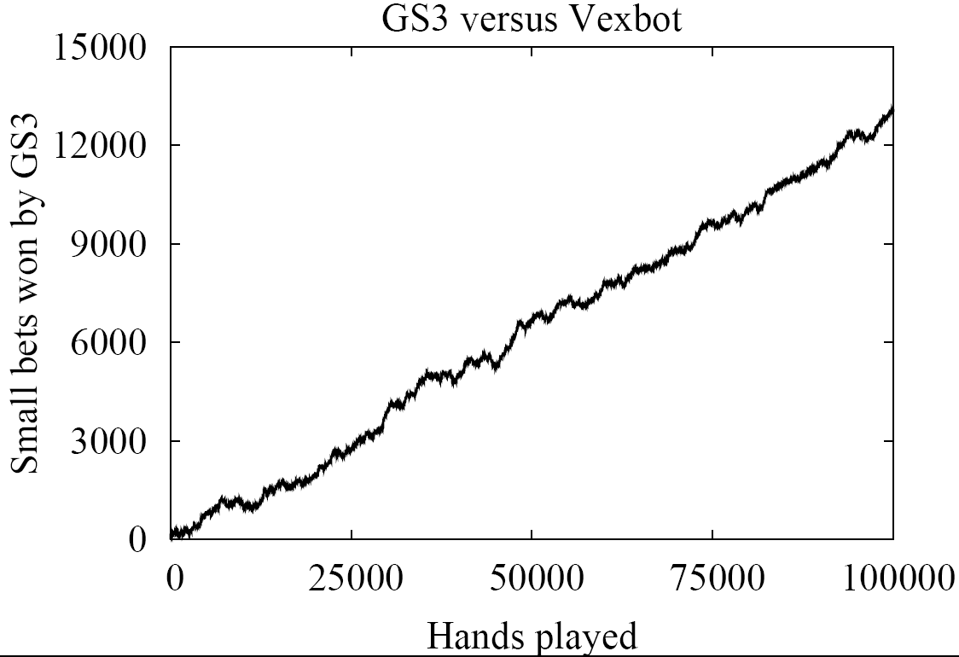
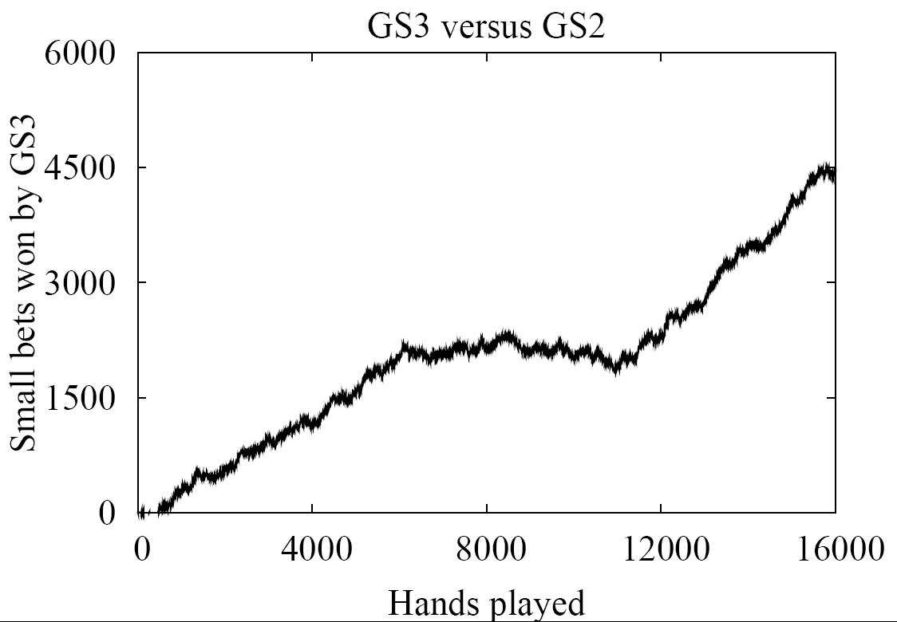
Money (unit = small bet)
All wins are statistically significant at the 99.5% level

Slide 73
Results (for GS4)
AAAI-08 Computer Poker Competition
  GS4 won the Limit Texas Hold’em bankroll category
    Played 4-4 in the pairwise comparisons. 4th of 9 in elimination category
  Tartanian did the best in terms of bankroll in No-Limit Texas Hold’em
    3rd out of 4 in elimination category

Slide 74
Our successes with these approaches in 2-player Texas Hold’em
AAAI-08 Computer Poker Competition
  Won Limit bankroll category
  Did best in terms of bankroll in No-Limit
AAAI-10 Computer Poker Competition
  Won bankroll competition in No-Limit
Notes:
GS4 Played 4-4 in the pairwise comparisons. 4th of 9 in elimination category
Tartanian 3rd out of 4 in elimination category

Slide 75
Comparison to prior poker AI
Rule-based
  Limited success in even small poker games
Simulation/Learning
  Do not take multi-agent aspect into account
Game-theoretic
  Small games
  Manual abstraction + LP for equilibrium finding [Billings et al. IJCAI-03]
  Ours
    Automated abstraction
    Custom solver for finding Nash equilibrium
    Domain independent

Slide 76
Iterated smoothing [Gilpin, Peña & Sandholm AAAI-08, Mathematical Programming, to appear]
Input: Game and ε_{target}
Initialize strategies x and y arbitrarily
ε  ε_{target}
repeat
  ε  gap(x, y) / e
  (x, y)  SmoothedGradientDescent(f, ε, x, y)
  until gap(x, y) < ε_{target}
O(1/ε)
→ O(log(1/ε))
Caveat: condition number.
Algorithm applies to all linear programming.

Slide 77
Outline
Abstraction
Equilibrium finding in 2-person 0-sum games
Strategy purification
Opponent exploitation
Multiplayer stochastic games
Leveraging qualitative models

Slide 78
Purification and thresholding
[Ganzfried, Sandholm & Waugh, AAMAS-11 poster]
Thresholding: Rounding the probabilities to 0 of those strategies whose probabilities are less than c (and rescaling the other probabilities)
  Purification is thresholding with c=0.5
Proposition (performance against equilibrium strategy): any of the 3 approaches (standard approach, thresholding (for any c), purification) can beat any other by arbitrarily much depending on the game
  Holds for any equilibrium-finding algorithm for one approach and any (potentially different) equilibrium-finding algorithm for the other approach

Slide 79
Experiments on random matrix games
2-player 3x3 zero-sum games
Abstraction that simply ignores last row and last column
Purified eq strategies from abstracted game beat
non-purified eq strategies from abstracted game
at 95% confidence level when played on the unabstracted game

Slide 80
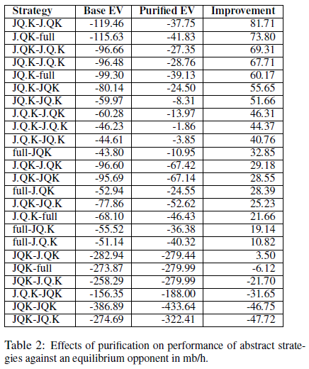
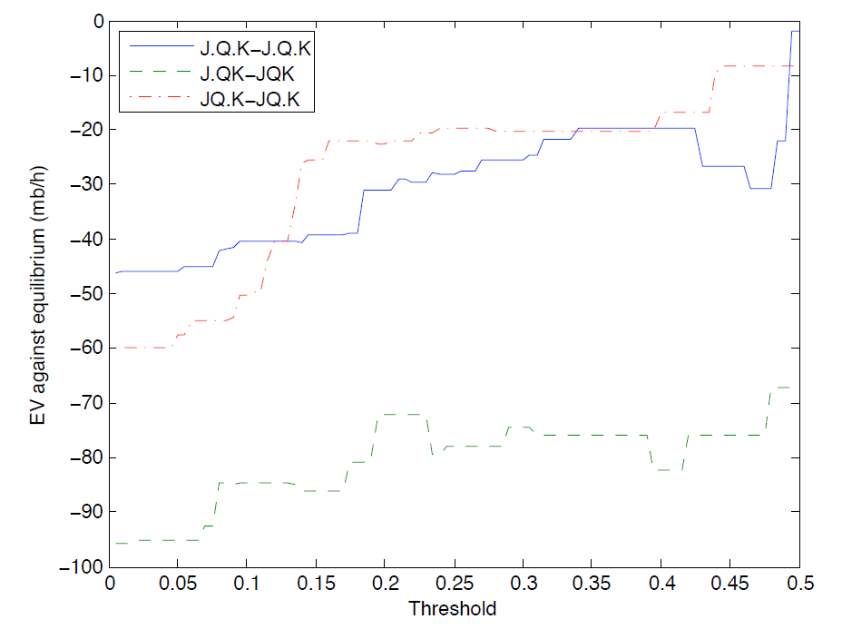
Experiments on Leduc Hold’em

Slide 81
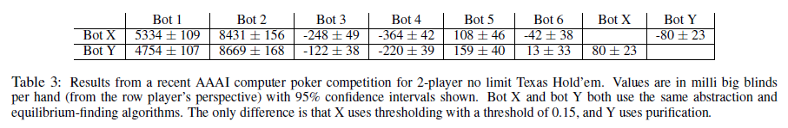
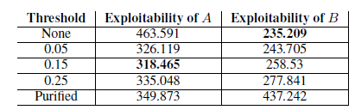
Experiments on no-limit Texas Hold’em
We submitted bot Y to the AAAI-10 bankroll competition; it won. We submitted bot X to the instant run-off competition; finished 3rd.
Worst-case exploitability
  Too much thresholding => not enough randomization => signal too much to the opponent
  Too little thresholding => strategy is overfit to the particular abstraction
Our 2010 competition bot
Alberta 2010 competition bot

Slide 82
Outline
Abstraction
Equilibrium finding in 2-person 0-sum games
Strategy purification
Opponent exploitation
Multiplayer stochastic games
Leveraging qualitative models

Slide 83
Traditionally two approaches
Game theory approach (abstraction+equilibrium finding)
  Safe in 2-person 0-sum games
  Doesn’t maximally exploit weaknesses in opponent(s)
Opponent modeling
  Get-taught-and-exploited problem [Sandholm AIJ-07]
  Needs prohibitively many repetitions to learn in large games (loses too much during learning)
    Crushed by game theory approach in Texas Hold’em…even with just 2 players and limit betting
    Same tends to be true of no-regret learning algorithms

Slide 84
Let’s hybridize the two approaches
Start playing based on game theory approach
As we learn opponent(s) deviate from equilibrium, start adjusting our strategy to exploit their weaknesses

Slide 85
The dream of safe exploitation
Wish: Let’s avoid the get-taught-and-exploited problem by exploiting only to an extent that risks what we have won so far
Proposition. It is impossible to exploit to any extent (beyond what the best equilibrium strategy would exploit) while preserving the safety guarantee of equilibrium play
So we give up some on worst-case safety …
Ganzfried & Sandholm AAMAS-11

Slide 86
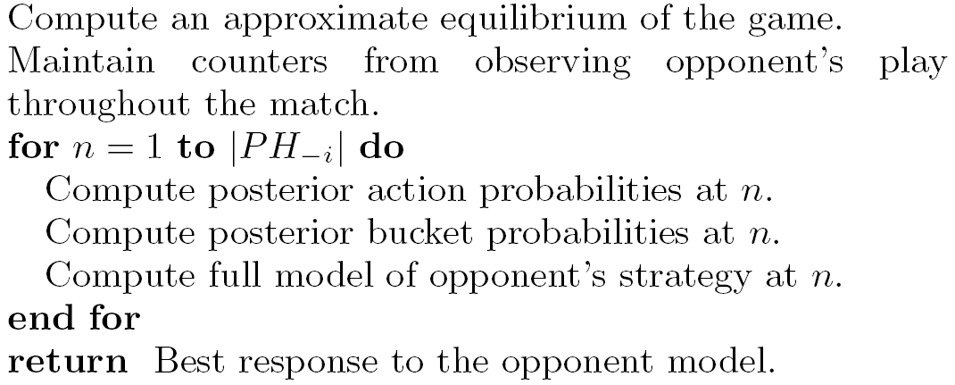
Deviation-Based Best Response (DBBR) algorithm
(can be generalized to multi-player non-zero-sum)
Public history
sets
Dirichlet prior
Many ways to determine opponent’s “best” strategy that is consistent with bucket probabilities
  L₁ or L₂ distance to equilibrium strategy
  Custom weight-shifting algorithm
  ...
Notes:
Diffs to Alberta algorithms (at least one of these applies to each of theirs): 1) they worked on tiny games like Kuhn poker or rock-scissors paper, 2) they precomputed a hadful of strategies and used an experts algorithm to just choose among them, 3) they assumed massive amounts of hand histories available before play, or 4) they assumed opponent’s private information was observable.

Slide 87
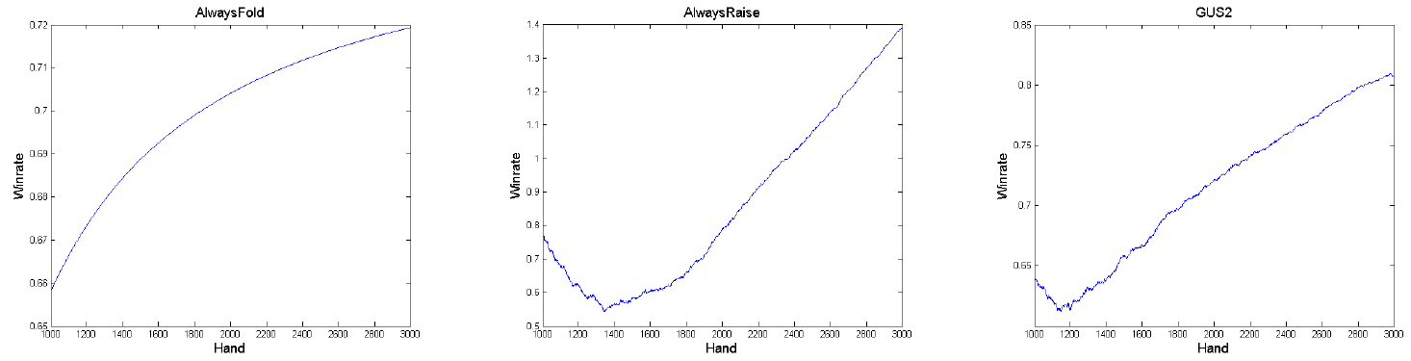
Experiments
Performs significantly better in 2-player Limit Texas Hold’em against trivial opponents, and weak opponents from AAAI computer poker competitions, than game-theory-based base strategy (GS5)
Don’t have to turn this on against strong opponents
Examples of winrate evolution:

Slide 88
Outline
Abstraction
Equilibrium finding in 2-person 0-sum games
Strategy purification
Opponent exploitation
Multiplayer stochastic games
Leveraging qualitative models

Slide 89
>2 players
(Actually, our abstraction algorithms, presented earlier in this talk, apply to >2 players)

Slide 90
Games with >2 players
Matrix games:
  2-player zero-sum: solvable in polytime
  >2 players zero-sum: PPAD-complete [Chen & Deng, 2006]
  No previously known algorithms scale beyond tiny games with >2 players
Stochastic games (undiscounted):
  2-player zero-sum: Nash equilibria exist
  3-player zero-sum: Existence of Nash equilibria still open

Slide 91
Stochastic games
N = {1,…,n} is finite set of players
S is finite set of states
A(s) = (A₁(s),…, A_{n}(s)), where A_{i}(s) is set of actions of player i at state s
p_{s,t}(a) is probability we transition from state s to state t when players follow action vector a
r(s) is vector of payoffs when state s is reached
Undiscounted vs. discounted
A stochastic game with one agent is a Markov Decision Process (MDP)
Notes:
Existence of Nash equilibrium open for undiscounted stochastic games with >2 players

Slide 92
Poker tournaments
Players buy in with cash (e.g., $10) and are given chips (e.g., 1500) that have no monetary value
Lose all you chips => eliminated from tournament
Payoffs depend on finishing order (e.g., $50 for 1st, $30 for 2nd, $20 for 3rd)
Computational issues:
  >2 players
  Tournaments are stochastic games (potentially infinite duration): each game state is a vector of stack sizes (and also encodes who has the button)
  We study 3-player endgame with fixed high blinds
    Potentially infinite duration
Notes:
Blinds usually escalate quickly. We assume constant blinds.

Slide 93
Jam/fold strategies
Jam/fold strategy: in the first betting round, go all-in or fold
In 2-player poker tournaments, when blinds become high compared to stacks, provably near-optimal to play jam/fold strategies [Miltersen & Sørensen 2007]
  Probability of winning ≈ fraction of chips one has
Solving a 3-player tournament [Ganzfried & Sandholm AAMAS-08, IJCAI-09]
  Compute an approximate equilibrium in jam/fold strategies
  169 strategically distinct starting hands
  Strategy spaces (for any given stack vectors) are 2¹⁶⁹, 2 • 2¹⁶⁹, 3 • 2¹⁶⁹
    But we do not use matrix form. We use extensive form. The best responses can be computed in linear time in the number of information sets: 169, 2 * 169, 3* 169
  Our solution challenges Independent Chip Model (ICM) accepted by poker community
  Unlike in 2-player case, tournament and cash game strategies differ substantially
Notes:
946 non-terminal states

Slide 94
Our first algorithm
Initialize payoffs for all game states using heuristic from poker community (ICM)
Repeat until “outer loop” converges
  “Inner loop”:
    Assuming current payoffs, compute an approximate equilibrium at each state using fictitious play
    Can be done efficiently by iterating over each player’s information sets
  “Outer loop”:
    Update the values with the values obtained by new strategy profile
    Similar to value iteration in MDPs

Slide 95
VI-FP: Our first algorithm for equilibrium finding in multiplayer stochastic games
[Ganzfried & Sandholm AAMAS-08]
Initialize payoffs V₀ for all game states, e.g., using Independent Chip Model (ICM)
Repeat
  Run “inner loop”:
    Assuming the payoffs V_{t} , compute an approximate equilibrium s_{t} at each non-terminal state (stack vector) using an extension of smoothed fictitious play to imperfect information games
  Run “outer loop”:
    Compute the values V_{t +1} at all non-terminal states by using the probabilities from s_{t} and values from V_{t}
until outer loop converges

Slide 96
Drawbacks of VI-FP
Neither the inner nor outer loop guaranteed to converge
Proposition. It is possible for outer-loop to converge to a non-equilibrium
  Proof:
    Initialize the values to all three players of stack vectors with all three players remaining to $100
    Initialize the stack vectors with only two players remaining according to ICM
    Then everyone will fold (except the short stack if he is all-in), payoffs will be $100 to everyone, and the algorithm will converge in one iteration to a non-equilibrium profile

Slide 97
Ex post check
Determine how much each player can gain by deviating from strategy profile s* computed by VI-FP
For each player, construct MDP M induced by the components of s* for the other players
Solve M using variant of policy iteration for our setting (described later)
Look at difference between the payoff of optimal policy in M and payoff under s*
Converged in just two iterations of policy iteration
No player can gain more than $0.049 (less than 0.5% of tournament entry fee) by deviating from s*

Slide 98

Optimal MDP solving in our setting
Our setting:
  Objective is expected total reward
  For all states s and policies p, the value of s under p is finite
  For each state s there exists at least one available action a that gives nonnegative reward
Value iteration: must initialize pessimistically
Policy iteration:
  Choose initial policy with nonnegative total reward
  Choose minimal non-negative solution to system of equations in
  evaluation step (if there is a choice):
  If the action chosen for some state in the previous iteration is still
  among the optimal actions, select it again

Slide 99
New algorithms [Ganzfried & Sandholm IJCAI-09]
Developed 3 new algorithms for solving multiplayer stochastic games of imperfect information
  Unlike first algorithm, if these algorithms converge, they converge to an equilibrium
  First known algorithms with this guarantee
  They also perform competitively with the first algorithm
Converged to an ε-equilibrium consistently and quickly despite not being guaranteed to do so
  New convergence guarantees?

Slide 100
Best one of the new algorithms
Initialize payoffs using ICM as before
Repeat until “outer loop” converges
  “Inner loop”:
    Assuming current payoffs, compute an approximate equilibrium at each state using our variant of fictitious play as before (until regret < thres)
  “Outer loop”: update the values with the values obtained by new strategy profile S_{t} using a modified version of policy iteration:
    Create the MDP M induced by others’ strategies in S_{t} (and initialize using own strategy in S_{t}):
    Run modified policy iteration on M
      In the matrix inversion step, always choose the minimal solution
      If there are multiple optimal actions at a state, prefer the action chosen last period if possible
Notes:
This is the first new algorithm in AAAI-08 submission.
Each non-terminal state of M corresponds to non-terminal state of the tournament and a table position: so 946 • 3 = 2838 non-terminal states of M.

Slide 101
Second new algorithm
Interchanging roles of fictitious play and policy iteration:
  Policy iteration used as inner loop to compute best response
  Fictitious play used as outer loop to combine BR with old strategy
Initialize strategies using ICM
Inner loop:
  Create MDP M induced from strategy profile
  Solve M using policy iteration variant (from previous slide)
Outer loop:
  Combine optimal policy of M with previous strategy using fictitious play updating rule

Slide 102
Third new algorithm
Using value iteration variant as the inner loop
Again we use MDP solving as inner loop and fictitious play as outer loop
Same as previous algorithm except different inner loop
New inner loop:
  Value iteration, but make sure initializations are pessimistic (underestimates of optimal values in the MDP)
  Pessimistic initialization can be accomplished by matrix inversion using outer loop strategy as initialization in induced MDP

Slide 103
Outline
Abstraction
Equilibrium finding in 2-person 0-sum games
Strategy purification
Opponent exploitation
Multiplayer stochastic games
Leveraging qualitative models

Slide 104
Computing Equilibria by Incorporating Qualitative Models
Sam Ganzfried and Tuomas Sandholm
Computer Science Department
Carnegie Mellon University

Slide 105
Introduction
Key idea: often it is much easier to come up with some aspects of an equilibrium than to actually compute one
E.g., threshold strategies are optimal in many settings:
  Sequences of take-it-or-leave-it offers
  Auctions
  Partnerships/contracts
  Poker…
We develop an algorithm for computing an equilibrium in imperfect-information games given a qualitative model of the structure of equilibrium strategies
  Applies to both infinite and finite games, with 2 or more players

Slide 106
Continuous (i.e., infinite) games
Games with infinite number of pure strategies
  E.g., strategies correspond to amount of time, money, space (such as computational billiards)
N is finite set of players
S_{i} is (a potentially infinite) pure strategy space of player i
u_{i}: S → R is utility function of player i
Theorem [Fudenberg/Levine]: If strategy spaces are nonempty compact subsets of a metric space and payoff functions are continuous, then there exists a Nash equilibrium

Slide 107
Poker example
Two players given private signals x₁, x₂ independently and uniformly at random from [0,1]
Pot initially has size P
Player 1 can bet or check
If player 1 checks, game is over and lower signal wins
If player 1 bets, player 2 can call or fold
If player 2 folds, player 1 wins
If player 2 calls, player with lower private signal wins P+1, while other player loses 1

Slide 108
Example cont’d
Strategy space of player 1: Set of measurable functions from [0,1] to {bet, check}
  Similar for player 2
Proposition. The strategy spaces are not compact
Proposition. All strategies surviving iterated dominance must follow a specific threshold structure (on next slide)
New strategy spaces are compact subsets of R
Proposition. The utility functions are continuous
Game can be solved by extremely simple procedure…

Slide 109
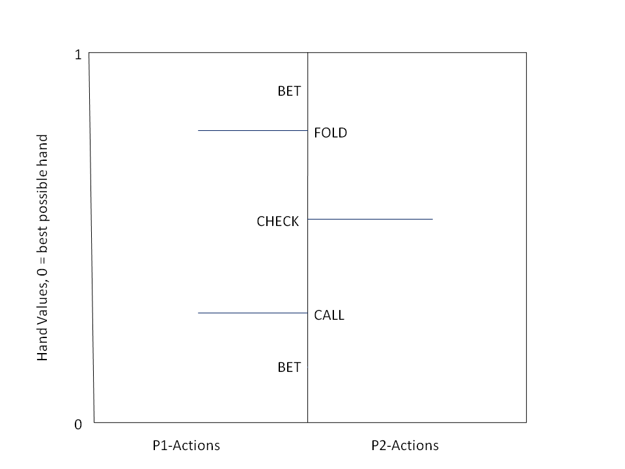
Example cont’d
Worst hand
Best hand

Slide 110
Setting:
Continuous Bayesian games
[Ganzfried & Sandholm AAMAS-10 & newer draft]
Finite set of players
For each player i:
  X_{i} is set of private signals (compact subset of R or discrete finite set)
  C_{i} is finite set of actions
  F_{i}: X_{i} → [0,1] is a piece-wise linear CDF of private signal
  u_{i}: C x X → R is continuous, measurable, type-order-based utility function: utilities depend on the actions taken and relative order of agents’ private signals (but not on the private signals explicitly)

Slide 111
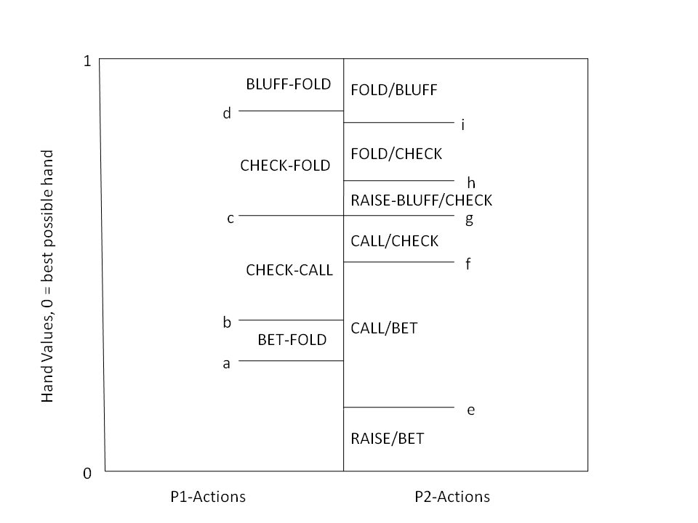
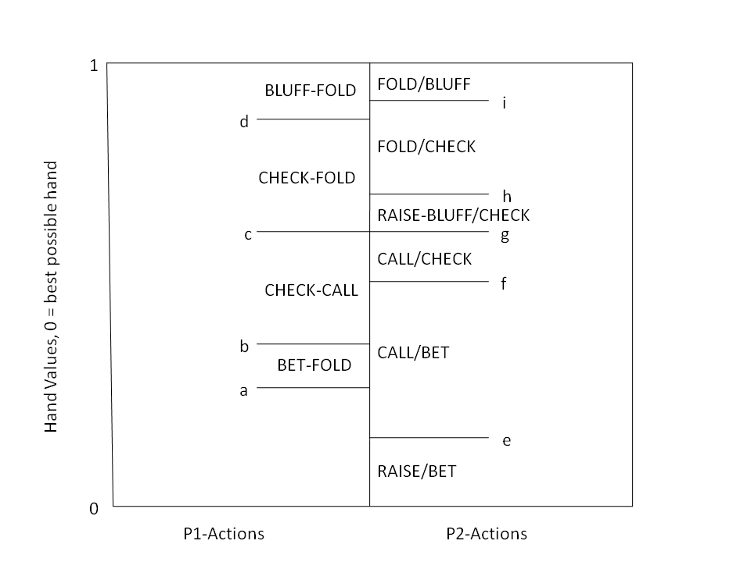
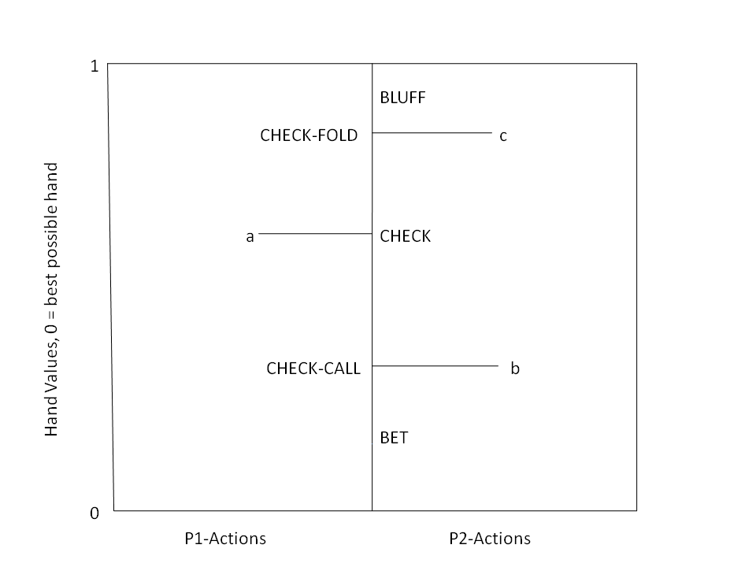
Parametric models
Worst hand
Best hand
Analogy to air combat

Slide 112
Parametric models
Way of dividing up signal space qualitatively into “action regions”
P = (T, Q, <)
T_{i} is number of regions of player i
Q_{i} is sequence of actions of player i
< is partial ordering of the region thresholds across agents
We saw that forcing strategies to conform to a parametric model can allow us to guarantee existence of an equilibrium and to compute one, when neither could be accomplished by prior techniques

Slide 113
Computing an equilibrium given a parametric model
Parametric models => can prove existence of equilibrium
Mixed-integer linear feasibility program (MILFP)
Let {t_{i}} denote union of sets of thresholds
Real-valued variables: x_{i} corresponding to F₁(t_{i}) and y_{i} to F₂(t_{i})
0-1 variables: z_{i,j} = 1 implies j-1 ≤ t_{i} ≤ j
  For this slide we assume that signals range 1, 2, …, k, but we have a MILFP for continuous signals also
  Easy post-processor to get mixed strategies in case where individual types have probability mass
Several types of constraints:
  Indifference, threshold ordering, consistency
Theorem. Given a candidate parametric model P, our algorithm outputs an equilibrium consistent with P if one exists. Otherwise it returns “no solution”

Slide 114
Works also for
>2 players
  Nonlinear indifference constraints => approximate by piecewise linear
    Theorem & experiments that tie #pieces to ε
    Gives an algorithm for solving multiplayer games without parametric models too
Multiple parametric models (with a common refinement) only some of which are correct
Dependent types

Slide 115
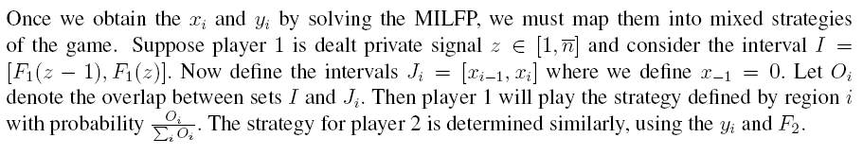

Slide 116
Multiple players
With more than 2 players, indifference constraints become nonlinear
We can compute an ε-equilibrium by approximating products of variables using linear constraints
  We provide a formula for the number of breakpoints per piecewise linear curve needed as a function of ε
Our algorithm uses a MILFP that is polynomial in #players
Can apply our technique to develop a MIP formulation for finding ε-equilibria in multiplayer normal and extensive-form games without qualitative models

Slide 117
Multiple parametric models
Often have several models and know at least one is correct, but not sure which
We give an algorithm for finding an equilibrium given several parametric models that have a common refinement
  Some of the models can be incorrect
  If none of the models are correct, our algorithm says so

Slide 118
Experiments
Games for which algs didn’t exist become solvable
  Multi-player games
Previously solvable games solvable faster
  Continuous approximation sometimes a better alternative than abstraction
Works in the large
  Improved performance of GS4 when used for last phase

Slide 119
Experiments

Slide 120
Texas Hold’em experiments
Once river card dealt, no more information revealed
Use GS4 and Bayes’ rule to generate distribution over possible hands both players could have
We developed 3 parametric models that have a common refinement (for 1-raise-per-player version)
  All three turned out necessary

Slide 121
Texas Hold’em experiments cont’d
We ran it against top 5 entrants from 2008 AAAI Computer Poker Competition
Performed better than GS4 against 4
Beat GS4 by 0.031 (± 0.011) small bets/hand
Averaged 0.25 seconds/hand overall

Slide 122
Multiplayer experiments
Simplified 3-player poker game
Rapid convergence to ε-equilibrium for several CDFs
Obtained ε = 0.01 using 5 breakpoints
  Theoretical bound ε ≈ 25
Notes:
Verified using ex post check

Slide 123
Approximating large finite games with continuous games
Traditional approach: abstraction
Suppose private signals in {1,..,n} in first poker example
  Runtime of computing equilibrium grows large as n increases
  Runtime of computing x∞ remains the same
Our approach can require much lower runtime to obtain given level of exploitability

Slide 124
Approximating large finite games with continuous games
Experiment on Generalized Kuhn poker [Kuhn ’50]
Compared value of game vs. payoff of x∞ against its nemesis
Agree to within .0001 for 250 signals
Traditional approach required very fine abstraction to obtain such low exploitability

Slide 125
Conclusions
Qualitative models can significantly help equilibrium finding
  Solving classes of games for which no prior algorithms exist
  Speedup
We develop an algorithm for computing an equilibrium given qualitative models of the structure of equilibrium strategies
  Sound and complete
  Some of the models can be incorrect
  If none are correct, our algorithm says so
Applies to both infinite and large finite games
  And to dependent type distributions
Experiments show practicality
  Endgames of 2-player Texas Hold’em
  Multiplayer games
  Continuous approximation superior to abstraction in some games

Slide 126
Future research
How to generate parametric models? Can this be automated?
Can this infinite projection approach compete with abstraction for large real-world games of interest?
In the case of multiple parametric models, can correctness of our algorithm be proven without assuming a common refinement?

Slide 127
Summary
Domain-independent techniques
Automated lossless abstraction
  Solved Rhode Island Hold’em exactly: 3.1 billion nodes in game tree
Automated lossy abstraction
  k-means clustering & integer programming
  Potential-aware
Novel scalable equilibrium-finding algorithms
  Scalable EGT & iterated smoothing
Purification and thresholding help
Provably safe opponent modeling (beyond equilibrium selection) impossible, but good performance in practice from starting with equilibrium strategy and adjusting it based on opponent’s play
Won categories in AAAI-08 & -10 Computer Poker Competitions
  Competitive with world’s best professional poker players
First algorithms for solving large stochastic games with >2 players
Leveraging qualitative models

Slide 128
Current & future research
Abstraction
  Provable approximation (ex ante / ex post)
  Better & automated action abstraction (requires reverse model)
  Other types of abstraction, e.g., strategy based
Equilibrium-finding algorithms with even better scalability
Other solution concepts: sequential equilibrium, coalitional deviations,…
Even larger #players (cash game & tournament)
Better opponent modeling, and better understanding of the tradeoffs
Actions beyond the ones discussed in the rules:
  Explicit information-revelation actions
  Timing, …
Trying these techniques in other games
Notes:
Ex ante & ex post

