Slide 1
Intelligent Lighting in Rain
Peter Barnum
September 18, 2008

Slide 2
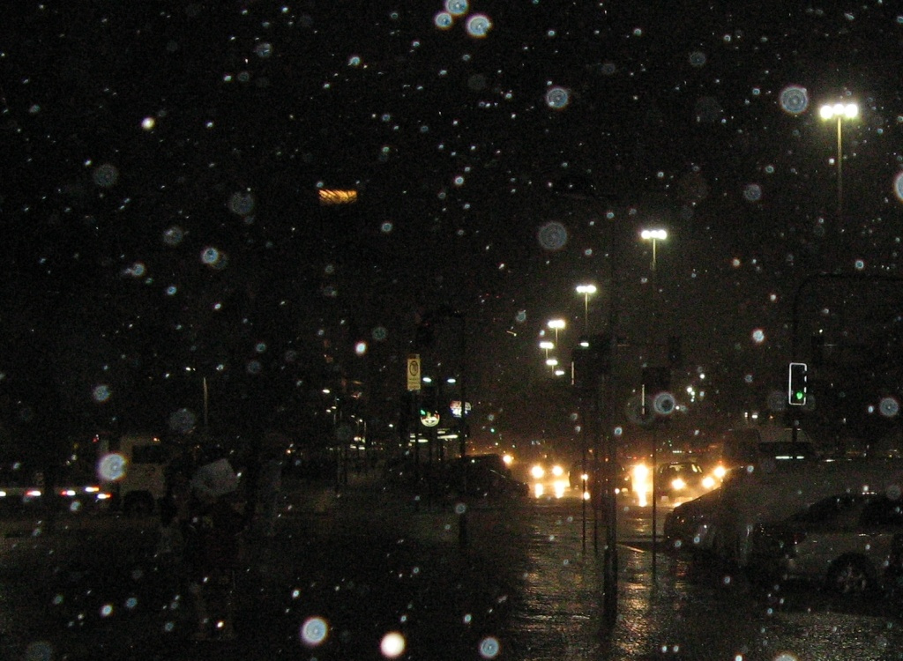

Slide 3



A scene at night

Slide 4


Lighting with a projector

Slide 5
The naïve adaptive solution

Slide 6
Is the naïve solution feasible?
1.2 m
9 m/s
= .002 m/pixel
600 pixels
.002 m/pixel
= .0002 s/pixel
9 m/s
1.2 m
This is too fast!
A standard video camera can only capture one frame every .03 seconds

Slide 7
Detection and prediction
Time=0 seconds
Time=1/50 seconds

Slide 8
Now what?
Wow, are we done?!
Not quite. Time measurements are inaccurate.
The solution?
  Additional detection planes?
  Additional cameras?
  Suggestions?

