Slide 1
How computers answer questions
An introduction to machine learning
Peter Barnum
August 7, 2008

Slide 2

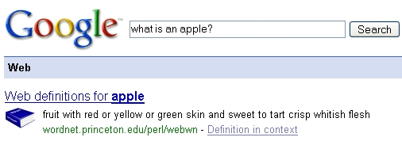
Searching with Google

Slide 3
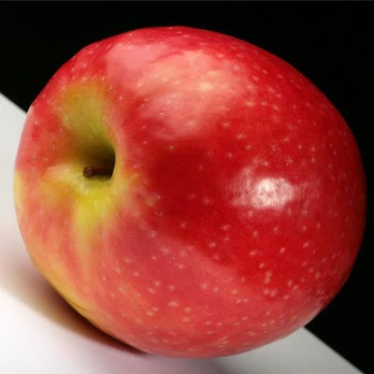
Computer Experts
Classification
Q. What is this?
A. It is an apple.
Regression
Q. How red is this apple?
A. It is 90% red
Notes:
Or stocks

Slide 4
Classification by Example
Label
Features
Color Shape Size Taste
Apple
Red
Round
Small
Sweet
Pear
Green Oval Small Sweet
Dog
Brown Oval Large Bad
Apple
Green Round Small Sweet
? Red Round Small Sweet
? Yellow Round Small Bad
Notes:
Or stocks

Slide 5
Artificial Neural Networks
Is it red?
-1
-1
-1
-1
x 1
x -1
x 1
x -1
-1
1
1
1
x 1
x 1
x 1
x -1
1
1
1
1
x 1
x 1
x 1
x 1
Is it round?
Predicted Answer
Sum
2
-2
-4
0
Is it small?
2
Is it sweet?
True Answer
4
-4
Notes:
Or stocks

Slide 6
Back to Searching with Google

