Slide 1
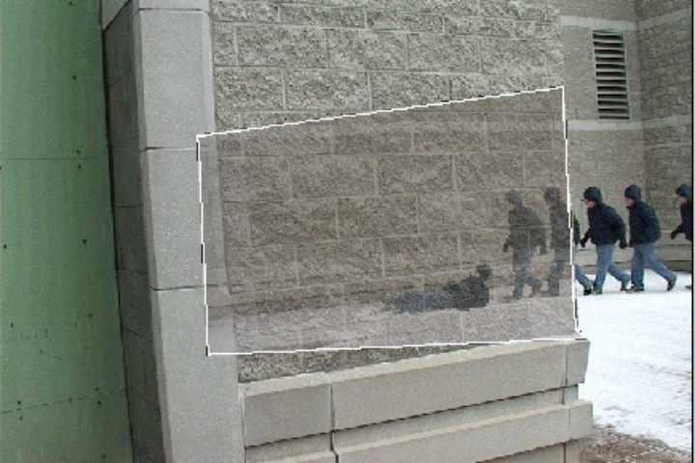
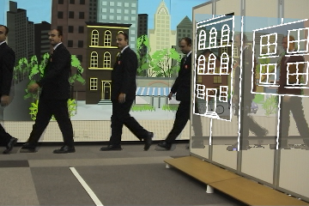
Dynamic Seethroughs:
Synthesizing Hidden Views of Moving Objects
Peter Barnum Yaser Sheikh Ankur Datta Takeo Kanade
Carnegie Mellon University
Robotics Institute
October 21, 2009
Notes:
The text in these comment sections is roughly what I said during the presentation. -Peter

Slide 2
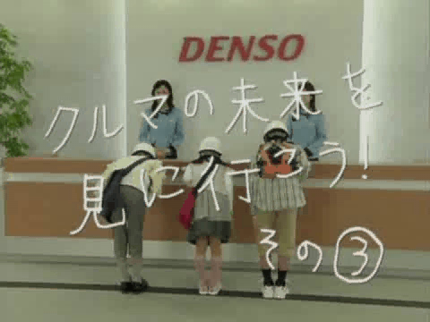
Notes:
English translation:
Children: Let's go to see the future of cars!
Lady: I'll let you drive a car of the future.
Children: Can we see hidden objects?
Children: Yes, we can see the guy behind the wall.
Children: The car too. The motorcycle too.
Lady: We are studying how to generate seethrough images by transferring observed images.
Children: With this technology, no traffic accidents will happen.
Children: But due to this technology, we can't play hide-and-seek anymore.
Lady: (laughs) We also have other interesting ones.

Slide 3
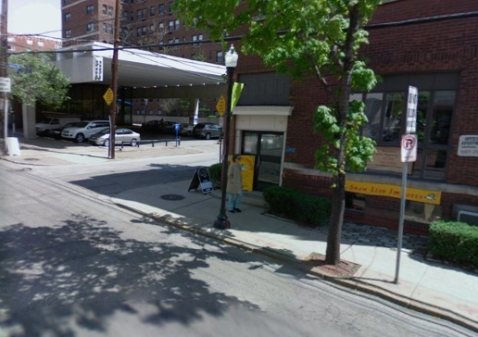
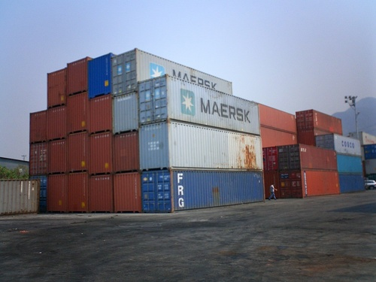
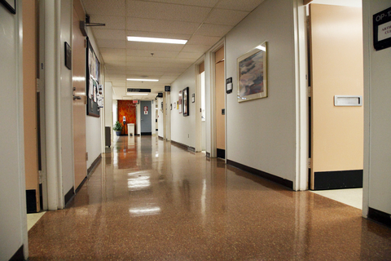

Applications of seethroughs
Traffic safety
Security surveillance
Hospital monitoring
Augmented tours
Notes:
There are various possible applications of seethrough images, such as seeing around dangerous corners, surveillance of a dockyard, monitoring of hospital patients, or augmented tours of museums or historic sites. But for this talk, we’ll mainly be focusing on traffic safety.

Slide 4
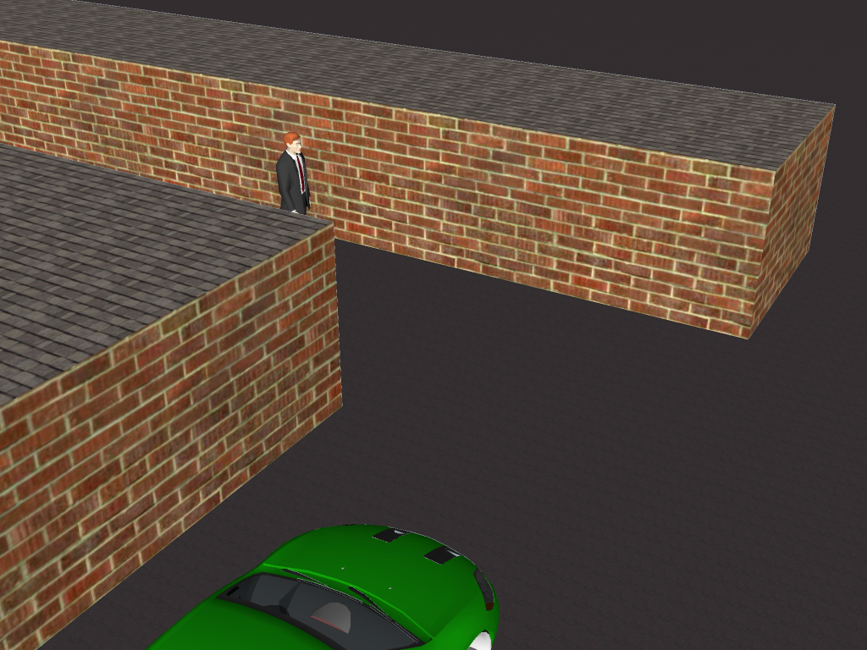
Notes:
There's a man walking along next to the back wall, and a car driving along the left wall. Suppose the car wants to make a left turn. The driver sees this view:

Slide 5
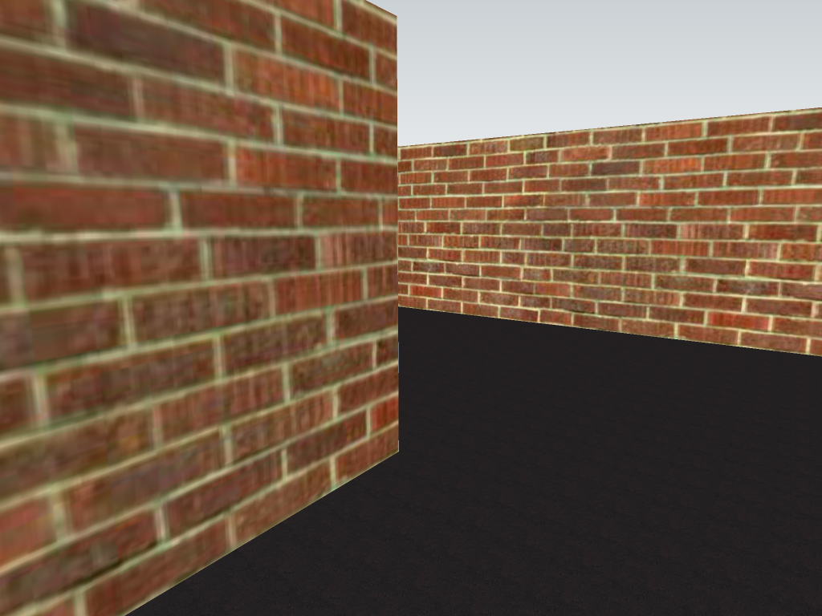
Notes:
Looks safe, right? But suppose superman is driving the car, he'd be able to look through the wall

Slide 6
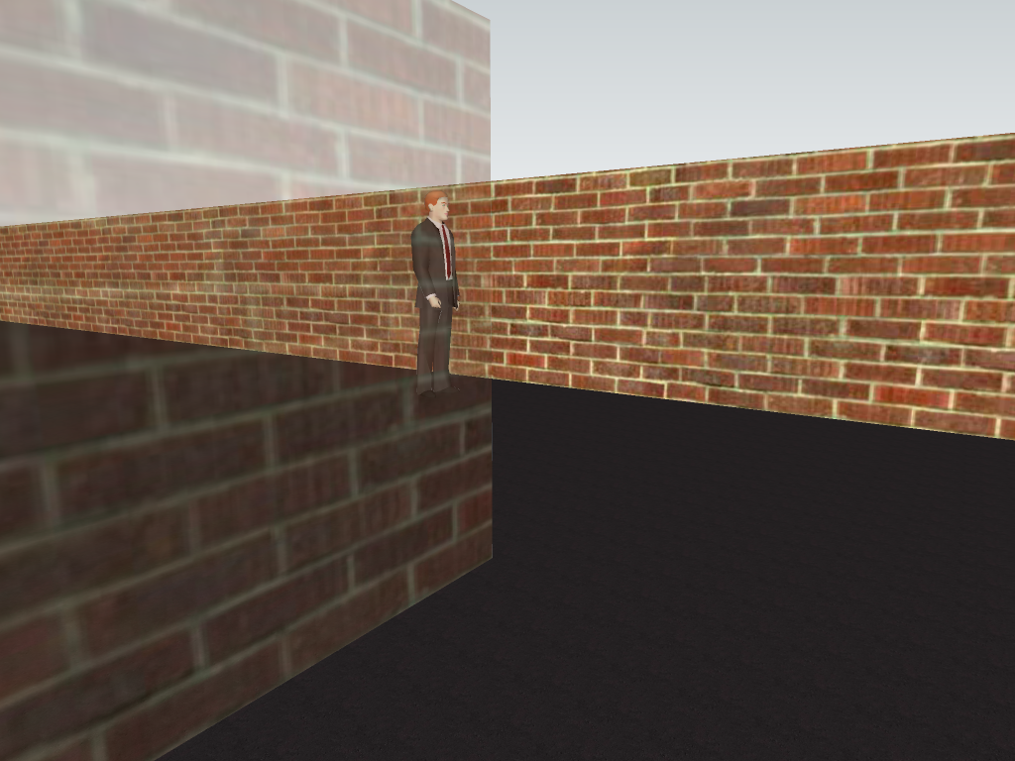
Notes:
and he'd see the man behind it, and he'd know to ease up on the gas. If I told you I wanted to create a see-through view like this with technology, maybe your first idea would be to do this all in 3D. If you had a good stereo rig behind the wall, or a laser range finder or something, you'd be able to figure out where the man was in 3D. Then if there's a camera on the car, you could spend a few minutes taking images of checkerboards and jointly calibrating the car's camera with the cameras behind the wall. If your calibration was good, you'd be able to render a nice picture like this. But what if you drive the car up a bit? You'd have to either manually or automatically re-estimate all the 3D projection parameters. Probably doable, but prone to estimation errors.

Slide 7
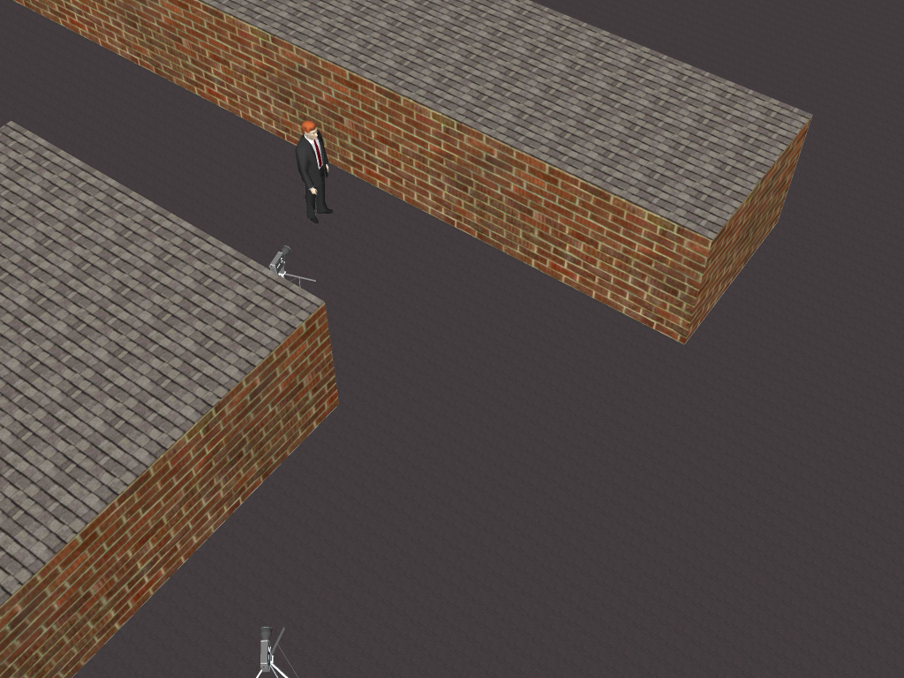
Back plane
Object of
interest
Reference camera
Source camera
Notes:
What are the important parts about this scene that we can use? We have some object of interest, the man, and a back plane. We have a reference camera that captures a picture of the hidden objects, which we want to somehow transfer to the source camera's point of view. And as I said before, we want to do this completely in 2D, so the only information we have is the view from

Slide 8
The two views
Reference camera
Source camera
Notes:
the reference camera and the source camera. Let's assume that the reference camera has been sitting here a while and has seen the background without the man.

Slide 9

Notes:
We can’t see the man in both cameras, so estimating the transformation is hard. But what we can see is the back wall, so let’s start with that.

Slide 10
Transferring the back plane
Reference camera
Source camera
Notes:
Both the reference and source cameras are looking at the same plane. So if we use some SIFT matches and RANSAC, we can warp the background plane image from the reference to the source image. That's pretty easy. But unfortunately, we can't do the same with the interesting part of the scene, the man, because we have no correspondences across the images. But the key of our paper is that we don't have to have correspondences across the images. Once we get this back plan homography, we can estimate a projective invariant in the reference camera that will allow us to also transfer the image of the man. Let's look at the specifics.

Slide 11
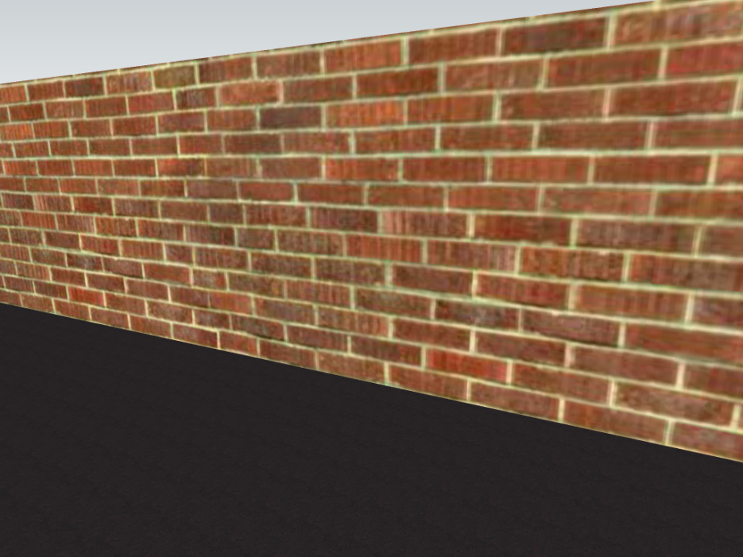
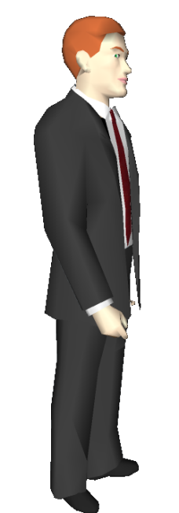
Step 1/3: Pop-in
Reference camera
Source camera
Notes:
Given this planar assumption, our algorithm has three steps. First, we estimate the transformation that will pop-in the man's plane to the back plane.

Slide 12
Step 2/3: Transfer
Reference camera
Source camera
Notes:
For the second step, since we have the homography to warp the back plane, we can warp the man too.

Slide 13
Step 3/3: Pop-out
Reference camera
Source camera
Notes:
For the third and final step, we determine the transform to pop-out the man from the backplane, which will let us create the final rendered image.

Slide 14
The key idea
Pop-in and pop-out are constrained by an invariant
Notes:
The key idea of our work is that you do not require correspondences of the occluded images between the images. Once we compute a projective invariant in the left view, we can use it to both pop-in the man in the left, and pop him out in the right.
To perform this pop-in and pop-out, we use a special kind of planar transformation called a homology. Let me put this in relation to homographies.

Slide 15
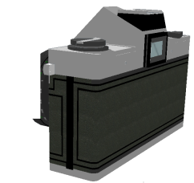
Review of homographies
Notes:
As you know, if you view a plane with a camera, then moving the plane will cause different distorted images.

Slide 16
Review of homographies
These three images are related by an
8 degrees of freedom homography
Notes:
These three images are related by an 8 degree of freedom planar transformation called a homography. This means that if you have one of these images and the homography between them, then you can generate any of the other images.

Slide 17
What is a homology?
fixed line v
fixed point a
Projective invariant
3x3 identity matrix
Notes:
A homology is similar, except all images of planes have to share a fixed point v and a fixed line a. The equation for a homology matrix can be written as a ratio of products of the fixed line v and fixed point a, a three by three identity matrix, and a characteristic invariant mu. You still end up with a three by three matrix homography, but instead of the eight degrees of freedom, you only have three, for the line, point, and characteristic invariant. So how do we compute the homology for our image, that will let us pop-in the man to the back wall?

Slide 18

Projective invariant
a vanishing axis
v
The projective invariant is the cross-ratio of:
v
Vanishing point
x
Bottom point of object
B
x
x
Back wall intersection
o
o
x
B
x
a
Axis intersection
x
a
Notes:
This image has a vanishing point and a vanishing axis (note that the point and line displayed are not the real ones, but are simply for illustration). These can be found by various methods, normally you would just manually click points on known parallel lines. And the projective invariant is the cross-ratio of four elements. The first two are the vanishing point, and the bottom point of the object, where is intersects the ground plane. If we draw a line connecting these two points, then we find the point where the line intersects the back wall and also the point where the line intersects the vanishing axis. So we compute the cross ratio of these four, and we can use it to build

Slide 19
Pop-in
a
v
Projective invariant
x
o
x
B
3x3 identity matrix
x
a
Notes:
the pop-in homology, which is an image-based transformation between the original image and the image where the man is popped onto the wall. Next, we use the full homography to transfer both the wall and the man to the other image. To reiterate, once we've computed the pop-in homology, there's nothing fancy here, you can use your favorite linearly-interpolated homography warping function. And again, the transfer part is straightforward, since we have the back plane homography between reference and source,

Slide 20

Transfer
Reference camera
Source camera
Notes:
We can transfer the man to the source camera view. And let's look at this image alone,

Slide 21
Pop-out
a
Different vertex and axis
v
Same projective invariant
Source camera
Notes:
Just like the other image, this source image has an axis a and a vertex v. The equation for the pop-out homology is very similar. The image has a different vertex and axis, but the key here, this part is important, is that the characteristic invariant mu is exactly the same. Once you've figured out the new vertex and axis by tracking the back and occluding planes, all you have to do is plug them into the equation, which will generate the pop-out homology, and places the man in the correct place with the correct aspect for this new image. This method works when the camera is stationary, as in this result

Slide 22
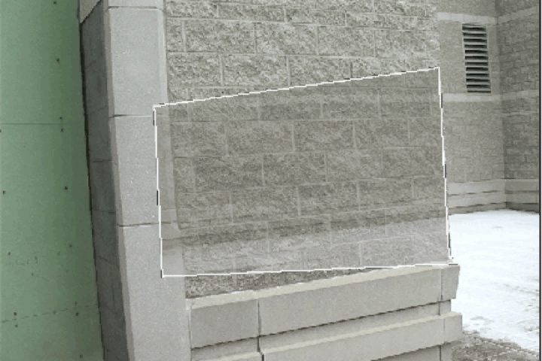
Result 1: Snow angel
Notes:
There are four main things you should be looking for in a good result. The first and simplest is that the objects transferred from the occluded view should have reasonable sizes, positions, and skews. Second, as the source camera moves, the objects must show proper parallax when on the occluded side, otherwise they appear to simply be pasted to the wall. Third, an object must pass seamlessly across the occlusion boundary. Fourth, a moving object should appear to keep the same smooth trajectory on both sides the boundary.

Slide 23
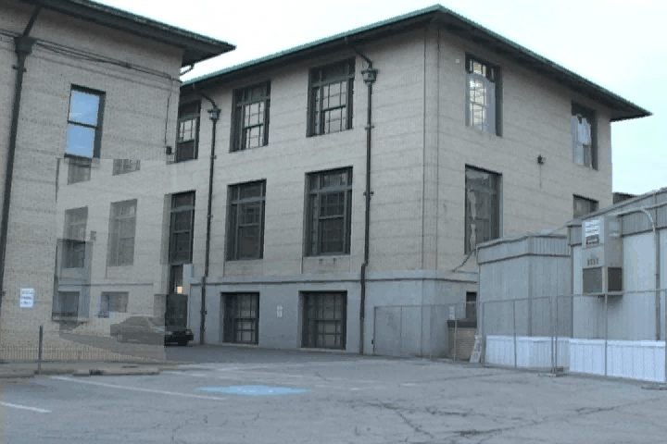
Result 2: Hidden car

Slide 24
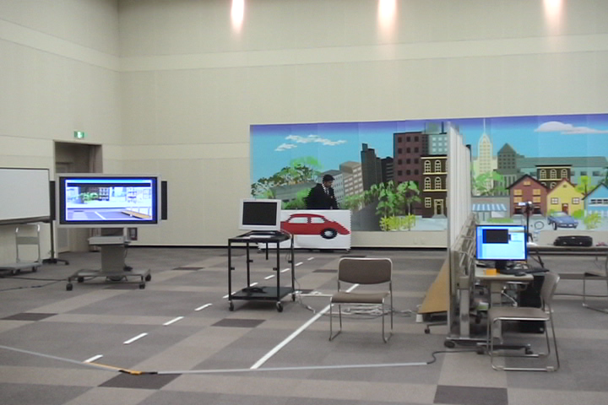
Result 3: Real-time demo
Reference
Camera
Object
Display
Source Camera
Notes:
This work was funded by a Japanese car company, Denso, and we demonstrated a real time version for them. We were able to run this for about two or three hours without re-initialization.

Slide 25
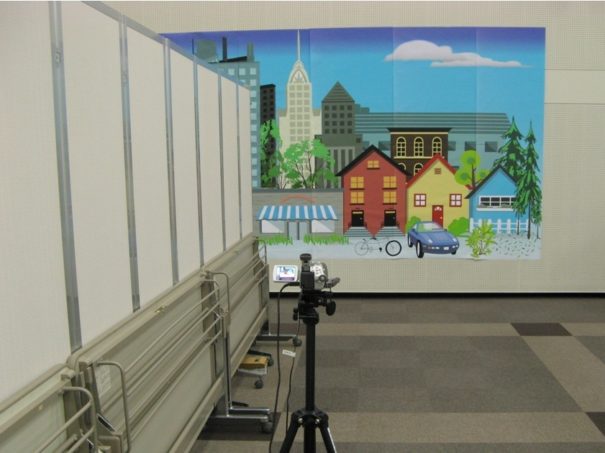
Reference camera
Notes:
The reference camera saw the hidden object

Slide 26
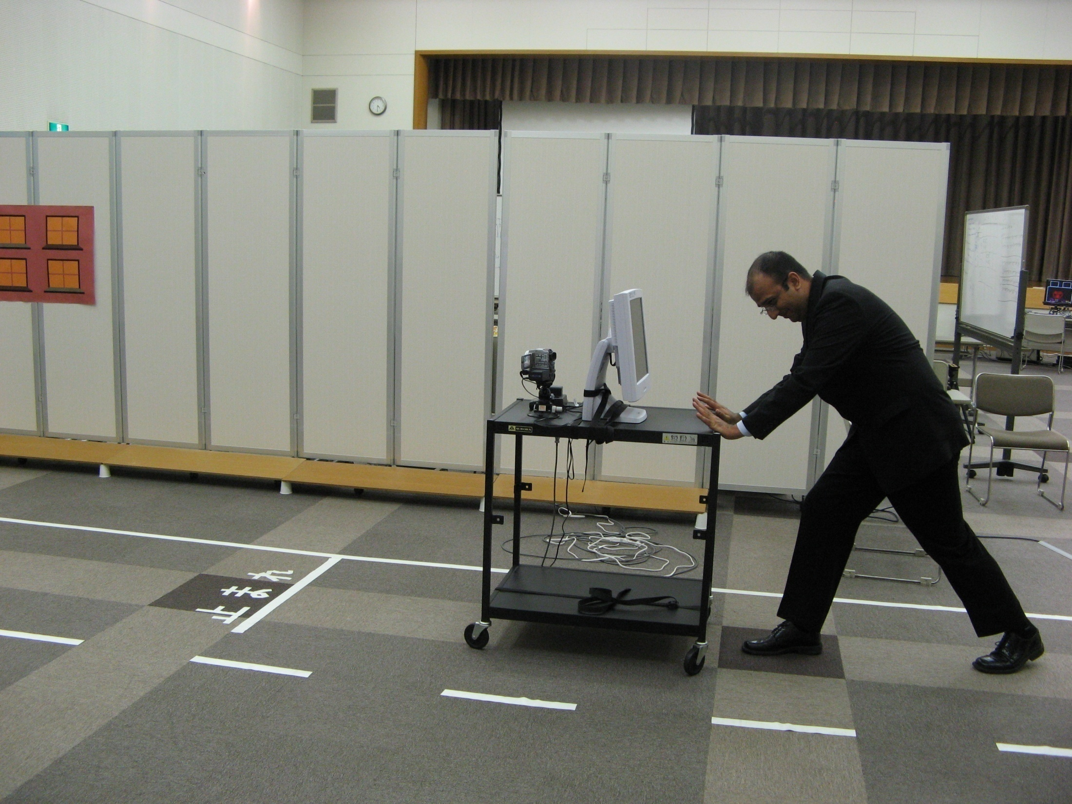
Source camera
Notes:
The source camera was on a cart that could be pushed around

Slide 27
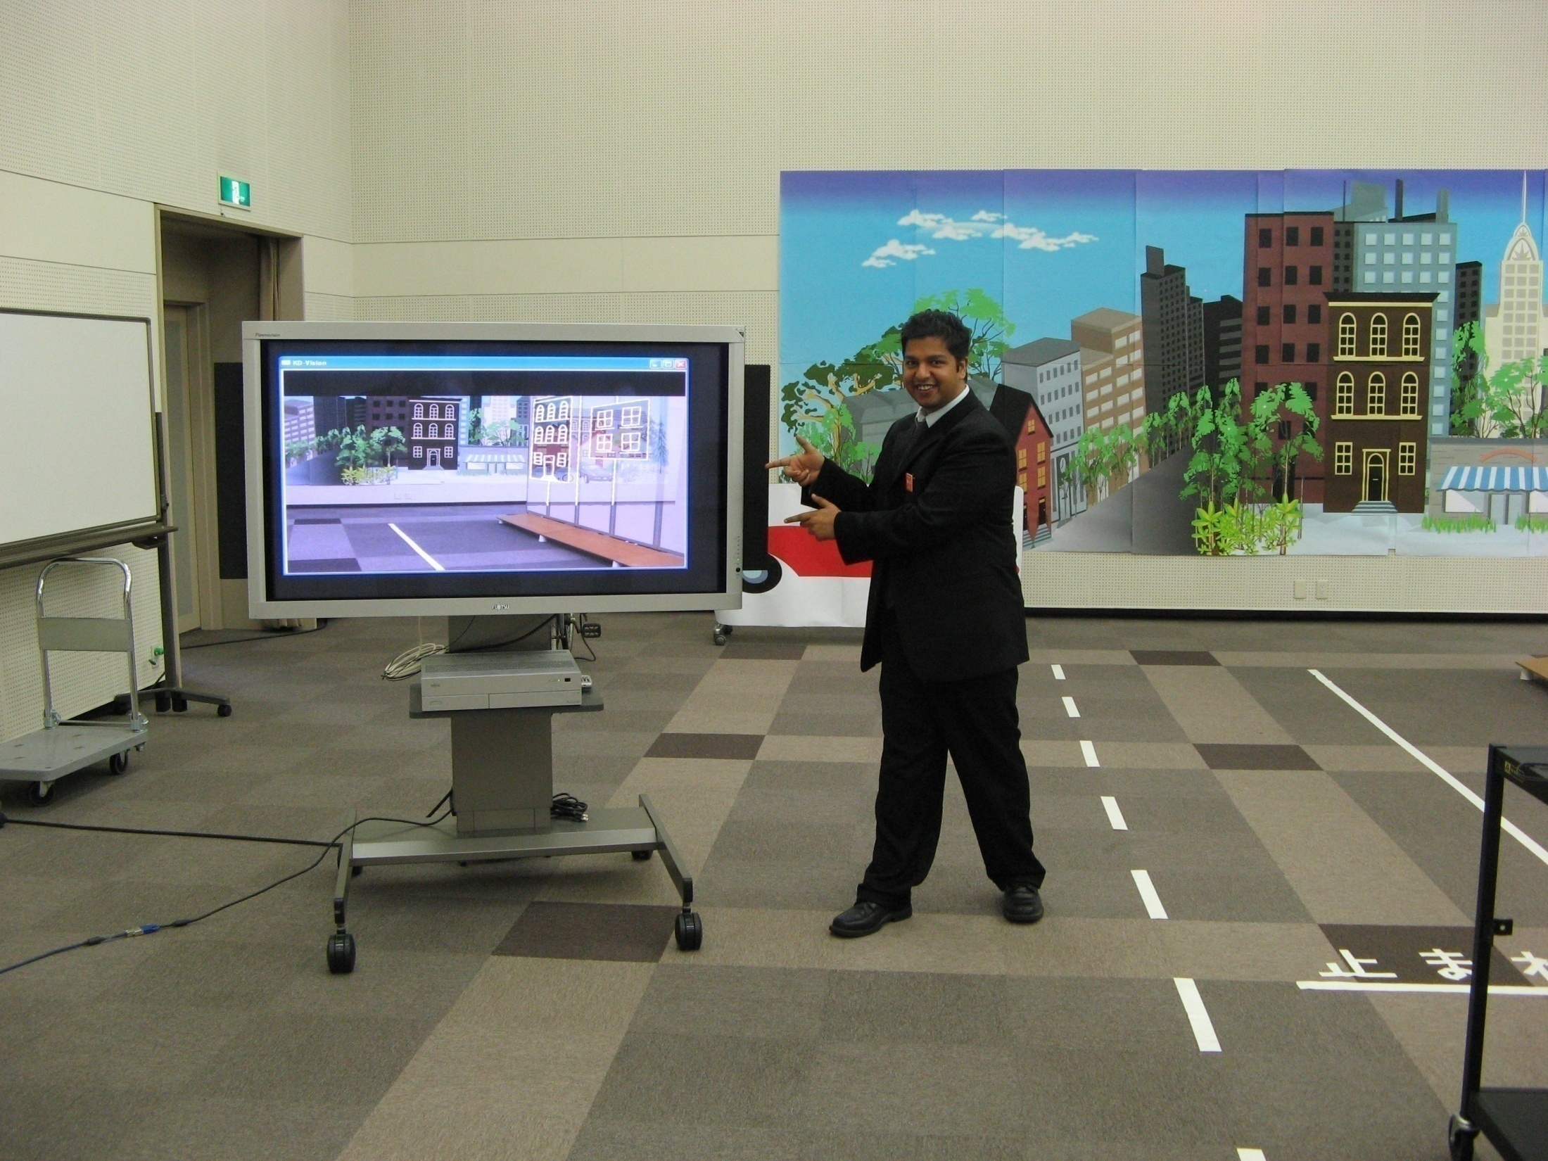
Display
Notes:
And the final result was displayed on a large television screen.

Slide 28
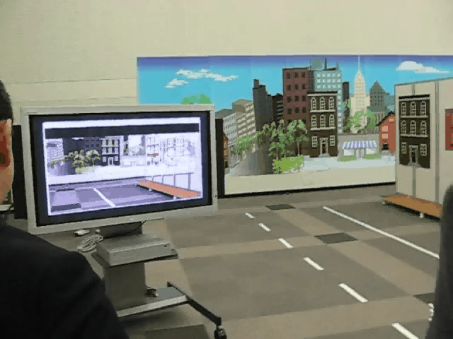
Result 3: Real-time demo

Slide 29
Conclusion
Using an easily computed projective invariant, we are able to compute a seethrough view of dynamic objects
This method can run in real-time for hours without drift
Notes:
Using an easily computed projective invariant, we are able to compute a seethrough view of dynamic objects. And not only do we show some cute equations, but we've implemented this in a system that can run in real-time for hours without drift.

