Slide 1
A Survey of
Differentially Constrained
Planning
Mihail Pivtoraiko

Slide 2
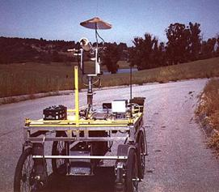
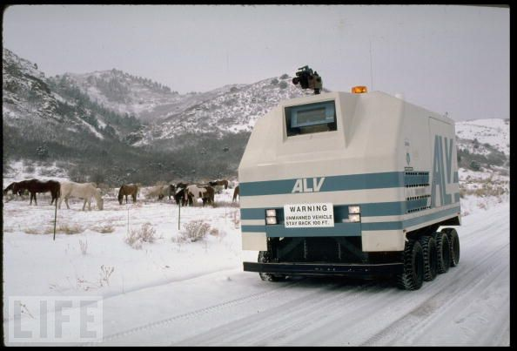
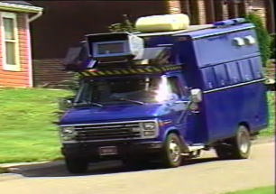
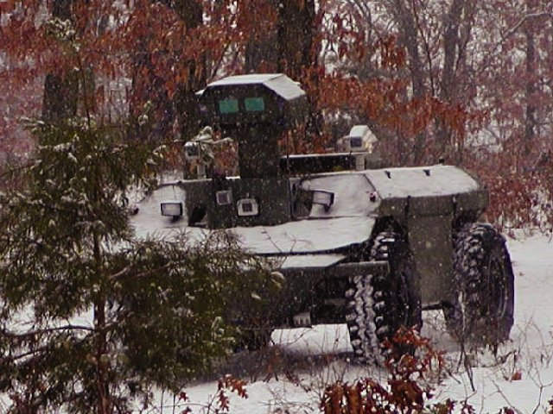
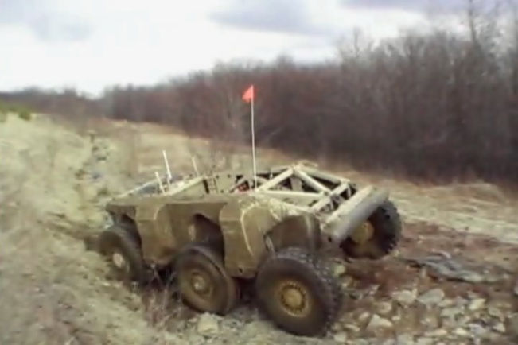
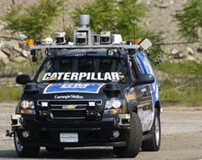
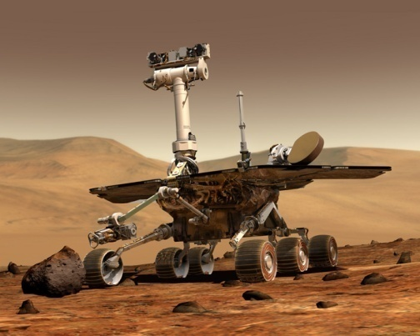
Motion Planning
The Challenge:
Reliable Autonomous Robots
Stanford Cart, 1979
ALV, 1988
XUV, 1998
NavLab, 1985
Crusher, 2006
Boss, 2007
MER, 2004

Slide 3
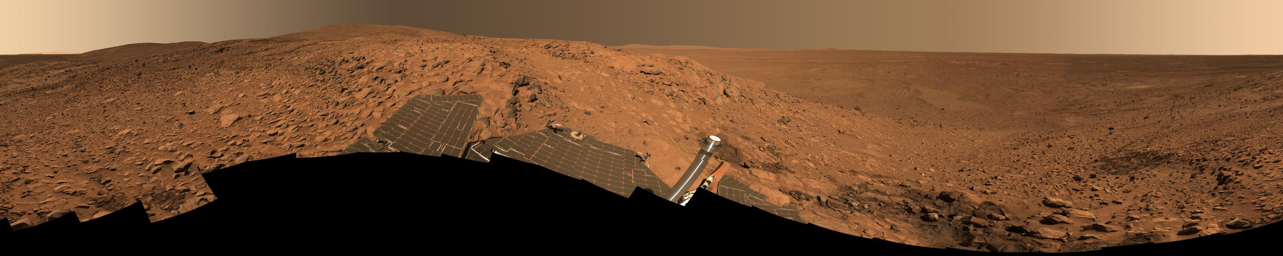
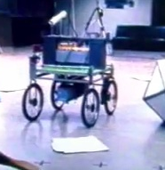



Agenda
Deterministic planners
  Path smoothing
  Control sampling
  State sampling
Randomized planners
  Probabilistic roadmaps
  Rapidly exploring Random Trees

Slide 4
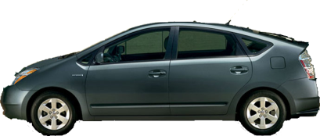
Motivation
  ALV (Daily et al., 1988)
Local
Global

Slide 5
Unstructured Environments
Structure imposed:
  Regular, fine grid
  Standard search (A*)
Local
Global

Slide 6
Unstructured and Uncertain
Uncertain terrain
  Potentially changing
?
Local
Global

Slide 7
Unstructured and Uncertain
Unseen obstacles
  Detected up close
  Invalidate the plan
?
Local
Global

Slide 8
Unstructured and Uncertain
  D*/Smarty (Stentz & Hebert, 1994)
  Ranger (Kelly, 1995)
  Morphin (Simmons et al., 1996)
  Gestalt (Maimone et al., 2002)
?
Local
Global
Efficient replanning

Slide 9

Mobility Constraints
2D global planners lead to nonconvergence in
difficult environments
Robot will fail to make the turn into the corridor
Global planner must understand the need to swing wide
Issues:
  Passage missed, or
  Point-turn is necessary…
Plan Step n
Plan Step n+1
Plan Step n+2

Slide 10
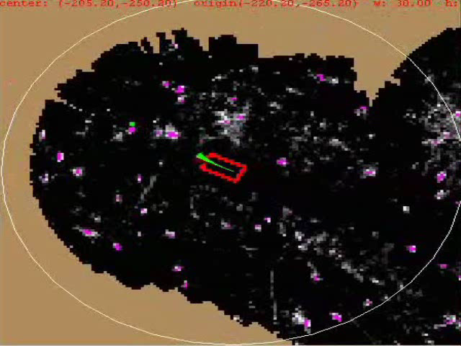
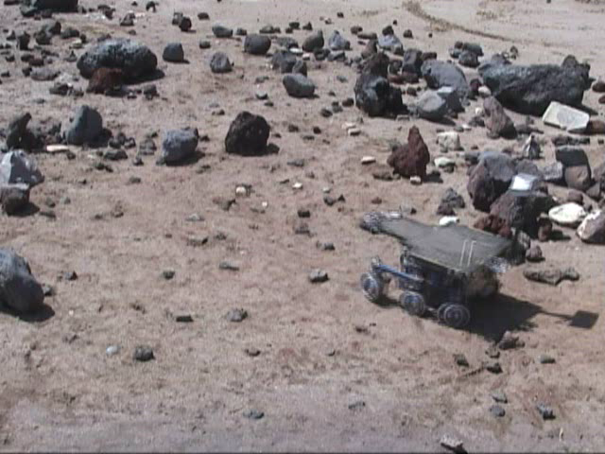
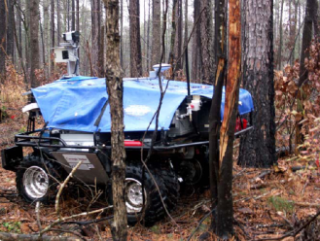
In the Field…
PerceptOR/UPI, 2005
Rover Navigation, 2008

Slide 11
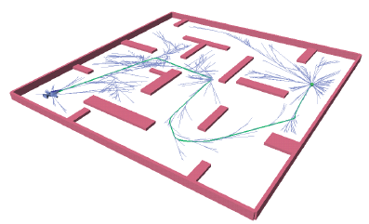
Mobility Constraints
Problem:
  Mal-informed global planner
  Vehicle constraints ignored:
  Heading
Potential solutions:
  Rapidly-Exploring Random Tree (RRT)
  [LaValle & Kuffner, 2001]
  PDST-EXPLORE
  [Ladd & Kavraki, 2004]
  Deterministic motion sampling
  [Barraquand & Latombe, 1993]
  LaValle & Kuffner, 2001
Notes:
We’re doing all this to avoid point turns…

Slide 12

Mobility Constraints
Bruntingthorpe Proving Grounds Leicestershire, UK
April 1999

Slide 13
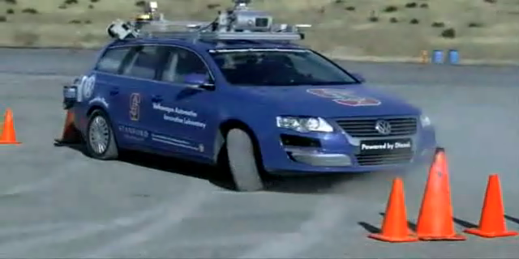
Extreme Maneuvering
Kolter et al., 2010

Slide 14
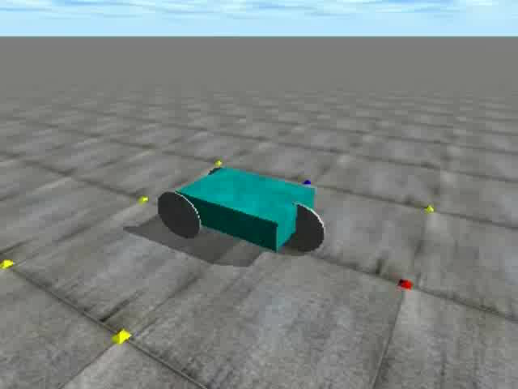
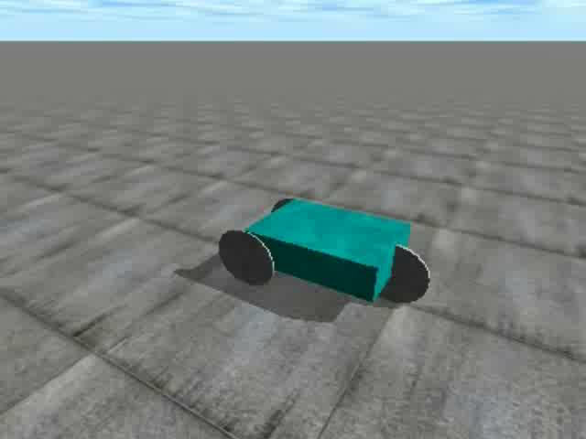
Arbitrary…

Slide 15
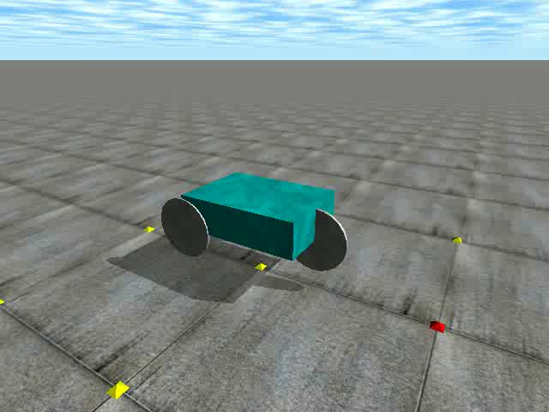
Dynamics Planning

Slide 16

Definitions
State space
x , y, z, ψ, ϕ, θ
x , y, z, ψ, ϕ, θ
v

Slide 17
Definitions
State space
Control space
  Accelerator
  Steering
x , y, z, ψ, ϕ, θ
x , y, z, ψ, ϕ, θ
v

Slide 18
Definitions
State space
Control space
Feasibility
  Satisfaction of
  differential constraints
  General formulation
x = f(x, u, t)

Slide 19
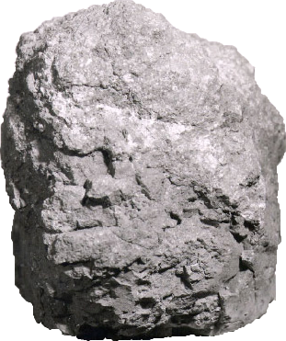
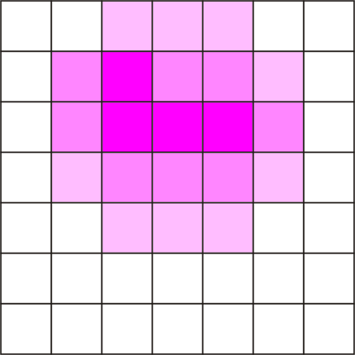
Definitions
State space
Control space
Feasibility
Partially-known
environment
  Sampled perception map

Slide 20
Definitions
State space
Control space
Feasibility
Partially-known
environment
  Sampled perception map
  Local, changing info

Slide 21
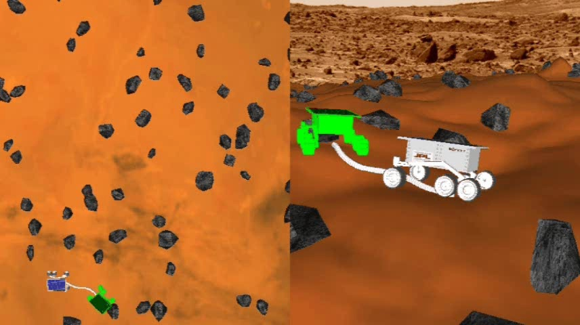
Definitions
Motion Planning
  Given two states, compute control sequence
  Qualities
    Feasibility
    Optimality
    Runtime
    Completeness

Slide 22
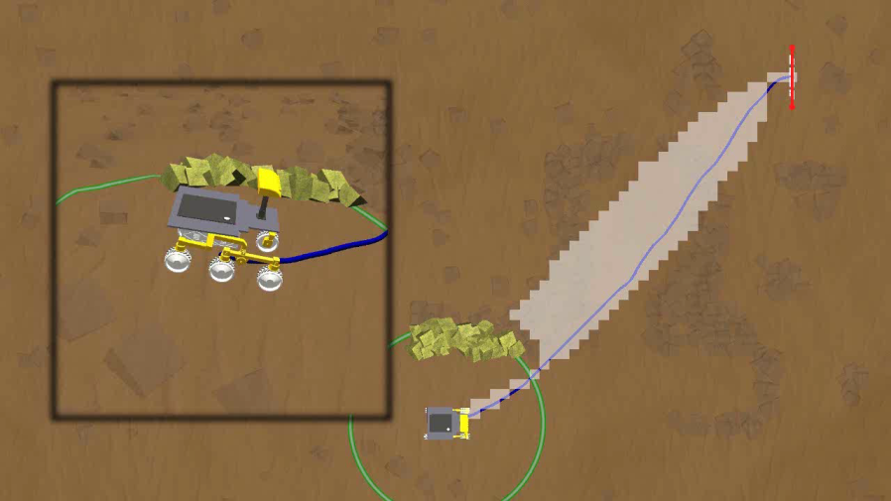
Definitions
Motion Planning
Dynamic Replanning
  Capacity to “repair” the plan
  Improves reaction time

Slide 23
Definitions
Motion Planning
Dynamic Replanning
Search Space
  Set of motion alternatives
  Unstructured environments Sampling
    State space
    Control space

Slide 24

Definitions
Motion Planning
Dynamic Replanning
Search Space
Deterministic sampling
  Fixed pattern, predictable
  “Curse of dimensionality”

Slide 25
Definitions
Search space design
  Input: robot properties
  Output: state, control sampling
  Maximize planner qualities (F, O, R, C)
Design principle
  Sampling rule
Notes:
Search space design is a constrained optimization problem.

Slide 26
Outline
Introduction
Deterministic Planning
  Hierarchical
  Path Smoothing
  Control Sampling
  State Sampling
Randomized Planning
  PRMs
  RRTs
Derandomized Planners
Some applications

Slide 27


Local/Global
Pros:
  Local motion evaluation is fast
  In sparse obstacles, works very well
Perception horizon
Blocked motions
Free motions
  ALV (Daily et al., 1988)
  D*/Smarty (Stentz & Hebert, 1994)
  Ranger (Kelly, 1995)
  Morphin (Krotkov et al., 1996)
  Gestalt (Goldberg, Maimone & Matthies, 2002)

Slide 28
Local/Global
Pros:
  Local motion evaluation is fast
  In sparse obstacles, works very well
Cons:
  Search space differences
  ALV (Daily et al., 1988)
  D*/Smarty (Stentz & Hebert, 1994)
  Ranger (Kelly, 1995)
  Morphin (Krotkov et al., 1996)
  Gestalt (Goldberg, Maimone & Matthies, 2002)

Slide 29
Local/Global
Pros:
  Local motion evaluation is fast
  In sparse obstacles, works very well
Cons:
  Search space differences
  ALV (Daily et al., 1988)
  D*/Smarty (Stentz & Hebert, 1994)
  Ranger (Kelly, 1995)
  Morphin (Krotkov et al., 1996)
  Gestalt (Goldberg, Maimone & Matthies, 2002)

Slide 30
Local/Global
Pros:
  Local motion evaluation is fast
  In sparse obstacles, works very well
Cons:
  Search space differences
  ALV (Daily et al., 1988)
  D*/Smarty (Stentz & Hebert, 1994)
  Ranger (Kelly, 1995)
  Morphin (Krotkov et al., 1996)
  Gestalt (Goldberg, Maimone & Matthies, 2002)

Slide 31
Local/Global
Pros:
  Local motion evaluation is fast
  In sparse obstacles, works very well
Cons:
  Search space differences
  ALV (Daily et al., 1988)
  D*/Smarty (Stentz & Hebert, 1994)
  Ranger (Kelly, 1995)
  Morphin (Krotkov et al., 1996)
  Gestalt (Goldberg, Maimone & Matthies, 2002)

Slide 32
Local/Global
Pros:
  Local motion evaluation is fast
  In sparse obstacles, works very well
Cons:
  Search space differences
  ALV (Daily et al., 1988)
  D*/Smarty (Stentz & Hebert, 1994)
  Ranger (Kelly, 1995)
  Morphin (Krotkov et al., 1996)
  Gestalt (Goldberg, Maimone & Matthies, 2002)

Slide 33
Local/Global
Pros:
  Local motion evaluation is fast
  In sparse obstacles, works very well
Cons:
  Search space differences
  ALV (Daily et al., 1988)
  D*/Smarty (Stentz & Hebert, 1994)
  Ranger (Kelly, 1995)
  Morphin (Krotkov et al., 1996)
  Gestalt (Goldberg, Maimone & Matthies, 2002)

Slide 34
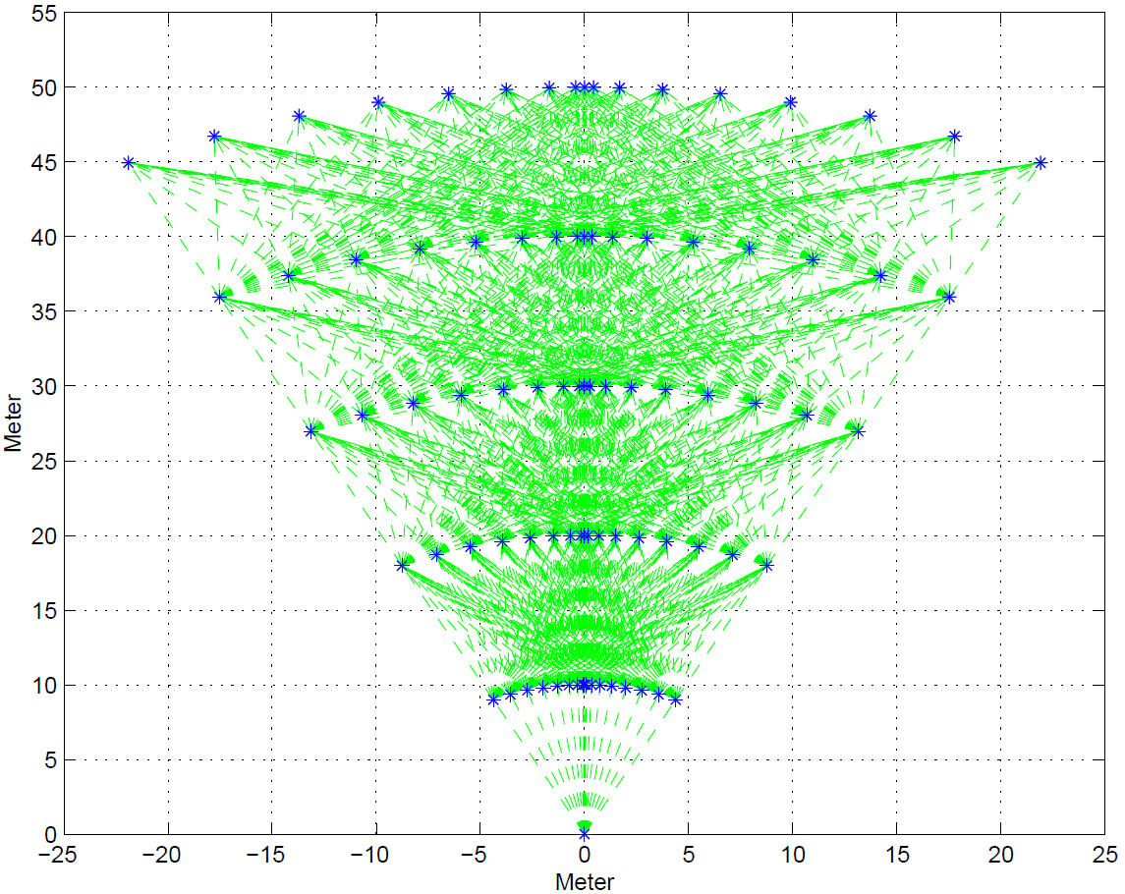
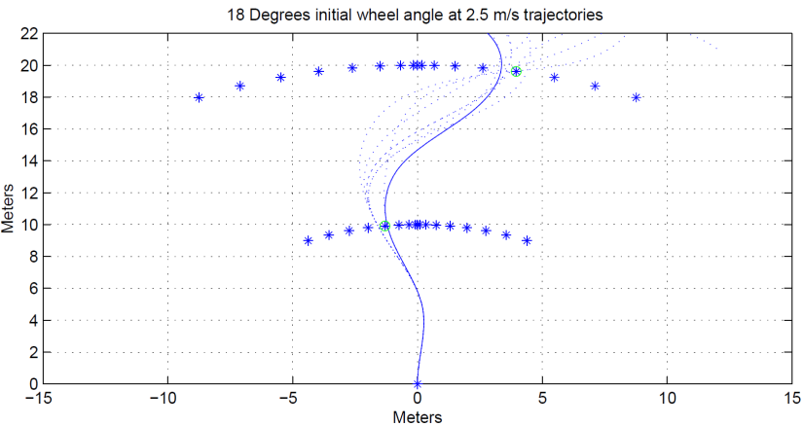
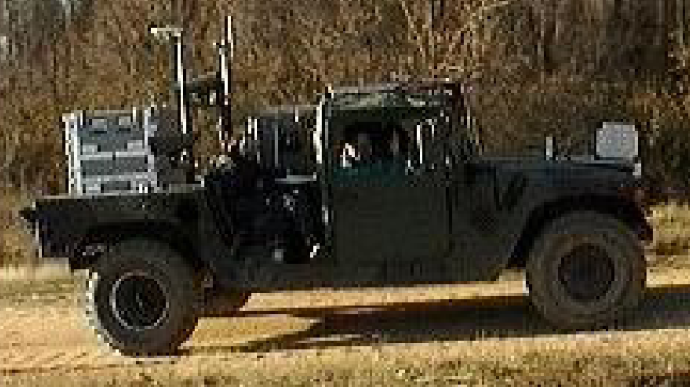
Egograph
Local/Global arrangement
Imposing Discretization
Pre-computed search space
  Tree depth: 5
  17 state samples per level
  7 segments
  4 velocities
  19 curvatures
  Lacaze et al., 1998

Slide 35
Outline
Introduction
Deterministic Planning
  Hierarchical
  Path Smoothing
  Control Sampling
  State Sampling
Randomized Planning
  PRMs
  RRTs
Derandomized Planners
Some applications

Slide 36
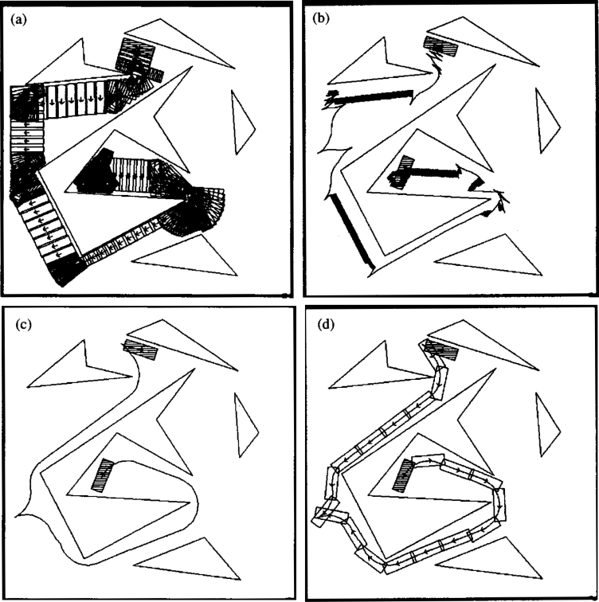

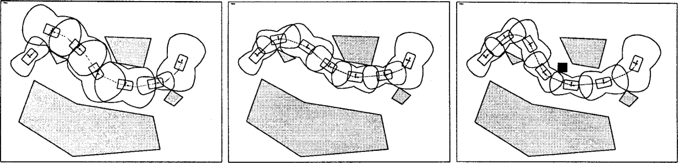
Path Post-Processing
Lamiraux et al., 2002
Laumond, Jacobs, Taix, Murray, 1994
Khatib, Jaouni, Chatila, Laumond, 1997

Slide 37

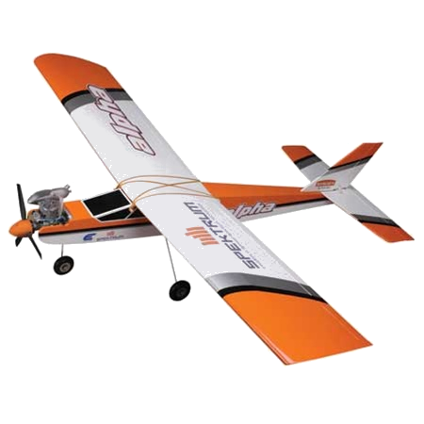

Topological Property
✓

Slide 38
Outline
Introduction
Deterministic Planning
  Hierarchical
  Path Smoothing
  Control Sampling
  State Sampling
Randomized Planning
  PRMs
  RRTs
Derandomized Planners
Some applications

Slide 39
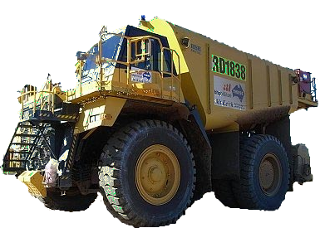
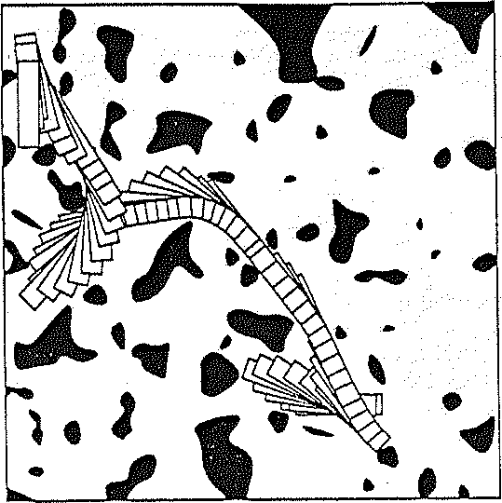
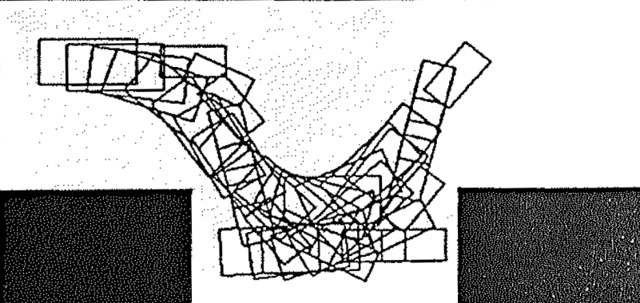
Control Space Sampling
✗
✗
Barraquand & Latombe:
3 arcs (+ reverse) at κ_{max}
Discontinuous curvature
Cost = number of reversals
Dijkstra’s search
Barraquand & Latombe, 1993
Lindemann & LaValle, 2006
Kammel et al., 2008

Slide 40
Robot-Fixed Search Space
Moves with the robot
Dense sampling
  Position
Symmetric sampling
  Heading
  Velocity
  Steering angle
  …
Tree depth
  1: Local (arcs) + Global (D*) (Stentz & Hebert, 1994)
  5: Egograph (Lacaze et al., 1998)
  ∞: Barraquand & Latombe (1993)
40

Slide 41
Outline
Introduction
Deterministic Planning
  Hierarchical
  Path Smoothing
  Control Sampling
  State Sampling
Randomized Planning
  PRMs
  RRTs
Derandomized Planners
Some applications

Slide 42

World-Fixed Search Space
Fixed to the world
Dense sampling
  (none)
Symmetric sampling
  Position
  Heading
  Velocity
  Steering angle
  …
Dependency
  Boundary value problem
Pivtoraiko & Kelly, 2005
Examples of BVP solvers:
Dubins, 1957
Reeds & Shepp, 1990
Lamiraux & Laumond, 2001
Kelly & Nagy, 2002
Pancanti et al., 2004
Kelly & Howard, 2005

Slide 43
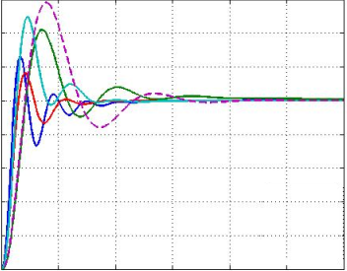
Robot-Fixed vs. World-Fixed
Barraquand
& Latombe
State Lattice
CONTROL
STATE
STATE
CONTROL

Slide 44
State Lattice Benefits
State Lattice
  Regularity in state sampling
  Position invariance
Pivtoraiko & Kelly, 2005

Slide 45
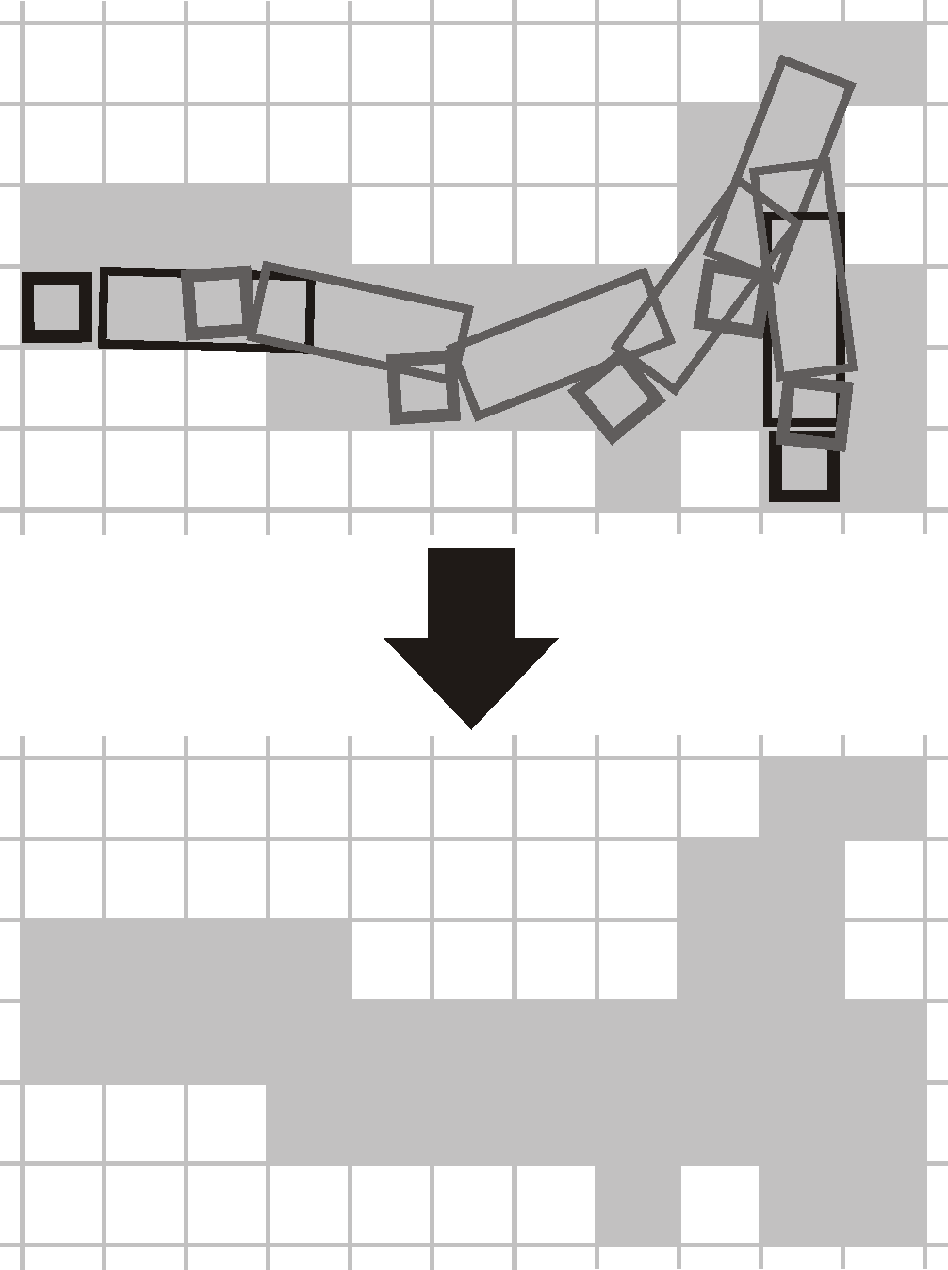
Path Swaths
State Lattice
  Regularity
  Position invariance
Benefits
  Pre-computing path swaths
Pivtoraiko & Kelly, 2007

Slide 46

World Fixed State Lattice
State Lattice
  Regularity
  Position invariance
Benefits
  Pre-computing path swaths
  Pre-computing heuristics
HLUT
Pivtoraiko & Kelly, 2005
Knepper & Kelly, 2006
Notes:
TODO:
- Say this in more detail

Slide 47
World Fixed State Lattice
State Lattice
  Regularity
  Position invariance
Benefits
  Pre-computing path swaths
  Pre-computing heuristics
  Dynamic replanning
?

Slide 48
World Fixed State Lattice
State Lattice
  Regularity
  Position invariance
Benefits
  Pre-computing path swaths
  Pre-computing heuristics
  Dynamic replanning

Slide 49
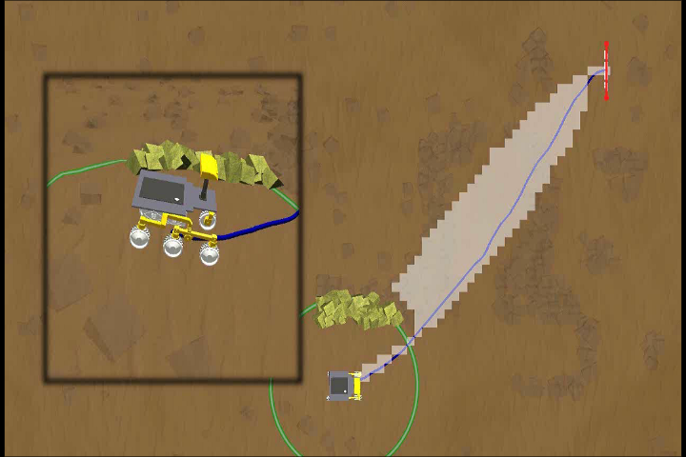
Nonholonomic D*
Expanded States
Motion Plan
Perception Horizon
Graphics: Thomas Howard

Slide 50

Nonholonomic D*
Pivtoraiko & Kelly, 2007
Graphics: Thomas Howard

Slide 51
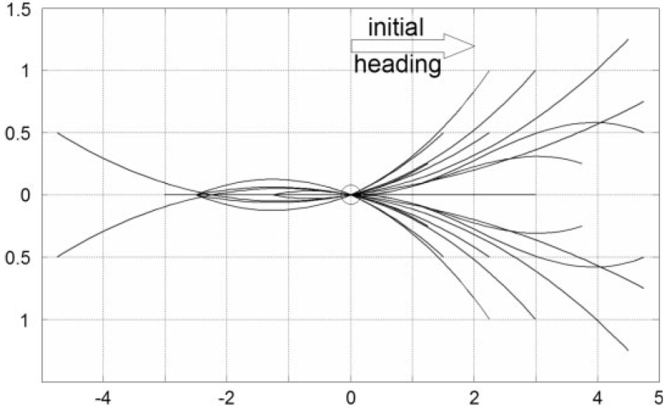
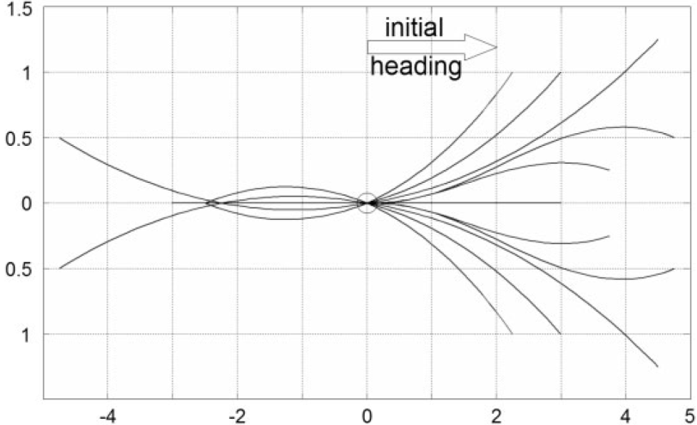
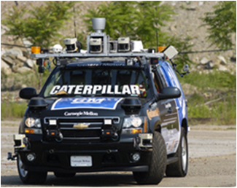
Boss
“Parking lot” planner
Regular 4D state sampling
Pre-computed search space
  Depth: unlimited
  Multi-resolution
  32 (16) headings
  2 velocities
  No curvature
  LIkhachev et al., 2008

Slide 52
World Fixed State Lattice
State Lattice
  Regularity
  Position invariance
Benefits
  Pre-computing path swaths
  Pre-computing heuristics
  Dynamic replanning
  Dynamic search space
G₅
G₄
G₃
G₁
G₀
Search graph ≡ G₀ ∪ G₁ ∪ … ∪ G_{n}
Pivtoraiko & Kelly, 2008

Slide 53
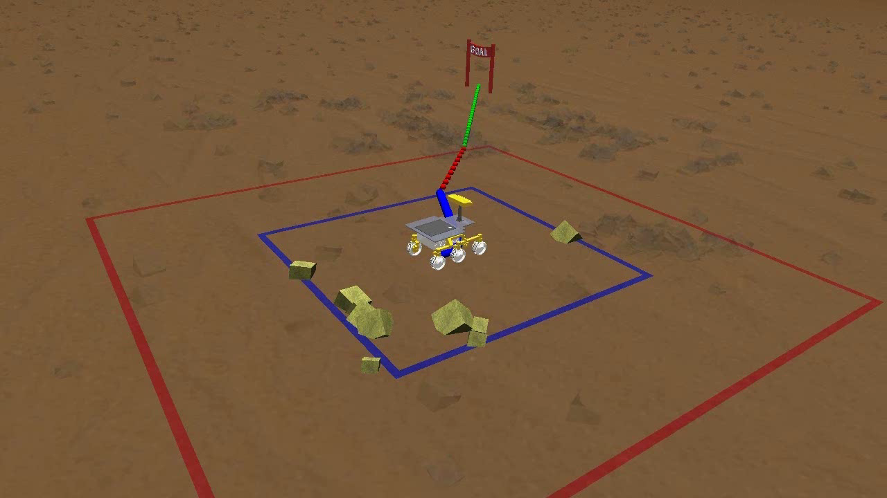
Dynamic Search Space
Pivtoraiko & Kelly, 2008
Graphics: Thomas Howard

Slide 54
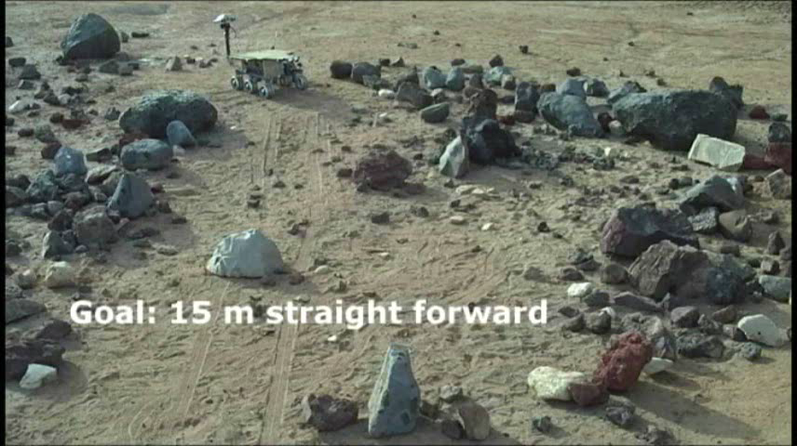
Dynamic Search Space

Slide 55

World Fixed State Lattice
State Lattice
  Regularity
  Position invariance
Benefits
  Pre-computing path swaths
  Pre-computing heuristics
  Dynamic replanning
  Dynamic search space
  Parallelized search
GOAL
START
Pivtoraiko & Kelly, 2010

Slide 56
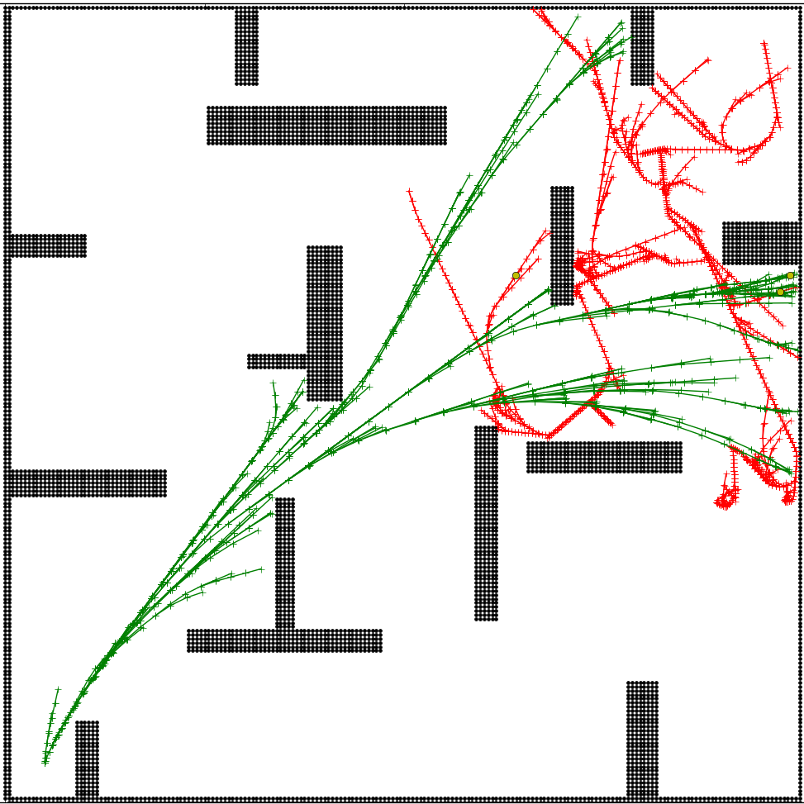
World Fixed State Lattice
GOAL
START
Pivtoraiko & Kelly, 2010

Slide 57
World Fixed State Lattice
GOAL
tree size ratio
START
Pivtoraiko & Kelly, 2010
epsilon

Slide 58
Search Space Comparison
World-Fixed
Pros:
Pre-computing path swaths
Pre-computing heuristics
Parallelized search
Dynamic replanning
Dynamic search space
Cons:
Boundary value problem
Robot-Fixed
Pros:
Any motion generation scheme
Cons:
NO Pre-computing path swaths
NO Pre-computing heuristics
NO Parallelized search
NO Dynamic replanning
NO Dynamic search space

Slide 59
Outline
Introduction
Deterministic Planning
  Hierarchical
  Path Smoothing
  Control Sampling
  State Sampling
Randomized Planning
  PRMs
  RRTs
Derandomized Planners
Some applications

Slide 60
A Few Randomized Planners
Probabilistic Roadmaps (PRM)
  Kavraki, Svestka, Latombe & Overmars, 1996
Expansive Space Tree (EST)
  Hsu, Kindel, Latombe & Rock, 2001
Rapidly-Exploring Random Tree (RRT)
  LaValle & Kuffner, 2001
R* Search
  Likhachev & Stentz, 2008
  LaValle & Kuffner, 2001

Slide 61
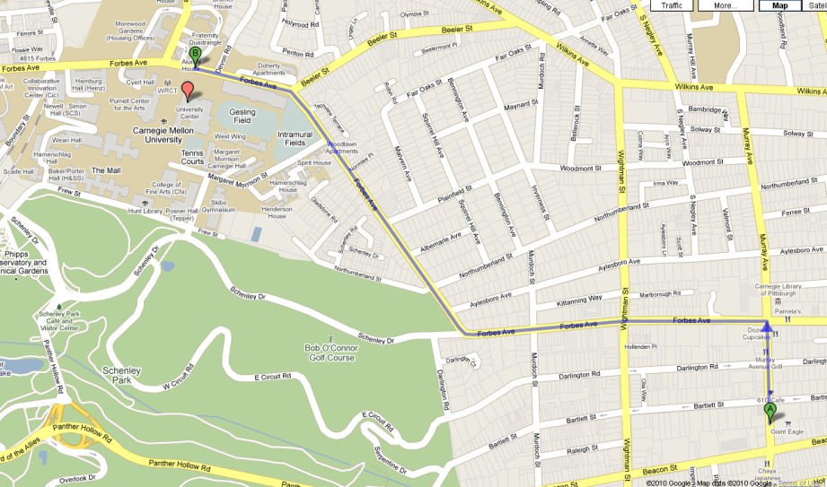
Probabilistic Roadmap
Static workspaces
  E.g. industrial workcells
Two phases:
  Learning: construct the
  roadmap
  Query: actually plan
Structure: undirected graph
Originally applied to holonomic robots

Slide 62
Learning Phase
Two steps:
  Construction
    Constructs edges and vertices to cover free C-space uniformly
  Expansion
    Tries to detect “difficult” regions and samples them more densely

Slide 63
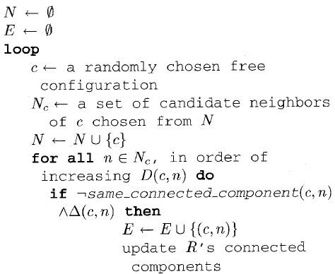
Construction Step
Two sub-steps:
  Sample a random configuration and add to the graph
  Select n neighbor vertices and
  (try to) connect to the new vertex
Components
  Distance metric
  Local planner
    Connections between vertices
  Kavraki, Svestka, Latombe & Overmars, 1996

Slide 64
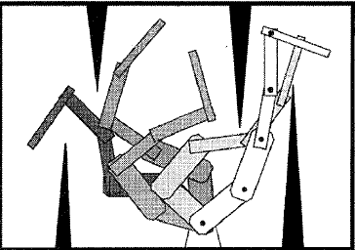
Query Phase
Graph is constructed
Apply any shortest-path graph search
Smoothing:
  Find “shortcuts”
  Local planner is reused
  Kavraki, Svestka, Latombe & Overmars, 1996

Slide 65
Outline
Introduction
Deterministic Planning
  Hierarchical
  Path Smoothing
  Control Sampling
  State Sampling
Randomized Planning
  PRMs
  RRTs
Derandomized Planners
Some applications

Slide 66
Original RRT
Rapidly-Exploring Random Tree
Proposed for kino-dynamic planning
  Holonomic randomized planners existed before
  Proposed to meet the need for randomized planners under differential constraints
Today, a work-horse for randomized search
  Probabilistically complete
  No optimality guarantees
  Avoids “curse of dimensionality”

Slide 67
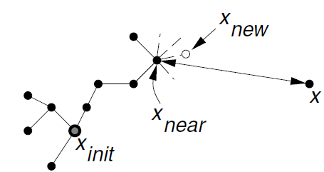
RRT in a Nutshell
Given a tree (initially only x_{init})
Pick a sample, x, in state space, X
  Randomly
  Sample uniform distribution over X
Find nearest neighbor tree node, x_{near}, to x
Find a control that approaches x_{near}
  Unless you solve the BVP problem, won’t approach exactly
  Just do your best; you’ll arrive at x_{new} near to x
Add x_{new} and the edge (x_{near}, x_{new}) to the tree
Repeat

Slide 68
RRT Origins
Khatib, IJRR 5(1), 1986
  Potential fields for obstacle avoidance, mobile robots and manipulators
Barraquand & Latombe, IJRR 10(6), 1993
  Builds and searches a graph connecting local minima of a potential field
  Monte-Carlo technique to escape local minima via Brownian motions
Kavraki, Svestka, Latombe & Overmars, Transactions 12(4), 1996
  Probabilistic roadmaps
  Randomly generate a graph in a configuration space
  Multi-query method, best for fixed manipulators
Hsu, Latombe & Motwani, Int. J. of Comput. Geometry & App., 1997
  Expansive Space Tree (EST), single-query method
  Choose tree node to extend via biased probability measure
  Apply random control
  Collision checking in state*time space

Slide 69
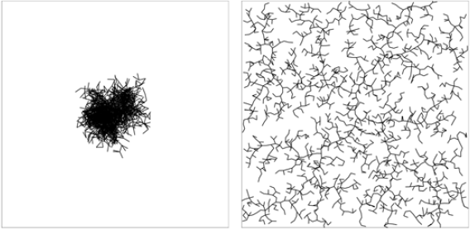
Rapidly-Exploring
Naïve random tree
RRT
Voronoi bias
  Sampling uniform distribution over state space
  Large empty regions have higher probability of being sampled
  Hence, tree “prefers” growing into empty regions

Slide 70
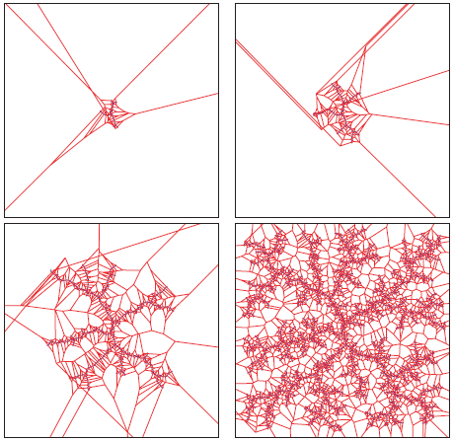
Voronoi Bias

Slide 71


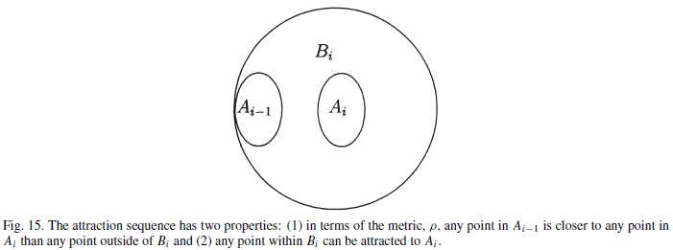

Analysis
Convergence to solution
  Probability of failure (to find solution) decreases exponentially with the number of iterations
Probabilistic completeness

Slide 72
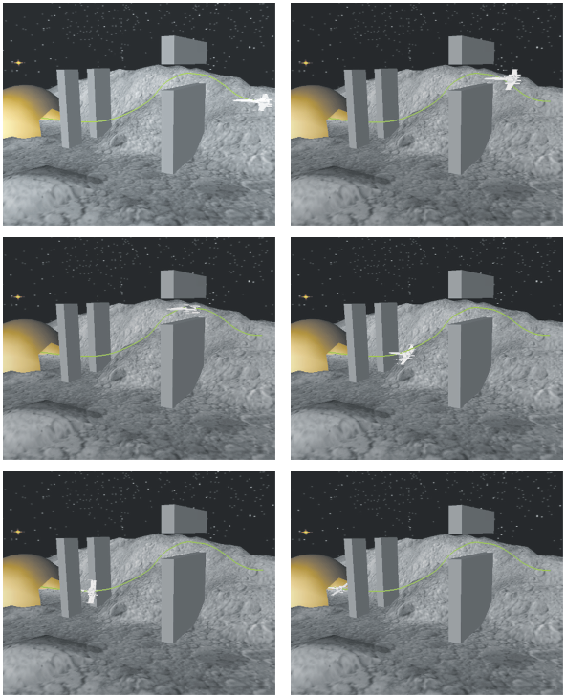
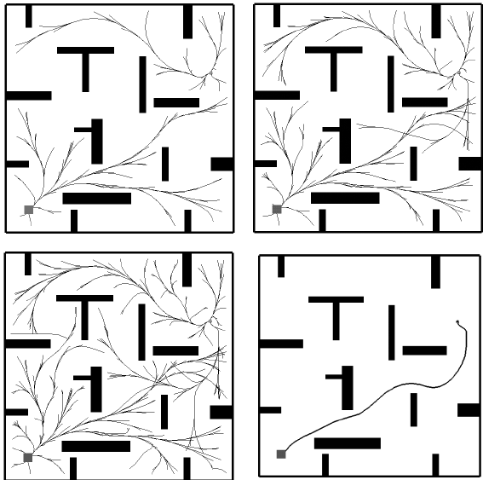
Examples

Slide 73
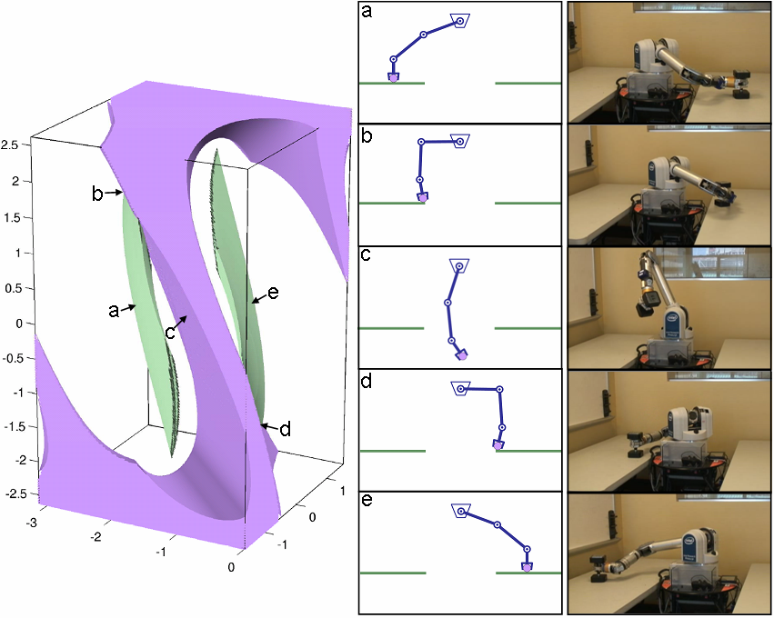
Quick overview of CBiRRT
Constrained Bi-directional RRT
Start with “unconstrained” RRT
Assume some constraints, e.g.:
  End-effector pose
  Torque
For each sample, x_{rand}, in X
  Get x_{new} by tweaking x_{rand} until constraints satisfied
  … via optimization (gradient descent)
  In text, “project sample onto constraint manifold”

Slide 74

Growing the Tree
Extending tree toward random sample
  The sample is q_{target}
  Nearest neighbor: q_{near}
Step from q_{near} to q_{target}
  In state space
  Project each step onto constraint manifold
  Until you reach q_{target}’s projection
  Return, if can’t continue, e.g.
    Obstacles
    Can’t project

Slide 75


Results
5kg
6kg
8kg

Slide 76
Outline
Introduction
Deterministic Planning
  Hierarchical
  Path Smoothing
  Control Sampling
  State Sampling
Randomized Planning
  PRMs
  RRTs
Derandomized Planners
Some Applications

Slide 77
Randomness for Planning
Pros:
  Allows rapid exploration of state space
  (via uniform sampling)
  Less susceptible to local minima
Cons:
  Inability to provide performance guarantees
  Obscures other useful features of planners
Moreover:
  There are deterministic incremental sampling methods
    E.g., Halton points
Van der Corput sequence (1935); generalized to multiple dimensions by Halton.

Slide 78
Derandomized RRT
Let’s implement Voronoi bias explicitly
  Given tree
  Compute Voronoi diagram wrt its nodes
  Pick the sample to extend toward:
    Centroid of largest Voronoi region, or
    Otherwise reduce size of largest empty ball
Problem:
  Voronoi diagram in arbitrary dimensions – prohibitively expensive

Slide 79
Semi-Deterministic RRT
So let’s go for a middle ground
Instead of a single x_{rand}
Draw a set k samples
Multi-Sample RRT (MS-RRT)
  Sort tree nodes acc. to:
    how many samples they’re nearest neighbor for
  Pick node that “collected” most neighbors
  Grow tree towards average of the neighbor samples
    It’s an estimate of the Voronoi centroid
    As k→∞, we get exact Voronoi centroid
“… I shall call him MS-RRTa!”

Slide 80
Now, a Deterministic RRT
… but with approximate Voronoi bias
Recall: picking k points
  Instead of randomly,
  Use k uniformly distributed, incremental deterministic samples
  E.g., Halton points
The rest stays essentially the same
Meet MS-RRTb!

Slide 81
Results
Local minima
  Both MS-RRT are more greedily Voronoi-biased
  Local minima issues – more pronounced than RRT
  Paper’s workaround:
    Introduce obstacle nodes in tree
    It’s the nodes that land in obstacles
    A mechanism “to remember” not to grow the tree there any more
Sensitivity to metrics
  Increased for MS-RRTa,b,
  Since Voronoi depends on metric
Nearest-neighbor computation
  More expensive than O(log n)
  Increased demand for it in MS-RRTa,b

Slide 82


Results

Slide 83
Outline
Introduction
Deterministic Planning
  Hierarchical
  Path Smoothing
  Control Sampling
  State Sampling
Randomized Planning
  PRMs
  RRTs
Derandomized Planners
Some applications

Slide 84



Mobile Manipulation
Arbitrary mobility constraints
Optimal solution
  Up to representation
Parallelized computation
Automatically designed

Slide 85
Dynamics Planning

Slide 86

Summary
Deterministic planning
  Hierarchical
  Path Smoothing
  Control Sampling
  State Sampling
Randomized planning
  PRMs
  RRTs

