Slide 1
Principal Component Analysis (PCA)
Learning Representations.
Dimensionality Reduction.
Maria-Florina Balcan
10/17/2016

Slide 2
Big & High-Dimensional Data
High-Dimensions = Lot of Features
Document classification
Features per document =
thousands of words/unigrams
millions of bigrams, contextual
information
Surveys - Netflix
480189 users x 17770 movies

Slide 3
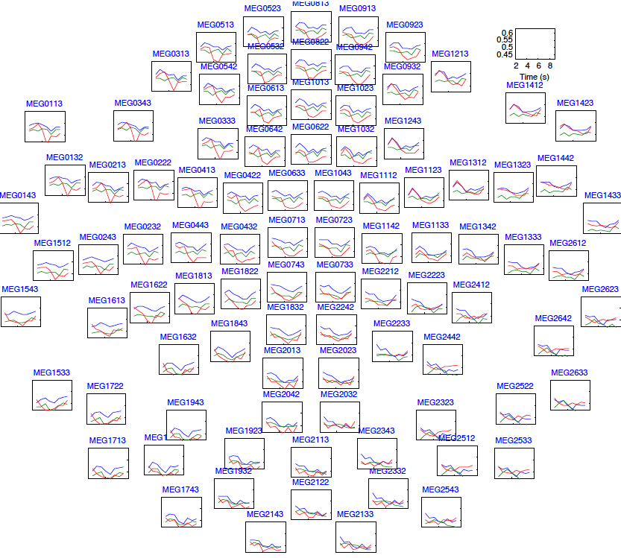
Big & High-Dimensional Data
High-Dimensions = Lot of Features
MEG Brain Imaging
120 locations x 500 time points
x 20 objects
Or any high-dimensional image data

Slide 4
Big & High-Dimensional Data.
Useful to learn lower dimensional representations of the data.

Slide 5
Learning Representations
PCA, Kernel PCA, ICA: Powerful unsupervised learning techniques for extracting hidden (potentially lower dimensional) structure from high dimensional datasets.
Useful for:
Visualization
More efficient use of resources
(e.g., time, memory, communication)
Statistical: fewer dimensions → better generalization
Noise removal (improving data quality)
Further processing by machine learning algorithms

Slide 6
Principal Component Analysis (PCA)
What is PCA: Unsupervised technique for extracting variance structure from high dimensional datasets.
PCA is an orthogonal projection or transformation of the data into a (possibly lower dimensional) subspace so that the variance of the projected data is maximized.

Slide 7
Principal Component Analysis (PCA)
Intrinsically lower dimensional than the dimension of the ambient space.
If we rotate data, again only one coordinate is more important.
Only one relevant feature
Both features are relevant
Question: Can we transform the features so that we only need to preserve one latent feature?

Slide 8
Principal Component Analysis (PCA)
In case where data lies on or near a low d-dimensional linear subspace, axes of this subspace are an effective representation of the data.
Identifying the axes is known as Principal Components Analysis, and can be obtained by using classic matrix computation tools (Eigen or Singular Value Decomposition).

Slide 9
Principal Component Analysis (PCA)
Principal Components (PC) are orthogonal directions that capture most of the variance in the data.
First PC – direction of greatest variability in data.
Projection of data points along first PC discriminates data most along any one direction (pts are the most spread out when we project the data on that direction compared to any other directions).
1st PC
Quick reminder:
$$x_{i}$$
||v||=1, Point $x_{i}$ (D-dimensional vector)
v
Projection of $x_{i}$ onto v is $v⋅ x_{i}$
$$v⋅ x_{i}$$

Slide 10
Principal Component Analysis (PCA)
Principal Components (PC) are orthogonal directions that capture most of the variance in the data.
1st PC – direction of greatest variability in data.
$$x_{i}$$
2nd PC
$$x_{i}−v⋅ x_{i}$$
1st PC
$$v⋅ x_{i}$$
2nd PC – Next orthogonal (uncorrelated) direction of greatest variability
(remove all variability in first direction, then find next direction of greatest variability)
And so on …

Slide 11
Principal Component Analysis (PCA)
Let $v_{1}$, $v_{2}$, …, $v_{d}$ denote the d principal components.
$$v_{i}⋅ v_{j} =0, i≠ j$$
and $v_{i}⋅ v_{i} =1, i= j$
Assume data is centered (we extracted the sample mean).
Let $X=[x_{1}, x_{2}, …, x_{n}]$ (columns are the datapoints)
Find vector that maximizes sample variance of projected data
Wrap constraints into the
objective function

Slide 12
Principal Component Analysis (PCA)
$\left(X X^{T}\right)v=λv$, so v (the first PC) is the eigenvector of sample correlation/covariance matrix $X X^{T}$
Sample variance of projection $v^{T}X X^{T}v=λv^{T}v=λ$
Thus, the eigenvalue $λ$denotes the amount of variability captured along that dimension (aka amount of energy along that dimension).
Eigenvalues $λ_{1}≥λ_{2}≥λ_{3}≥…$
The 1st PC $v_{1}$ is the the eigenvector of the sample covariance matrix $X X^{T}$ associated with the largest eigenvalue
The 2nd PC $v_{2}$ is the the eigenvector of the sample covariance matrix $X X^{T}$ associated with the second largest eigenvalue
And so on …

Slide 13
Principal Component Analysis (PCA)
So, the new axes are the eigenvectors of the matrix of sample correlations $X X^{T}$ of the data.
Transformed features are uncorrelated.
x2
v^{T}x2
v^{T}x1
x1
Geometrically: centering followed by rotation.
Linear transformation
Key computation: eigendecomposition of $XX^{T}$ (closely related to SVD of $X$).

Slide 14
Two Interpretations
So far: Maximum Variance Subspace. PCA finds vectors v such that projections on to the vectors capture maximum variance in the data
Alternative viewpoint: Minimum Reconstruction Error. PCA finds vectors v such that projection on to the vectors yields minimum MSE reconstruction
$$x_{i}$$
v
$$v⋅ x_{i}$$

Slide 15
Two Interpretations
E.g., for the first component.
Maximum Variance Direction: 1st PC a vector v such that projection on to this vector capture maximum variance in the data (out of all possible one dimensional projections)
Minimum Reconstruction Error: 1st PC a vector v such that projection on to this vector yields minimum MSE reconstruction
$$x_{i}$$
v
$$v⋅ x_{i}$$

Slide 16
Why? Pythagorean Theorem
E.g., for the first component.
Maximum Variance Direction: 1st PC a vector v such that projection on to this vector capture maximum variance in the data (out of all possible one dimensional projections)
Minimum Reconstruction Error: 1st PC a vector v such that projection on to this vector yields minimum MSE reconstruction
blue² + green² = black²
$$x_{i}$$
v
black² is fixed (it’s just the data)
$$v⋅ x_{i}$$
So, maximizing blue² is equivalent to minimizing green²

Slide 17
Dimensionality Reduction using PCA
The eigenvalue $λ$denotes the amount of variability captured along that dimension (aka amount of energy along that dimension).
Zero eigenvalues indicate no variability along those directions => data lies exactly on a linear subspace
Only keep data projections onto principal components with non-zero eigenvalues, say $v_{1}, …, v_{k}$, where k=rank($X X^{T}$)
Original representation
Transformed representation
Data point
$$x_{i}=(x_{i}^{1}, …,x_{i}^{D})$$
projection
$$(v_{1}⋅x^{i}, …,v_{d}⋅x^{i})$$
x_{i}
v
D-dimensional vector
d-dimensional vector
v^{T}x_{i}

Slide 18
Dimensionality Reduction using PCA
In high-dimensional problems, data sometimes lies near a linear subspace, as noise introduces small variability
Only keep data projections onto principal components with large eigenvalues
Can ignore the components of smaller significance.
Might lose some info, but if eigenvalues are small, do not lose much

Slide 19
Can represent a face image using just 15 numbers!

Slide 20
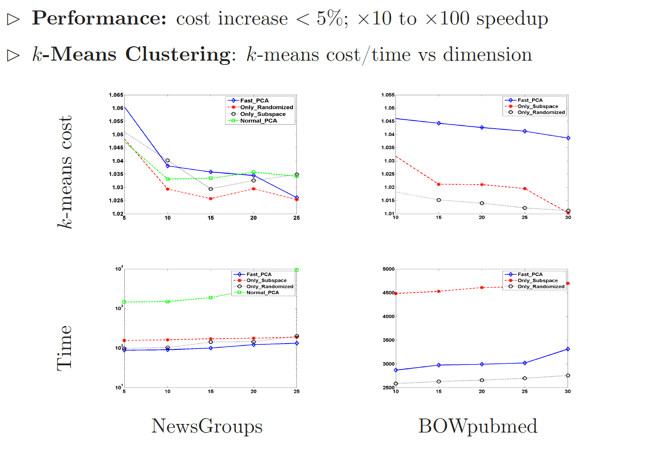
PCA provably useful before doing k-means clustering and also empirically useful. E.g.,

Slide 21
PCA Discussion
Strengths
Eigenvector method
No tuning of the parameters
No local optima
Weaknesses
Limited to second order statistics
Limited to linear projections

Slide 22
What You Should Know
Principal Component Analysis (PCA)
What PCA is, what is useful for.
Both the maximum variance subspace and the minimum reconstruction error viewpoint.

