Slide 1


Matrix Factorization and
Collaborative Filtering
School of Computer Science
10-601B Introduction to Machine Learning
Readings:
Koren et al. (2009)
Gemulla et al. (2011)
Matt Gormley
Lecture 26
November 30, 2016

Slide 2
Reminders
Homework 7
  due Mon., Dec. 5
In-class Review Session
  Mon., Dec. 5
Final Exam
  in-class Wed., Dec. 7

Slide 3
Outline
Recommender Systems
  Content Filtering
  Collaborative Filtering
  CF: Neighborhood Methods
  CF: Latent Factor Methods
Matrix Factorization
  User / item vectors
  Prediction model
  Training by SGD
Extra: Matrix Multiplication in ML
  Matrix Factorization
  Linear Regression
  PCA
  (Autoencoders)
  K-means

Slide 4
Recommender Systems

Slide 5
Recommender Systems
A Common Challenge:
  Assume you’re a company selling items of some sort: movies, songs, products, etc.
  Company collects millions of ratings from users of their items
  To maximize profit / user happiness, you want to recommend items that users are likely to want

Slide 6

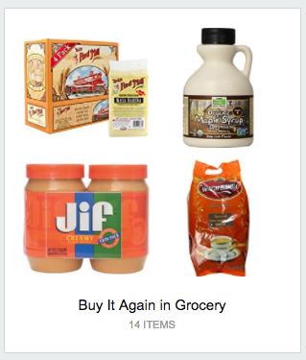
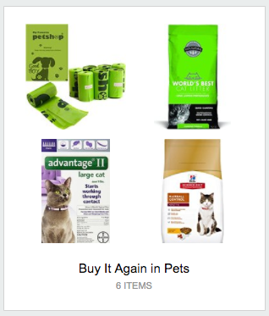
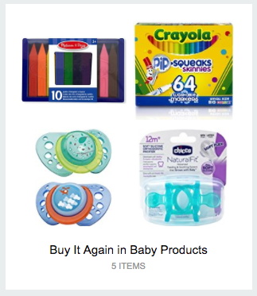
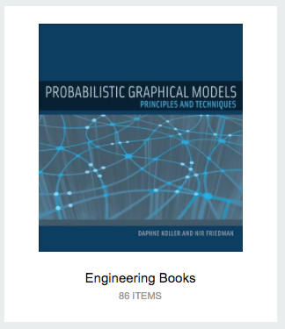
Recommender Systems

Slide 7
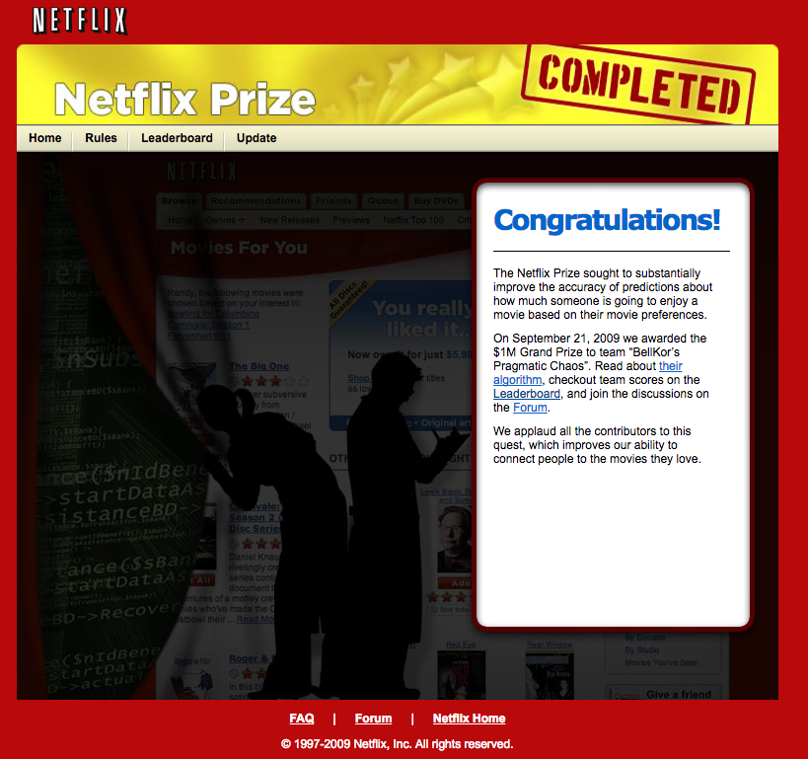
Recommender Systems

Slide 8
Recommender Systems

Slide 9
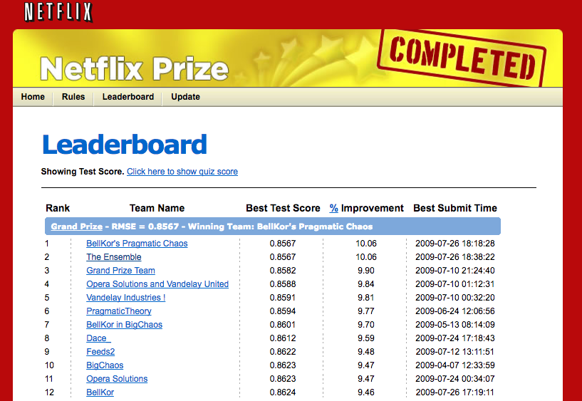
Recommender Systems
Problem Setup
500,000 users
20,000 movies
100 million ratings
Goal: To obtain lower root mean squared error (RMSE) than Netflix’s existing system on 3 million held out ratings

Slide 10
Recommender Systems

Slide 11
Recommender Systems
Setup:
  Items:
  movies, songs, products, etc.
  (often many thousands)
  Users:
  watchers, listeners, purchasers, etc.
  (often many millions)
  Feedback:
  5-star ratings, not-clicking ‘next’, purchases, etc.
Key Assumptions:
  Can represent ratings numerically as a user/item matrix
  Users only rate a small number of items (the matrix is sparse)
 | Doctor Strange | Star Trek: Beyond | Zootopia
Alice | 1 |  | 5
Bob | 3 | 4
Charlie | 3 | 5 | 2

Slide 12
Recommender Systems

Slide 13
Two Types of Recommender Systems
Content Filtering
Collaborative Filtering
Example: Pandora.com music recommendations (Music Genome Project)
Con: Assumes access to side information about items (e.g. properties of a song)
Pro: Got a new item to add? No problem, just be sure to include the side information
Example: Netflix movie recommendations
Pro: Does not assume access to side information about items (e.g. does not need to know about movie genres)
Con: Does not work on new items that have no ratings

Slide 14
Content Filtering

Slide 15
Collaborative Filtering
Everyday Examples of Collaborative Filtering...
  Bestseller lists
  Top 40 music lists
  The “recent returns” shelf at the library
  Unmarked but well-used paths thru the woods
  The printer room at work
  “Read any good books lately?”
  …
Common insight: personal tastes are correlated
  If Alice and Bob both like X and Alice likes Y then Bob is more likely to like Y
  especially (perhaps) if Bob knows Alice
Slide from William Cohen

Slide 16
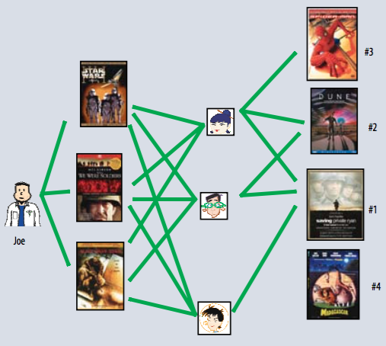
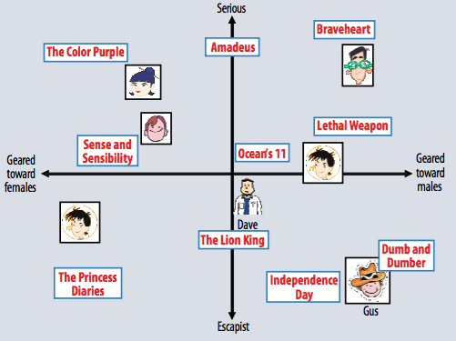
Two Types of Collaborative Filtering
1. Neighborhood Methods
2. Latent Factor Methods
Figures from Koren et al. (2009)

Slide 17
Two Types of Collaborative Filtering
1. Neighborhood Methods
In the figure, assume that a green line indicates the movie was watched
Algorithm:
Find neighbors based on similarity of movie preferences
Recommend movies that those neighbors watched
Figures from Koren et al. (2009)

Slide 18
Two Types of Collaborative Filtering
2. Latent Factor Methods
Assume that both movies and users live in some low-dimensional space describing their properties
Recommend a movie based on its proximity to the user in the latent space
Figures from Koren et al. (2009)

Slide 19
Matrix Factorization

Slide 20
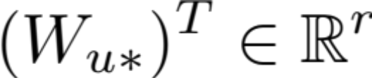
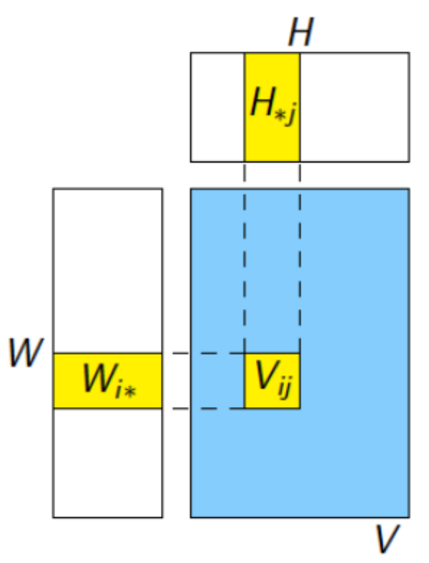

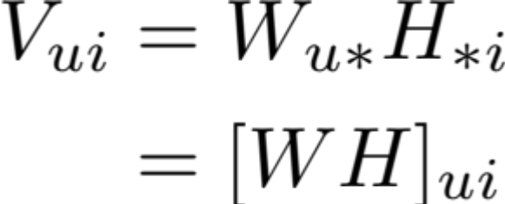
Matrix Factorization
(with matrices)
User vectors:
Item vectors:
Rating prediction:
Figures from Koren et al. (2009)
Figures from Gemulla et al. (2011)

Slide 21


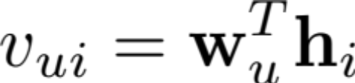
Matrix Factorization
(with vectors)
User vectors:
Item vectors:
Rating prediction:
Figures from Koren et al. (2009)

Slide 22

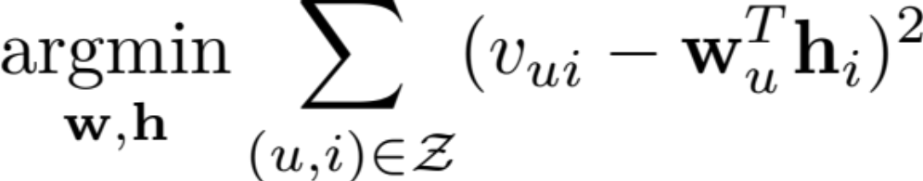
Matrix Factorization
(with vectors)
Set of non-zero entries:
Objective:
Figures from Koren et al. (2009)

Slide 23
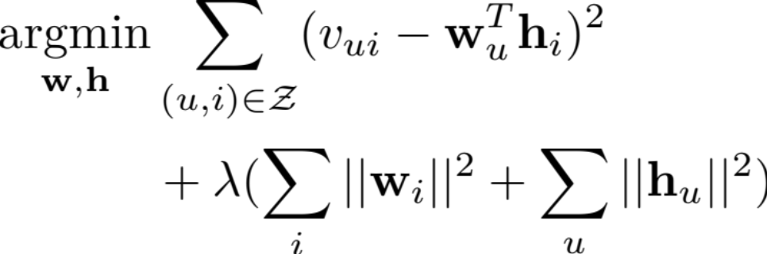
Matrix Factorization
(with vectors)
Regularized Objective:
SGD update for random (u,i):
Figures from Koren et al. (2009)

Slide 24
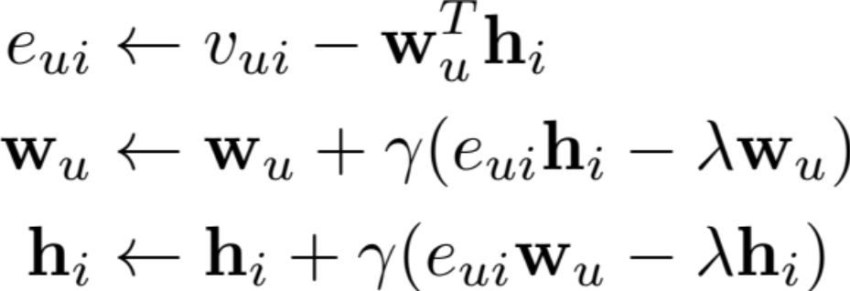
Matrix Factorization
(with vectors)
Regularized Objective:
SGD update for random (u,i):
Figures from Koren et al. (2009)

Slide 25
Matrix Factorization
(with matrices)
User vectors:
Item vectors:
Rating prediction:
Figures from Koren et al. (2009)
Figures from Gemulla et al. (2011)

Slide 26
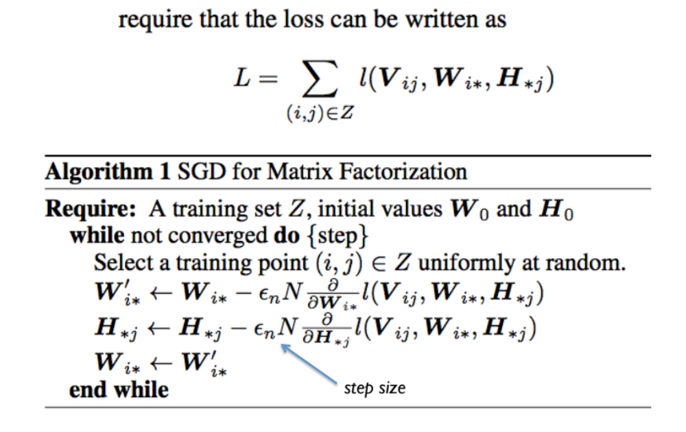
Matrix Factorization
(with matrices)
SGD
Figures from Koren et al. (2009)
Figure from Gemulla et al. (2011)
Figure from Gemulla et al. (2011)

Slide 27
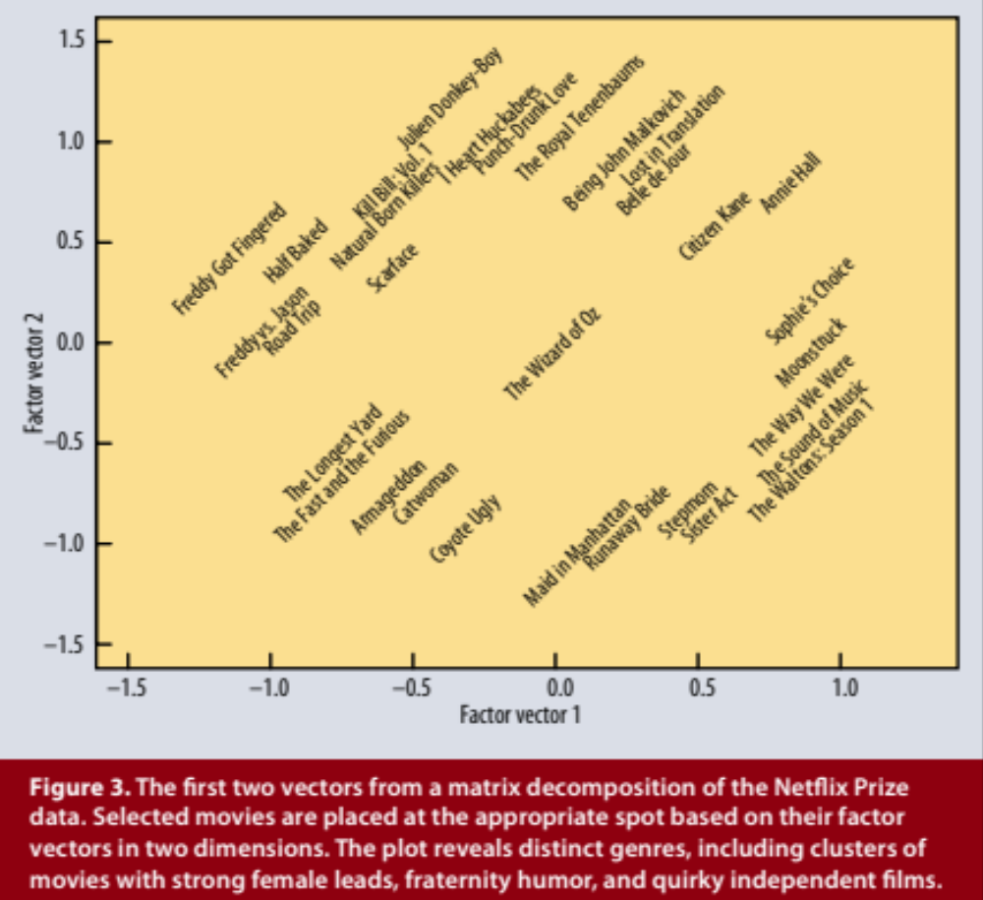
Matrix Factorization
Example Factors
Figure from Koren et al. (2009)

Slide 28
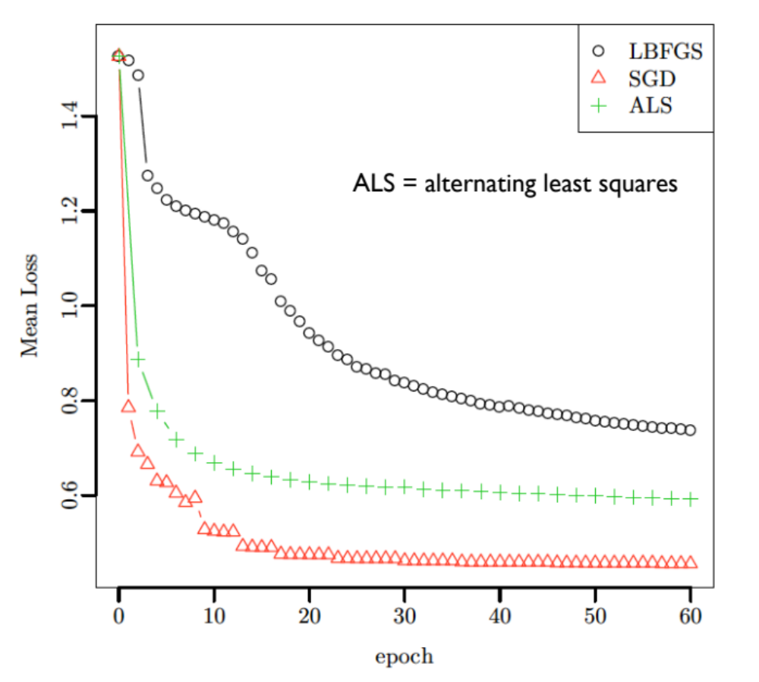
Matrix Factorization
Comparison of Optimization Algorithms
Figure from Gemulla et al. (2011)

Slide 29
Matrix Multiplication in Machine Learning
Slides in this section from William Cohen

Slide 30
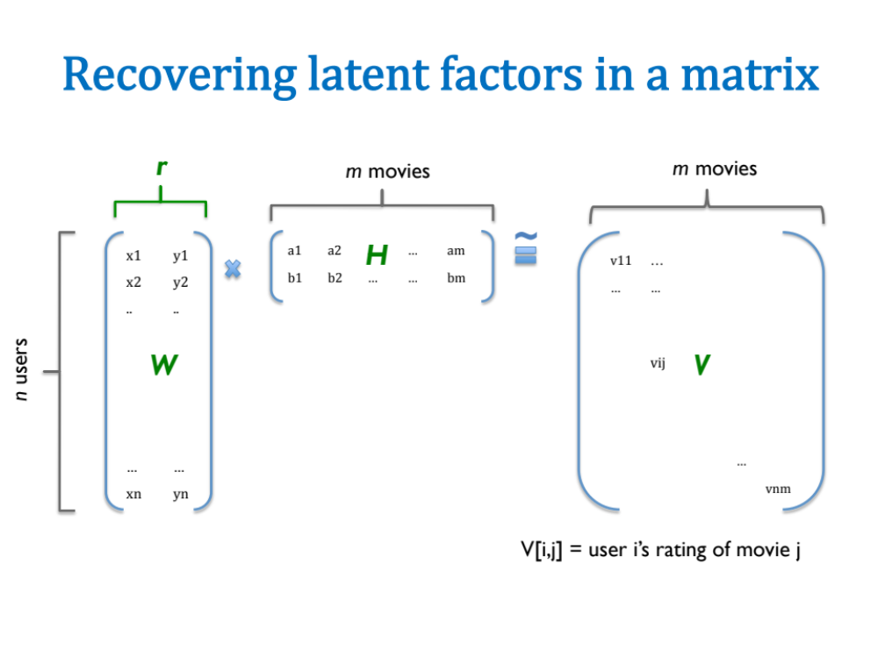
Slide from William Cohen

Slide 31
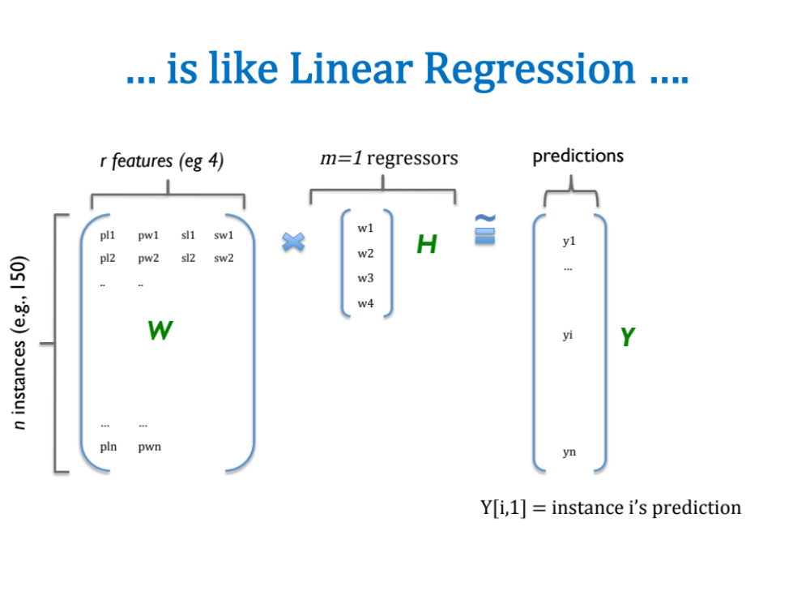
Slide from William Cohen

Slide 32
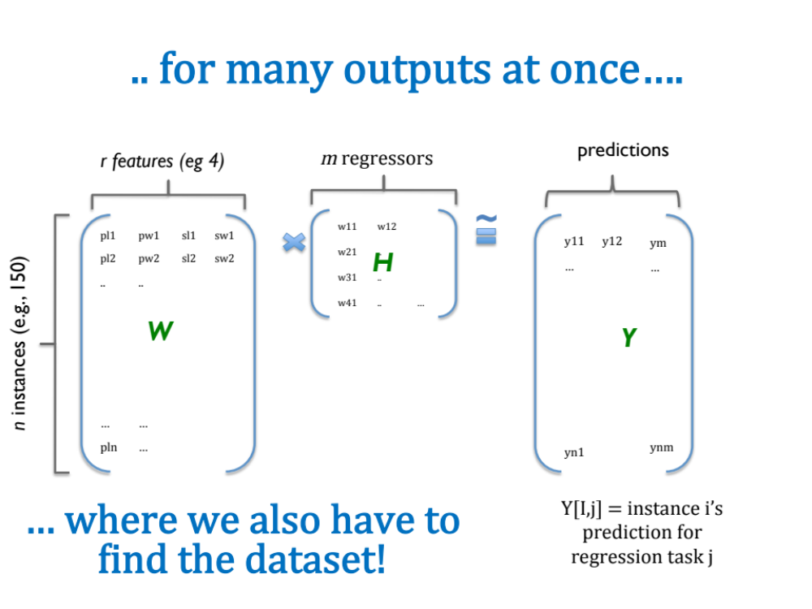
Slide from William Cohen

Slide 33
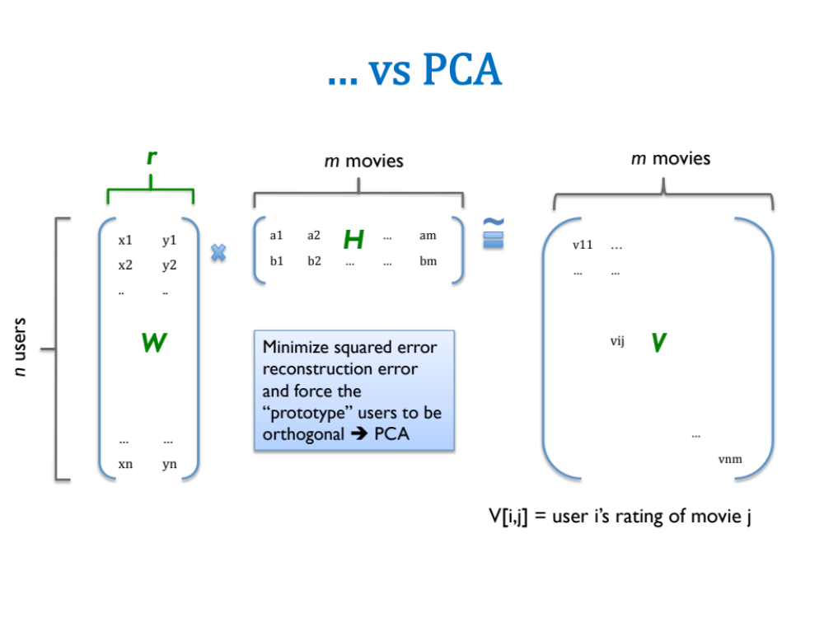
Slide from William Cohen

Slide 34
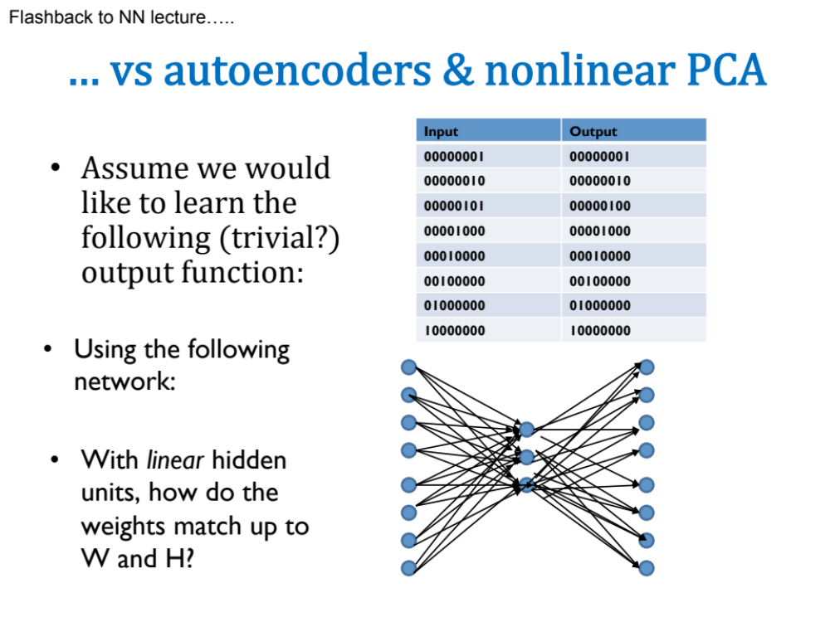
Slide from William Cohen

Slide 35
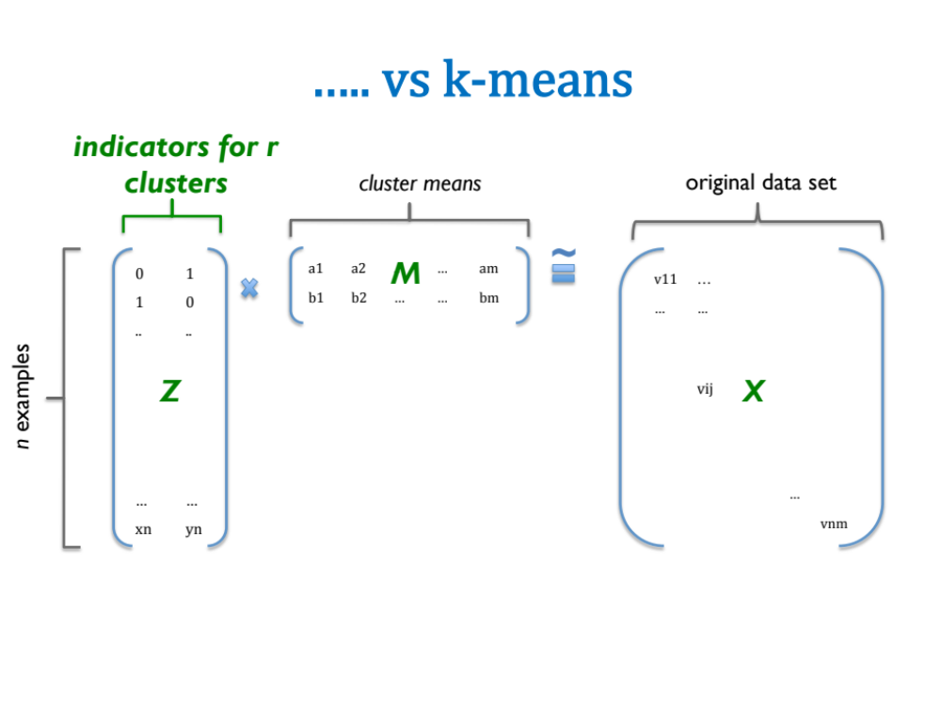
Slide from William Cohen

Slide 36
Slide from William Cohen

Slide 37
Summary
Recommender systems solve many real-world (*large-scale) problems
Collaborative filtering by Matrix Factorization (MF) is an efficient and effective approach
MF is just another example of a common recipe:
    define a model
    define an objective function
    optimize with SGD

