Slide 1


Expectation-Maximization (EM)
School of Computer Science
10-601B Introduction to Machine Learning
Readings:
Matt Gormley
Lecture 24
November 21, 2016

Slide 2
Reminders
Final Exam
  in-class Wed., Dec. 7

Slide 3
Outline
Models:
  Gaussian Naïve Bayes (GNB)
  Mixture Model (MM)
  Gaussian Mixture Model (GMM)
  Gaussian Discriminant Analysis
Hard Expectation-Maximization (EM)
  Hard EM Algorithm
  Example: Mixture Model
  Example: Gaussian Mixture Model
  K-Means as Hard EM
(Soft) Expectation-Maximization (EM)
  Soft EM Algorithm
  Example: Gaussian Mixture Model
Extra Slides: Why Does EM Work?
Properties of EM
  Nonconvexity / Local Optimization
  Example: Grammar Induction
  Variants of EM

Slide 4
Gaussian Mixture Model

Slide 5

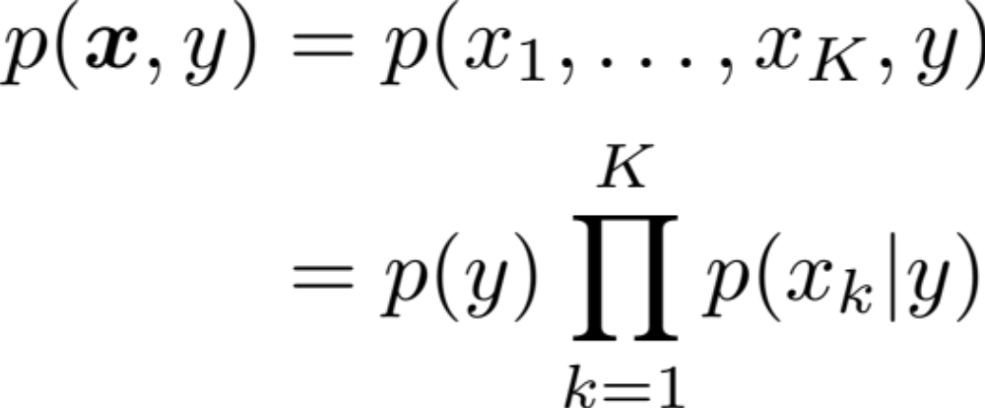
Model 3: Gaussian Naïve Bayes
Recall…
Data:
Model: Product of prior and the event model
Y
X₁
X₂
…
X_{M}

Slide 6
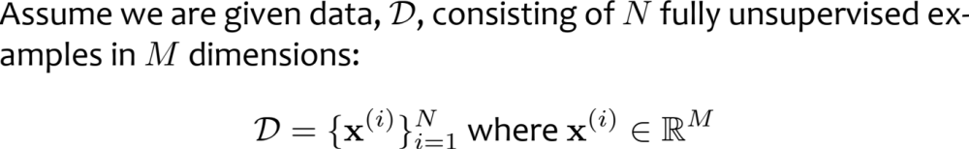
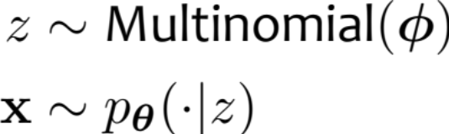
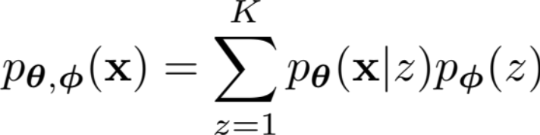
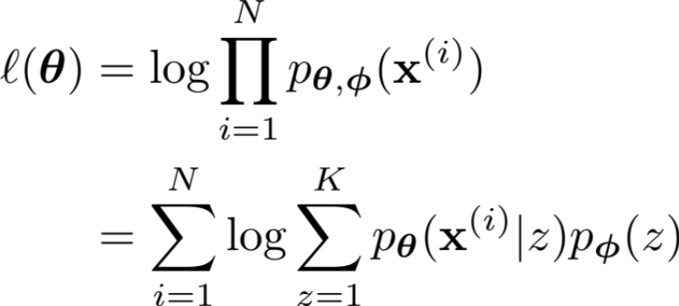
Mixture-Model
Data:
Generative Story:
Model:
Joint:
Marginal:
(Marginal) Log-likelihood:

Slide 7


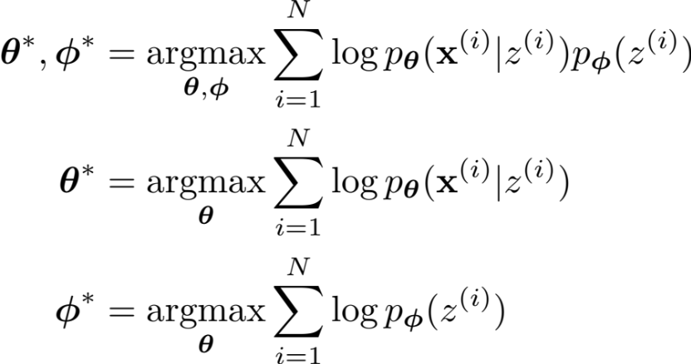
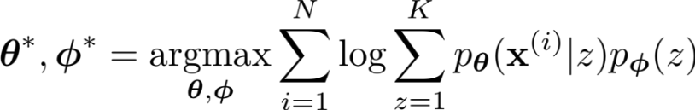
Learning a Mixture Model
Supervised Learning: The parameters decouple!
Unsupervised Learning: Parameters are coupled by marginalization.
Z
Z
X₁
X₂
…
X_{M}
X₁
X₂
…
X_{M}

Slide 8
Learning a Mixture Model
Supervised Learning: The parameters decouple!
Unsupervised Learning: Parameters are coupled by marginalization.
Z
Z
Training certainly isn’t as simple as the supervised case.
In many cases, we could still use some black-box optimization method (e.g. Newton-Raphson) to solve this coupled optimization problem.
This lecture is about an even simpler method: EM.
X₁
X₂
…
X_{M}
X₁
X₂
…
X_{M}

Slide 9
Mixture-Model
Z
X₁
X₂
…
X_{M}
Data:
Generative Story:
Model:
Joint:
Marginal:
(Marginal) Log-likelihood:

Slide 10
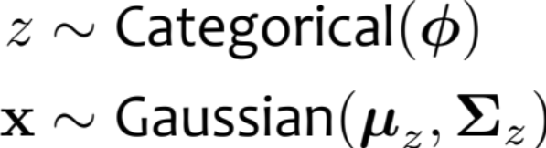
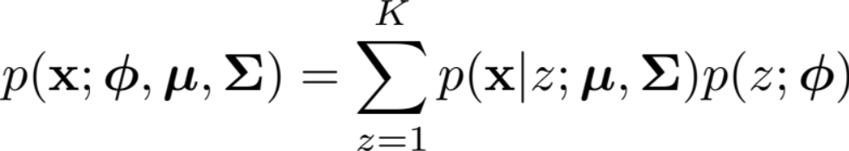
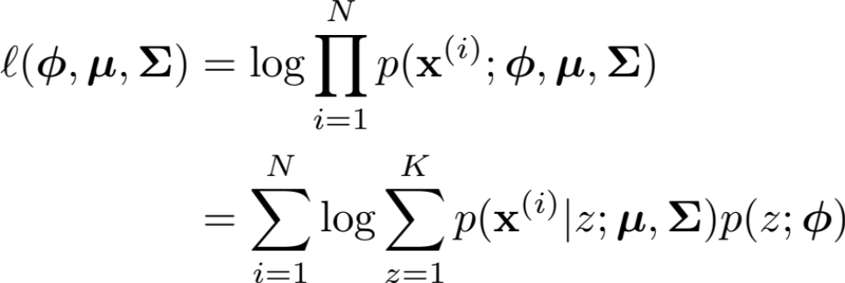
Gaussian Mixture-Model
Z
X₁
X₂
…
X_{M}
Data:
Generative Story:
Model:
Joint:
Marginal:
(Marginal) Log-likelihood:

Slide 11
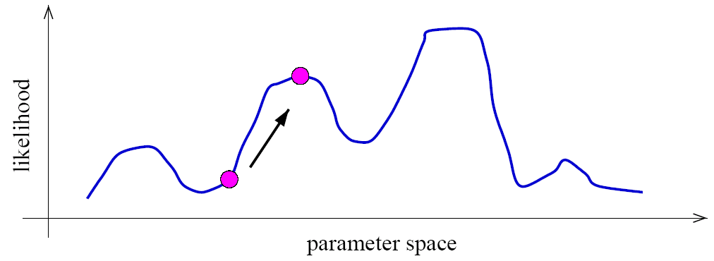
Identifiability
A mixture model induces a multi-modal likelihood.
Hence gradient ascent can only find a local maximum.
Mixture models are unidentifiable, since we can always switch the hidden labels without affecting the likelihood.
Hence we should be careful in trying to interpret the “meaning” of latent variables.

Slide 12
Hard EM
aka. Viterbi EM

Slide 13
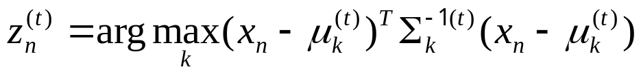
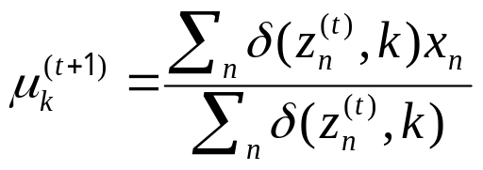

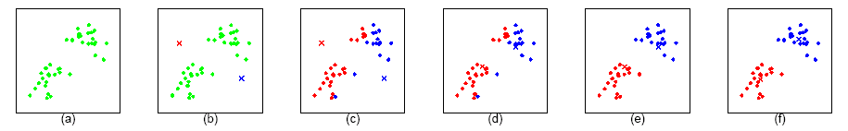
K-means as Hard EM
Loop:
  For each point n=1 to N,
  compute its cluster label:
  For each cluster k=1:K

Slide 14
Whiteboard
Background: Coordinate Descent algorithm

Slide 15
Hard Expectation-Maximization
Initialize parameters randomly
while not converged
  E-Step:
  Set the latent variables to the the values that maximizes likelihood, treating parameters as observed
  M-Step:
  Set the parameters to the values that maximizes likelihood, treating latent variables as observed
Hallucinate some data
Standard Bayes Net training

Slide 16
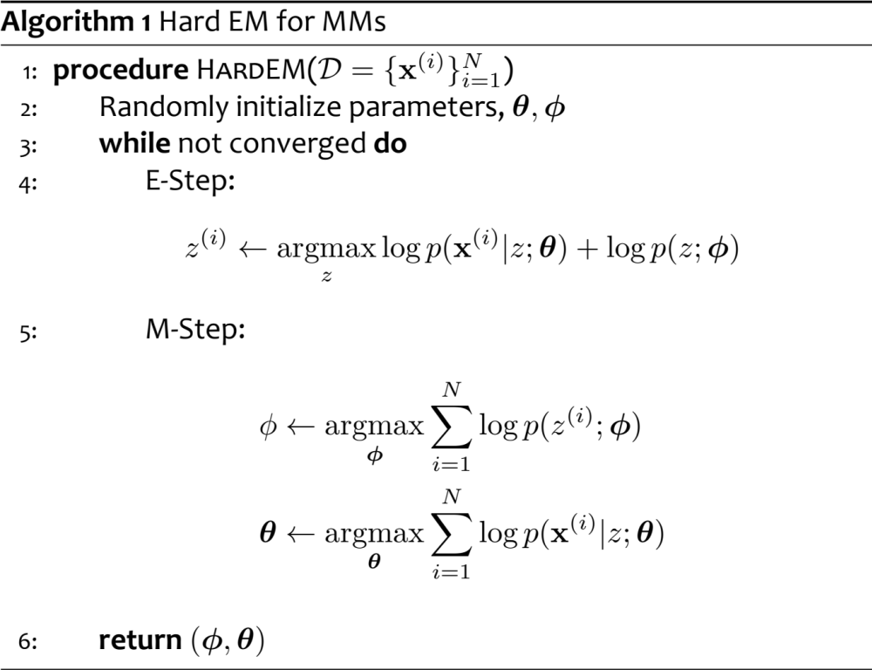
Hard EM for Mixture Models
Implementation: For loop over possible values of latent variable
Implementation: supervised Bayesian Network learning

Slide 17
Gaussian Mixture-Model
Z
X₁
X₂
…
X_{M}
Data:
Generative Story:
Model:
Joint:
Marginal:
(Marginal) Log-likelihood:

Slide 18
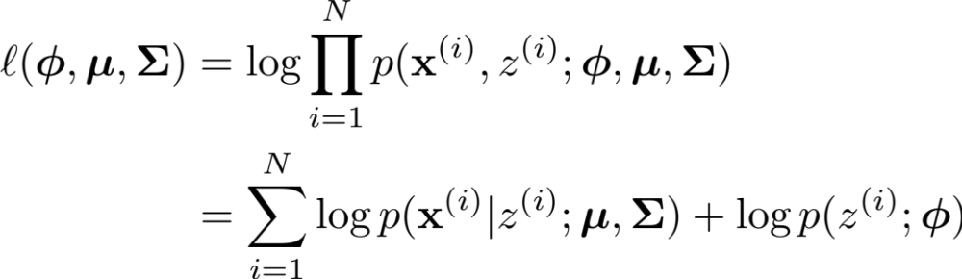
Gaussian Discriminant
Analysis
Z
X₁
X₂
…
X_{M}
Data:
Generative Story:
Model:
Joint:
Log-likelihood:

Slide 19
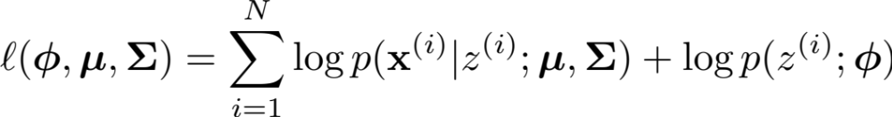
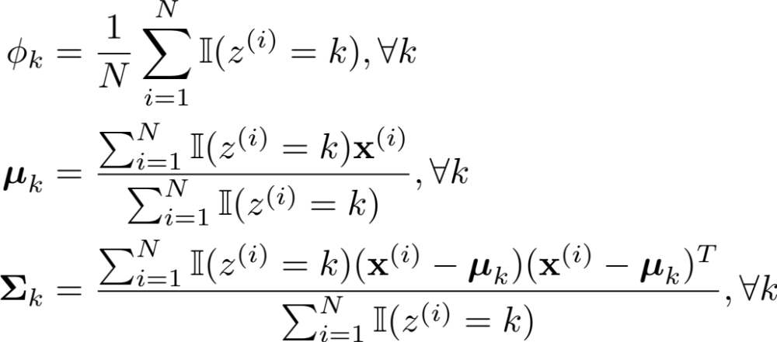
Gaussian Discriminant
Analysis
Z
X₁
X₂
…
X_{M}
Data:
Log-likelihood:
Maximum Likelihood Estimates:
Take the derivative of the Lagrangian, set it equal to zero and solve.
Implementation:
Just counting

Slide 20
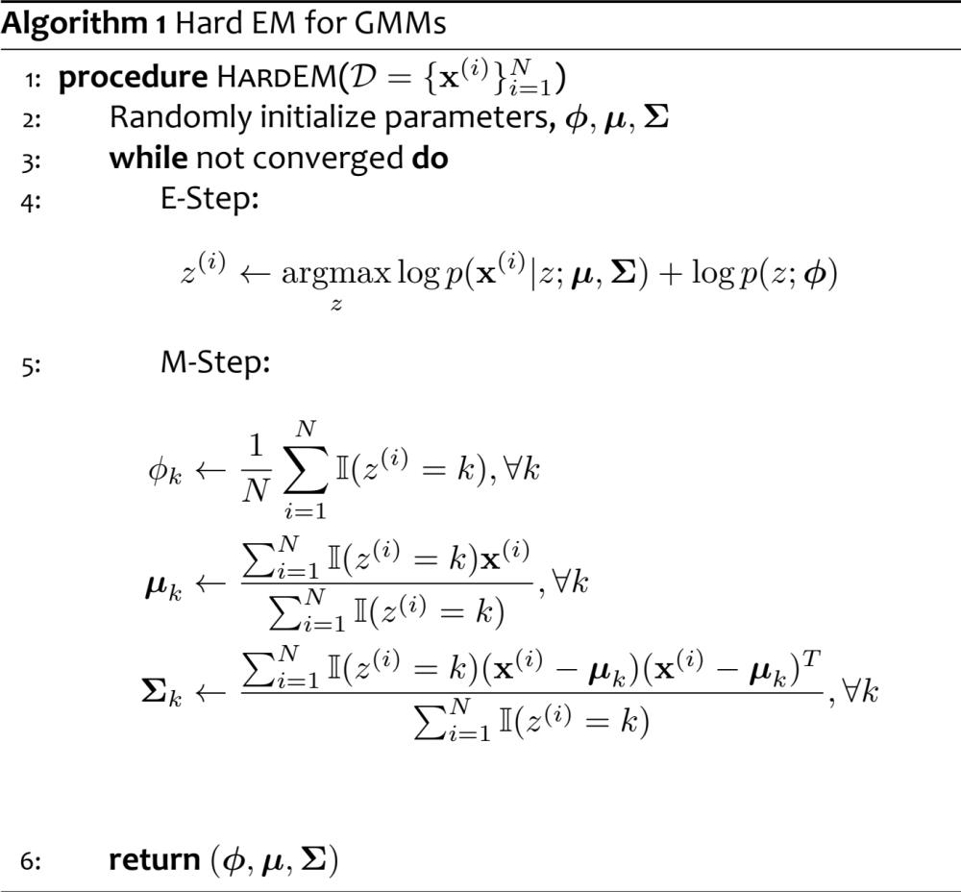
Hard EM for GMMs
Implementation: For loop over possible values of latent variable
Implementation:
Just counting as in supervised setting

Slide 21
K-means as Hard EM
Loop:
  For each point n=1 to N,
  compute its cluster label:
  For each cluster k=1:K

Slide 22
(Soft) EM
The standard EM algorithm

Slide 23
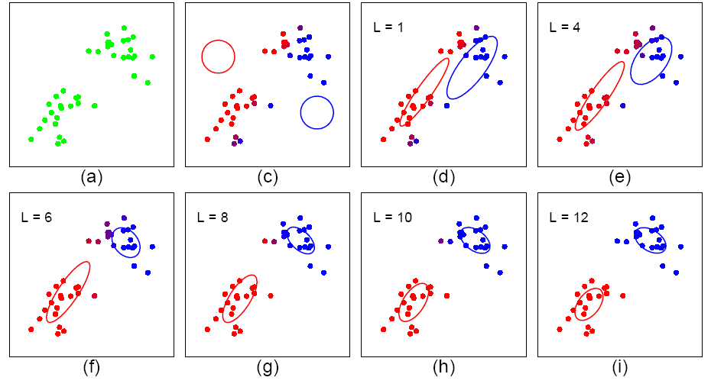
(Soft) EM for GMM
Start:
  "Guess" the centroid μ_{k} and coveriance Σ_{k} of each of the K clusters
Loop:

Slide 24
(Soft) Expectation-Maximization
Initialize parameters randomly
while not converged
  E-Step:
  Create one training example for each possible value of the latent variables
  Weight each example according to model’s confidence
  Treat parameters as observed
  M-Step:
  Set the parameters to the values that maximizes likelihood
  Treat pseudo-counts from above as observed
Hallucinate some data
Standard Bayes Net training

Slide 25
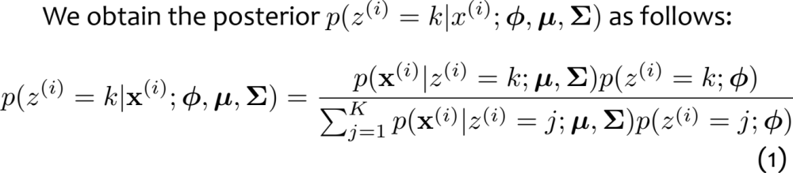
Posterior Inference for Mixture Model

Slide 26
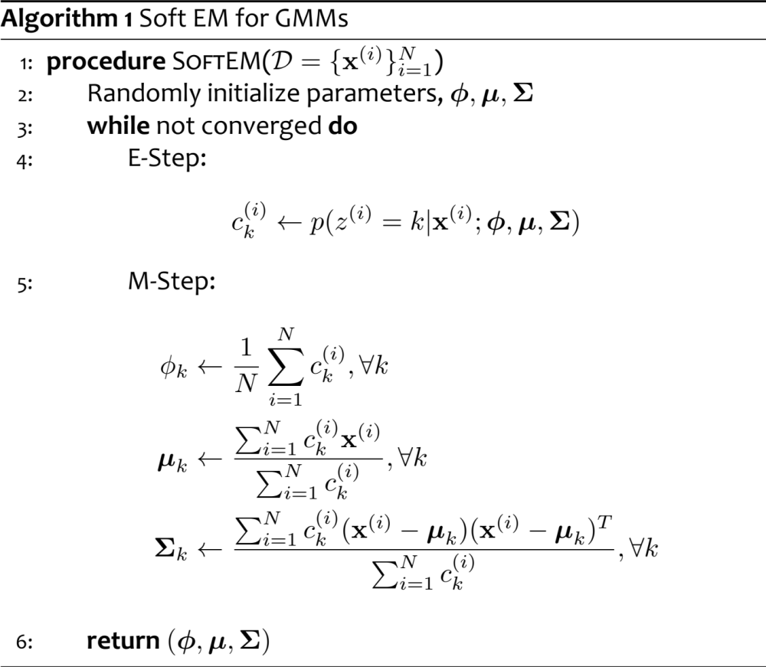
(Soft) EM for GMM
Initialize parameters randomly
while not converged
  E-Step:
  Create one training example for each possible value of the latent variables
  Weight each example according to model’s confidence
  Treat parameters as observed
  M-Step:
  Set the parameters to the values that maximizes likelihood
  Treat pseudo-counts from above as observed

Slide 27
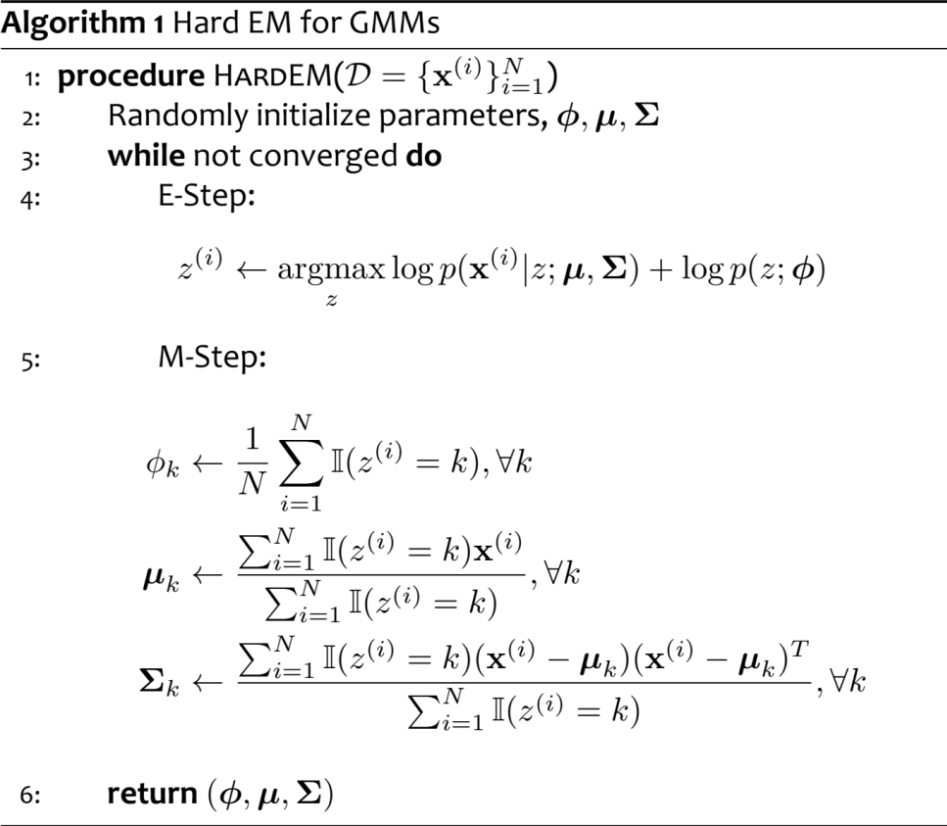
Hard EM vs. Soft EM

Slide 28
(Soft) EM for GMM
Start:
  "Guess" the centroid μ_{k} and coveriance Σ_{k} of each of the K clusters
Loop:

Slide 29
Why Does EM Work?
Extra Slides

Slide 30
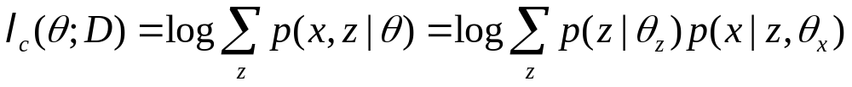
Theory underlying EM
Extra Slides
What are we doing?
Recall that according to MLE, we intend to learn the model parameter that would have maximize the likelihood of the data.
But we do not observe z, so computing
is difficult!
What shall we do?

Slide 31
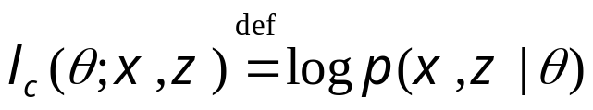
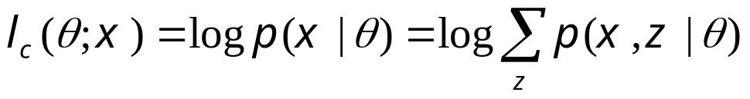
Complete & Incomplete Log Likelihoods
Extra Slides
Complete log likelihood
  Let X denote the observable variable(s), and Z denote the latent variable(s).
  If Z could be observed, then
  Usually, optimizing l_{c}() given both z and x is straightforward (c.f. MLE for fully observed models).
  Recalled that in this case the objective for, e.g., MLE, decomposes into a sum of factors, the parameter for each factor can be estimated separately.
  But given that Z is not observed, l_{c}() is a random quantity, cannot be maximized directly.
Incomplete log likelihood
  With z unobserved, our objective becomes the log of a marginal probability:
  This objective won't decouple

Slide 32
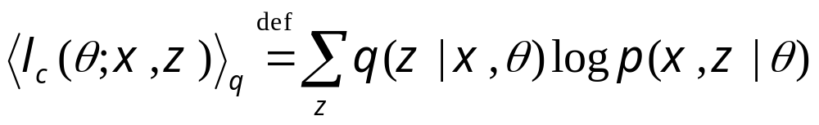
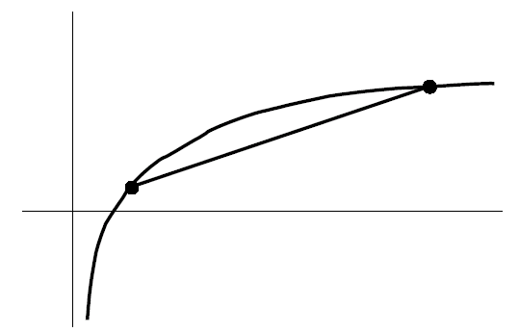
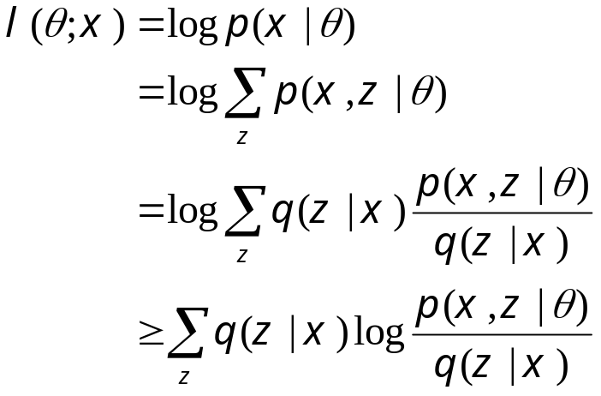
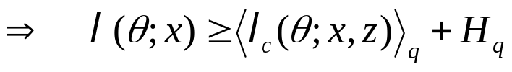
Expected Complete Log Likelihood
Extra Slides
For any distribution q(z), define expected complete log likelihood:
    A deterministic function of θ
    Linear in l_{c}() --- inherit its factorizabiility
    Does maximizing this surrogate yield a maximizer of the likelihood?
Jensen’s inequality

Slide 33
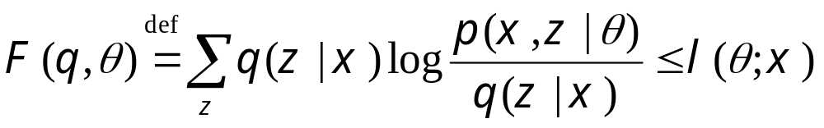
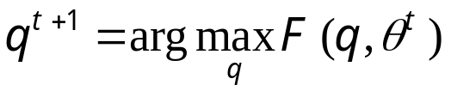
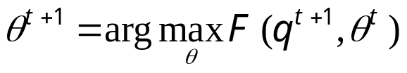
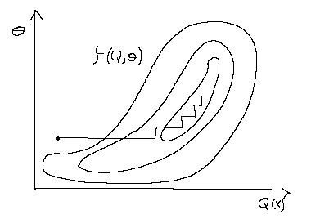
Lower Bounds and Free Energy
Extra Slides
For fixed data x, define a functional called the free energy:
The EM algorithm is coordinate-ascent on F :
  E-step:
  M-step:

Slide 34
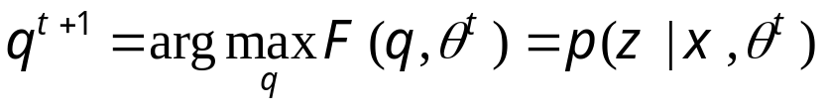
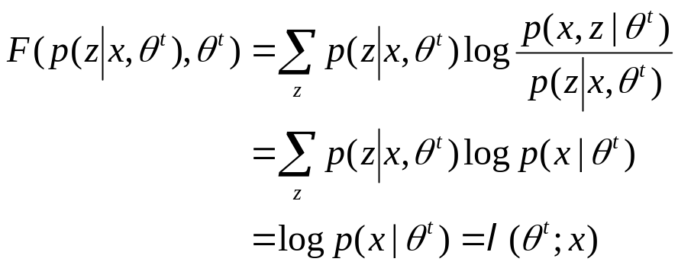
E-step: maximization of expected l_{c} w.r.t. q
Extra Slides
Claim:
  This is the posterior distribution over the latent variables given the data and the parameters. Often we need this at test time anyway (e.g. to perform classification).
Proof (easy): this setting attains the bound l(θ;x)≥F(q,θ )
Can also show this result using variational calculus or the fact that

Slide 35
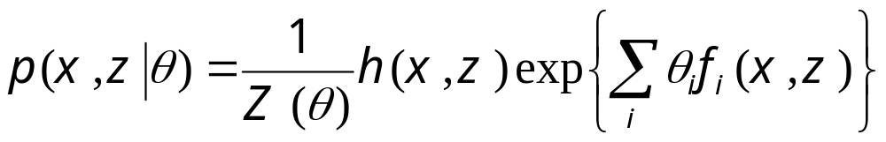


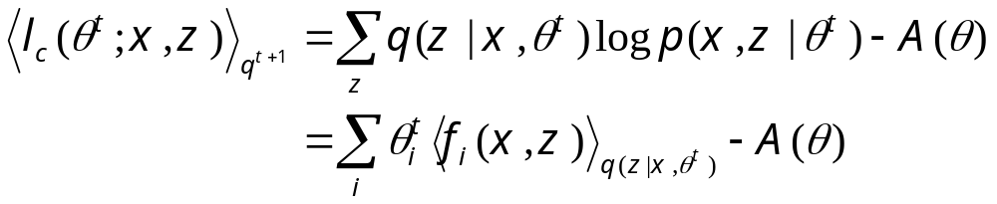
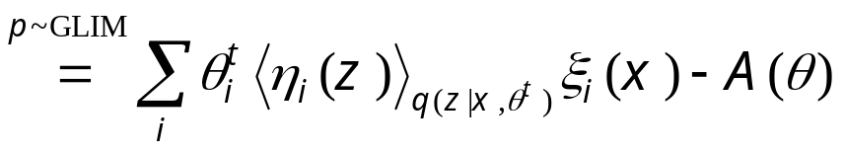
E-step ≡ plug in posterior expectation of latent variables
Extra Slides
Without loss of generality: assume that p(x,z|θ) is a generalized exponential family distribution:
  Special cases: if p(X|Z) are GLIMs, then
The expected complete log likelihood under is

Slide 36
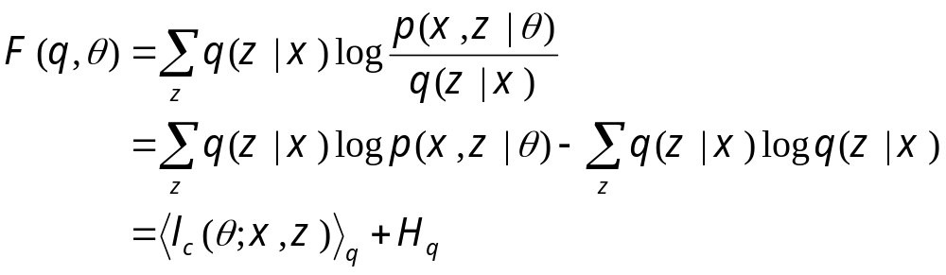
M-step: maximization of expected l_{c} w.r.t. θ
Extra Slides
Note that the free energy breaks into two terms:
  The first term is the expected complete log likelihood (energy) and the second term, which does not depend on θ, is the entropy.
Thus, in the M-step, maximizing with respect to θ for fixed q we only need to consider the first term:
  Under optimal q^{t+1}, this is equivalent to solving a standard MLE of fully observed model p(x,z|θ), with the sufficient statistics involving z replaced by their expectations w.r.t. p(z|x,θ).

Slide 37
Summary: EM Algorithm
Extra Slides
A way of maximizing likelihood function for latent variable models. Finds MLE of parameters when the original (hard) problem can be broken up into two (easy) pieces:
  Estimate some “missing” or “unobserved” data from observed data and current parameters.
  Using this “complete” data, find the maximum likelihood parameter estimates.
Alternate between filling in the latent variables using the best guess (posterior) and updating the parameters based on this guess:
  E-step:
  M-step:
In the M-step we optimize a lower bound on the likelihood. In the E-step we close the gap, making bound=likelihood.

Slide 38
Properties of EM

Slide 39
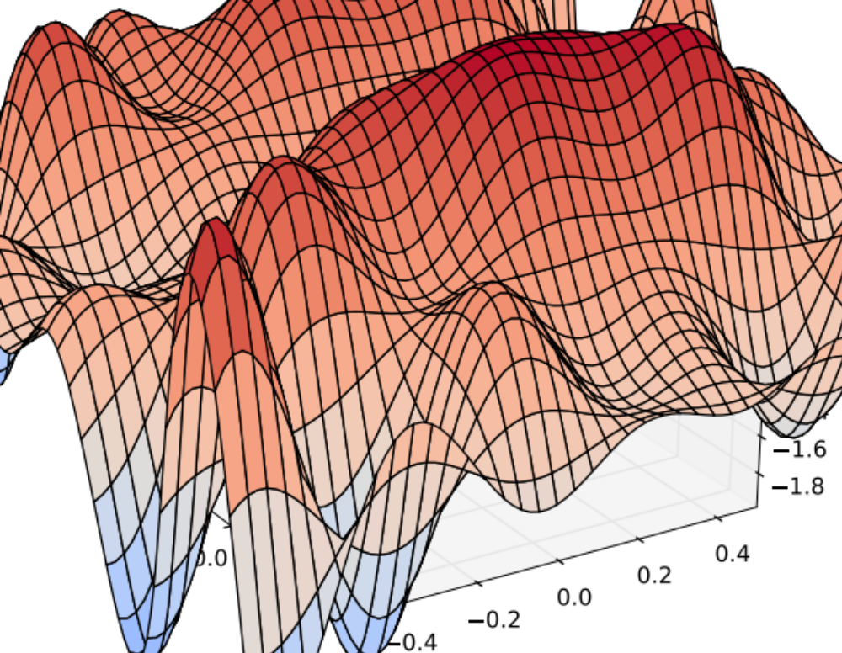
Properties of EM
EM is trying to optimize a nonconvex function
But EM is a local optimization algorithm
Typical solution: Random Restarts
  Just like K-Means, we run the algorithm many times
  Each time initialize parameters randomly
  Pick the parameters that give highest likelihood

Slide 40
Example: Grammar Induction
Grammar Induction is an unsupervised learning problem
We try to recover the syntactic parse for each sentence without any supervision

Slide 41

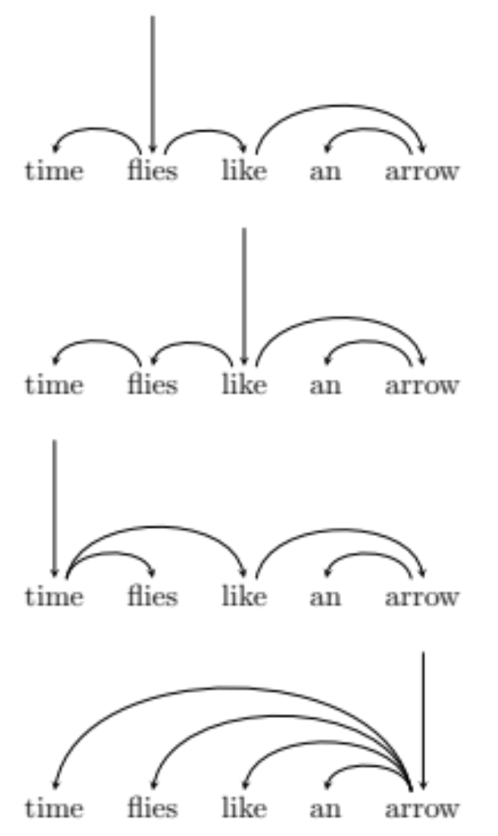
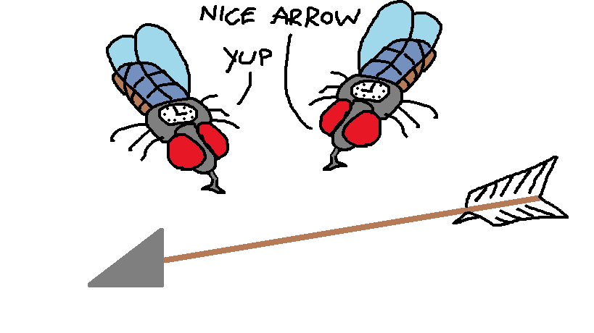
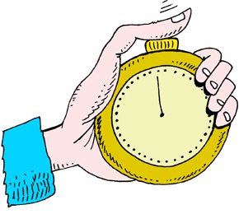

Example: Grammar Induction
…
No semantic interpretation

Slide 42
Example: Grammar Induction
Training Data: Sentences only, without parses
Sample 1:
time
flies
like
an
arrow
x⁽¹⁾
Sample 2:
real
flies
like
soup
x⁽²⁾
Sample 3:
flies
fly
with
their
wings
x⁽³⁾
Sample 4:
with
time
you
will
see
x⁽⁴⁾
Test Data: Sentences with parses, so we can evaluate accuracy

Slide 43
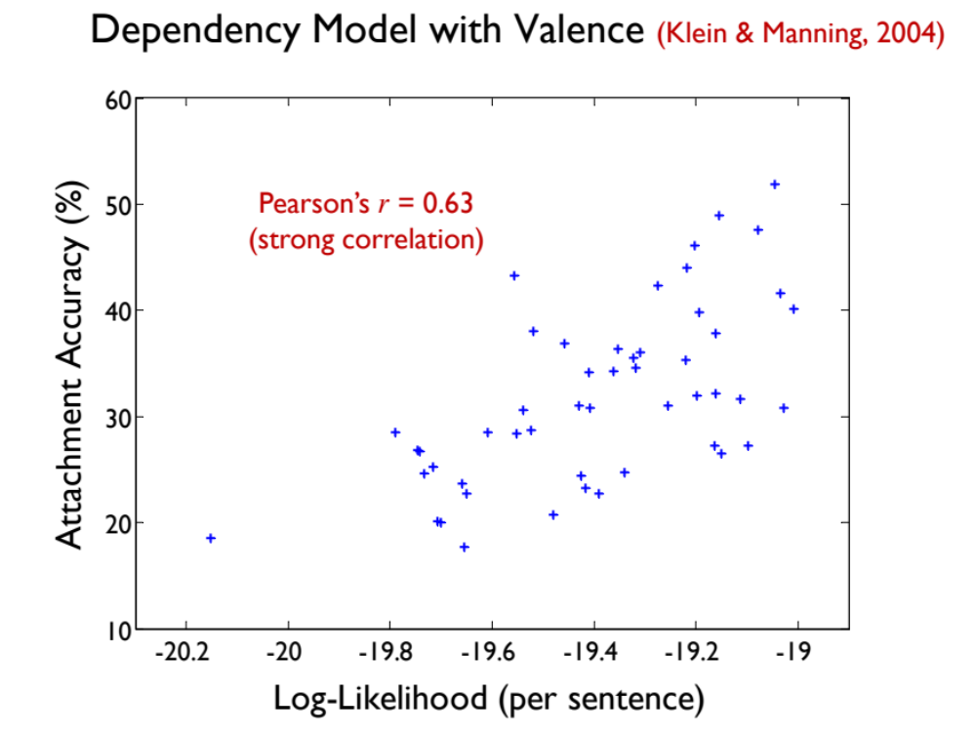
Example: Grammar Induction
Q: Does likelihood correlate with accuracy on a task we care about?
A: Yes, but there is still a wide range of accuracies for a particular likelihood value
Figure from Gimpel & Smith (NAACL 2012) - slides

Slide 44
Variants of EM
Generalized EM: Replace the M-Step by a single gradient-step that improves the likelihood
Monte Carlo EM: Approximate the E-Step by sampling
Sparse EM: Keep an “active list” of points (updated occasionally) from which we estimate the expected counts in the E-Step
Incremental EM / Stepwise EM: If standard EM is described as a batch algorithm, these are the online equivalent
etc.

Slide 45
A Report Card for EM
Some good things about EM:
  no learning rate (step-size) parameter
  automatically enforces parameter constraints
  very fast for low dimensions
  each iteration guaranteed to improve likelihood
Some bad things about EM:
  can get stuck in local minima
  can be slower than conjugate gradient (especially near convergence)
  requires expensive inference step
  is a maximum likelihood/MAP method

