Slide 1


HMMs and CRFs
School of Computer Science
10-601B Introduction to Machine Learning
Readings:
Bishop 13.1-13.2
Bishop 8.3-8.4
Sutton & McCallum (2006)
Lafferty et al. (2001)
Matt Gormley
Lecture 23
November 16, 2016

Slide 2
Reminders
Homework 6
  due Mon., Nov. 21
Final Exam
  in-class Wed., Dec. 7
Readings for Lecture 23 and Lecture 24 are swapped
  today: HMM/CRF
  next time: EM

Slide 3

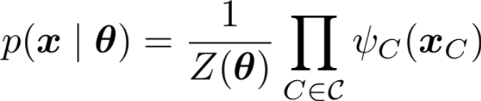
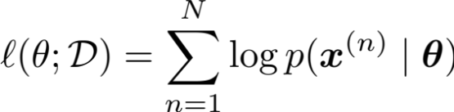
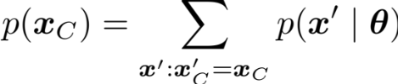
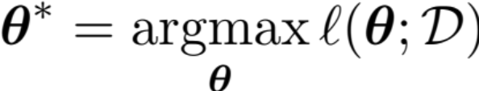
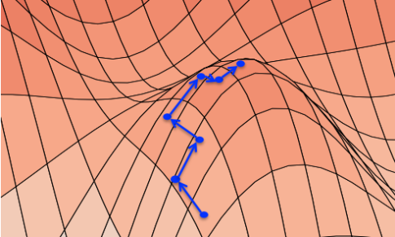


1. Data
2. Model
Sample 1:
n
v
p
d
n
time
flies
like
an
arrow
T₁
T₂
T₃
T₄
T₅
Sample 2:
n
n
v
d
n
time
flies
like
an
arrow
W₁
W₂
W₃
W₄
W₅
Sample 3:
n
v
p
n
n
3. Objective
flies
fly
with
their
wings
Sample 4:
p
n
n
v
v
with
time
you
will
see
5. Inference
4. Learning
1. Marginal Inference
2. Partition Function
3. MAP Inference

Slide 4
Hidden markov Model (HMM)

Slide 5

Dataset for Supervised
Part-of-Speech (POS) Tagging
Data:
n
v
p
d
n
y⁽¹⁾
Sample 1:
time
flies
like
an
arrow
x⁽¹⁾
n
n
v
d
n
y⁽²⁾
Sample 2:
time
flies
like
an
arrow
x⁽²⁾
n
v
p
n
n
y⁽³⁾
Sample 3:
flies
fly
with
their
wings
x⁽³⁾
p
n
n
v
v
y⁽⁴⁾
Sample 4:
with
time
you
will
see
x⁽⁴⁾
Notes:
Why would you want a model that’s not a linear chain?
Well, here’s an example.
Here I’ll generate tagged sentences.
When I pull a sample out of my pocket, sometimes it’s a tagging of “Time flies like an arrow” … but sometimes it’s a tagging of some other sentence.
Some sentences are more likely than others, and we are using POS tags to help model which sentences are likely.
The bigram “an arrow” is likely not because there’s a bigram parameter for it – there isn’t – but because the model captures something more general: determiners like to be followed by nouns.

Slide 6
Naïve Bayes for Time Series Data
We could treat each word-tag pair (i.e. token) as independent. This corresponds to a Naïve Bayes model with a single feature (the word).
p(n, v, p, d, n, time, flies, like, an, arrow) = (.3 * .8 * .1 * .5 * …)
v | .1
n | .8
p | .2
d | .2
v | .1
n | .8
p | .2
d | .2
n
v
p
d
n
 | time | flies | like | …
v | .2 | .5 | .2
n | .3 | .4 | .2
p | .1 | .1 | .3
d | .1 | .2 | .1
 | time | flies | like | …
v | .2 | .5 | .2
n | .3 | .4 | .2
p | .1 | .1 | .3
d | .1 | .2 | .1
time
flies
like
an
arrow

Slide 7
Hidden Markov Model
A Hidden Markov Model (HMM) provides a joint distribution over the the sentence/tags with an assumption of dependence between adjacent tags.
p(n, v, p, d, n, time, flies, like, an, arrow) = (.3 * .8 * .2 * .5 * …)
 | v | n | p | d
v | .1 | .4 | .2 | .3
n | .8 | .1 | .1 | 0
p | .2 | .3 | .2 | .3
d | .2 | .8 | 0 | 0
 | v | n | p | d
v | .1 | .4 | .2 | .3
n | .8 | .1 | .1 | 0
p | .2 | .3 | .2 | .3
d | .2 | .8 | 0 | 0
<START>
n
v
p
d
n
 | time | flies | like | …
v | .2 | .5 | .2
n | .3 | .4 | .2
p | .1 | .1 | .3
d | .1 | .2 | .1
 | time | flies | like | …
v | .2 | .5 | .2
n | .3 | .4 | .2
p | .1 | .1 | .3
d | .1 | .2 | .1
time
flies
like
an
arrow

Slide 8
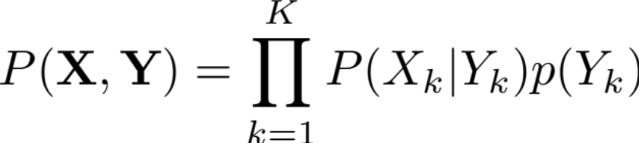
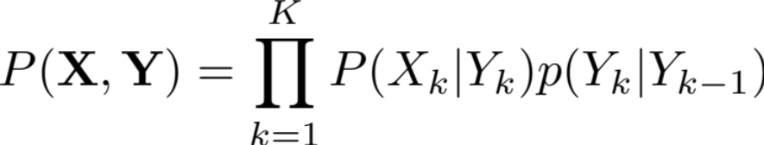
From NB to HMM
“Naïve Bayes”:
Y₁
Y₂
Y₃
Y₄
Y₅
X₁
X₂
X₃
X₄
X₅
HMM:
Y₀
Y₁
Y₂
Y₃
Y₄
Y₅
X₁
X₂
X₃
X₄
X₅

Slide 9
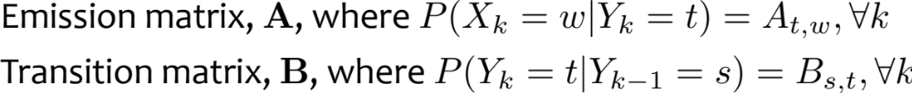
Hidden Markov Model
HMM Parameters:
 | v | n | p | d
v | 1 | 6 | 3 | 4
n | 8 | 4 | 2 | 0.1
p | 1 | 3 | 1 | 3
d | 0.1 | 8 | 0 | 0
 | v | n | p | d
v | 1 | 6 | 3 | 4
n | 8 | 4 | 2 | 0.1
p | 1 | 3 | 1 | 3
d | 0.1 | 8 | 0 | 0
Y₀
Y₁
Y₂
Y₃
Y₄
Y₅
 | time | flies | like | …
v | 3 | 5 | 3
n | 4 | 5 | 2
p | 0.1 | 0.1 | 3
d | 0.1 | 0.2 | 0.1
 | time | flies | like | …
v | 3 | 5 | 3
n | 4 | 5 | 2
p | 0.1 | 0.1 | 3
d | 0.1 | 0.2 | 0.1
X₁
X₂
X₃
X₄
X₅

Slide 10

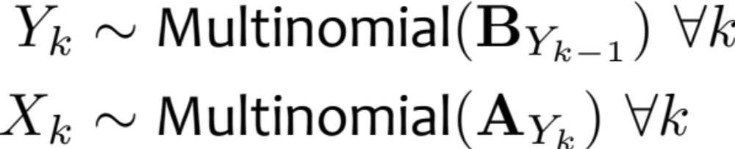
Hidden Markov Model
HMM Parameters:
Assumption:
Generative Story:
Y₀
Y₁
Y₂
Y₃
Y₄
Y₅
X₁
X₂
X₃
X₄
X₅

Slide 11
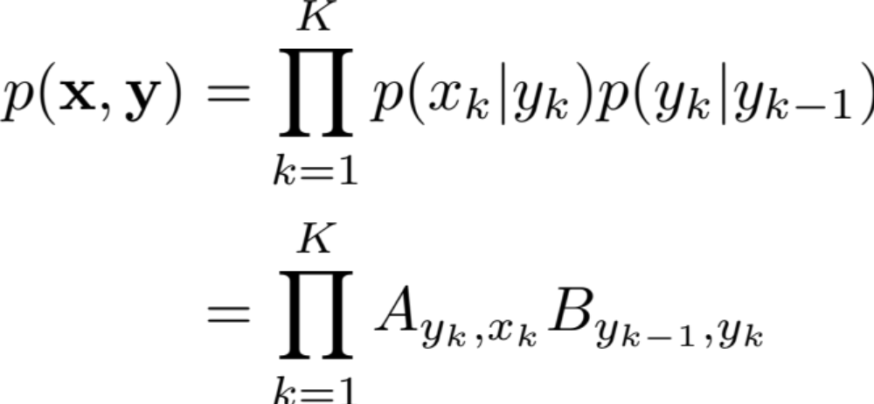
Hidden Markov Model
Joint Distribution:
Y₀
Y₁
Y₂
Y₃
Y₄
Y₅
X₁
X₂
X₃
X₄
X₅

Slide 12
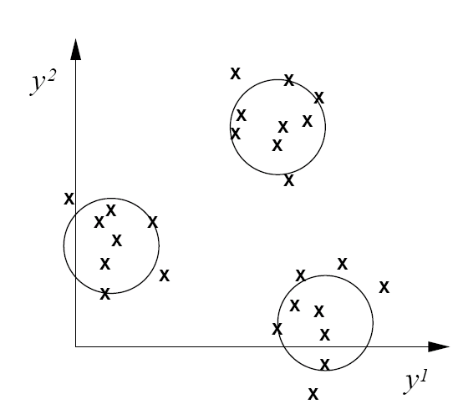
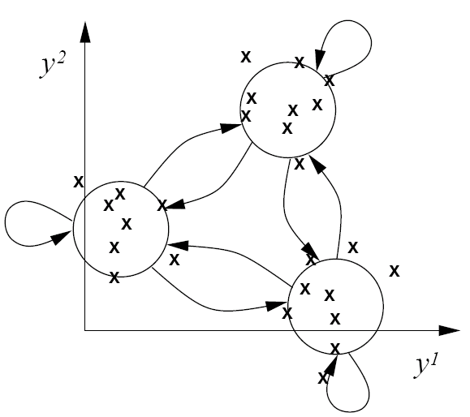
From static to dynamic mixture models
Static mixture
Dynamic mixture
Y₁
Y₁
Y₂
Y₃
...
Y_{T}
X₁
A
X₂
A
X₃
A
X_{T}
X₁
A
A
...
N

Slide 13
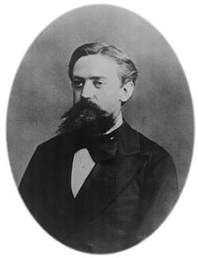
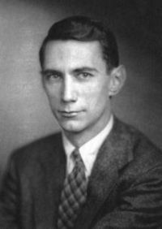
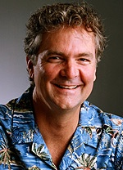
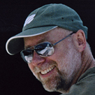
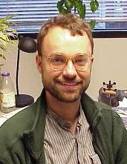
HMMs: History
Markov chains: Andrey Markov (1906)
  Random walks and Brownian motion
Used in Shannon’s work on information theory (1948)
Baum-Welsh learning algorithm: late 60’s, early 70’s.
  Used mainly for speech in 60s-70s.
Late 80’s and 90’s: David Haussler (major player in learning theory in 80’s) began to use HMMs for modeling biological sequences
Mid-late 1990’s: Dayne Freitag/Andrew McCallum
  Freitag thesis with Tom Mitchell on IE from Web using logic programs, grammar induction, etc.
  McCallum: multinomial Naïve Bayes for text
  With McCallum, IE using HMMs on CORA
…
Slide from William Cohen

Slide 14
Higher-order HMMs
1st-order HMM (i.e. bigram HMM)
2nd-order HMM (i.e. trigram HMM)
3rd-order HMM
<START>
Y₁
Y₂
Y₃
Y₄
Y₅
X₁
X₂
X₃
X₄
X₅
<START>
Y₁
Y₂
Y₃
Y₄
Y₅
X₁
X₂
X₃
X₄
X₅
<START>
Y₁
Y₂
Y₃
Y₄
Y₅
X₁
X₂
X₃
X₄
X₅

Slide 15
Supervised Learning for Bayes Nets

Slide 16
Machine Learning
The data inspires the structures we want to predict
Our model defines a score for each structure
It also tells us what to optimize
Domain Knowledge
Mathematical Modeling
ML
Inference finds
{best structure, marginals, partition function} for a new observation
Combinatorial Optimization
Optimization
Learning tunes the parameters of the model
(Inference is usually called as a subroutine in learning)

Slide 17
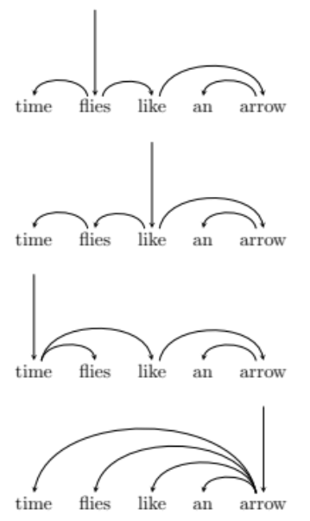
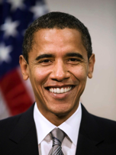
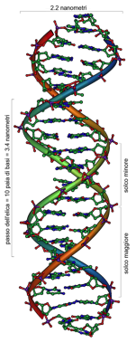
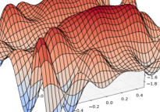
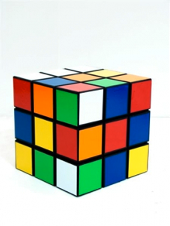
Machine Learning
Model
Data
X₁
X₂
X₃
X₄
X₅
Objective
Inference
Learning
(Inference is usually called as a subroutine in learning)

Slide 18
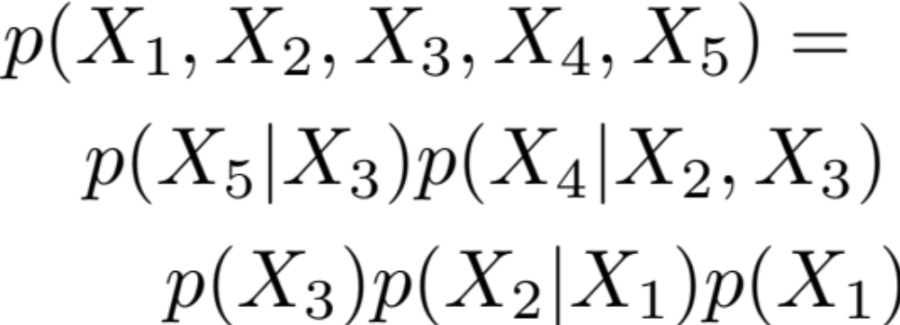
Learning Fully Observed BNs
Recall…
X₁
X₃
X₂
X₄
X₅

Slide 19
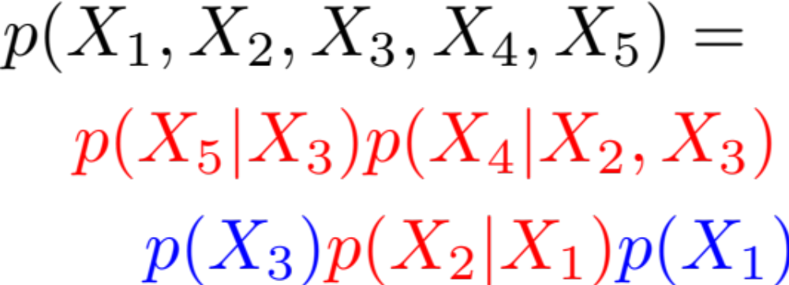
Learning Fully Observed BNs
Recall…
X₁
X₃
X₂
X₄
X₅

Slide 20
Learning Fully Observed BNs
Recall…
X₁
X₃
X₂
X₄
X₅
How do we learn these conditional and marginal distributions for a Bayes Net?

Slide 21
Learning Fully Observed BNs
Recall…
Learning this fully observed Bayesian Network is equivalent to learning five (small / simple) independent networks from the same data
X₁
X₁
X₁
X₃
X₂
X₃
X₂
X₃
X₃
X₄
X₅
X₂
X₄
X₅

Slide 22
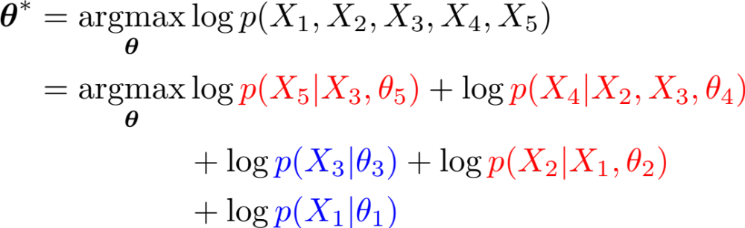
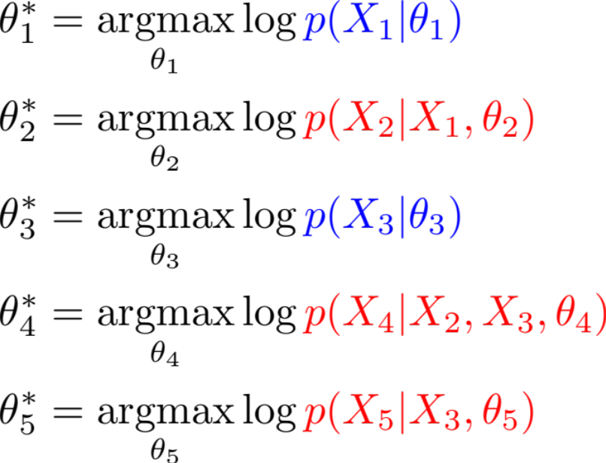
Learning Fully Observed BNs
How do we learn these conditional and marginal distributions for a Bayes Net?
X₁
X₃
X₂
X₄
X₅

Slide 23
Supervised Learning for HMMs

Slide 24
Hidden Markov Model
HMM Parameters:
 | v | n | p | d
v | 1 | 6 | 3 | 4
n | 8 | 4 | 2 | 0.1
p | 1 | 3 | 1 | 3
d | 0.1 | 8 | 0 | 0
 | v | n | p | d
v | 1 | 6 | 3 | 4
n | 8 | 4 | 2 | 0.1
p | 1 | 3 | 1 | 3
d | 0.1 | 8 | 0 | 0
Y₀
Y₁
Y₂
Y₃
Y₄
Y₅
 | time | flies | like | …
v | 3 | 5 | 3
n | 4 | 5 | 2
p | 0.1 | 0.1 | 3
d | 0.1 | 0.2 | 0.1
 | time | flies | like | …
v | 3 | 5 | 3
n | 4 | 5 | 2
p | 0.1 | 0.1 | 3
d | 0.1 | 0.2 | 0.1
X₁
X₂
X₃
X₄
X₅

Slide 25
Hidden Markov Model
HMM Parameters:
Assumption:
Generative Story:
Y₀
Y₁
Y₂
Y₃
Y₄
Y₅
X₁
X₂
X₃
X₄
X₅

Slide 26
Hidden Markov Model
Joint Distribution:
Y₀
Y₁
Y₂
Y₃
Y₄
Y₅
X₁
X₂
X₃
X₄
X₅

Slide 27
Whiteboard
MLEs for HMM

Slide 28
The Forward-Backward Algorithm

Slide 29
Learning and Inference Summary
For discrete variables:
 | Learning | Marginal Inference | MAP Inference
HMM |  | Forward-backward | Viterbi
Linear-chain CRF |  | Forward-backward | Viterbi

Slide 30
Forward-Backward Algorithm
Y₁
Y₂
Y₃
find
preferred
tags
Could be verb or noun
Could be adjective or verb
Could be noun or verb
30

Slide 31
Forward-Backward Algorithm
Y₁
Y₂
Y₃
v
v
v
START
n
n
n
END
a
a
a
find
preferred
tags
Show the possible values for each variable
31

Slide 32
Forward-Backward Algorithm
Y₁
Y₂
Y₃
v
v
v
START
n
n
n
END
a
a
a
find
preferred
tags
Let’s show the possible values for each variable
One possible assignment
32

Slide 33
Forward-Backward Algorithm
Y₁
Y₂
Y₃
v
v
v
START
n
n
n
END
a
a
a
find
preferred
tags
Let’s show the possible values for each variable
One possible assignment
And what the 7 factors think of it …
33

Slide 34
Viterbi Algorithm: Most Probable Assignment
Y₁
Y₂
Y₃
v
v
v
ψ_{{0,1}}(START,v)
ψ_{{1}}(v)
START
n
ψ_{{1,2}}(v,a)
n
n
ψ_{{3,4}}(a,END)
END
ψ_{{2,3}}(a,n)
ψ_{{3}}(n)
a
a
a
ψ_{{2}}(a)
find
preferred
tags
So p(v a n) = (1/Z) * product of 7 numbers
Numbers associated with edges and nodes of path
Most probable assignment = path with highest product
34

Slide 35
Viterbi Algorithm: Most Probable Assignment
Y₁
Y₂
Y₃
v
v
v
ψ_{{0,1}}(START,v)
ψ_{{1}}(v)
START
n
ψ_{{1,2}}(v,a)
n
n
ψ_{{3,4}}(a,END)
END
ψ_{{2,3}}(a,n)
ψ_{{3}}(n)
a
a
a
ψ_{{2}}(a)
find
preferred
tags
So p(v a n) = (1/Z) * product weight of one path
35

Slide 36
Forward-Backward Algorithm: Finds Marginals
Y₁
Y₂
Y₃
v
v
v
START
n
n
n
END
a
a
a
find
preferred
tags
So p(v a n) = (1/Z) * product weight of one path
Marginal probability p(Y₂ = a)
= (1/Z) * total weight of all paths through
a
36

Slide 37
Forward-Backward Algorithm: Finds Marginals
Y₁
Y₂
Y₃
v
v
v
START
n
n
n
END
a
a
a
find
preferred
tags
So p(v a n) = (1/Z) * product weight of one path
Marginal probability p(Y₂ = a)
= (1/Z) * total weight of all paths through
n
37

Slide 38
Forward-Backward Algorithm: Finds Marginals
Y₁
Y₂
Y₃
v
v
v
START
n
n
n
END
a
a
a
find
preferred
tags
So p(v a n) = (1/Z) * product weight of one path
Marginal probability p(Y₂ = a)
= (1/Z) * total weight of all paths through
v
38

Slide 39
Forward-Backward Algorithm: Finds Marginals
Y₁
Y₂
Y₃
v
v
v
START
n
n
n
END
a
a
a
find
preferred
tags
So p(v a n) = (1/Z) * product weight of one path
Marginal probability p(Y₂ = a)
= (1/Z) * total weight of all paths through
n
39

Slide 40
Forward-Backward Algorithm: Finds Marginals
Y₁
Y₂
Y₃
v
v
v
START
n
n
n
END
a
a
a
find
preferred
tags
α₂(n)
= total weight of these
path prefixes
40
(found by dynamic programming: matrix-vector products)

Slide 41
Forward-Backward Algorithm: Finds Marginals
Y₁
Y₂
Y₃
v
v
v
START
n
n
n
END
a
a
a
find
preferred
tags
β₂(n)
= total weight of these
path suffixes
41
(found by dynamic programming: matrix-vector products)

Slide 42
Forward-Backward Algorithm: Finds Marginals
Y₁
Y₂
Y₃
v
v
v
START
n
n
n
END
a
a
a
find
preferred
tags
α₂(n)
= total weight of these
path prefixes
β₂(n)
= total weight of these
path suffixes
(a + b + c)
(x + y + z)
42
Product gives ax+ay+az+bx+by+bz+cx+cy+cz = total weight of paths

Slide 43
Forward-Backward Algorithm: Finds Marginals
Y₁
Y₂
Y₃
v
v
v
Oops! The weight of a path through a state also includes a weight at that state.
So α(n)∙β(n) isn’t enough.
The extra weight is the opinion of the unigram factor at this variable.
START
n
n
n
END
“belief that Y₂ = n”
α₂(n)
β₂(n)
a
a
a
ψ_{{2}}(n)
find
preferred
tags
n
total weight of all paths through
= ⋅ ⋅
α₂(n)
ψ_{{2}}(n)
β₂(n)
43

Slide 44
Forward-Backward Algorithm: Finds Marginals
Y₁
Y₂
Y₃
v
v
v
“belief that Y₂ = v”
START
n
n
n
END
“belief that Y₂ = n”
α₂(v)
β₂(v)
a
a
a
ψ_{{2}}(v)
find
preferred
tags
v
total weight of all paths through
= ⋅ ⋅
α₂(v)
ψ_{{2}}(v)
β₂(v)
44

Slide 45
Forward-Backward Algorithm: Finds Marginals
v | 1.8
n | 0
a | 4.2
Y₁
Y₂
Y₃
v
v
v
“belief that Y₂ = v”
divide
by Z=6 to get marginal probs
v | 0.3
n | 0
a | 0.7
n
n
START
n
“belief that Y₂ = n”
END
α₂(a)
β₂(a)
a
a
a
“belief that Y₂ = a”
sum = Z
(total probability
of all paths)
ψ_{{2}}(a)
find
preferred
tags
a
total weight of all paths through
= ⋅ ⋅
α₂(a)
ψ_{{2}}(a)
β₂(a)
45

Slide 46
CRF Tagging Model
Y₁
Y₂
Y₃
find
preferred
tags
Could be verb or noun
Could be adjective or verb
Could be noun or verb
46

Slide 47
Whiteboard
Forward-backward algorithm
Viterbi algorithm

Slide 48
Linear-Chain CRFs
Conditional Random Fields (CRFs) for time series data

Slide 49
Shortcomings of
Hidden Markov Models
HMM models capture dependences between each state and only its corresponding observation
  NLP example: In a sentence segmentation task, each segmental state may depend not just on a single word (and the adjacent segmental stages), but also on the (non-local) features of the whole line such as line length, indentation, amount of white space, etc.
Mismatch between learning objective function and prediction objective function
  HMM learns a joint distribution of states and observations P(Y, X), but in a prediction task, we need the conditional probability P(Y|X)
START
Y₁
Y₂
…
…
…
Y_{n}
X₁
X₂
…
…
…
X_{n}

Slide 50

Conditional Random Field (CRF)
Conditional distribution over tags X_{i} given words w_{i}.
The factors and Z are now specific to the sentence w.
p(n, v, p, d, n | time, flies, like, an, arrow) = (4 * 8 * 5 * 3 * …)
 | v | n | p | d
v | 1 | 6 | 3 | 4
n | 8 | 4 | 2 | 0.1
p | 1 | 3 | 1 | 3
d | 0.1 | 8 | 0 | 0
 | v | n | p | d
v | 1 | 6 | 3 | 4
n | 8 | 4 | 2 | 0.1
p | 1 | 3 | 1 | 3
d | 0.1 | 8 | 0 | 0
<START>
n
v
p
ψ₆
d
n
ψ₀
ψ₂
ψ₄
ψ₈
v | 3
n | 4
p | 0.1
d | 0.1
ψ₁
ψ₃
v | 5
n | 5
p | 0.1
d | 0.2
ψ₅
ψ₇
ψ₉
time
flies
like
an
arrow
Notes:
We’re not trying to predict the sentence anymore.
But given a sentence, we’ll construct a bunch of factors that model a distribution over its taggings.

Slide 51
Conditional Random Field (CRF)
Recall: Shaded nodes in a graphical model are observed
 | v | n | p | d
v | 1 | 6 | 3 | 4
n | 8 | 4 | 2 | 0.1
p | 1 | 3 | 1 | 3
d | 0.1 | 8 | 0 | 0
 | v | n | p | d
v | 1 | 6 | 3 | 4
n | 8 | 4 | 2 | 0.1
p | 1 | 3 | 1 | 3
d | 0.1 | 8 | 0 | 0
<START>
Y₁
Y₂
Y₃
ψ₆
Y₄
Y₅
ψ₀
ψ₂
ψ₄
ψ₈
v | 3
n | 4
p | 0.1
d | 0.1
ψ₁
ψ₃
v | 5
n | 5
p | 0.1
d | 0.2
ψ₅
ψ₇
ψ₉
X₁
X₂
X₃
X₄
X₅
Notes:
We’re not trying to predict the sentence anymore.
But given a sentence, we’ll construct a bunch of factors that model a distribution over its taggings.

Slide 52
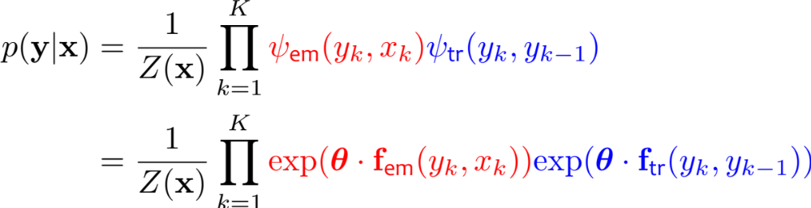
Conditional Random Field (CRF)
This linear-chain CRF is just like an HMM, except that its factors are not necessarily probability distributions
<START>
Y₁
Y₂
Y₃
ψ₆
Y₄
Y₅
ψ₀
ψ₂
ψ₄
ψ₈
ψ₁
ψ₃
ψ₅
ψ₇
ψ₉
X₁
X₂
X₃
X₄
X₅
Notes:
We’re not trying to predict the sentence anymore.
But given a sentence, we’ll construct a bunch of factors that model a distribution over its taggings.

Slide 53
Quiz
Multiple Choice: Which model does the above distribution share the most in common with?
  Hidden Markov Model
  Bernoulli Naïve Bayes
  Gaussian Naïve Bayes
  Logistic Regression

Slide 54
Conditional Random Field (CRF)
This linear-chain CRF is just like an HMM, except that its factors are not necessarily probability distributions
<START>
Y₁
Y₂
Y₃
ψ₆
Y₄
Y₅
ψ₀
ψ₂
ψ₄
ψ₈
ψ₁
ψ₃
ψ₅
ψ₇
ψ₉
X₁
X₂
X₃
X₄
X₅
Notes:
We’re not trying to predict the sentence anymore.
But given a sentence, we’ll construct a bunch of factors that model a distribution over its taggings.

Slide 55
Conditional Random Field (CRF)
That is the vector X
Because it’s observed, we can condition on it for free
Conditioning is how we converted from the MRF to the CRF
(i.e. when taking a slice of the emission factors)
 | v | n | p | d
v | 1 | 6 | 3 | 4
n | 8 | 4 | 2 | 0.1
p | 1 | 3 | 1 | 3
d | 0.1 | 8 | 0 | 0
 | v | n | p | d
v | 1 | 6 | 3 | 4
n | 8 | 4 | 2 | 0.1
p | 1 | 3 | 1 | 3
d | 0.1 | 8 | 0 | 0
<START>
Y₁
Y₂
Y₃
ψ₆
Y₄
Y₅
ψ₀
ψ₂
ψ₄
ψ₈
v | 3
n | 4
p | 0.1
d | 0.1
ψ₁
ψ₃
v | 5
n | 5
p | 0.1
d | 0.2
ψ₅
ψ₇
ψ₉
X
Notes:
We’re not trying to predict the sentence anymore.
But given a sentence, we’ll construct a bunch of factors that model a distribution over its taggings.

Slide 56
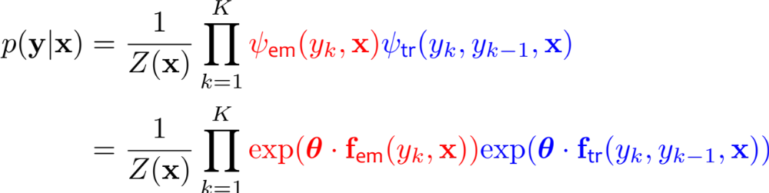
Conditional Random Field (CRF)
This is the standard linear-chain CRF definition
It permits rich, overlapping features of the vector X
<START>
Y₁
Y₂
Y₃
ψ₆
Y₄
Y₅
ψ₀
ψ₂
ψ₄
ψ₈
ψ₁
ψ₃
ψ₅
ψ₇
ψ₉
X
Notes:
We’re not trying to predict the sentence anymore.
But given a sentence, we’ll construct a bunch of factors that model a distribution over its taggings.

Slide 57
Conditional Random Field (CRF)
This is the standard linear-chain CRF definition
It permits rich, overlapping features of the vector X
<START>
Y₁
Y₂
Y₃
ψ₆
Y₄
Y₅
ψ₀
ψ₂
ψ₄
ψ₈
ψ₁
ψ₃
ψ₅
ψ₇
ψ₉
Visual Notation: Usually we draw a CRF without showing the variable corresponding to X
Notes:
We’re not trying to predict the sentence anymore.
But given a sentence, we’ll construct a bunch of factors that model a distribution over its taggings.

Slide 58
Whiteboard
Forward-backward algorithm
for linear-chain CRF

Slide 59
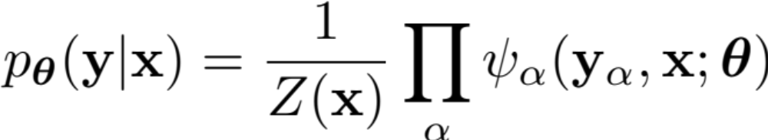
General CRF
The topology of the graphical model for a CRF doesn’t have to be a chain
Y₉
ψ_{{1,8,9}}
ψ_{{1,8,9}}
ψ_{{1,8,9}}
ψ_{{1,8,9}}
ψ_{{1,8,9}}
ψ_{{1,8,9}}
ψ_{{1,8,9}}
ψ_{{1,8,9}}
ψ_{{1,8,9}}
ψ_{{1,8,9}}
ψ_{{1,8,9}}
ψ_{{1,8,9}}
Y₈
ψ_{{2,7,8}}
Y₇
ψ_{{3,6,7}}
Y₆
ψ₁₀
ψ₁₀
ψ₁₀
Y₁
ψ₂
Y₂
Y₃
ψ_{{3,4}}
Y₄
Y₅
ψ₂
ψ₂
ψ₂
ψ₂
ψ₂
ψ₂
ψ₂
ψ₂
ψ₂
ψ₈
ψ₈
ψ₈
ψ_{{1,2}}
ψ_{{2,3}}
ψ₈
ψ₅
ψ₅
ψ₅
ψ₅
ψ₅
ψ₅
ψ₅
ψ₉
ψ₉
ψ₉
ψ₁
ψ₉
ψ₁
ψ₁
ψ₁
ψ₁
ψ₁
ψ₁
ψ₁
ψ₁
ψ₁
ψ₁
ψ₃
ψ₃
ψ₃
ψ₃
ψ₃
ψ₃
ψ₃
ψ₃
ψ₃
ψ₇
ψ₇
ψ₇
ψ₇
ψ₇
ψ_{{1}}
ψ_{{2}}
ψ_{{3}}
ψ₇
time
flies
like
an
arrow

Slide 60
Standard CRF Parameterization
Define each potential function in terms of a fixed set of feature functions:
Predicted
variables
Observed
variables

Slide 61


Standard CRF Parameterization
Define each potential function in terms of a fixed set of feature functions:
n
v
p
ψ₆
d
n
ψ₂
ψ₄
ψ₈
ψ₁
ψ₃
ψ₅
ψ₇
ψ₉
time
flies
like
an
arrow

Slide 62
Standard CRF Parameterization
Define each potential function in terms of a fixed set of feature functions:
s
ψ₁₃
vp
ψ₁₂
pp
ψ₁₁
np
ψ₁₀
n
ψ₂
v
ψ₄
p
ψ₆
d
ψ₈
n
ψ₁
ψ₃
ψ₅
ψ₇
ψ₉
time
flies
like
an
arrow

Slide 63
Belief Propagation
Exact inference for tree-structured factor graphs

Slide 64
Inference for HMMs
Sum-product BP on an HMM is called the forward-backward algorithm
Max-product BP on an HMM is called the Viterbi algorithm

Slide 65
Inference for CRFs
Sum-product BP on a CRF is called the forward-backward algorithm
Max-product BP on a CRF is called the Viterbi algorithm

Slide 66
CRF Tagging by Belief Propagation
Forward algorithm =
message passing
(matrix-vector products)
Backward algorithm =
message passing
(matrix-vector products)
belief
v | 1.8
n | 0
a | 4.2
α
message
message
α
β
β
v | 7
n | 2
a | 1
 | v | n | a
v | 0 | 2 | 1
n | 2 | 1 | 0
a | 0 | 3 | 1
v | 3
n | 1
a | 6
 | v | n | a
v | 0 | 2 | 1
n | 2 | 1 | 0
a | 0 | 3 | 1
…
v | 2
n | 1
a | 7
v | 3
n | 6
a | 1
…
v | 0.3
n | 0
a | 0.1
find
preferred
tags
Forward-backward is a message passing algorithm.
It’s the simplest case of belief propagation.
66
Notes:
66

Slide 67
Supervised Learning for CRFs

Slide 68
What is Training?
That’s easy:
Training = picking good model parameters!
But how do we know if the
model parameters are any “good”?

Slide 69
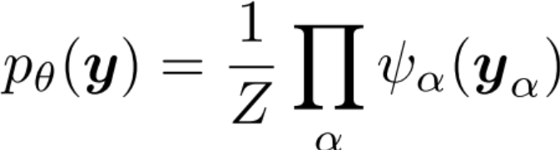
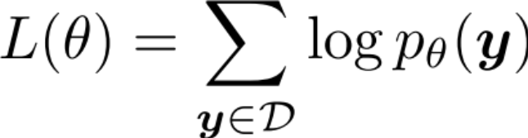
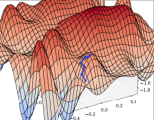
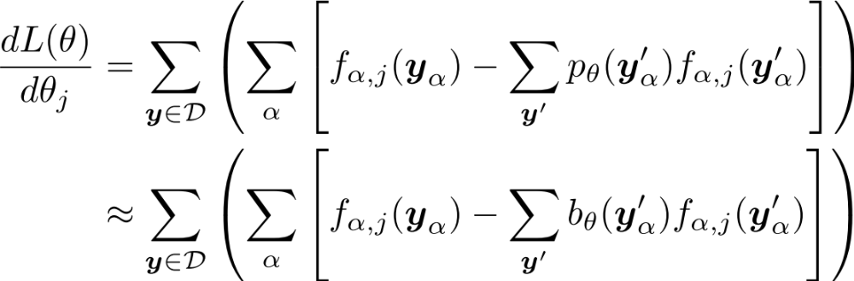
Log-likelihood Training
Machine Learning
Choose model
Such that derivative in #3 is ea
Choose objective:
Assign high probability to the things we observe and low probability to everything else
Compute derivative by hand using the chain rule
Replace exact inference by approximate inference

Slide 70
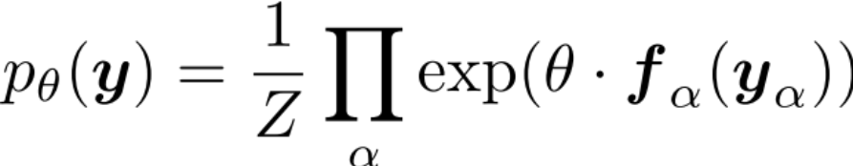
Log-likelihood Training
Machine Learning
Choose model
Such that derivative in #3 is easy
Choose objective:
Assign high probability to the things we observe and low probability to everything else
Compute derivative by hand using the chain rule
Compute the marginals by exact inference
Note that these are factor marginals which are just the (normalized)
factor beliefs from BP!

Slide 71
Recipe for Gradient-based Learning
Write down the objective function
Compute the partial derivatives of the objective (i.e. gradient, and maybe Hessian)
Feed objective function and derivatives into black box
Retrieve optimal parameters from black box
Optimization

Slide 72
Optimization Algorithms
What is the black box?
Newton’s method
Hessian-free / Quasi-Newton methods
  Conjugate gradient
  L-BFGS
Stochastic gradient methods
  Stochastic gradient descent (SGD)
  Stochastic meta-descent
  AdaGrad
Optimization

Slide 73
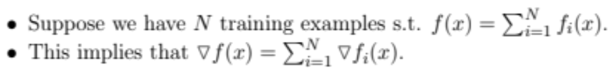
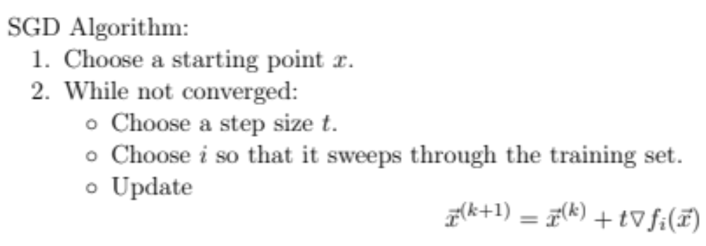
Stochastic Gradient Descent

Slide 74
Whiteboard
CRF model
CRF data log-likelihood
CRF derivatives

Slide 75
Practical Considerations for Gradient-based Methods
Overfitting
  L2 regularization
  L1 regularization
  Regularization by early stopping
For SGD: Sparse updates

Slide 76
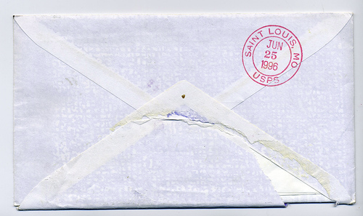
“Empirical” Comparison of Parameter Estimation Methods
Example NLP task: CRF dependency parsing
Suppose: Training time is dominated by inference
Dataset: One million tokens
Inference speed: 1,000 tokens / sec
➔ 0.27 hours per pass through dataset
 | # passes through data to converge | # hours to converge
GIS | 1000+ | 270
L-BFGS | 100+ | 27
SGD | 10 | ~3

Slide 77
Feature Engineering for CRFs

Slide 78
Features
Slide adapted from 600.465 - Intro to NLP - J. Eisner
General idea:
Make a list of interesting substructures.
The feature f_{k}(x,y) counts tokens of k^{th} substructure in (x,y).

Slide 79
Features for tagging …
Slide courtesy of 600.465 - Intro to NLP - J. Eisner
N
V
P
D
N
Time flies like an arrow
Count of tag P as the tag for “like”
Weight of this feature is like
log of an emission probability
in an HMM

Slide 80
Features for tagging …
Slide courtesy of 600.465 - Intro to NLP - J. Eisner
N
V
P
D
N
Time flies like an arrow
Count of tag P as the tag for “like”
Count of tag P

Slide 81
Features for tagging …
Slide courtesy of 600.465 - Intro to NLP - J. Eisner
N
V
P
D
N
Time flies like an arrow
0
1
2
3
4
5
Count of tag P as the tag for “like”
Count of tag P
Count of tag P in the middle third of the sentence

Slide 82
Features for tagging …
Slide courtesy of 600.465 - Intro to NLP - J. Eisner
N
V
P
D
N
Time flies like an arrow
Count of tag P as the tag for “like”
Count of tag P
Count of tag P in the middle third of the sentence
Count of tag bigram V P
Weight of this feature is like
log of a transition probability
in an HMM

Slide 83
Features for tagging …
Slide courtesy of 600.465 - Intro to NLP - J. Eisner
N
V
P
D
N
Time flies like an arrow
Count of tag P as the tag for “like”
Count of tag P
Count of tag P in the middle third of the sentence
Count of tag bigram V P
Count of tag bigram V P followed by “an”

Slide 84
Features for tagging …
Slide courtesy of 600.465 - Intro to NLP - J. Eisner
N
V
P
D
N
Time flies like an arrow
Count of tag P as the tag for “like”
Count of tag P
Count of tag P in the middle third of the sentence
Count of tag bigram V P
Count of tag bigram V P followed by “an”
Count of tag bigram V P where P is the tag for “like”

Slide 85
Features for tagging …
Slide courtesy of 600.465 - Intro to NLP - J. Eisner
N
V
P
D
N
Time flies like an arrow
Count of tag P as the tag for “like”
Count of tag P
Count of tag P in the middle third of the sentence
Count of tag bigram V P
Count of tag bigram V P followed by “an”
Count of tag bigram V P where P is the tag for “like”
Count of tag bigram V P where both words are lowercase

Slide 86
Features for tagging …
Slide courtesy of 600.465 - Intro to NLP - J. Eisner
N
V
P
D
N
Time flies like an arrow
Count of tag trigram N V P?
  A bigram tagger can only consider within-bigram features:
  only look at 2 adjacent blue tags (plus arbitrary red context).
  So here we need a trigram tagger, which is slower.
  The forward-backward states would remember two previous tags.
P
N V
V P
We take this arc once per N V P triple,
so its weight is the total weight of
the features that fire on that triple.

Slide 87
Features for tagging …
Slide courtesy of 600.465 - Intro to NLP - J. Eisner
N
V
P
D
N
Time flies like an arrow
Count of tag trigram N V P?
  A bigram tagger can only consider within-bigram features:
  only look at 2 adjacent blue tags (plus arbitrary red context).
  So here we need a trigram tagger, which is slower.
Count of “post-verbal” nouns? (“discontinuous bigram” V N)
  An n-gram tagger can only look at a narrow window.
  Here we need a fancier model (finite state machine) whose states remember whether there was a verb in the left context.
V
P
D
N
N
V
P
D
N
V … P
V … D
V … N
Post-verbal
P D bigram
Post-verbal
D N bigram

Slide 88
How might you come up with the features that you will use to score (x,y)?
Slide courtesy of 600.465 - Intro to NLP - J. Eisner
Think of some attributes (“basic features”) that you can compute at each position in (x,y).
For position i in a tagging, these might include:
  Full name of tag i
  First letter of tag i (will be “N” for both “NN” and “NNS”)
  Full name of tag i-1 (possibly BOS); similarly tag i+1 (possibly EOS)
  Full name of word i
  Last 2 chars of word i (will be “ed” for most past-tense verbs)
  First 4 chars of word i (why would this help?)
  “Shape” of word i (lowercase/capitalized/all caps/numeric/…)
  Whether word i is part of a known city name listed in a “gazetteer”
  Whether word i appears in thesaurus entry e (one attribute per e)
  Whether i is in the middle third of the sentence

Slide 89
How might you come up with the features that you will use to score (x,y)?
Slide courtesy of 600.465 - Intro to NLP - J. Eisner
Think of some attributes (“basic features”) that you can compute at each position in (x,y).
Now conjoin them into various “feature templates.”
E.g., template 7 might be (tag(i-1), tag(i), suffix2(i+1)).
At each position of (x,y), exactly one of the many template7 features will fire:
N
V
P
D
N
Time flies like an arrow
At i=1, we see an instance of “template7=(BOS,N,-es)”
so we add one copy of that feature’s weight to score(x,y)

Slide 90
How might you come up with the features that you will use to score (x,y)?
Slide courtesy of 600.465 - Intro to NLP - J. Eisner
Think of some attributes (“basic features”) that you can compute at each position in (x,y).
Now conjoin them into various “feature templates.”
E.g., template 7 might be (tag(i-1), tag(i), suffix2(i+1)).
At each position of (x,y), exactly one of the many template7 features will fire:
N
V
P
D
N
Time flies like an arrow
At i=2, we see an instance of “template7=(N,V,-ke)”
so we add one copy of that feature’s weight to score(x,y)

Slide 91
How might you come up with the features that you will use to score (x,y)?
Slide courtesy of 600.465 - Intro to NLP - J. Eisner
Think of some attributes (“basic features”) that you can compute at each position in (x,y).
Now conjoin them into various “feature templates.”
E.g., template 7 might be (tag(i-1), tag(i), suffix2(i+1)).
At each position of (x,y), exactly one of the many template7 features will fire:
N
V
P
D
N
Time flies like an arrow
At i=3, we see an instance of “template7=(N,V,-an)”
so we add one copy of that feature’s weight to score(x,y)

Slide 92
How might you come up with the features that you will use to score (x,y)?
Slide courtesy of 600.465 - Intro to NLP - J. Eisner
Think of some attributes (“basic features”) that you can compute at each position in (x,y).
Now conjoin them into various “feature templates.”
E.g., template 7 might be (tag(i-1), tag(i), suffix2(i+1)).
At each position of (x,y), exactly one of the many template7 features will fire:
N
V
P
D
N
Time flies like an arrow
At i=4, we see an instance of “template7=(P,D,-ow)”
so we add one copy of that feature’s weight to score(x,y)

Slide 93
How might you come up with the features that you will use to score (x,y)?
Slide courtesy of 600.465 - Intro to NLP - J. Eisner
Think of some attributes (“basic features”) that you can compute at each position in (x,y).
Now conjoin them into various “feature templates.”
E.g., template 7 might be (tag(i-1), tag(i), suffix2(i+1)).
At each position of (x,y), exactly one of the many template7 features will fire:
N
V
P
D
N
Time flies like an arrow
At i=5, we see an instance of “template7=(D,N,-)”
so we add one copy of that feature’s weight to score(x,y)

Slide 94
How might you come up with the features that you will use to score (x,y)?
Slide courtesy of 600.465 - Intro to NLP - J. Eisner
Think of some attributes (“basic features”) that you can compute at each position in (x,y).
Now conjoin them into various “feature templates.”
E.g., template 7 might be (tag(i-1), tag(i), suffix2(i+1)).
This template gives rise to many features, e.g.:
    score(x,y) = …
    + θ[“template7=(P,D,-ow)”] * count(“template7=(P,D,-ow)”)
    + θ[“template7=(D,D,-xx)”] * count(“template7=(D,D,-xx)”)
    + …
With a handful of feature templates and a large vocabulary, you can easily end up with millions of features.

Slide 95
How might you come up with the features that you will use to score (x,y)?
Slide courtesy of 600.465 - Intro to NLP - J. Eisner
Think of some attributes (“basic features”) that you can compute at each position in (x,y).
Now conjoin them into various “feature templates.”
E.g., template 7 might be (tag(i-1), tag(i), suffix2(i+1)).
Note: Every template should mention at least some blue.
  Given an input x, a feature that only looks at red will contribute the same weight to score(x,y₁) and score(x,y₂).
  So it can’t help you choose between outputs y₁, y₂.

Slide 96
HMMs vs CRFs

Slide 97
Generative vs. Discriminative
Liang & Jordan (ICML 2008) compares HMM and CRF with identical features
Dataset 1: (Real)
  WSJ Penn Treebank (38K train, 5.5K test)
  45 part-of-speech tags
Dataset 2: (Artificial)
  Synthetic data generated from HMM learned on Dataset 1 (1K train, 1K test)
Evaluation Metric: Accuracy
Model is misspecified
Model is
well-specified

Slide 98
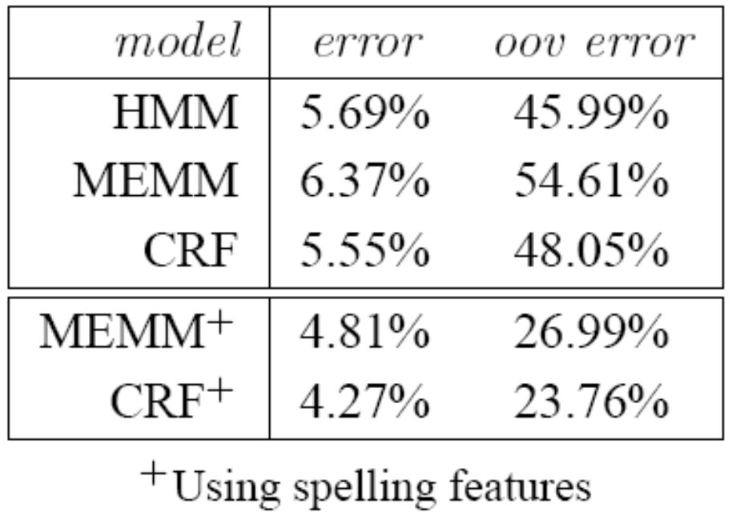
CRFs: some empirical results
Parts of Speech tagging
  Using same set of features: HMM >=< CRF > MEMM
  Using additional overlapping features: CRF⁺ > MEMM⁺ >> HMM

Slide 99
MBR Decoding

Slide 100
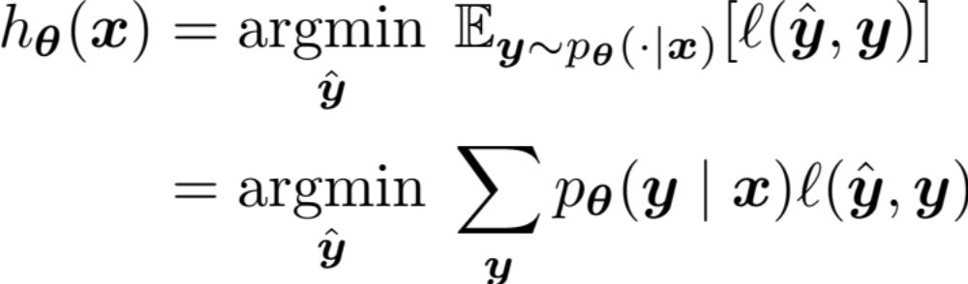
Minimum Bayes Risk Decoding
Suppose we given a loss function l(y’, y) and are asked for a single tagging
How should we choose just one from our probability distribution p(y|x)?
A minimum Bayes risk (MBR) decoder h(x) returns the variable assignment with minimum expected loss under the model’s distribution

Slide 101

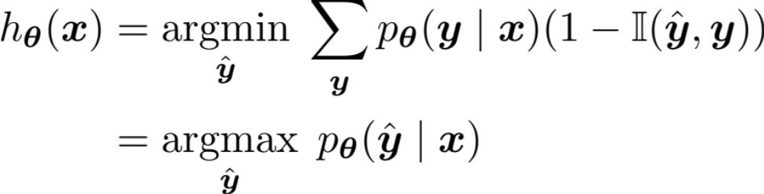
Minimum Bayes Risk Decoding
Consider some example loss functions:
The 0-1 loss function returns 1 only if the two assignments are identical and 0 otherwise:
The MBR decoder is:
which is exactly the MAP inference problem!

Slide 102
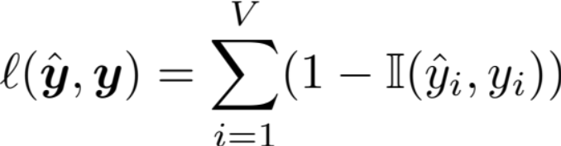
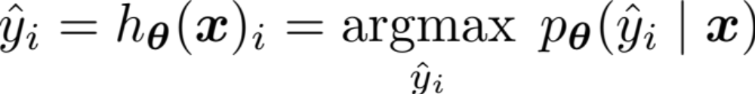
Minimum Bayes Risk Decoding
Consider some example loss functions:
The Hamming loss corresponds to accuracy and returns the number of incorrect variable assignments:
The MBR decoder is:
This decomposes across variables and requires the variable marginals.

Slide 103
Summary

Slide 104
Summary: Learning and Inference
For discrete variables:
 | Learning | Marginal Inference | MAP Inference
HMM | MLE by counting | Forward-backward | Viterbi
Linear-chain CRF | Gradient based – doesn’t decompose because of Z(x) and requires marginal inference | Forward-backward | Viterbi

Slide 105
Summary: Models
 | Classification | Structured Prediction
Generative | Naïve Bayes | HMM
Discriminative | Logistic Regression | CRF

