Slide 1


Deep Learning
(Part I)
School of Computer Science
10-601B Introduction to Machine Learning
Readings:
Nielsen (online book) Neural Networks and Deep Learning
Matt Gormley
Lecture 16
October 24, 2016

Slide 2
Reminders
Midsemester grades released today

Slide 3
Outline
Deep Neural Networks (DNNs)
  Three ideas for training a DNN
  Experiments: MNIST digit classification
  Autoencoders
  Pretraining
Convolutional Neural Networks (CNNs)
  Convolutional layers
  Pooling layers
  Image recognition
Recurrent Neural Networks (RNNs)
  Bidirectional RNNs
  Deep Bidirectional RNNs
  Deep Bidirectional LSTMs
  Connection to forward-backward algorithm
Part I
Part II

Slide 4
Pre-Training for Deep Nets

Slide 5
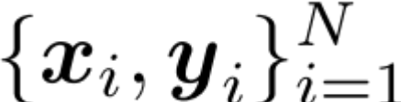
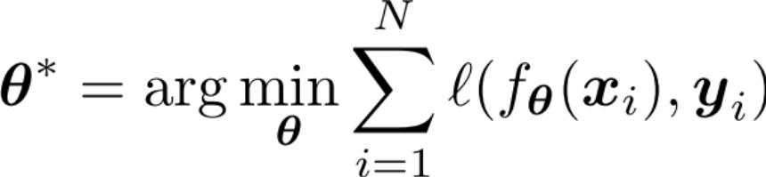


A Recipe for
Machine Learning
Background
Goals for Today’s Lecture
1. Given training data:
3. Define goal:
Explore a new class of decision functions
(Deep Neural Networks)
Consider variants of this recipe for training
2. Choose each of these:
  Decision function
  Loss function
4. Train with SGD:
(take small steps opposite the gradient)

Slide 6
Idea #1: No pre-training
Training
Idea #1: (Just like a shallow network)
  Compute the supervised gradient by backpropagation.
  Take small steps in the direction of the gradient (SGD)

Slide 7
Comparison on MNIST
Training
Results from Bengio et al. (2006) on
MNIST digit classification task
Percent error (lower is better)

Slide 8
Comparison on MNIST
Training
Results from Bengio et al. (2006) on
MNIST digit classification task
Percent error (lower is better)

Slide 9
Idea #1: No pre-training
Training
Idea #1: (Just like a shallow network)
  Compute the supervised gradient by backpropagation.
  Take small steps in the direction of the gradient (SGD)
What goes wrong?
  Gets stuck in local optima
    Nonconvex objective
    Usually start at a random (bad) point in parameter space
  Gradient is progressively getting more dilute
    “Vanishing gradients”

Slide 10
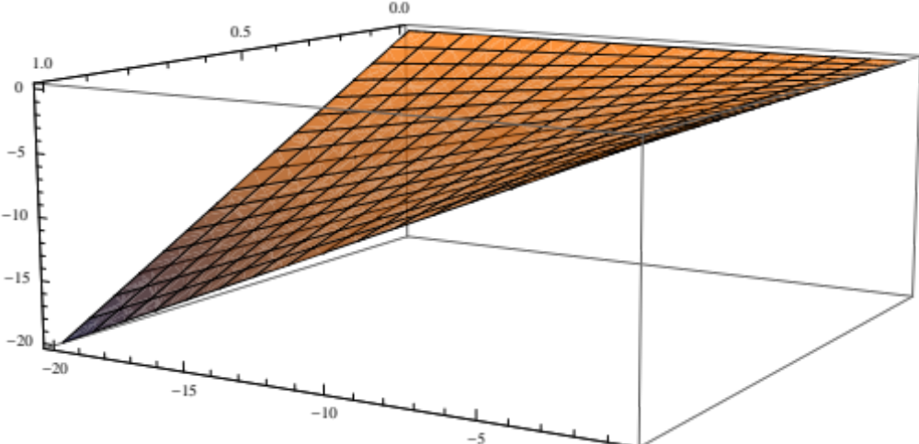
Problem A:
Nonconvexity
Training
Where does the nonconvexity come from?
Even a simple quadratic z = xy objective is nonconvex:
z
y
x

Slide 11
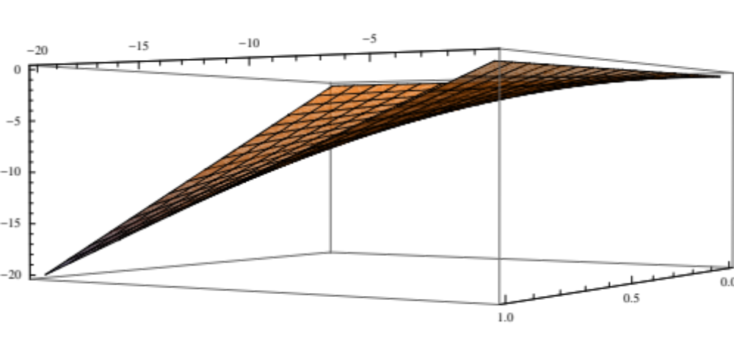
Problem A:
Nonconvexity
Training
Where does the nonconvexity come from?
Even a simple quadratic z = xy objective is nonconvex:
z
y
x

Slide 12
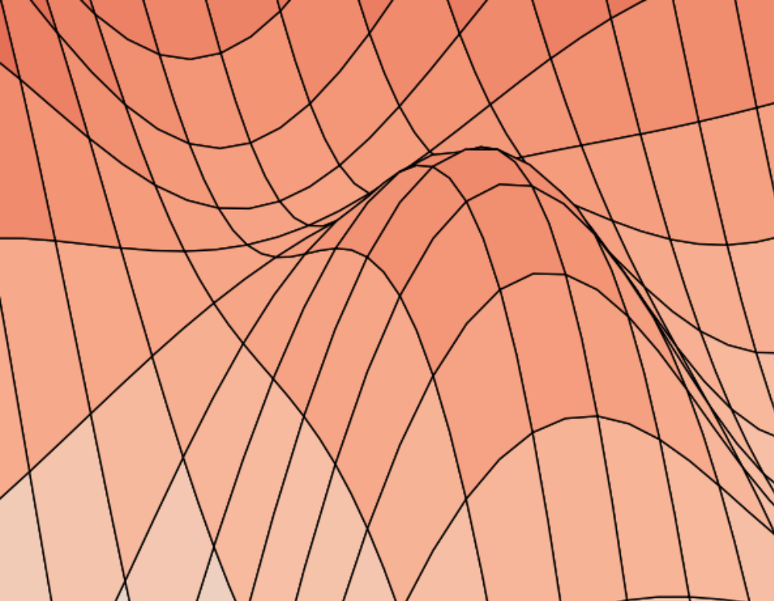
Training
Problem A:
Nonconvexity
Stochastic Gradient
Descent…
…climbs to the top of the nearest hill…

Slide 13
Training
Problem A:
Nonconvexity
Stochastic Gradient
Descent…
…climbs to the top of the nearest hill…

Slide 14
Training
Problem A:
Nonconvexity
Stochastic Gradient
Descent…
…climbs to the top of the nearest hill…

Slide 15
Training
Problem A:
Nonconvexity
Stochastic Gradient
Descent…
…climbs to the top of the nearest hill…

Slide 16
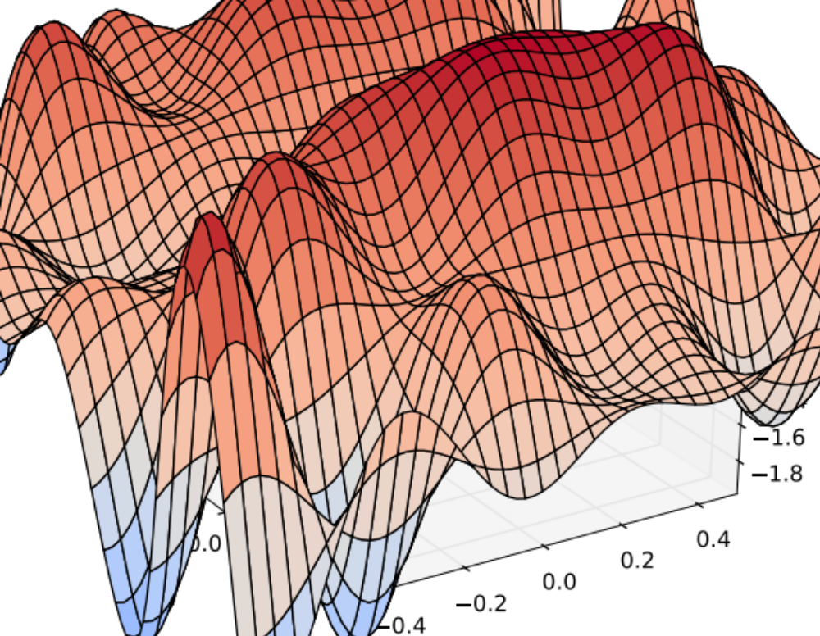
Training
Problem A:
Nonconvexity
Stochastic Gradient
Descent…
…climbs to the top of the nearest hill…
…which might not lead to the top of the mountain
Notes:
TODO: Important note: this surface is a function of the parameters – before we discussed surfaces which were functions of the input.

Slide 17
Problem B:
Vanishing Gradients
Training
The gradient for an edge at the base of the network depends on the gradients of many edges above it
The chain rule multiplies many of these partial derivatives together
Output
y
Hidden Layer
c₁
c₂
…
c_{F}
Hidden Layer
b₁
b₂
…
b_{E}
Hidden Layer
a₁
a₂
…
a_{D}
Input
x₁
x₂
x₃
…
x_{M}
Notes:
TODO: Drop this. Too much detail.
TODO: Show vanishing gradients as less dark over the layers. Suppose WLOG we scale everything such that the gradients are less than one. What happens with backprop?
TODO: Mention the activation function. Relu can already start to solve this problem. Let’s try to solve it another way though.

Slide 18
Problem B:
Vanishing Gradients
Training
The gradient for an edge at the base of the network depends on the gradients of many edges above it
The chain rule multiplies many of these partial derivatives together
Output
y
Hidden Layer
c₁
c₂
…
c_{F}
Hidden Layer
b₁
b₂
…
b_{E}
Hidden Layer
a₁
a₂
…
a_{D}
Input
x₁
x₂
x₃
…
x_{M}
Notes:
TODO: Drop this. Too much detail.
TODO: Show vanishing gradients as less dark over the layers. Suppose WLOG we scale everything such that the gradients are less than one. What happens with backprop?
TODO: Mention the activation function. Relu can already start to solve this problem. Let’s try to solve it another way though.

Slide 19
Problem B:
Vanishing Gradients
Training
The gradient for an edge at the base of the network depends on the gradients of many edges above it
The chain rule multiplies many of these partial derivatives together
Output
y
0.1
Hidden Layer
c₁
c₂
…
c_{F}
0.3
Hidden Layer
b₁
b₂
…
b_{E}
0.2
Hidden Layer
a₁
a₂
…
a_{D}
0.7
Input
x₁
x₂
x₃
…
x_{M}
Notes:
TODO: Drop this. Too much detail.
TODO: Show vanishing gradients as less dark over the layers. Suppose WLOG we scale everything such that the gradients are less than one. What happens with backprop?
TODO: Mention the activation function. Relu can already start to solve this problem. Let’s try to solve it another way though.

Slide 20
Idea #1: No pre-training
Training
Idea #1: (Just like a shallow network)
  Compute the supervised gradient by backpropagation.
  Take small steps in the direction of the gradient (SGD)
What goes wrong?
  Gets stuck in local optima
    Nonconvex objective
    Usually start at a random (bad) point in parameter space
  Gradient is progressively getting more dilute
    “Vanishing gradients”

Slide 21
Idea #2: Supervised
Pre-training
Training
Idea #2: (Two Steps)
  Train each level of the model in a greedy way
  Then use our original idea
Supervised Pre-training
  Use labeled data
  Work bottom-up
    Train hidden layer 1. Then fix its parameters.
    Train hidden layer 2. Then fix its parameters.
    …
    Train hidden layer n. Then fix its parameters.
Supervised Fine-tuning
  Use labeled data to train following “Idea #1”
  Refine the features by backpropagation so that they become tuned to the end-task
Notes:
TODO: doesn’t work → works a little better ; or won’t work when labeled data is limited.

Slide 22
Idea #2: Supervised
Pre-training
Training
Idea #2: (Two Steps)
  Train each level of the model in a greedy way
  Then use our original idea
Output
y
Hidden Layer 1
a₁
a₂
…
a_{D}
Input
x₁
x₂
x₃
…
x_{M}

Slide 23
Idea #2: Supervised
Pre-training
Training
Idea #2: (Two Steps)
  Train each level of the model in a greedy way
  Then use our original idea
Output
y
Hidden Layer 2
b₁
b₂
…
b_{E}
Hidden Layer 1
a₁
a₂
…
a_{D}
Input
x₁
x₂
x₃
…
x_{M}

Slide 24
Idea #2: Supervised
Pre-training
Training
Idea #2: (Two Steps)
  Train each level of the model in a greedy way
  Then use our original idea
Output
y
Hidden Layer 3
c₁
c₂
…
c_{F}
Hidden Layer 2
b₁
b₂
…
b_{E}
Hidden Layer 1
a₁
a₂
…
a_{D}
Input
x₁
x₂
x₃
…
x_{M}

Slide 25
Idea #2: Supervised
Pre-training
Training
Idea #2: (Two Steps)
  Train each level of the model in a greedy way
  Then use our original idea
Output
y
Hidden Layer 3
c₁
c₂
…
c_{F}
Hidden Layer 2
b₁
b₂
…
b_{E}
Hidden Layer 1
a₁
a₂
…
a_{D}
Input
x₁
x₂
x₃
…
x_{M}

Slide 26
Comparison on MNIST
Training
Results from Bengio et al. (2006) on
MNIST digit classification task
Percent error (lower is better)

Slide 27
Comparison on MNIST
Training
Results from Bengio et al. (2006) on
MNIST digit classification task
Percent error (lower is better)

Slide 28
Idea #3: Unsupervised
Pre-training
Training
Idea #3: (Two Steps)
  Use our original idea, but pick a better starting point
  Train each level of the model in a greedy way
Unsupervised Pre-training
  Use unlabeled data
  Work bottom-up
    Train hidden layer 1. Then fix its parameters.
    Train hidden layer 2. Then fix its parameters.
    …
    Train hidden layer n. Then fix its parameters.
Supervised Fine-tuning
  Use labeled data to train following “Idea #1”
  Refine the features by backpropagation so that they become tuned to the end-task

Slide 29
The solution:
Unsupervised pre-training
Unsupervised pre-training of the first layer:
What should it predict?
What else do we observe?
The input!
This topology defines an Auto-encoder.
Output
y
Hidden Layer
a₁
a₂
…
a_{D}
Input
x₁
x₂
x₃
…
x_{M}

Slide 30
The solution:
Unsupervised pre-training
Unsupervised pre-training of the first layer:
What should it predict?
What else do we observe?
The input!
This topology defines an Auto-encoder.
x₁
x₂
x₃
x_{M}
“Input”
’
’
’
…
’
Hidden Layer
a₁
a₂
…
a_{D}
Input
x₁
x₂
x₃
…
x_{M}

Slide 31
Auto-Encoders
Key idea: Encourage z to give small reconstruction error:
  x’ is the reconstruction of x
  Loss = || x – DECODER(ENCODER(x)) ||²
  Train with the same backpropagation algorithm for 2-layer Neural Networks with x_{m} as both input and output.
x₁
x₂
x₃
x_{M}
“Input”
’
’
’
…
’
DECODER: x’ = h(W’z)
Hidden Layer
a₁
a₂
…
a_{D}
ENCODER: z = h(Wx)
Input
x₁
x₂
x₃
…
x_{M}
Slide adapted from Raman Arora

Slide 32
The solution:
Unsupervised pre-training
Unsupervised pre-training
Work bottom-up
  Train hidden layer 1. Then fix its parameters.
  Train hidden layer 2. Then fix its parameters.
  …
  Train hidden layer n. Then fix its parameters.
x₁
x₂
x₃
x_{M}
“Input”
’
’
’
…
’
Hidden Layer
a₁
a₂
…
a_{D}
Input
x₁
x₂
x₃
…
x_{M}

Slide 33
The solution:
Unsupervised pre-training
Unsupervised pre-training
Work bottom-up
  Train hidden layer 1. Then fix its parameters.
  Train hidden layer 2. Then fix its parameters.
  …
  Train hidden layer n. Then fix its parameters.
a₁
a₂
a_{F}
’
’
…
’
Hidden Layer
b₁
b₂
…
b_{F}
Hidden Layer
a₁
a₂
…
a_{D}
Input
x₁
x₂
x₃
…
x_{M}

Slide 34
The solution:
Unsupervised pre-training
b₁
b₂
b_{F}
Unsupervised pre-training
Work bottom-up
  Train hidden layer 1. Then fix its parameters.
  Train hidden layer 2. Then fix its parameters.
  …
  Train hidden layer n. Then fix its parameters.
’
’
…
’
Hidden Layer
c₁
c₂
…
c_{F}
Hidden Layer
b₁
b₂
…
b_{F}
Hidden Layer
a₁
a₂
…
a_{D}
Input
x₁
x₂
x₃
…
x_{M}

Slide 35
The solution:
Unsupervised pre-training
Unsupervised pre-training
Work bottom-up
  Train hidden layer 1. Then fix its parameters.
  Train hidden layer 2. Then fix its parameters.
  …
  Train hidden layer n. Then fix its parameters.
Supervised fine-tuning
Backprop and update all parameters
y
Output
Hidden Layer
c₁
c₂
…
c_{F}
Hidden Layer
b₁
b₂
…
b_{F}
Hidden Layer
a₁
a₂
…
a_{D}
Input
x₁
x₂
x₃
…
x_{M}

Slide 36
Deep Network Training
Idea #1:
  Supervised fine-tuning only
Idea #2:
  Supervised layer-wise pre-training
  Supervised fine-tuning
Idea #3:
  Unsupervised layer-wise pre-training
  Supervised fine-tuning

Slide 37
Comparison on MNIST
Training
Results from Bengio et al. (2006) on
MNIST digit classification task
Percent error (lower is better)

Slide 38
Comparison on MNIST
Training
Results from Bengio et al. (2006) on
MNIST digit classification task
Percent error (lower is better)

Slide 39
Is layer-wise pre-training always necessary?
Training
In 2010, a record on a hand-writing recognition task was set by standard supervised backpropagation (our Idea #1).
How? A very fast implementation on GPUs.
See Ciresen et al. (2010)

Slide 40
Deep Learning
Goal: learn features at different levels of abstraction
Training can be tricky due to…
  Nonconvexity
  Vanishing gradients
Unsupervised layer-wise pre-training can help with both!

