Slide 1
Section 5:
What if even BP is slow?
Computing fewer message updates
Computing them faster

Slide 2
Outline
Do you want to push past the simple NLP models (logistic regression, PCFG, etc.) that we've all been using for 20 years?
Then this tutorial is extremely practical for you!
  Models: Factor graphs can express interactions among linguistic structures.
  Algorithm: BP estimates the global effect of these interactions on each variable, using local computations.
  Intuitions: What’s going on here? Can we trust BP’s estimates?
  Fancier Models: Hide a whole grammar and dynamic programming algorithm within a single factor. BP coordinates multiple factors.
  Tweaked Algorithm: Finish in fewer steps and make the steps faster.
  Learning: Tune the parameters. Approximately improve the true predictions -- or truly improve the approximate predictions.
  Software: Build the model you want!

Slide 3
Outline
Do you want to push past the simple NLP models (logistic regression, PCFG, etc.) that we've all been using for 20 years?
Then this tutorial is extremely practical for you!
  Models: Factor graphs can express interactions among linguistic structures.
  Algorithm: BP estimates the global effect of these interactions on each variable, using local computations.
  Intuitions: What’s going on here? Can we trust BP’s estimates?
  Fancier Models: Hide a whole grammar and dynamic programming algorithm within a single factor. BP coordinates multiple factors.
  Tweaked Algorithm: Finish in fewer steps and make the steps faster.
  Learning: Tune the parameters. Approximately improve the true predictions -- or truly improve the approximate predictions.
  Software: Build the model you want!

Slide 4
Loopy Belief Propagation Algorithm
For every directed edge, initialize its message to the uniform distribution.
Repeat until all normalized beliefs converge:
  Pick a directed edge u → v.
  Update its message: recompute u → v from its “parent” messages v’ → u for v’ ≠ v.
  Or if u has high degree, can share work for speed:
  Compute all outgoing messages u → … at once, based on all incoming messages … → u.

Slide 5
Loopy Belief Propagation Algorithm
For every directed edge, initialize its message to the uniform distribution.
Repeat until all normalized beliefs converge:
  Pick a directed edge u → v.
  Update its message: recompute u → v from its “parent” messages v’ → u for v’ ≠ v.
Which edge do we pick and recompute?
A “stale” edge?

Slide 6
Message Passing in Belief Propagation
v | 1
n | 6
a | 3
My other factors think I’m a noun
…
X
…
Ψ
…
But my other variables and I think you’re a verb
…
v | 6
n | 1
a | 3
6

Slide 7
Stale Messages
We update this message from its antecedents.
Now it’s “fresh.” Don’t need to update it again.
…
X
…
Ψ
antecedents
…
…
7

Slide 8
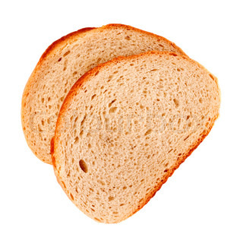
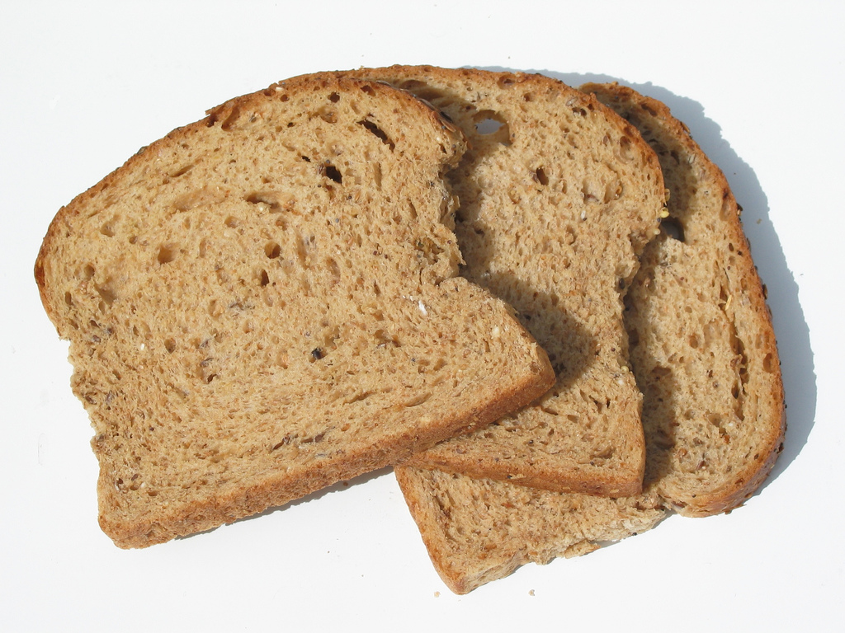
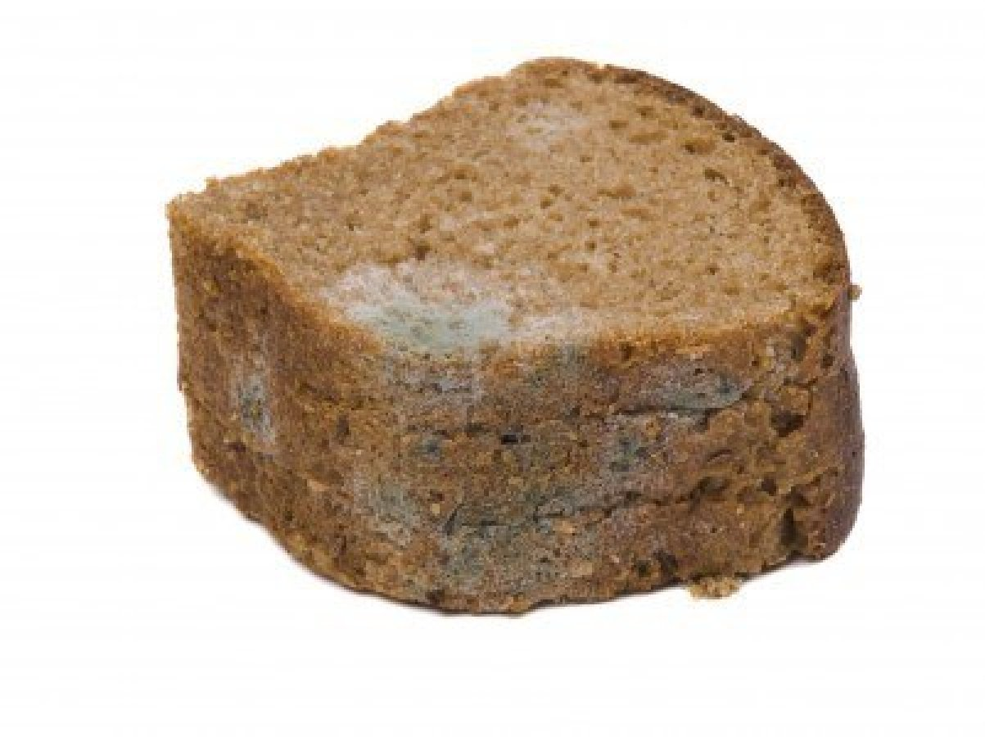
Stale Messages
We update this message from its antecedents.
Now it’s “fresh.” Don’t need to update it again.
…
X
…
Ψ
antecedents
…
But it again becomes “stale” – out of sync with its antecedents – if they change.
Then we do need to revisit.
…
The edge is very stale if its antecedents have changed a lot since its last update. Especially in a way that might make this edge change a lot.
8

Slide 9
Stale Messages
…
…
Ψ
…
…
For a high-degree node that likes to update all its outgoing messages at once …
We say that the whole node is very stale if its incoming messages have changed a lot.
9

Slide 10
Stale Messages
…
…
Ψ
…
…
For a high-degree node that likes to update all its outgoing messages at once …
We say that the whole node is very stale if its incoming messages have changed a lot.
10

Slide 11
Maintain an Queue of Stale Messages to Update
Initially all messages are uniform.
Messages from factors are stale.
Messages from variables
are actually fresh (in sync
with their uniform antecedents).
X₈
X₇
X₉
X₆
X₁
X₂
X₃
X₄
X₅
time
flies
like
an
arrow

Slide 12
Maintain an Queue of Stale Messages to Update
X₈
X₇
X₉
X₆
X₁
X₂
X₃
X₄
X₅
time
flies
like
an
arrow

Slide 13
Maintain an Queue of Stale Messages to Update
X₈
X₇
X₉
X₆
X₁
X₂
X₃
X₄
X₅
time
flies
like
an
arrow

Slide 14
Maintain an Queue of Stale Messages to Update
a priority queue! (heap)
Residual BP: Always update the message that is most stale (would be most changed by an update).
Maintain a priority queue of stale edges (& perhaps variables).
  Each step of residual BP: “Pop and update.”
  Prioritize by degree of staleness.
  When something becomes stale, put it on the queue.
  If it becomes staler, move it earlier on the queue.
  Need a measure of staleness.
So, process biggest updates first.
Dramatically improves speed of convergence.
  And chance of converging at all. ☺
(Elidan et al., 2006)

Slide 15
But what about the topology?
In a graph with no cycles:
Send messages from the leaves to the root.
Send messages from the root to the leaves.
Each outgoing message is sent only after all its incoming messages have been received.
X₈
X₇
X₉
X₆
X₁
X₂
X₃
X₄
X₅
time
flies
like
an
15
arrow

Slide 16
A bad update order for residual BP!
X₀
X₁
X₂
X₃
X₄
X₅
<START>
time
flies
like
an
arrow

Slide 17
Try updating an entire acyclic subgraph
X₈
X₇
X₉
X₆
X₁
X₂
X₃
X₄
X₅
time
flies
like
an
arrow
17
Tree-based Reparameterization (Wainwright et al. 2001); also see Residual Splash

Slide 18
Try updating an entire acyclic subgraph
Pick this subgraph;
update leaves to root,
then root to leaves
X₈
X₇
X₉
X₆
X₁
X₂
X₃
X₄
X₅
time
flies
like
an
arrow
18
Tree-based Reparameterization (Wainwright et al. 2001); also see Residual Splash

Slide 19
Try updating an entire acyclic subgraph
Another subgraph;
update leaves to root,
then root to leaves
X₈
X₇
X₉
X₆
X₁
X₂
X₃
X₄
X₅
time
flies
like
an
arrow
19
Tree-based Reparameterization (Wainwright et al. 2001); also see Residual Splash

Slide 20
Try updating an entire acyclic subgraph
Another subgraph;
update leaves to root,
then root to leaves
X₈
X₇
X₉
X₆
X₁
X₂
X₃
X₄
X₅
time
flies
like
an
arrow
At every step, pick a spanning
tree (or spanning forest)
that covers many stale edges
As we update messages in the tree, it affects staleness of messages outside the tree
20
Tree-based Reparameterization (Wainwright et al. 2001); also see Residual Splash

Slide 21
Acyclic Belief Propagation
In a graph with no cycles:
Send messages from the leaves to the root.
Send messages from the root to the leaves.
Each outgoing message is sent only after all its incoming messages have been received.
X₈
X₇
X₉
X₆
X₁
X₂
X₃
X₄
X₅
time
flies
like
an
arrow
21

Slide 22
Summary of Update Ordering
In what order do we send messages for Loopy BP?
Asynchronous
  Pick a directed edge: update its message
  Or, pick a vertex: update all its outgoing messages at once
Wait for your antecedents
Don’t update a message if its antecedents will get a big update.
Otherwise, will have to re-update.
X₈
Size. Send big updates first.
  Forces other messages to wait for them.
Topology. Use graph structure.
  E.g., in an acyclic graph, a message can wait for all updates before sending.
X₇
X₉
X₆
X₁
X₂
X₃
X₄
X₅
time
flies
like
an
arrow
22

Slide 23
Message Scheduling
The order in which messages are sent has a significant effect on convergence
Synchronous (bad idea)
  Compute all the messages
  Send all the messages
Asynchronous
  Pick an edge: compute and send that message
Tree-based Reparameterization
  Successively update embedded spanning trees
  Choose spanning trees such that each edge is included in at least one
Residual BP
  Pick the edge whose message would change the most if sent: compute and send that message
Figure from (Elidan, McGraw, & Koller, 2006)

Slide 24
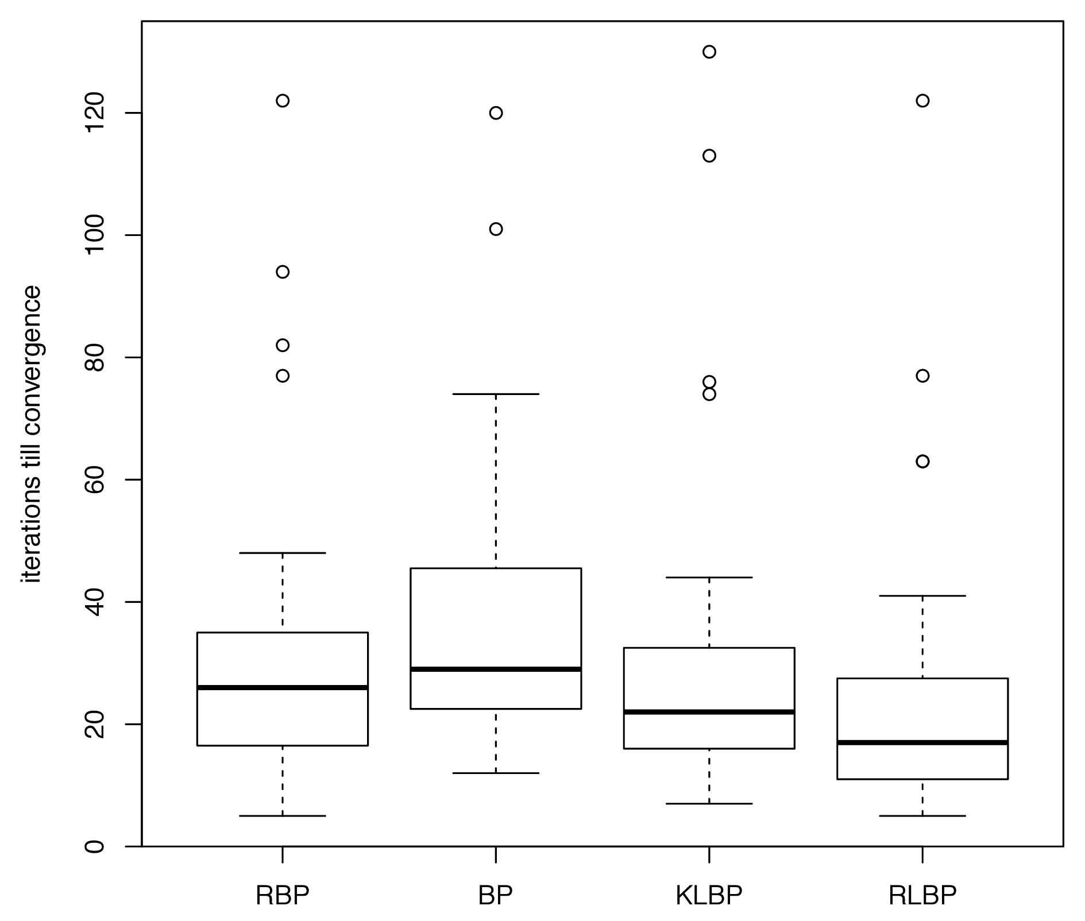
Message Scheduling
Even better dynamic scheduling may be possible by reinforcement learning of a problem-specific heuristic for choosing which edge to update next.
(Jiang, Moon, Daumé III, & Eisner, 2013)

Slide 25
Section 5:
What if even BP is slow?
Computing fewer message updates
Computing them faster
A variable has k possible values.
What if k is large or infinite?
25

Slide 26
Computing Variable Beliefs
Suppose…
  X_{i} is a discrete variable
  Each incoming messages is a Multinomial
Pointwise product is easy when the variable’s domain is small and discrete
ring | 1
rang | 2
rung | 2
ring | 0.1
rang | 3
rung | 1
ring | 4
rang | 1
rung | 0
X
ring | .4
rang | 6
rung | 0

Slide 27
Computing Variable Beliefs
Suppose…
  X_{i} is a real-valued variable
  Each incoming message is a Gaussian
The pointwise product of n Gaussians is…
…a Gaussian!
X

Slide 28
Computing Variable Beliefs
Suppose…
  X_{i} is a real-valued variable
  Each incoming messages is a mixture of k Gaussians
The pointwise product explodes!
X
p(x) = p₁(x) p₂(x)…p_{n}(x)
( 0.3 q_{1,1}(x)
+ 0.7 q_{1,2}(x))
( 0.5 q_{2,1}(x)
+ 0.5 q_{2,2}(x))

Slide 29
Computing Variable Beliefs
Suppose…
  X_{i} is a string-valued variable (i.e. its domain is the set of all strings)
  Each incoming messages is a FSA
The pointwise product explodes!
X

Slide 30
Example: String-valued Variables
a
X₁
a
a
a
a
ε
ψ₁
ψ₂
a
X₂
a
a
Messages can grow larger when sent through a transducer factor
Repeatedly sending messages through a transducer can cause them to grow to unbounded size!
(Dreyer & Eisner, 2009)

Slide 31
Example: String-valued Variables
a
a
X₁
a
a
a
a
ε
ψ₁
ψ₂
a
X₂
a
a
Messages can grow larger when sent through a transducer factor
Repeatedly sending messages through a transducer can cause them to grow to unbounded size!
(Dreyer & Eisner, 2009)

Slide 32
Example: String-valued Variables
a
a
X₁
a
a
a
a
ε
ψ₁
ψ₂
a
X₂
a
a
a
Messages can grow larger when sent through a transducer factor
Repeatedly sending messages through a transducer can cause them to grow to unbounded size!
(Dreyer & Eisner, 2009)

Slide 33
Example: String-valued Variables
a
a
a
X₁
a
a
a
a
ε
ψ₁
ψ₂
a
X₂
a
a
a
Messages can grow larger when sent through a transducer factor
Repeatedly sending messages through a transducer can cause them to grow to unbounded size!
(Dreyer & Eisner, 2009)

Slide 34
Example: String-valued Variables
a
a
a
a
a
a
a
a
a
a
a
a
a
X₁
a
a
a
a
ε
ψ₁
ψ₂
a
X₂
a
a
Messages can grow larger when sent through a transducer factor
Repeatedly sending messages through a transducer can cause them to grow to unbounded size!
(Dreyer & Eisner, 2009)

Slide 35
Example: String-valued Variables
a
a
a
a
a
a
a
a
a
a
a
a
a
The domain of these variables is infinite (i.e. Σ*);
WSFA’s representation is finite – but the size of the representation can grow
In cases where the domain of each variable is small and finite this is not an issue
X₁
a
a
a
a
ε
ψ₁
ψ₂
a
X₂
a
a
Messages can grow larger when sent through a transducer factor
Repeatedly sending messages through a transducer can cause them to grow to unbounded size!
(Dreyer & Eisner, 2009)

Slide 36
Message Approximations
Three approaches to dealing with complex messages:
  Particle Belief Propagation (see Section 3)
  Message pruning
  Expectation propagation

Slide 37
Message Pruning
Problem: Product of d messages = complex distribution.
  Solution: Approximate with a simpler distribution.
  For speed, compute approximation without computing full product.
For real variables, try a mixture of K Gaussians:
  E.g., true product is a mixture of K^{d} Gaussians
    Prune back: Randomly keep just K of them
    Chosen in proportion to weight in full mixture
    Gibbs sampling to efficiently choose them
  What if incoming messages are not Gaussian mixtures?
    Could be anything sent by the factors …
    Can extend technique to this case.
X
(Sudderth et al., 2002 –“Nonparametric BP”)

Slide 38
Message Pruning
Problem: Product of d messages = complex distribution.
  Solution: Approximate with a simpler distribution.
  For speed, compute approximation without computing full product.
For string variables, use a small finite set:
  Each message µ_{i} gives positive probability to …
    … every word in a 50,000 word vocabulary
    … every string in ∑* (using a weighted FSA)
  Prune back to a list L of a few “good” strings
    Each message adds its own K best strings to L
    For each x ∈ L, let µ(x) = ∏_{i} µ_{i}(x) – each message scores x
    For each x ∉ L, let µ(x) = 0
X
(Dreyer & Eisner, 2009)
38

Slide 39
Expectation Propagation (EP)
Problem: Product of d messages = complex distribution.
  Solution: Approximate with a simpler distribution.
  For speed, compute approximation without computing full product.
EP provides four special advantages over pruning:
General recipe that can be used in many settings.
Efficient. Uses approximations that are very fast.
Conservative. Unlike pruning, never forces b(x) to 0.
  Never kills off a value x that had been possible.
Adaptive. Approximates µ(x) more carefully
if x is favored by the other messages.
  Tries to be accurate on the most “plausible” values.
(Minka, 2001; Heskes & Zoeter, 2002)
39

Slide 40

Expectation Propagation (EP)
Belief at X₃
will be simple!
Messages to and from X₃ will be simple!
X₇
exponential-family
approximations inside
X₃
X₁
X₄
X₂
X₅

Slide 41
Expectation Propagation (EP)
Key idea: Approximate variable X’s incoming messages µ.
We force them to have a simple parametric form:
µ(x) = exp (θ ∙ f(x)) “log-linear model” (unnormalized)
where f(x) extracts a feature vector from the value x.
For each variable X, we’ll choose a feature function f.
Maybe unnormalizable, e.g., initial message θ=0
is uniform “distribution”
So by storing a few parameters θ, we’ve defined µ(x) for all x.
Now the messages are super-easy to multiply:
µ₁(x) µ₂(x) = exp (θ ∙ f(x)) exp (θ ∙ f(x)) = exp ((θ₁+θ₂) ∙ f(x))
Represent a message by its parameter vector θ.
To multiply messages, just add their θ vectors!
So beliefs and outgoing messages also have this simple form.
41

Slide 42
Expectation Propagation
Form of messages/beliefs at X₃?
  Always µ(x) = exp (θ ∙ f(x))
If x is real:
  Gaussian: Take f(x) = (x,x²)
If x is string:
  Globally normalized trigram model: Take f(x) = (count of aaa, count of aab, … count of zzz)
If x is discrete:
  Arbitrary discrete distribution
  (can exactly represent original message, so we get ordinary BP)
  Coarsened discrete distribution, based on features of x
Can’t use mixture models, or other models that use latent variables
to define µ(x) = ∑_{y} p(x, y)
X₇
exponential-family
approximations inside
X₃
X₁
X₄
X₂
X₅

Slide 43
Expectation Propagation
Each message to X₃ is
µ(x) = exp (θ ∙ f(x))
for some θ. We only store θ.
To take a product of such messages, just add their θ
  Easily compute belief at X₃ (sum of incoming θ vectors)
  Then easily compute each outgoing message
  (belief minus one incoming θ)
All very easy …
X₇
exponential-family
approximations inside
X₃
X₁
X₄
X₂
X₅

Slide 44
Expectation Propagation
But what about messages from factors?
  Like the message M₄.
  This is not exponential family! Uh-oh!
  It’s just whatever the factor happens to send.
This is where we need to approximate, by µ₄ .
X₇
X₃
µ₄
X₁
M₄
X₄
X₂
X₅

Slide 45
Expectation Propagation
blue = arbitrary distribution,
green = simple distribution exp (θ ∙ f(x))
The belief at x “should” be
p(x) = µ₁(x) ∙ µ₂(x) ∙ µ₃ (x) ∙ M₄(x)
But we’ll be using
b(x) = µ₁(x) ∙ µ₂(x) ∙ µ₃ (x) ∙ µ₄(x)
Choose the simple distribution b that minimizes KL(p || b).
Then, work backward from belief b to message µ₄.
  Take θ vector of b and subtract
  off the θ vectors of µ₁, µ₂, µ₃.
Chooses µ₄ to preserve belief well.
X₇
µ₁
X₃
µ₂
µ₄
X₁
M₄
µ₃
X₄
That is, choose b that assigns high probability to samples from p.
X₂
Find b’s params θ in closed
form – or follow gradient:
E_{x~p}[f(x)] – E_{x~b}[f(x)]
X₅
Notes:
Cares more about x if p(x) is large.
So takes µ1, µ2, µ3 into account.

Slide 46



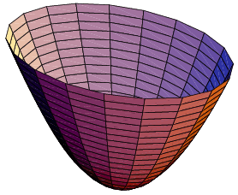
ML Estimation = Moment Matching
fo = 3
foo = 1
fo | 2.6
foo | -0.5
bar | 1.2
az | 3.1
xy | -6.0
bar = 2
az = 4
Broadcast n-gram counts
Fit model that predicts same counts

Slide 47
FSA Approx. = Moment Matching
fo = 3.1
foo = 0.9
fo | 2.6
foo | -0.5
bar | 1.2
az | 3.1
xy | -6.0
s
a
e
h
bar = 2.2
s
r
a
i
n
h
g
e
r
i
u
n
g
zz= 0.1
e
ε
az = 4.1
e
u
ε
xx = 0.1
A distribution over strings
Fit model that predicts same fractional counts
(can compute with forward-backward)
Notes:
ADD MORE NUMBERS (one or two with very small counts)

Slide 48
FSA Approx. = Moment Matching
min_{θ}
KL( || )
s
a
e
h
fo
bar
az
r
i
n
g
θ
e
u
ε
Finds parameters θ that minimize KL “error” in belief

Slide 49
How to approximate a message?
fo
bar
az
?
fo | 0.6
bar | 0.6
az | -1.0
θ
s
a
e
h
KL( || )
i
n
g
u
ε
s
a
e
h
fo | 2.0
bar | -1.0
az | 3.0
r
i
n
g
e
u
ε
fo | 1.2
bar | 0.5
az | 4.3
fo | 0.2
bar | 1.1
az | -0.3
fo | 1.2
bar | 0.5
az | 4.3
fo | 0.2
bar | 1.1
az | -0.3
=
a
=
a
s
e
h
s
e
h
i
n
g
i
n
g
u
u
ε
ε
Wisely, KL doesn’t insist on good approximations for values that are low-probability in the belief
Finds message parameters θ that minimize KL “error”
of resulting belief

Slide 50

Analogy: Scheduling by approximate email messages
“I prefer Tue/Thu, and I’m away the last week of July.”
Tue | 1.0
Thu | 1.0
last | -3.0
KL( || )
(This is an approximation to my true schedule. I’m not actually free on all Tue/Thu, but the bad Tue/Thu dates have already been ruled out by messages from other folks.)
Wisely, KL doesn’t insist on good approximations for values that are low-probability in the belief

Slide 51
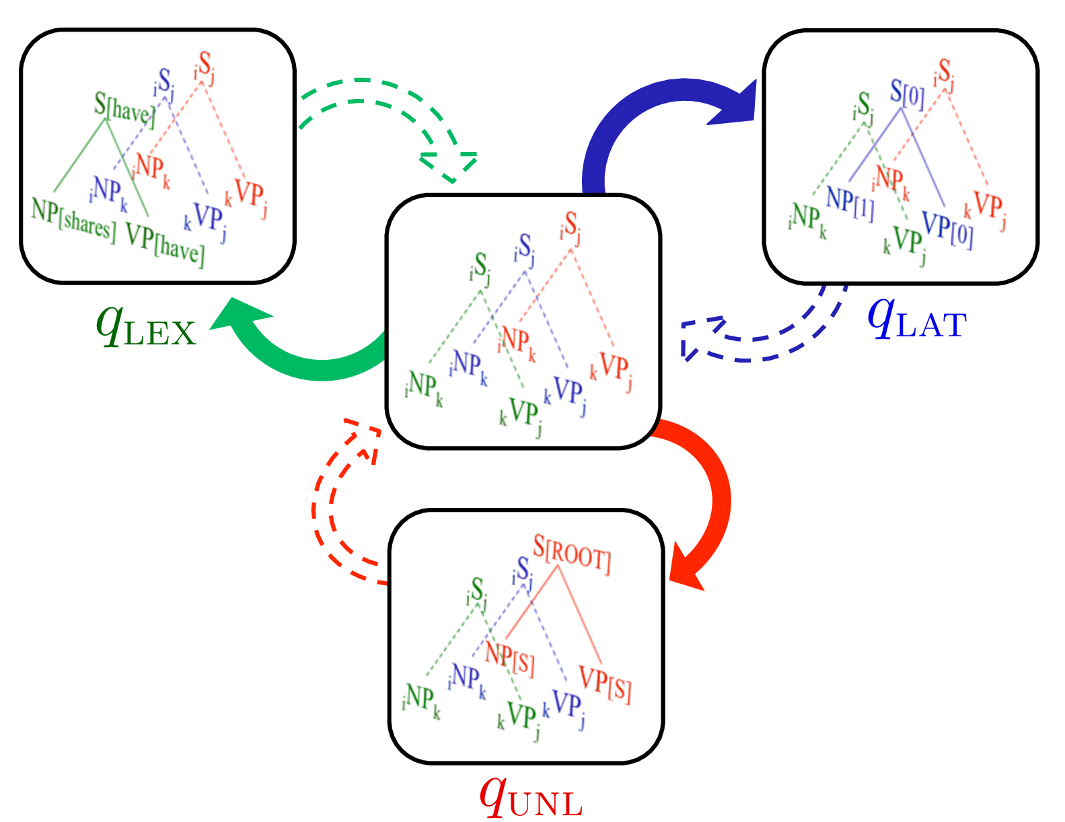
Expectation Propagation
Example: Factored PCFGs
Task: Constituency parsing, with factored annotations
  Lexical annotations
  Parent annotations
  Latent annotations
Approach:
  Sentence specific approximation is an anchored grammar:
  q(A → B C, i, j, k)
  Sending messages is equivalent to marginalizing out the annotations
adaptive
approximation
(Hall & Klein, 2012)
51

