Slide 1
Structured Belief Propagation for NLP
Matthew R. Gormley & Jason Eisner
ACL ‘15 Tutorial
July 26, 2015
For the latest version of these slides, please visit:
http://www.cs.jhu.edu/~mrg/bp-tutorial/
Notes:
We’re going to talk about how to work with complicated graphical models.
Models that make you feel like a linguist.

Slide 2
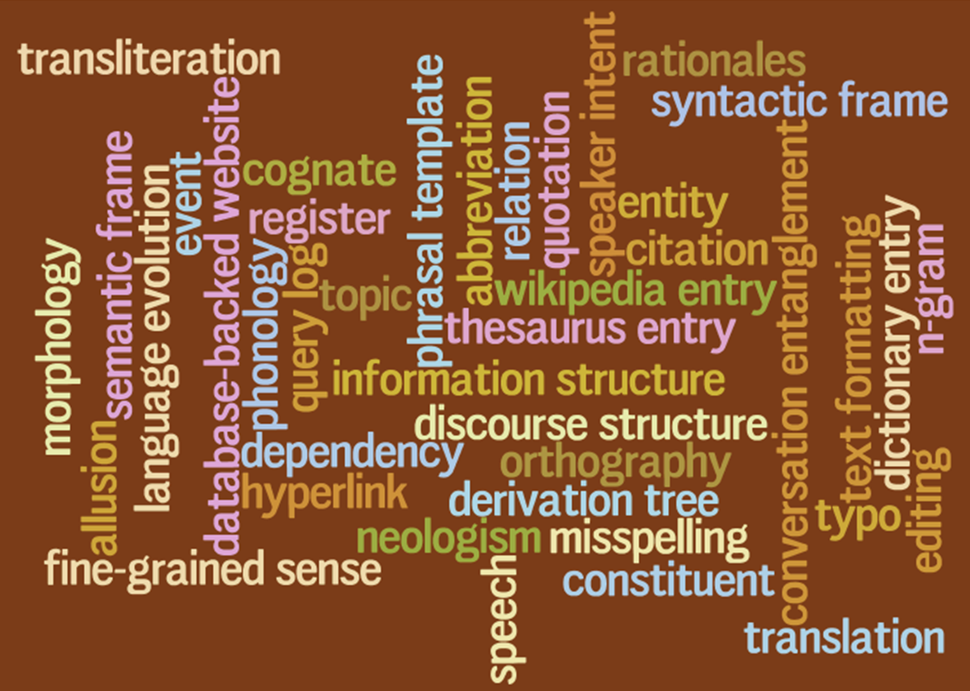
Language has a lot going on at once
Structured representations of utterances
Structured knowledge of the language
Many interacting parts
for BP to reason about!
Notes:
There’s a lot going on in language. So you may want to put a lot into your NLP model. What’s really going on in an utterance includes morphology, syntax and semantics. Above that, pragmatics and discourse. Below that, phonology and phonetics; or if you’re working on text, orthography and typos. And that’s just one utterance. All the utterances of a language are tied together because they share lexicon entries and grammar rules and continuous parameters. Which you might not observe. So to make good guesses about what’s really going on, you might need to include a lot of latent variables in your graphical model. Linguistic variables. Do you believe good NLP demands feature engineering? With more latent variables, you can design smarter features. The feature weights model interactions among these variables. Linguistic interactions. BP is a basic algorithm for reasoning about lots of interactions at once.

Slide 3
Outline
Do you want to push past the simple NLP models (logistic regression, PCFG, etc.) that we've all been using for 20 years?
Then this tutorial is extremely practical for you!
  Models: Factor graphs can express interactions among linguistic structures.
  Algorithm: BP estimates the global effect of these interactions on each variable, using local computations.
  Intuitions: What’s going on here? Can we trust BP’s estimates?
  Fancier Models: Hide a whole grammar and dynamic programming algorithm within a single factor. BP coordinates multiple factors.
  Tweaked Algorithm: Finish in fewer steps and make the steps faster.
  Learning: Tune the parameters. Approximately improve the true predictions -- or truly improve the approximate predictions.
  Software: Build the model you want!
Notes:
Our formalism will be factor graphs. That’s a very general graphical model formalism. I’ll define them and lay out the BP algorithm. Then Matt will give you intuitions about what BP is doing. That’s the first half. The second half is more advanced. In NLP, our representations may involve data structures like trees and strings. How do we set up those factor graphs, and can we make BP work on them? Finally, BP is just an approximation, so can we train discriminatively to make the best of it?

Slide 4
Outline
Do you want to push past the simple NLP models (logistic regression, PCFG, etc.) that we've all been using for 20 years?
Then this tutorial is extremely practical for you!
  Models: Factor graphs can express interactions among linguistic structures.
  Algorithm: BP estimates the global effect of these interactions on each variable, using local computations.
  Intuitions: What’s going on here? Can we trust BP’s estimates?
  Fancier Models: Hide a whole grammar and dynamic programming algorithm within a single factor. BP coordinates multiple factors.
  Tweaked Algorithm: Finish in fewer steps and make the steps faster.
  Learning: Tune the parameters. Approximately improve the true predictions -- or truly improve the approximate predictions.
  Software: Build the model you want!
Notes:
Our formalism will be factor graphs. That’s a very general graphical model formalism. I’ll define them and lay out the BP algorithm. Then Matt will give you intuitions about what BP is doing. That’s the first half. The second half is more advanced. In NLP, our representations may involve data structures like trees and strings. How do we set up those factor graphs, and can we make BP work on them? Finally, BP is just an approximation, so can we train discriminatively to make the best of it?

Slide 5
Outline
Do you want to push past the simple NLP models (logistic regression, PCFG, etc.) that we've all been using for 20 years?
Then this tutorial is extremely practical for you!
  Models: Factor graphs can express interactions among linguistic structures.
  Algorithm: BP estimates the global effect of these interactions on each variable, using local computations.
  Intuitions: What’s going on here? Can we trust BP’s estimates?
  Fancier Models: Hide a whole grammar and dynamic programming algorithm within a single factor. BP coordinates multiple factors.
  Tweaked Algorithm: Finish in fewer steps and make the steps faster.
  Learning: Tune the parameters. Approximately improve the true predictions -- or truly improve the approximate predictions.
  Software: Build the model you want!
Notes:
Our formalism will be factor graphs. That’s a very general graphical model formalism. I’ll define them and lay out the BP algorithm. Then Matt will give you intuitions about what BP is doing. That’s the first half. The second half is more advanced. In NLP, our representations may involve data structures like trees and strings. How do we set up those factor graphs, and can we make BP work on them? Finally, BP is just an approximation, so can we train discriminatively to make the best of it?

Slide 6
Outline
Do you want to push past the simple NLP models (logistic regression, PCFG, etc.) that we've all been using for 20 years?
Then this tutorial is extremely practical for you!
  Models: Factor graphs can express interactions among linguistic structures.
  Algorithm: BP estimates the global effect of these interactions on each variable, using local computations.
  Intuitions: What’s going on here? Can we trust BP’s estimates?
  Fancier Models: Hide a whole grammar and dynamic programming algorithm within a single factor. BP coordinates multiple factors.
  Tweaked Algorithm: Finish in fewer steps and make the steps faster.
  Learning: Tune the parameters. Approximately improve the true predictions -- or truly improve the approximate predictions.
  Software: Build the model you want!
Notes:
Our formalism will be factor graphs. That’s a very general graphical model formalism. I’ll define them and lay out the BP algorithm. Then Matt will give you intuitions about what BP is doing. That’s the first half. The second half is more advanced. In NLP, our representations may involve data structures like trees and strings. How do we set up those factor graphs, and can we make BP work on them? Finally, BP is just an approximation, so can we train discriminatively to make the best of it?

Slide 7
Outline
Do you want to push past the simple NLP models (logistic regression, PCFG, etc.) that we've all been using for 20 years?
Then this tutorial is extremely practical for you!
  Models: Factor graphs can express interactions among linguistic structures.
  Algorithm: BP estimates the global effect of these interactions on each variable, using local computations.
  Intuitions: What’s going on here? Can we trust BP’s estimates?
  Fancier Models: Hide a whole grammar and dynamic programming algorithm within a single factor. BP coordinates multiple factors.
  Tweaked Algorithm: Finish in fewer steps and make the steps faster.
  Learning: Tune the parameters. Approximately improve the true predictions -- or truly improve the approximate predictions.
  Software: Build the model you want!
Notes:
Our formalism will be factor graphs. That’s a very general graphical model formalism. I’ll define them and lay out the BP algorithm. Then Matt will give you intuitions about what BP is doing. That’s the first half. The second half is more advanced. In NLP, our representations may involve data structures like trees and strings. How do we set up those factor graphs, and can we make BP work on them? Finally, BP is just an approximation, so can we train discriminatively to make the best of it?

Slide 8
Outline
Do you want to push past the simple NLP models (logistic regression, PCFG, etc.) that we've all been using for 20 years?
Then this tutorial is extremely practical for you!
  Models: Factor graphs can express interactions among linguistic structures.
  Algorithm: BP estimates the global effect of these interactions on each variable, using local computations.
  Intuitions: What’s going on here? Can we trust BP’s estimates?
  Fancier Models: Hide a whole grammar and dynamic programming algorithm within a single factor. BP coordinates multiple factors.
  Tweaked Algorithm: Finish in fewer steps and make the steps faster.
  Learning: Tune the parameters. Approximately improve the true predictions -- or truly improve the approximate predictions.
  Software: Build the model you want!
Notes:
Our formalism will be factor graphs. That’s a very general graphical model formalism. I’ll define them and lay out the BP algorithm. Then Matt will give you intuitions about what BP is doing. That’s the first half. The second half is more advanced. In NLP, our representations may involve data structures like trees and strings. How do we set up those factor graphs, and can we make BP work on them? Finally, BP is just an approximation, so can we train discriminatively to make the best of it?

Slide 9
Outline
Do you want to push past the simple NLP models (logistic regression, PCFG, etc.) that we've all been using for 20 years?
Then this tutorial is extremely practical for you!
  Models: Factor graphs can express interactions among linguistic structures.
  Algorithm: BP estimates the global effect of these interactions on each variable, using local computations.
  Intuitions: What’s going on here? Can we trust BP’s estimates?
  Fancier Models: Hide a whole grammar and dynamic programming algorithm within a single factor. BP coordinates multiple factors.
  Tweaked Algorithm: Finish in fewer steps and make the steps faster.
  Learning: Tune the parameters. Approximately improve the true predictions -- or truly improve the approximate predictions.
  Software: Build the model you want!
Notes:
Our formalism will be factor graphs. That’s a very general graphical model formalism. I’ll define them and lay out the BP algorithm. Then Matt will give you intuitions about what BP is doing. That’s the first half. The second half is more advanced. In NLP, our representations may involve data structures like trees and strings. How do we set up those factor graphs, and can we make BP work on them? Finally, BP is just an approximation, so can we train discriminatively to make the best of it?

Slide 10
Outline
Do you want to push past the simple NLP models (logistic regression, PCFG, etc.) that we've all been using for 20 years?
Then this tutorial is extremely practical for you!
  Models: Factor graphs can express interactions among linguistic structures.
  Algorithm: BP estimates the global effect of these interactions on each variable, using local computations.
  Intuitions: What’s going on here? Can we trust BP’s estimates?
  Fancier Models: Hide a whole grammar and dynamic programming algorithm within a single factor. BP coordinates multiple factors.
  Tweaked Algorithm: Finish in fewer steps and make the steps faster.
  Learning: Tune the parameters. Approximately improve the true predictions -- or truly improve the approximate predictions.
  Software: Build the model you want!
Notes:
Our formalism will be factor graphs. That’s a very general graphical model formalism. I’ll define them and lay out the BP algorithm. Then Matt will give you intuitions about what BP is doing. That’s the first half. The second half is more advanced. In NLP, our representations may involve data structures like trees and strings. How do we set up those factor graphs, and can we make BP work on them? Finally, BP is just an approximation, so can we train discriminatively to make the best of it?

Slide 11
Section 1:
Introduction
Modeling with Factor Graphs

Slide 12
Sampling from a Joint Distribution
A joint distribution defines a probability p(x) for each assignment of values x to variables X.
This gives the proportion of samples that will equal x.
Sample 1:
n
v
p
d
n
Sample 2:
n
n
v
d
n
Sample 3:
n
v
p
d
n
Sample 4:
v
n
p
d
n
Sample 5:
v
n
v
d
n
Sample 6:
n
v
p
d
n
X₀
ψ₀
X₁
ψ₂
X₂
ψ₄
X₃
ψ₆
X₄
ψ₈
X₅
<START>
ψ₁
ψ₃
ψ₅
ψ₇
ψ₉
time
flies
like
an
arrow
Notes:
Here’s a sentence. It’s ambiguous, so I don’t know what the POS sequence is. But I have a probability distribution here in my pocket. Let’s pull a sample x out of that distribution … and another … 3rd is the same as the 1st … So far, it looks like the third tag, x₃, is most likely to be a preposition. And if we keep taking samples, we see that that is indeed a property of my distribution (as currently trained). In fact, there are T*T*T*T*T possible sequences, but we don’t have to see all of them to spot the pattern.

Slide 13
Sampling from a Joint Distribution
A joint distribution defines a probability p(x) for each assignment of values x to variables X.
This gives the proportion of samples that will equal x.
Sample 1:
Sample 2:
ψ₁₁
ψ₁₁
ψ₁₂
ψ₁₀
ψ₁₂
ψ₁₀
ψ₂
ψ₄
ψ₆
ψ₂
ψ₄
ψ₆
ψ₈
ψ₈
ψ₅
Sample 4:
ψ₁
Sample 3:
ψ₅
ψ₁
ψ₇
ψ₇
ψ₃
ψ₁₁
ψ₉
ψ₃
ψ₁₁
ψ₉
ψ₁₂
ψ₁₂
ψ₁₀
ψ₄
ψ₆
ψ₁₀
ψ₄
ψ₆
ψ₂
ψ₅
ψ₈
ψ₂
ψ₅
ψ₈
ψ₁
ψ₁
ψ₇
ψ₇
ψ₃
ψ₉
ψ₃
ψ₉
X₇
X₆
ψ₁₁
X₃
X₁
ψ₁₂
ψ₁₀
ψ₂
ψ₄
ψ₆
X₄
X₂
ψ₅
ψ₈
X₅
ψ₁
ψ₇
ψ₃
ψ₉
Notes:
Here’s a more complicated graphical model.
The white circles are still variables.
And each sample is a way of filling in those circles by assigning values (colors) to those variables.

Slide 14
Sampling from a Joint Distribution
A joint distribution defines a probability p(x) for each assignment of values x to variables X.
This gives the proportion of samples that will equal x.
n
v
p
d
n
Sample 1:
time
flies
like
an
arrow
n
n
v
d
n
Sample 2:
time
flies
like
an
arrow
n
v
p
n
n
Sample 3:
flies
fly
with
their
wings
p
n
n
v
v
Sample 4:
with
time
you
will
see
X₀
ψ₀
X₁
ψ₂
X₂
ψ₄
X₃
ψ₆
X₄
ψ₈
X₅
<START>
ψ₁
ψ₃
ψ₅
ψ₇
ψ₉
W₁
W₂
W₃
W₄
W₅
Notes:
Why would you want a model that’s not a linear chain?
Well, here’s an example.
Here I’ll generate tagged sentences.
When I pull a sample out of my pocket, sometimes it’s a tagging of “Time flies like an arrow” … but sometimes it’s a tagging of some other sentence.
Some sentences are more likely than others, and we are using POS tags to help model which sentences are likely.
The bigram “an arrow” is likely not because there’s a bigram parameter for it – there isn’t – but because the model captures something more general: determiners like to be followed by nouns.

Slide 15
Factors have local opinions (≥ 0)
Each black box looks at some of the tags X_{i} and words W_{i}
Note: We chose to reuse the same factors at different positions in the sentence.
 | v | n | p | d
v | 1 | 6 | 3 | 4
n | 8 | 4 | 2 | 0.1
p | 1 | 3 | 1 | 3
d | 0.1 | 8 | 0 | 0
 | v | n | p | d
v | 1 | 6 | 3 | 4
n | 8 | 4 | 2 | 0.1
p | 1 | 3 | 1 | 3
d | 0.1 | 8 | 0 | 0
X₀
ψ₀
X₁
ψ₂
X₂
ψ₄
X₃
ψ₆
X₄
ψ₈
X₅
<START>
ψ₁
ψ₃
ψ₅
ψ₇
ψ₉
 | time | flies | like | …
v | 3 | 5 | 3
n | 4 | 5 | 2
p | 0.1 | 0.1 | 3
d | 0.1 | 0.2 | 0.1
 | time | flies | like | …
v | 3 | 5 | 3
n | 4 | 5 | 2
p | 0.1 | 0.1 | 3
d | 0.1 | 0.2 | 0.1
W₁
W₂
W₃
W₄
W₅
Notes:
So what are these black boxes that connect the variables?
They’re called factors, or potential functions. If you look inside a factor, it has an opinion about the variables it’s connected to.
This prefers certain tag bigrams for X1 X2, and this prefers certain tag bigrams – the same ones – for X2 X3.

Slide 16
Factors have local opinions (≥ 0)
Each black box looks at some of the tags X_{i} and words W_{i}
p(n, v, p, d, n, time, flies, like, an, arrow) = ?
 | v | n | p | d
v | 1 | 6 | 3 | 4
n | 8 | 4 | 2 | 0.1
p | 1 | 3 | 1 | 3
d | 0.1 | 8 | 0 | 0
 | v | n | p | d
v | 1 | 6 | 3 | 4
n | 8 | 4 | 2 | 0.1
p | 1 | 3 | 1 | 3
d | 0.1 | 8 | 0 | 0
<START>
n
v
p
ψ₆
d
n
ψ₀
ψ₂
ψ₄
ψ₈
 | time | flies | like | …
v | 3 | 5 | 3
n | 4 | 5 | 2
p | 0.1 | 0.1 | 3
d | 0.1 | 0.2 | 0.1
ψ₁
ψ₃
ψ₅
ψ₇
ψ₉
 | time | flies | like | …
v | 3 | 5 | 3
n | 4 | 5 | 2
p | 0.1 | 0.1 | 3
d | 0.1 | 0.2 | 0.1
time
flies
like
an
arrow
16

Slide 17
Global probability = product of local opinions
Each black box looks at some of the tags X_{i} and words W_{i}
p(n, v, p, d, n, time, flies, like, an, arrow) = (4 * 8 * 5 * 3 * …)
 | v | n | p | d
v | 1 | 6 | 3 | 4
n | 8 | 4 | 2 | 0.1
p | 1 | 3 | 1 | 3
d | 0.1 | 8 | 0 | 0
 | v | n | p | d
v | 1 | 6 | 3 | 4
n | 8 | 4 | 2 | 0.1
p | 1 | 3 | 1 | 3
d | 0.1 | 8 | 0 | 0
Uh-oh! The probabilities of the various assignments sum up to Z > 1.
So divide them all by Z.
<START>
n
v
p
ψ₆
d
n
ψ₀
ψ₂
ψ₄
ψ₈
 | time | flies | like | …
v | 3 | 5 | 3
n | 4 | 5 | 2
p | 0.1 | 0.1 | 3
d | 0.1 | 0.2 | 0.1
ψ₁
ψ₃
ψ₅
ψ₇
ψ₉
 | time | flies | like | …
v | 3 | 5 | 3
n | 4 | 5 | 2
p | 0.1 | 0.1 | 3
d | 0.1 | 0.2 | 0.1
time
flies
like
an
arrow
Notes:
Does time go well with Noun? Does noun go well with verb? Does verb go well with flies? Does verb go well with preposition?
Now there’s a problem here – this probability’s greater than 1. It’s got to be at most 1, and generally much smaller … if there are a billion possible assignments then it should be 10⁻⁹ on average … But we can fix that.

Slide 18
Markov Random Field (MRF)
Joint distribution over tags X_{i} and words W_{i}
The individual factors aren’t necessarily probabilities.
p(n, v, p, d, n, time, flies, like, an, arrow) = (4 * 8 * 5 * 3 * …)
 | v | n | p | d
v | 1 | 6 | 3 | 4
n | 8 | 4 | 2 | 0.1
p | 1 | 3 | 1 | 3
d | 0.1 | 8 | 0 | 0
 | v | n | p | d
v | 1 | 6 | 3 | 4
n | 8 | 4 | 2 | 0.1
p | 1 | 3 | 1 | 3
d | 0.1 | 8 | 0 | 0
<START>
n
v
p
ψ₆
d
n
ψ₀
ψ₂
ψ₄
ψ₈
 | time | flies | like | …
v | 3 | 5 | 3
n | 4 | 5 | 2
p | 0.1 | 0.1 | 3
d | 0.1 | 0.2 | 0.1
ψ₁
ψ₃
ψ₅
ψ₇
ψ₉
 | time | flies | like | …
v | 3 | 5 | 3
n | 4 | 5 | 2
p | 0.1 | 0.1 | 3
d | 0.1 | 0.2 | 0.1
time
flies
like
an
arrow
18

Slide 19
Hidden Markov Model
But sometimes we choose to make them probabilities.
Constrain each row of a factor to sum to one. Now Z = 1.
p(n, v, p, d, n, time, flies, like, an, arrow) = (.3 * .8 * .2 * .5 * …)
 | v | n | p | d
v | .1 | .4 | .2 | .3
n | .8 | .1 | .1 | 0
p | .2 | .3 | .2 | .3
d | .2 | .8 | 0 | 0
 | v | n | p | d
v | .1 | .4 | .2 | .3
n | .8 | .1 | .1 | 0
p | .2 | .3 | .2 | .3
d | .2 | .8 | 0 | 0
<START>
n
v
p
d
n
 | time | flies | like | …
v | .2 | .5 | .2
n | .3 | .4 | .2
p | .1 | .1 | .3
d | .1 | .2 | .1
 | time | flies | like | …
v | .2 | .5 | .2
n | .3 | .4 | .2
p | .1 | .1 | .3
d | .1 | .2 | .1
time
flies
like
an
arrow

Slide 20
Markov Random Field (MRF)
Joint distribution over tags X_{i} and words W_{i}
p(n, v, p, d, n, time, flies, like, an, arrow) = (4 * 8 * 5 * 3 * …)
 | v | n | p | d
v | 1 | 6 | 3 | 4
n | 8 | 4 | 2 | 0.1
p | 1 | 3 | 1 | 3
d | 0.1 | 8 | 0 | 0
 | v | n | p | d
v | 1 | 6 | 3 | 4
n | 8 | 4 | 2 | 0.1
p | 1 | 3 | 1 | 3
d | 0.1 | 8 | 0 | 0
<START>
n
v
p
ψ₆
d
n
ψ₀
ψ₂
ψ₄
ψ₈
 | time | flies | like | …
v | 3 | 5 | 3
n | 4 | 5 | 2
p | 0.1 | 0.1 | 3
d | 0.1 | 0.2 | 0.1
ψ₁
ψ₃
ψ₅
ψ₇
ψ₉
 | time | flies | like | …
v | 3 | 5 | 3
n | 4 | 5 | 2
p | 0.1 | 0.1 | 3
d | 0.1 | 0.2 | 0.1
time
flies
like
an
arrow
20

Slide 21

Conditional Random Field (CRF)
Conditional distribution over tags X_{i} given words w_{i}.
The factors and Z are now specific to the sentence w.
p(n, v, p, d, n, time, flies, like, an, arrow) = (4 * 8 * 5 * 3 * …)
 | v | n | p | d
v | 1 | 6 | 3 | 4
n | 8 | 4 | 2 | 0.1
p | 1 | 3 | 1 | 3
d | 0.1 | 8 | 0 | 0
 | v | n | p | d
v | 1 | 6 | 3 | 4
n | 8 | 4 | 2 | 0.1
p | 1 | 3 | 1 | 3
d | 0.1 | 8 | 0 | 0
<START>
n
v
p
ψ₆
d
n
ψ₀
ψ₂
ψ₄
ψ₈
v | 3
n | 4
p | 0.1
d | 0.1
ψ₁
ψ₃
v | 5
n | 5
p | 0.1
d | 0.2
ψ₅
ψ₇
ψ₉
time
flies
like
an
arrow
Notes:
We’re not trying to predict the sentence anymore.
But given a sentence, we’ll construct a bunch of factors that model a distribution over its taggings.

Slide 22
How General Are Factor Graphs?
Factor graphs can be used to describe
  Markov Random Fields (undirected graphical models)
    i.e., log-linear models over a tuple of variables
  Conditional Random Fields
  Bayesian Networks (directed graphical models)
Inference treats all of these interchangeably.
  Convert your model to a factor graph first.
  Pearl (1988) gave key strategies for exact inference:
    Belief propagation, for inference on acyclic graphs
    Junction tree algorithm, for making any graph acyclic
    (by merging variables and factors: blows up the runtime)
Notes:
Warning: BP is sensitive to the structure of the factor graph. Approximate inference using BP might get different answers on different factor graphs that describe the same model.

Slide 23
Object-Oriented Analogy
What is a sample?
A datum: an immutable object that describes a linguistic structure.
What is the sample space?
The class of all possible sample objects.
What is a random variable?
An accessor method of the class, e.g., one that returns a certain field.
  Will give different values when called on different random samples.
class Tagging:
int n; // length of sentence
Word[] w; // array of n words (values w_{i})
Tag[] t; // array of n tags (values t_{i})
Word W(int i) { return w[i]; } // random var W_{i}
Tag T(int i) { return t[i]; } // random var T_{i}
String S(int i) { // random var S_{i}
return suffix(w[i], 3); }
Random variable W₅ takes value w₅ == “arrow” in this sample
Notes:
Here’s another way I think about modeling for structured prediction.
You could use this when teaching probability to computer scientists.
A sample is just a data structure. For instance, a sample parse is a tree.
If samples are described by objects, then the sample space of all legal objects is described by a class.
And that class has methods, called random variables.
A random variable is a method. The value of that variable is whatever that method returns, which varies from sample to sample.

Slide 24
Object-Oriented Analogy
What is a sample?
A datum: an immutable object that describes a linguistic structure.
What is the sample space?
The class of all possible sample objects.
What is a random variable?
An accessor method of the class, e.g., one that returns a certain field.
A model is represented by a different object. What is a factor of the model?
A method of the model that computes a number ≥ 0 from a sample, based on the sample’s values of a few random variables, and parameters stored in the model.
What probability does the model assign to a sample?
A product of its factors (rescaled). E.g., uprob(tagging) / Z().
How do you find the scaling factor?
Add up the probabilities of all possible samples. If the result Z != 1, divide the probabilities by that Z.
class TaggingModel:
float transition(Tagging tagging, int i) { // tag-tag bigram
return tparam[tagging.t(i-1)][tagging.t(i)]; }
float emission(Tagging tagging, int i) { // tag-word bigram
return eparam[tagging.t(i)][tagging.w(i)]; }
float uprob(Tagging tagging) { // unnormalized prob
float p=1;
for (i=1; i <= tagging.n; i++) {
p *= transition(i) * emission(i); } return p; }
24

Slide 25
Modeling with Factor Graphs
Factor graphs can be used to model many linguistic structures.
Here we highlight a few example NLP tasks.
  People have used BP for all of these.
We’ll describe how variables and factors were used to describe structures and the interactions among their parts.
Notes:
Let’s look at some ways you could use factor graphs in your work.

Slide 26
Annotating a Tree
Given: a sentence and unlabeled parse tree.
s
vp
pp
np
n
v
p
d
n
time
flies
like
an
arrow

Slide 27
Annotating a Tree
Given: a sentence and unlabeled parse tree.
Construct a factor graph which mimics the tree structure, to predict the tags / nonterminals.
X₉
ψ₁₃
X₈
ψ₁₂
X₇
ψ₁₁
X₆
ψ₁₀
X₁
ψ₂
X₂
ψ₄
X₃
ψ₆
X₄
ψ₈
X₅
ψ₁
ψ₃
ψ₅
ψ₇
ψ₉
time
flies
like
an
arrow
Notes:
You want to guess what goes in these white circles.
Those are your variables.

Slide 28
Annotating a Tree
Given: a sentence and unlabeled parse tree.
Construct a factor graph which mimics the tree structure, to predict the tags / nonterminals.
s
ψ₁₃
vp
ψ₁₂
pp
ψ₁₁
np
ψ₁₀
n
ψ₂
v
ψ₄
p
ψ₆
d
ψ₈
n
ψ₁
ψ₃
ψ₅
ψ₇
ψ₉
time
flies
like
an
arrow
Notes:
Here’s one possible guess.
I’ve included a factor connecting this parent to its two children.
So it evaluates whether the parent goes well with those children.
The model will prefer trees that make this factor happy.

Slide 29
Annotating a Tree
Given: a sentence and unlabeled parse tree.
Construct a factor graph which mimics the tree structure, to predict the tags / nonterminals.
s
ψ₁₃
vp
ψ₁₂
pp
ψ₁₁
np
ψ₁₀
n
ψ₂
v
ψ₄
p
ψ₆
d
ψ₈
n
ψ₁
ψ₃
ψ₅
ψ₇
ψ₉
time
flies
like
an
arrow
We could add a linear chain structure between tags.
(This creates cycles!)
Notes:
If you want an even better model, throw in some more factors.
So now we can reward this “noun verb” bigram directly, instead of just saying that n tends to start s which tends to continue with vp which tends to start with v.
That already gave us some probability of “noun verb”, but now we can adjust that up or down, by multiplying in this new factor as well.
With more factors, there’s less conditional independence.
That gives us a more expressive model, but it makes inference and learning harder.

Slide 30
Constituency Parsing
What if we needed to predict the tree structure too?
Use more variables: Predict the nonterminal of each substring, or ∅ if it’s not a constituent.
s
∅
ψ₁₃
vp
ψ₁₀
ψ₁₂
∅
∅
pp
ψ₁₀
ψ₁₀
ψ₁₁
∅
∅
∅
np
ψ₁₀
ψ₁₀
ψ₁₀
ψ₁₀
n
ψ₂
v
ψ₄
p
ψ₆
d
ψ₈
n
ψ₁
ψ₃
ψ₅
ψ₇
ψ₉
time
flies
like
an
arrow
Notes:
I said I’d give you the tree, but suppose I didn’t. Now you have to predict that too.
To describe the tree, let’s add a new variable for each substring of the sentence.
So O(n^2) new variables.
This variable goes with the substring “flies like an.”
What kind of constituent is that substring? NP? VP? Well, it’s not a constituent at all, so this variable has a special value null.
On the other hand, “like an arrow” is a PP.

Slide 31
Constituency Parsing
What if we needed to predict the tree structure too?
Use more variables: Predict the nonterminal of each substring, or ∅ if it’s not a constituent.
But nothing prevents non-tree structures.
s
∅
ψ₁₃
vp
ψ₁₀
ψ₁₂
∅
∅
pp
ψ₁₀
ψ₁₀
ψ₁₁
s
∅
∅
np
ψ₁₀
ψ₁₀
ψ₁₀
ψ₁₀
n
ψ₂
v
ψ₄
p
ψ₆
d
ψ₈
n
ψ₁
ψ₃
ψ₅
ψ₇
ψ₉
time
flies
like
an
arrow
Notes:
Now, there’s one problem with this scheme.
If we got this sample of the variables, how would we print out the tree?

Slide 32
Constituency Parsing
What if we needed to predict the tree structure too?
Use more variables: Predict the nonterminal of each substring, or ∅ if it’s not a constituent.
But nothing prevents non-tree structures.
s
∅
ψ₁₃
vp
ψ₁₀
ψ₁₂
∅
∅
pp
ψ₁₀
ψ₁₀
ψ₁₁
s
∅
∅
np
ψ₁₀
ψ₁₀
ψ₁₀
ψ₁₀
n
ψ₂
v
ψ₄
p
ψ₆
d
ψ₈
n
ψ₁
ψ₃
ψ₅
ψ₇
ψ₉
time
flies
like
an
arrow
Notes:
Actually there is no tree with this description!
We can’t have constituents both here and here, because they’d have crossing brackets.
“Time flies” can’t be a constituent if “flies like an arrow” is.
So, it’s important that this assignment have probability 0, so that we’ll never get this sample.

Slide 33
Constituency Parsing
What if we needed to predict the tree structure too?
Use more variables: Predict the nonterminal of each substring, or ∅ if it’s not a constituent.
But nothing prevents non-tree structures.
s
∅
ψ₁₃
vp
ψ₁₀
ψ₁₂
∅
∅
pp
ψ₁₀
ψ₁₀
ψ₁₁
s
∅
∅
np
ψ₁₀
ψ₁₀
ψ₁₀
ψ₁₀
n
ψ₂
v
ψ₄
p
ψ₆
d
ψ₈
n
ψ₁
ψ₃
ψ₅
ψ₇
ψ₉
time
flies
like
an
arrow
Add a factor which multiplies in 1 if the variables form a tree and 0 otherwise.
Notes:
For this we’ll have to use one super-complicated factor.
It looks at all the variables.
It multiplies in 0 if their values are incoherent and don’t form a tree.
If any factor says 0, the whole probability is 0.
So we have no chance of sampling this kind of non-tree.

Slide 34
Constituency Parsing
What if we needed to predict the tree structure too?
Use more variables: Predict the nonterminal of each substring, or ∅ if it’s not a constituent.
But nothing prevents non-tree structures.
s
∅
ψ₁₃
vp
ψ₁₀
ψ₁₂
∅
∅
pp
ψ₁₀
ψ₁₀
ψ₁₁
∅
∅
∅
np
ψ₁₀
ψ₁₀
ψ₁₀
ψ₁₀
n
ψ₂
v
ψ₄
p
ψ₆
d
ψ₈
n
ψ₁
ψ₃
ψ₅
ψ₇
ψ₉
time
flies
like
an
arrow
Add a factor which multiplies in 1 if the variables form a tree and 0 otherwise.

Slide 35
Constituency Parsing
Example Task:
Variables:
  Constituent type (or ∅) for each of O(n²) substrings
Interactions:
  Constituents must describe a binary tree
  Tag bigrams
  Nonterminal triples (parent, left-child, right-child)
  [these factors not shown]
s
vp
pp
np
n
v
p
d
n
time
flies
like
an
arrow
s
∅
ψ₁₃
vp
∅
ψ₁₀
∅
ψ₁₂
pp
ψ₁₀
∅
ψ₁₀
ψ₁₁
∅
∅
np
ψ₁₀
ψ₁₀
ψ₁₀
ψ₁₀
n
ψ₂
v
ψ₄
p
ψ₆
d
ψ₈
n
(Naradowsky, Vieira, & Smith, 2012)
ψ₁
ψ₃
ψ₅
ψ₇
ψ₉
time
flies
like
an
arrow
Notes:
We’ll come back to this example.
But the general point is, we’ve designed variables to represent our linguistic data structure.
And we’ve designed factors to represent both hard invariants of that data structure, and probabilistic interactions among the pieces of the data structure.

Slide 36
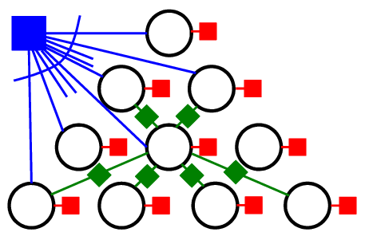
Dependency Parsing
Example Task:
Variables:
  POS tag for each word
  Syntactic label (or ∅) for each of O(n²) possible directed arcs
Interactions:
  Arcs must form a tree
  Discourage (or forbid) crossing edges
  Features on edge pairs that share a vertex
time
flies
like
an
arrow
*Figure from Burkett & Klein (2012)
    Learn to discourage a verb from having 2 objects, etc.
    Learn to encourage specific multi-arc constructions
(Smith & Eisner, 2008)
Notes:
Dependency parsing is very similar.
There are n words, so about n^2 possible directed edges.
For each one, make a variable that gives the edge label or says “no edge.”
And we need a factor saying that the edges form a tree.
Other factors model other interactions. They might discourage crossing edges, or discourage a verb from having two objects, or encourage certain constructions that require multiple arcs.

Slide 37
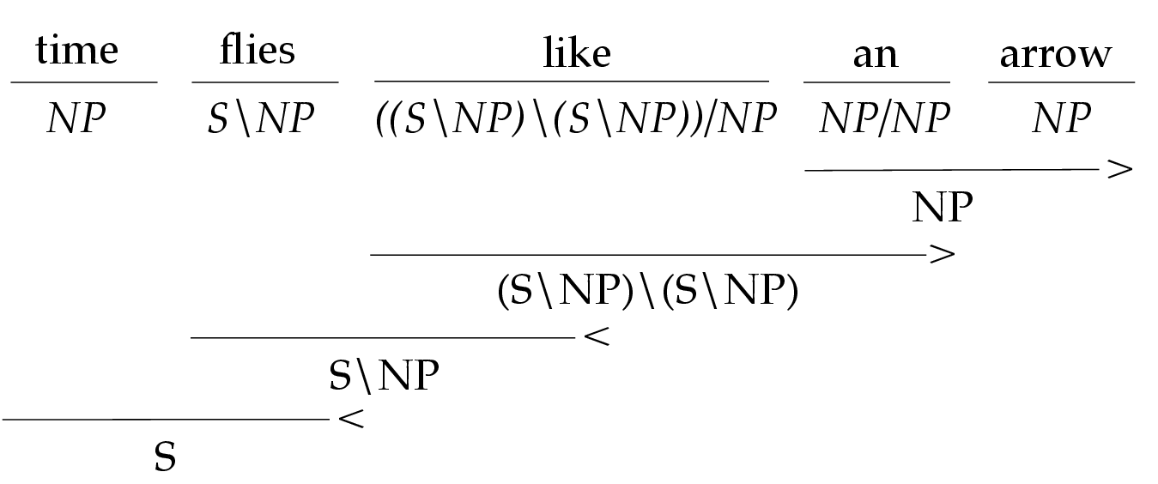
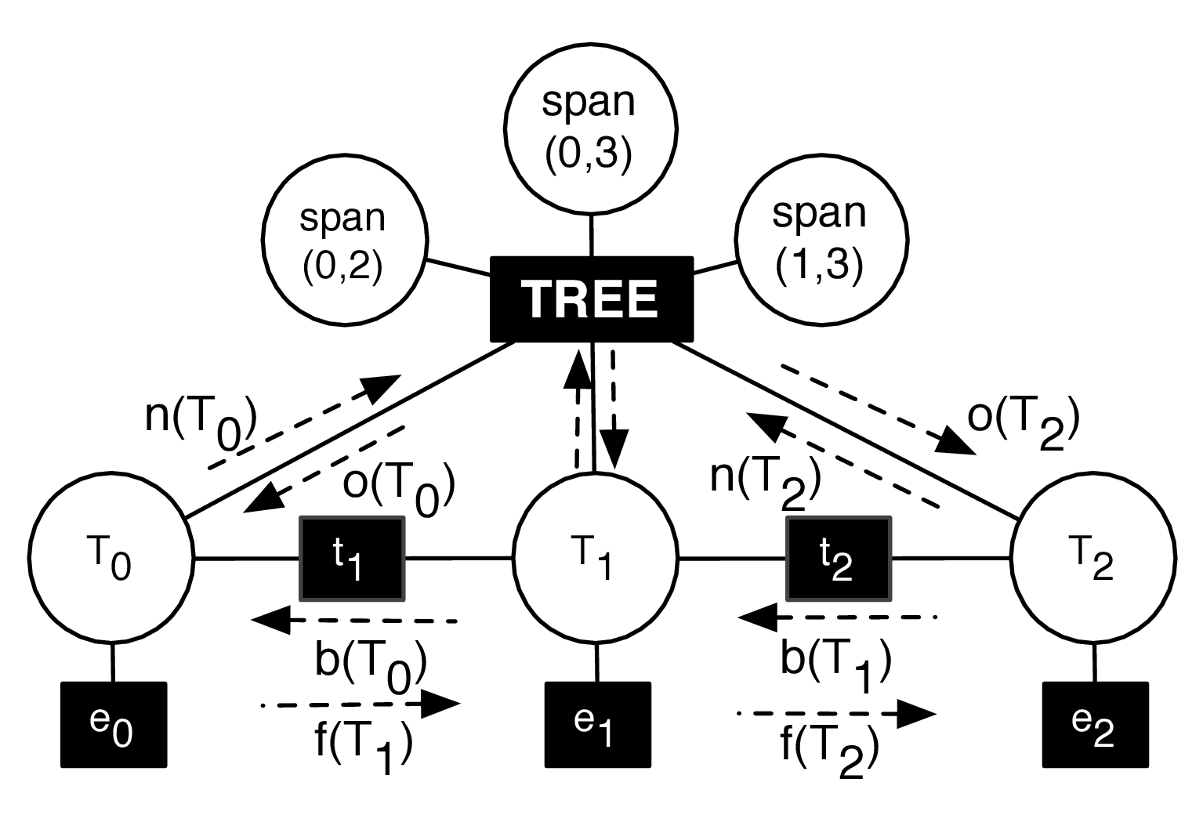
Joint CCG Parsing and Supertagging
Example Task:
Variables:
  Spans
  Labels on non-terminals
  Supertags on pre-terminals
Interactions:
  Spans must form a tree
  Triples of labels: parent, left-child, and right-child
  Adjacent tags
(Auli & Lopez, 2011)

Slide 38
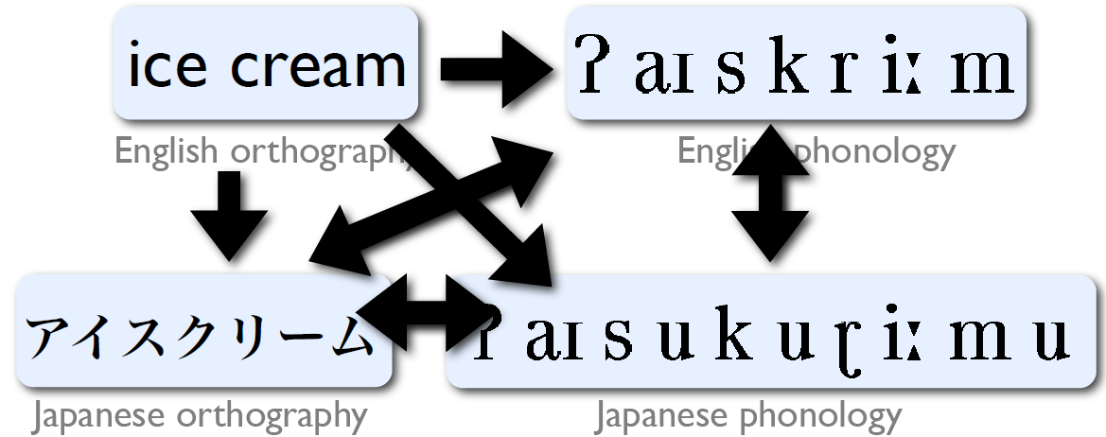
Transliteration or Back-Transliteration
Example task:
Variables (string):
  English and Japanese orthographic strings
  English and Japanese phonological strings
Interactions:
  All pairs of strings could be relevant
Figure thanks to Markus Dreyer

Slide 39
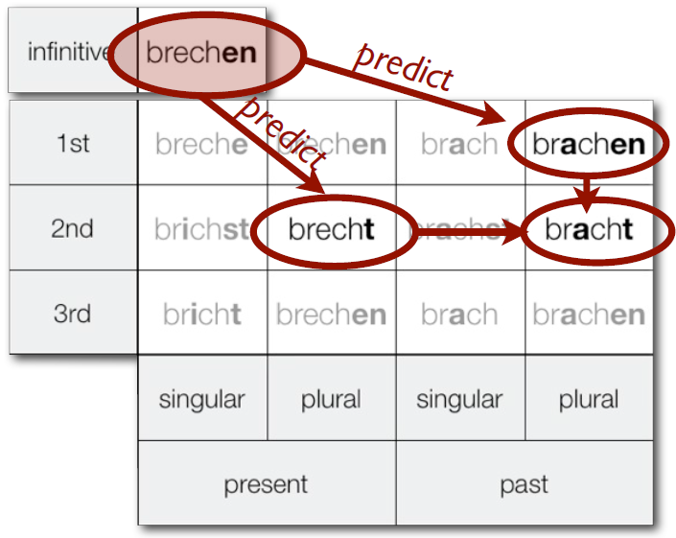
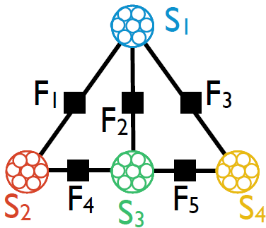
Morphological Paradigms
Example task:
Variables (string):
  Inflected forms
  of the same verb
Interactions:
  Between pairs of entries in the table
  (e.g. infinitive form affects present-singular)
(Dreyer & Eisner, 2009)
39
Notes:
Here a sample consisting of 13 strings – all the inflected forms of some verb.
A different sample would correspond to a different verb.
So we have 13 random variables, of type string.
And of course they’re highly correlated!
If you know that the infinitive is brechen, it’s a reasonable guess that this past tense form is brachen – a vowel change.
And here’s a suffix change. And both a vowel change and a suffix change.
So with the right factor graph, we can model all these interactions.

Slide 40
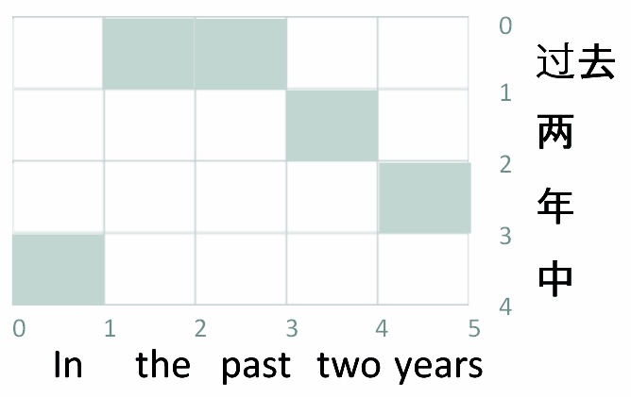
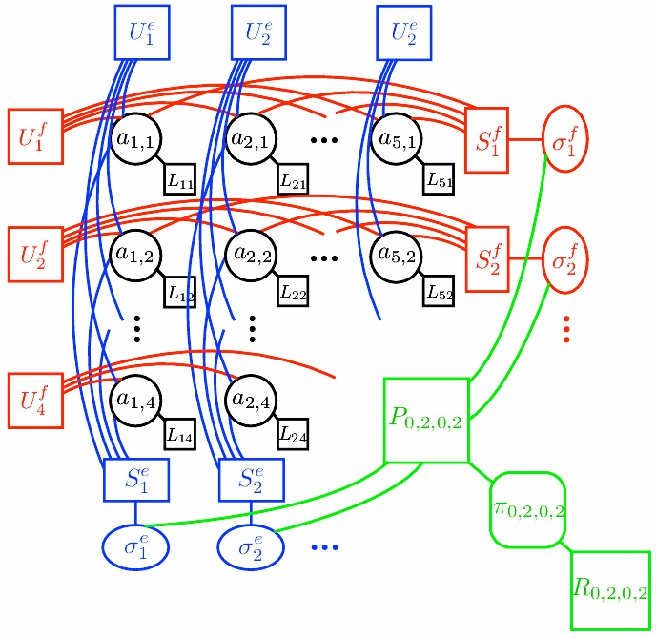
Word Alignment / Phrase Extraction
Application:
Variables (boolean):
  For each (Chinese phrase, English phrase) pair,
  are they linked?
Interactions:
  Word fertilities
  Few “jumps” (discontinuities)
  Syntactic reorderings
  “ITG contraint” on alignment
  Phrases are disjoint (?)
(Burkett & Klein, 2012)
Notes:
Maybe you work on MT. You’ve got a French sentence and an English sentence, 10 words each. So there’s 100 possible alignment links. Each could be on or off.
So we’re encoding an alignment as a vector of 100 bits, describing which links are present. You want to assign a probability to each of those vectors.
And there are lots of things to consider …
If word 3 aligns to word 10, maybe it doesn’t align to anything else.
It’s bad if words 3 and 4, which are adjacent, align to words 10 and 20, which are far apart.
This is a CRF, by the way, since the factors that evaluate an alignment are specific to the sentence pair.

Slide 41
Congressional Voting
Application:
Variables:
  Representative’s vote
  Text of all speeches of a representative
  Local contexts of references between two representatives
Interactions:
  Words used by representative and their vote
  Pairs of representatives and their local context
(Stoyanov & Eisner, 2012)
Notes:
Here’s an example with language in the world.
You’re trying to predict how each politician voted.
This depends on sentiment analysis of her speeches.
But also, her vote is correlated with the votes of other politicians.
If she attacks you in her speech, probably the two of you are voting differently.
So we have an inference problem to predict all of the votes at once.

Slide 42
Semantic Role Labeling with Latent Syntax
Application:
Variables:
  Semantic predicate sense
  Semantic dependency arcs
  Labels of semantic arcs
  Latent syntactic dependency arcs
Interactions:
  Pairs of syntactic and semantic dependencies
  Syntactic dependency arcs must form a tree
arg1
arg0
time
flies
like
an
arrow
L_{0,4}
L_{1,4}
L_{4,1}
L_{0,3}
L_{1,3}
L_{3,1}
R_{1,4}
R_{4,1}
L_{2,4}
L_{4,2}
L_{0,2}
L_{1,2}
L_{2,1}
R_{1,3}
R_{3,1}
L_{2,3}
L_{3,2}
R_{2,4}
R_{4,2}
L_{3,4}
L_{4,3}
L_{0,1}
0
R_{1,2}
R_{2,1}
R_{2,3}
R_{3,2}
R_{3,4}
R_{4,3}
1
2
3
4
<WALL>
The
barista
made
coffee
(Naradowsky, Riedel, & Smith, 2012)
(Gormley, Mitchell, Van Durme, & Dredze, 2014)
Notes:
Now, nothing limits you to solving one task at a time.
You could predict semantic and syntactic parses together.
It’s just more variables, and more factors to model their interactions.

Slide 43
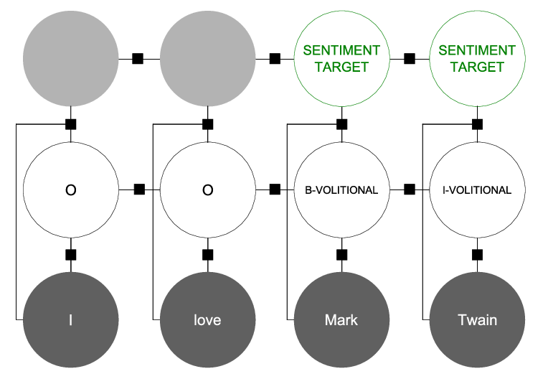
Joint NER & Sentiment Analysis
Application:
Variables:
  Named entity spans
  Sentiment directed toward each entity
Interactions:
  Words and entities
  Entities and sentiment
PERSON
I
love
Mark
Twain
POSITIVE
(Mitchell, Aguilar, Wilson, & Van Durme, 2013)
Notes:
Or you could jointly extract named entities and the sentiment expressed toward those entities.

Slide 44
Variable-centric view of the world
When we deeply understand language, what representations
(type and token) does that understanding comprise?
Notes:
In short, I think to build a really good model of language, you should first think about what the representations look like.
What variables are involved?

Slide 45
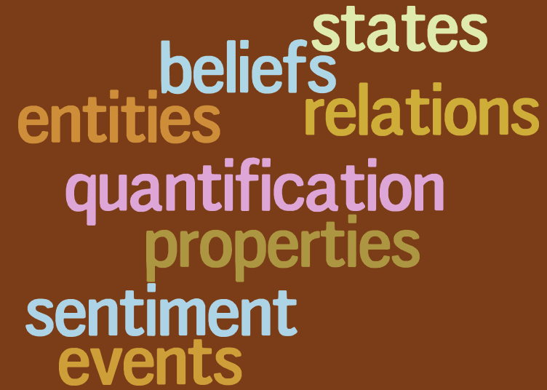
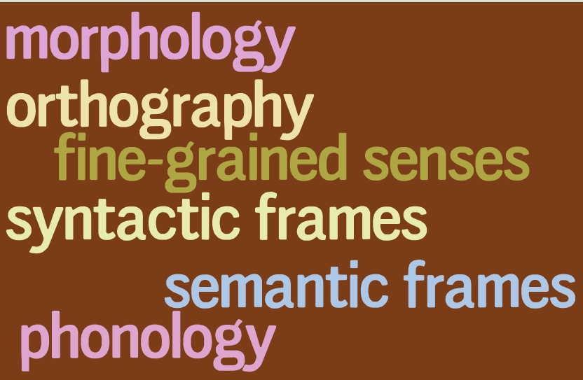
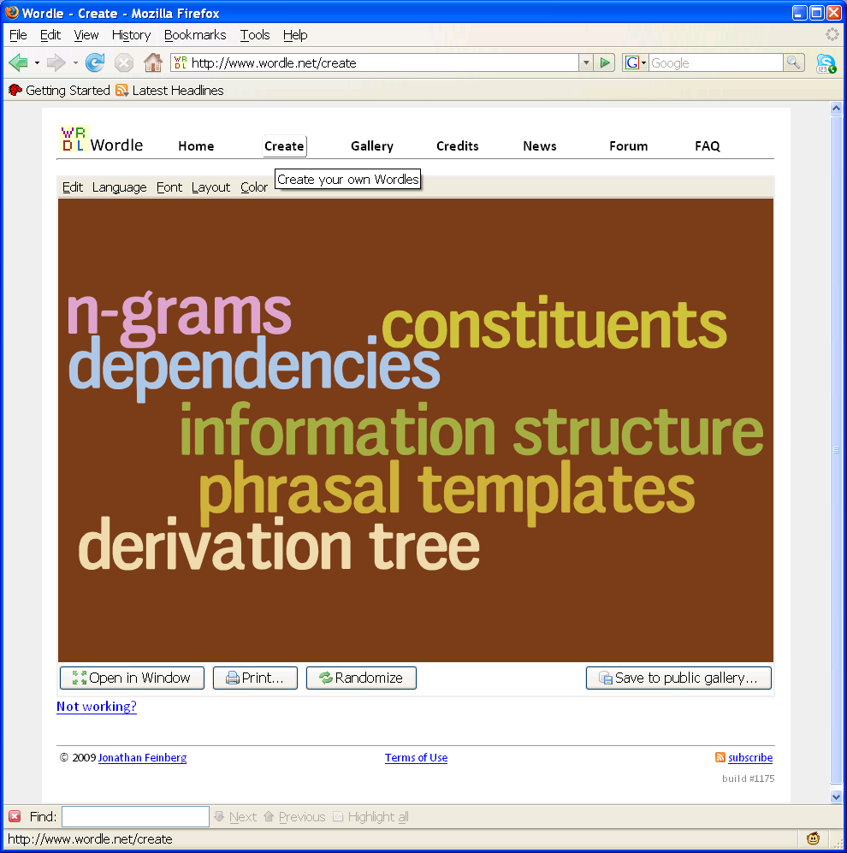
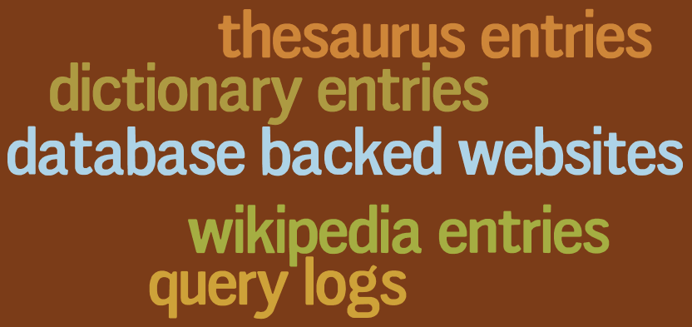
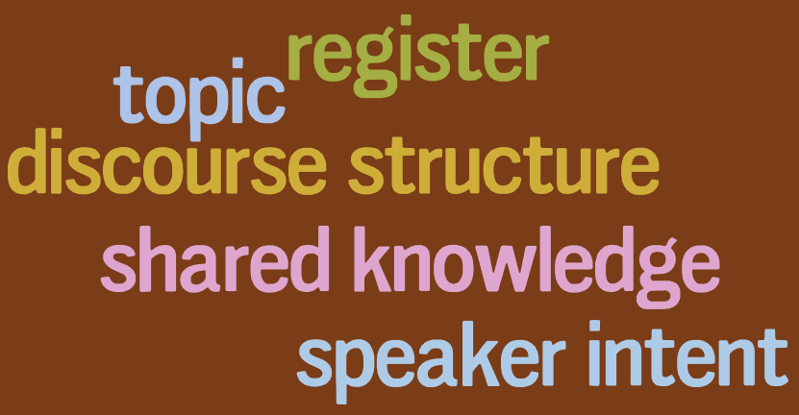
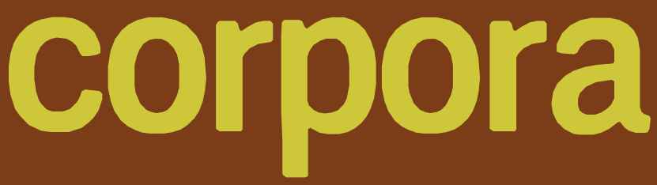
semantics
lexicon (word types)
inflection
cognates
transliteration
abbreviation
neologism
language evolution
entailment
correlation
tokens
sentences
N
translation
alignment
editing
quotation
resources
speech
misspellings,typos
formatting
entanglement
annotation
discourse context
To recover variables,
model and exploit
their correlations
Notes:
And what are the interactions among those variables?
Here’s my big graphical model of all of linguistics, a good way to end this section.
You might be able to observe some of these variables, with the help of annotators or linguistic resources.
But remember that a graphical model can handle noisy or incomplete observations.

