Slide 1
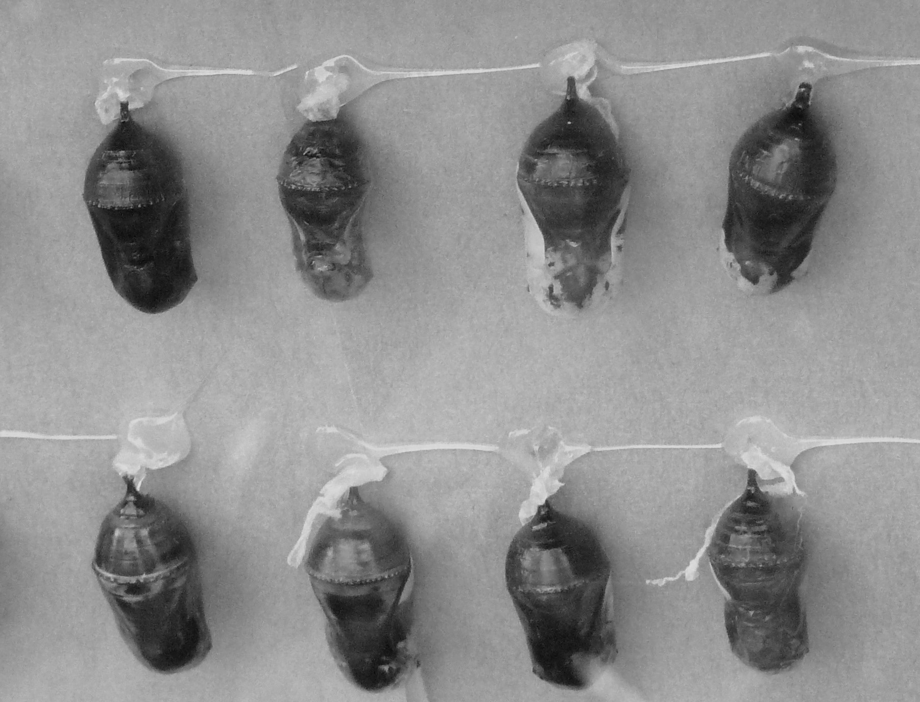
Chrysalis Analysis:
Incorporating Synchronization Arcs in
Dataflow-Analysis-Based Parallel Monitoring
Michelle Goodstein*, Shimin Chen†,
Phillip B. Gibbons‡, Michael A. Kozuch‡
and Todd C. Mowry*
*Carnegie Mellon University
†HP Labs China
‡Intel Labs Pittsburgh

Slide 2

Motivation
Software bugs are common, even in sequential code
Chip multi-processors increasing importance of parallel software
Parallel software introduces new “species” of bugs
Bugs can lead to crashes, security exploits and other harms to system
We would like to detect bugs before they cause harm
One solution: Monitor programs at runtime using lifeguards

Slide 3
Dynamic Program Monitoring
Update p₂’s metadata
Metadata:
Tainted?
.
.
taint p₂
.
.
*p₂
.
.
Update
metadata
p₁ | 0
p₂
p₃ | .
p₄ | .
Commit Order
Lifeguard
0
1
Application
Application is dynamically monitored by a lifeguard as it runs
  Monitors each dynamic instruction
Lifeguard maintains finite-state machine model of correct execution
  Checks metadata to see if program does something wrong
    Ex: Is performing *p2 safe (e.g., is p2 untainted)?

Slide 4
Dynamic Program Monitoring
ERROR: metadata for
p₂ tainted
Is *p₂ safe ?
Metadata:
Tainted?
.
.
taint p₂
.
.
*p₂
.
.
Check
metadata
p₁ | 0
p₂ | 1
p₃ | .
p₄ | .
Commit Order
Lifeguard
Application
Application is dynamically monitored by a lifeguard as it runs
  Monitors each dynamic instruction
Lifeguard maintains finite-state machine model of correct execution
  Checks metadata to see if program does something wrong
    Ex: Is performing *p2 safe (e.g., is p2 untainted)?

Slide 5
Dynamically Monitoring Parallel Programs
.
.
.
untaint p
*p
.
.
Lifeguard 0
Lifeguard 1
Lifeguard 2
.
.
.
.
.
.
.
.
Commit Order
.
.
.
taint p
.
.
.
.
Thread 0
Thread 1
Thread 2
Updating metadata straightforward for sequential programs
Intuition: Monitor parallel applications with parallel lifeguards
Parallel apps: inter-thread data dependences complicate lifeguards
  Ideal: Lifeguards process trace in app instructions’ global commit order
  Butterfly Analysis [ASPLOS 2010] : No inter-thread data dependences
    Cannot measure using today’s hardware
    Relaxed memory consistency models: no total order

Slide 6
Butterfly Analysis: Dynamic Parallel Monitoring
.
.
.
untaint p
*p
.
.
Lifeguard 0
Lifeguard 1
Lifeguard 2
.
.
.
.
.
.
.
.
Commit Order
.
.
.
taint p
.
.
.
.
Thread 0
Thread 1
Thread 2
Butterfly Analysis
  + Proceed without capturing inter-thread data dependences
  + Supports relaxed memory consistency models
  Ignores explicit software synchronization

Slide 7
Chrysalis Analysis: Generic Dynamic Dataflow Analysis Platform
.
.
.
.
.
.
.
.
.
.
lock L
untaint p
*p
unlock L
.
.
.
.
lock L
taint p: unlock L
.
.
Commit Order
Lifeguard 0
Lifeguard 1
Lifeguard 2
Thread 0
Thread 1
Thread 2
Generic parallel dynamic dataflow analysis framework
  Lifeguards can be built on top of generic dataflow examples
  This talk: TaintCheck
Not only race detection: Analyses robust even when races present
Behaves conservatively but correctly
  When two conflicting metadata values possible, assume worst case
Incorporates high-level synchronization arcs
  Our experiments: 97% reduction in false positives (relative to Butterfly)

Slide 8
Roadmap for Remainder of Talk
Review of Butterfly Analysis
Highlight key changes to execution model to incorporate sync arcs
  Vector clocks
  Asymmetry
Illustrate research challenges and solutions
  Calculating local/global states
  Computing side-in/side-out primitives
Experimental evaluation
Template color coding: Butterfly , Chrysalis

Slide 9
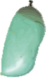
Butterfly Analysis: Fundamentals
Occurs strictly
before *p
Occurs strictly
before *p
.
.
.
.
.
.
.
.
.
.
.
.
untaint p
*p
.
.
.
.
.
.
.
taint p
.
.
Window
Commit Order
Concurrent
region
Concurrent
region
Key Insight: Only consider a window W of uncertainty
  W must account for all buffering in pipeline and memory system
    Large relative to ROB, memory access latency
    Small relative to total execution
  Our experiments: 1000s-10,000s of instructions/thread

Slide 10
Butterfly Analysis: Reasoning About Concurrent Regions
Concurrent Region of Execution Traces
.
.
.
.
.
.
.
.
.
.
.
A: untaint p
B: *p
.
.
.
.
.
.
C: taint p
.
.
.
.
Lifeguard 1
Commit Order
Three Possible Orderings
Thread 0
Thread 1
Thread 2
A
C
A
C
A
B
B
B
C
Lifeguard must behave conservatively
p tainted
*p unsafe
p untainted
*p safe

Slide 11
Butterfly Analysis: Ignoring Sync Arcs Causes False Positives
Concurrent Region of Execution Traces
.
.
D: lock L
A: untaint p
B: *p
E: unlock L
.
.
.
.
.
.
.
.
.
.
.
D: lock L
A: untaint p
B: *p
E: unlock L
.
.
.
.
.
.
.
.
.
.
.
.
F: lock L
C: taint p
G: unlock L
.
.
.
.
.
.
F: lock L
C: taint p
G: unlock L
.
.
.
Lifeguard 1
Commit Order
Commit Order
Three Possible Orderings
Thread 1
A
C
A
Thread 0
Thread 1
Thread 0
Thread 2
Thread 2
C
A
B
B
B
C
Butterfly Analysis considers an
impossible interleaving to be valid
p tainted
*p unsafe
p untainted
*p safe

Slide 12
Chrysalis Analysis: Incorporating Sync Arcs Improves Precision
Concurrent Region of Execution Traces
.
.
.
.
.
.
.
.
.
.
D: lock L
A: untaint p
B: *p
E: unlock L
.
.
.
.
F: lock L
C: taint p
G: unlock L
.
.
.
Lifeguard 1
Two Possible Orderings
Commit Order
F
D
A
D
C
Thread 0
Thread 1
Thread 2
B
F
A
G
C
B
E
G
E
p untainted
*p safe
p untainted
*p safe
Under all possible orderings,
*p safe!

Slide 13
Chrysalis Analysis: Incorporating Sync Arcs Into Butterfly Analysis
.
.
.
.
.
.
.
.
.
.
D: lock L
A: untaint p
B: *p
E: unlock L
.
.
.
.
F: lock L
C: taint p
G: unlock L
.
.
.
Commit Order
Lifeguard 0
Lifeguard 1
Lifeguard 2
Thread 0
Thread 1
Thread 2
Chrysalis Analysis: Generalize Butterfly Analysis to include sync arcs
  + Improved precision (compared to Butterfly Analysis)
  + Relaxed consistency models OK, no explicit hardware required
Research challenges solved
  More complex thread execution model
  More complex dataflow analysis framework

Slide 14
Butterfly Analysis: A Brief Review
.
.
.
.
.
.
.
.
.
.
.
.
.
.
.
.
.
.
.
.
.
.
.
untaint p
*p
.
.
.
.
.
.
.
.
.
.
.
.
taint p
.
.
.
.
.
.
.
.
.
.
Commit Order
Consider an online execution trace

Slide 15
Butterfly Analysis: Epochs Partition Thread Execution
Epoch 0
W
taint p
Epoch 1
untaint p
*p
Epoch 2
Commit Order
Epoch 3
Epoch 4
Execution divided into epochs separated by at least W events/thread

Slide 16
Epochs: Reasoning About Concurrency
taint p
W
untaint p
*p
Relative To Center Epoch
untaint p
*p
Sliding window
limited to 3 epochs
Commit Order
W
From the perspective of the center epoch
Most epochs are non-adjacent
  Instructions in these epochs execute strictly before or strictly after
Two epochs are adjacent to center epoch
3 epoch window of potentially concurrent instructions

Slide 17
Butterfly Analysis: Concurrency Within Three Epoch Window
Thread t
Head
l-1
Body
l
Epochs
Commit Order
Tail
l+1
Wings
Wings

Slide 18
Butterfly Analysis: Parallel Forward Dataflow Analysis
Thread t
l-1
Head
Body
l
Epochs
Commit Order
Tail
l+1
Wings
Wings
Extend standard dataflow primitives (In, Out, Gen, Kill)
Introduced two new primitives: Side-Out and Side-In
  Side-Out: Effects of concurrency a block exposes to other threads
  Side-In: Effects of concurrency other threads expose to a block

Slide 19
Butterfly Analysis: Parallel Dataflow Analysis
Thread t
l-1
Head
Body
l
Epochs
Commit Order
Tail
l+1
Wings
Wings
Extend standard dataflow primitives (In, Out, Gen, Kill)
Introduced two new primitives: Side-Out and Side-In
  Side-Out: Effects of concurrency a block exposes to other threads
  Side-In: Effects of concurrency other threads expose to a block

Slide 20
Butterfly Analysis: Parallel Dataflow Analysis
Thread t
l-1
Head
Body
l
Epochs
Commit Order
Tail
l+1
Wings
Wings
Two-pass lifeguard analysis over 3-epoch sliding window
Lifeguard threads execute in parallel
Maintains state
  Global state: Summarizes earlier epochs outside the window
  Local state: Global state augmented with info from the head

Slide 21
Generalizing Butterfly Analysis: Incorporating Sync Arcs
Thread 0
Thread 1
Thread 0
Thread 1
.
.
.
taint p
.
.
.
.
.
lock L
taint p
unlock L
Epoch 1
Epoch 1
.
.
untaint p
*p
.
.
.
lock L
untaint p
*p
unlock L
.
.
.
Epoch 2
Epoch 2
Butterfly Analysis: p conservatively tainted at *p in Thread 0, epoch 2
If mutual exclusivity is enforced, *p must be untainted!
  Useful ordering information implied by sync also lost

Slide 22
Chrysalis Analysis: Incorporating Sync Arcs To Improve Precision
Thread 0
Thread 1
.
.
.
.
.
lock L
taint p
unlock L
.
.
Epoch 1
Commit Order
lock L
untaint p
*p
unlock L
.
.
.
.
.
.
Epoch 2
Goal: Incorporate synchronization-based happens-before arcs
Butterfly Analysis framework not general enough to handle arbitrary arcs…

Slide 23
Chrysalis Analysis: Incorporating Synchronization Arcs
Thread 0
Thread 1
.
.
.
lock L
taint p
unlock L
<1, 0>
<0,1>
Epoch 1
No longer simple, symmetric graph…
<0,2>
lock L
untaint p
*p
unlock L
.
.
.
Asymmetry causes complexity
Commit Order
<2, 1>
Epoch 2
<0,3>
<3, 1>
Goal: Incorporate synchronization-based happens-before arcs
Instrument sync with vector clocks to capture happens-before arcs
Calculate dataflow primitives (In, Out, Side-In, Side-Out, Gen, Kill) at boundaries
Chrysalis Analysis considers p untainted at *p in subblock <2,1>

Slide 24
Butterfly Analysis: Recall Graph Model
Thread t
Head
l-1
Body
l
Epochs
l+1
Tail
Commit Order
Wings
Wings
Original Butterfly Analysis: From perspective of the body

Slide 25
Butterfly Analysis: Creating Local State
Thread t
taint p
l-1
taint:
{}
untaint p
*p
l
Epochs
l+1
Commit Order
Wings
Wings
Local State ( ) calculated by augmenting Global State with effects of Head

Slide 26
Butterfly Analysis: Calculating Side-Out
Thread t
taint p
l-1
taint: {p}
p: 1
untaint p
*p
l
Epochs
l+1
Commit Order
Wings
Wings
Each block in the wings has a side-out ( ) generated by lifeguard

Slide 27
Butterfly Analysis: Computing Side-In
Thread t
taint p
l-1
p:1
p:1
taint: {p}
untaint p
*p
l
Epochs
l+1
Commit Order
Wings
Wings
All side-out from the wings are combined into one side-in ( )

Slide 28
Chrysalis Analysis: Incorporating Sync Arcs
Thread t
Head
Head
l-1
Body
l
Epochs
Body
Body
l+1
Tail
Commit Order
Wings
Wings
In general: Sync introduces asymmetry/complexity, in body and wings

Slide 29
Chrysalis Analysis: Calculating Local State
Thread t
meet
taint p
taint p
taint p
l-1
p:1
taint: {p}
untaint p
untaint p
untaint p
p:0
untaint: {p}
*p
*p
l
Epochs
l+1
Commit Order
Wings
Wings
Highlighted blocks involved in local state computation for body

Slide 30
Chrysalis Analysis: Calculating Local State
Thread t
taint p
taint p
l-1
untaint p
untaint p
*p
*p
meet
l
Epochs
l+1
Commit Order
Wings
Wings
Calculating local state becomes increasingly complex with more arcs

Slide 31
Chrysalis Analysis: Side-In/Side-Out
Thread t
taint p
l-1
untaint p
*p
*p
l
Epochs
l+1
Commit Order
Wings
Wings
Arcs to/from the body alter the wings for each subblock, and the side-in

Slide 32
Chrysalis Analysis: Side-In/Side-Out
Thread t
taint p
l-1
untaint p
*p
*p
l
Epochs
l+1
Commit Order
Wings
Wings
Arcs to/from the body alter the wings for each subblock, and the side-in

Slide 33
Chrysalis Analysis: Side-In/Side-Out
Thread t
taint p
l-1
untaint p
*p
*p
l
Epochs
l+1
Commit Order
Wings
Wings
Arcs to/from the body alter the wings for each subblock, and the side-in

Slide 34
Chrysalis Analysis: Side-In/Side-Out
Thread t
taint p
l-1
untaint p
*p
*p
l
Epochs
l+1
Commit Order
Wings
Wings
Arcs to/from the body alter the wings for each subblock, and the side-in

Slide 35
Chrysalis Analysis: Side-In/Side-Out (Reversed Arc)
Thread t
taint p
l-1
untaint p
*p
*p
l
Epochs
l+1
Commit Order
Wings
Wings
Each subblock in the body can have different set of wings

Slide 36
Contrast: Butterfly vs Chrysalis Analyses
Thread t
Thread t
l-1
Head
l-1
Head
l
Body
l
Epochs
Epochs
Body
l+1
Tail
l+1
Tail
Wings
Wings
Wings
Wings
Butterfly Analysis
Local state: calculate from head
One set of wings/side-in per body
“Simple” epoch summary updates global state
- False positives due to missed synch
Chrysalis Analysis
Local state: calculate from all predecessors
Wings/side-in differ for each body subblock
Epoch summary must consider partial order
  Includes arcs from epochs l+1 to l [extended epoch]
+ Improved precision
Research Challenges

Slide 37
Chrysalis Analysis: Parallel Forward Dataflow Analysis With Sync Arcs
Thread t
l-1
Head
l
Epochs
Body
Commit Order
l+1
Tail
Wings
Wings
General dataflow analysis framework
  2-pass lifeguards + global state update
  Canonical examples: Reaching Definitions, Available Expressions
  Memory/Security lifeguards: TaintCheck, AddrCheck
Provably sound
  Framework never misses an error (zero false negatives)
Efficient analysis
  Use dataflow meet to avoid excessive recomputations

Slide 38
Experimental Methodology
Prototype built upon the Log-Based Architecture (LBA) framework [Chen08]
  Full Butterfly & Chrysalis Analysis stacks implemented in software
  Simulated hardware on shared-memory CMP using Simics
  Used LBA for dynamic instruction traces, inserting epoch boundaries
  Used LBA shim library to dynamically instrument synchronization calls
Measured 2 CMP configurations: {4,8} cores
  Corresponds to {2,4} application and {2,4} lifeguard threads
4 SPLASH Benchmarks: FFT, FMM, LU, BARNES
Comparison of Butterfly Analysis and Chrysalis Analysis

Slide 39
Performance Results: Chrysalis Slowdown (relative to Butterfly)
Average Slowdown: 1.9x

Slide 40
Precision Results: Potential Errors, Chrysalis vs Butterfly
62
38
93
Average Reduction in Reported Errors: 17.9x

Slide 41
Precision Results: Percent Reduction in Potential Errors
Average Reduction in Reported Errors: 97%

Slide 42
Chrysalis Analysis: Conclusions and Future Work
General purpose parallel dynamic dataflow analysis platform
  Provably sound (never misses an error)
Generalization retains advantages of Butterfly Analysis
  Supports relaxed memory consistency models
  Software framework
  No detailed inter-thread data dependence tracking
TaintCheck Implementation
  Large reduction in false positives (average: 17.9x)
  Modest relative increase in overhead (average: 1.9x)
Future work: Build many sophisticated runtime analysis tools in framework

Slide 43
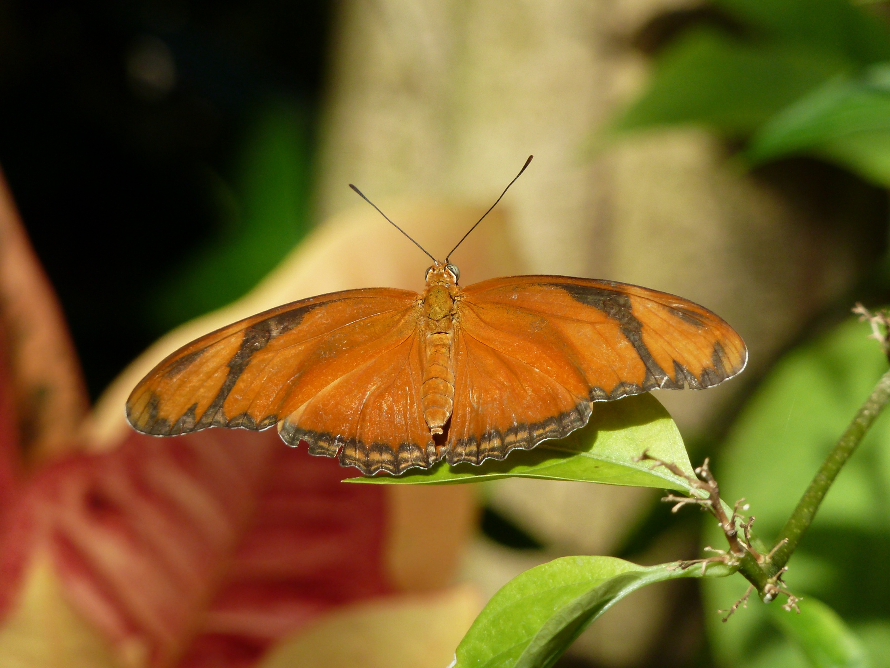
Questions?

