Slide 1
Markov Nets
Dhruv Batra,
10-708 Recitation
10/30/2008

Slide 2
Contents
MRFs
  Semantics / Comparisons with BNs
  Applications to vision
  HW4 implementation

Slide 3
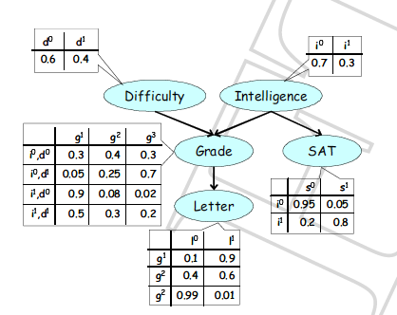
Semantics
Bayes Nets

Slide 4
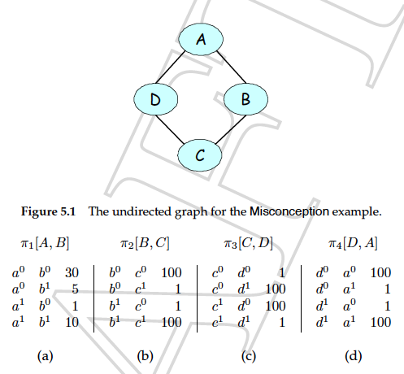
Semantics
Markov Nets

Slide 5
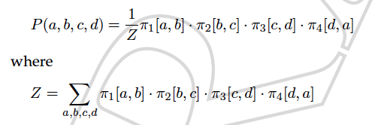
Semantics
Decomposition
  Bayes Nets
  Markov Nets

Slide 6
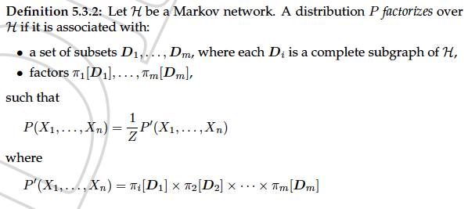
Semantics
Factorization
What happens in BNs?

Slide 7
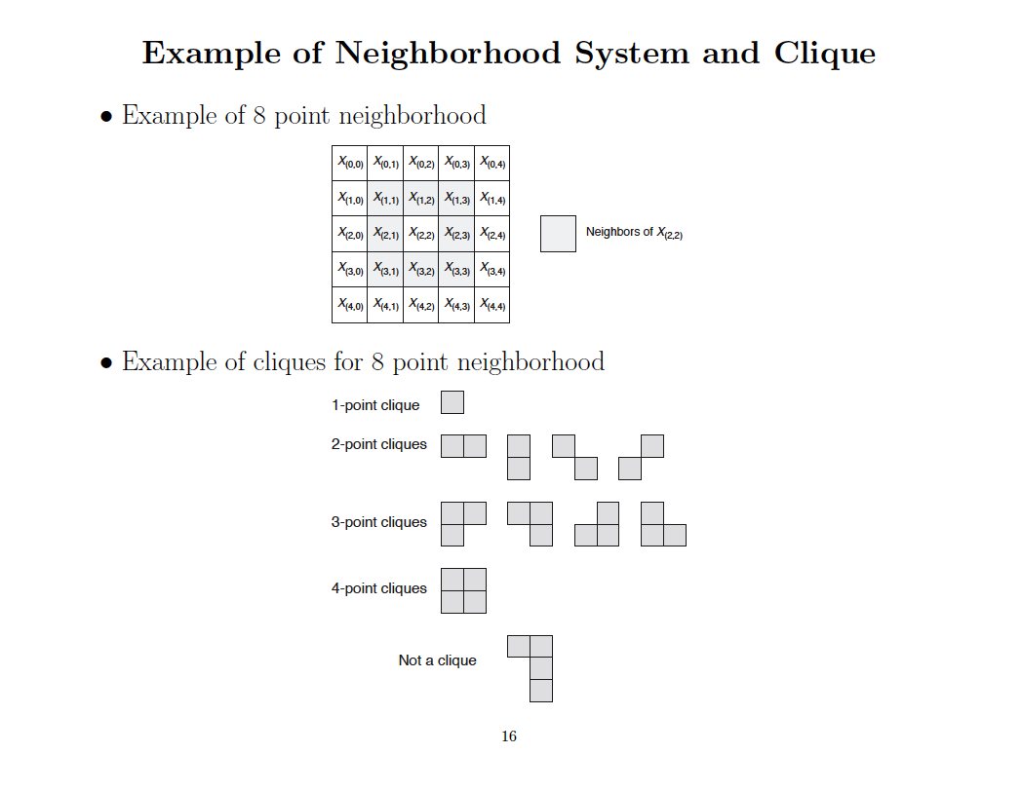

Slide 8

Semantics
Active Trails in MNs
What happens in BNs?

Slide 9
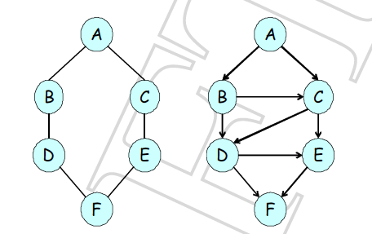


Semantics
Independence Assumptions
Markov Nets
Bayes Nets
Global Ind
Assumption, d-sep
Local Ind
Assumptions
Markov
Blanket

Slide 10
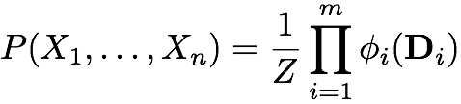
Representation Theorem for Markov Networks
If joint probability distribution P:
Then
H is an I-map for P
If H is an I-map for P
and
P is a positive distribution
Then
joint probability distribution P:

Slide 11


Semantics
Factorization
Energy functions
Equivalent representation

Slide 12
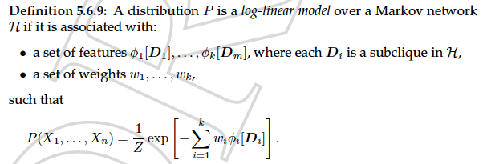
Semantics
Log Linear Models

Slide 13


Semantics
Energies in pairwise MRFs
What is encoded on nodes and edges?

Slide 14
Semantics
Priors on edges
  Ising Prior / Potts Model
  Metric MRFs

Slide 15
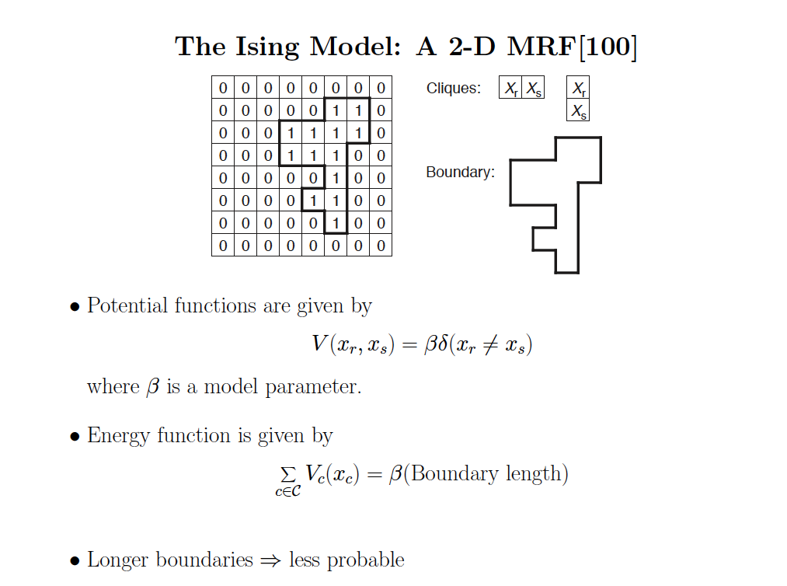

Slide 16

Metric MRFs
Energies in pairwise MRFs

Slide 17
Applications in Vision
Image Labelling tasks
  Denoising
  Stereo
  Segmentation, Object Recognition
  Geometry Estimation

Slide 18
MRF nodes as pixels
Winkler, 1995, p. 32

Slide 19
MRF nodes as patches
image patches
scene patches
image
Φ(x_{i}, y_{i})
Ψ(x_{i}, x_{j})
scene

Slide 20
Network joint probability
1
∏
∏
P
=
Ψ
Φ
(
x
,
y
)
(
x
,
x
)
(
x
,
y
)
Z
i
j
i
i
,
i
j
i
scene
Scene-scene
compatibility
function
Image-scene
compatibility
function
image
neighboring
scene nodes
local
observations

Slide 21
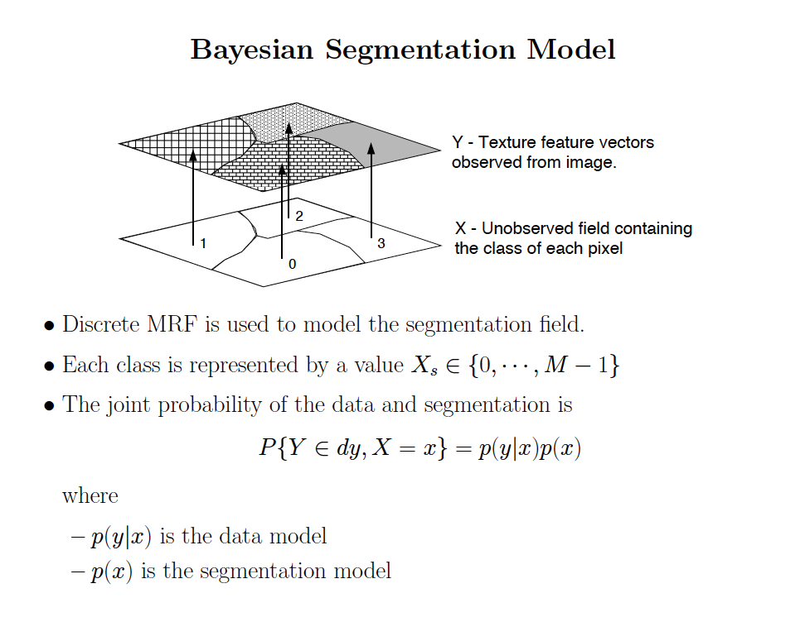
Application
Motion Estimation

Slide 22
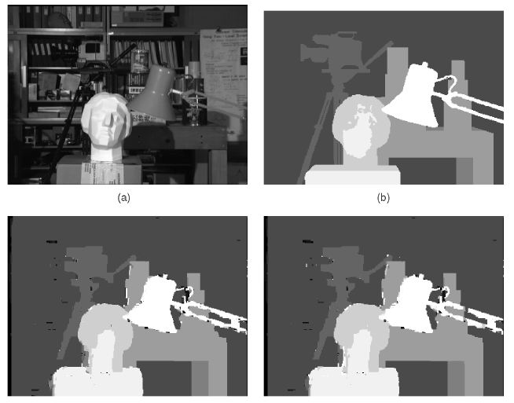
Stereo

Slide 23
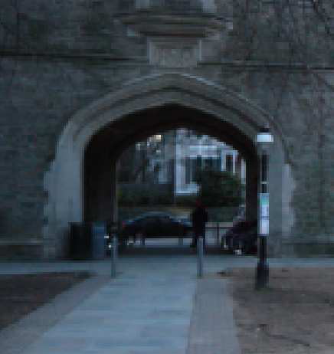
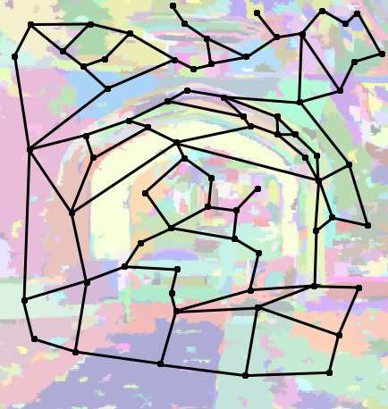
Geometry Estimation

Slide 24
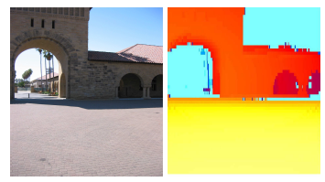
Geometry Estimation

Slide 25
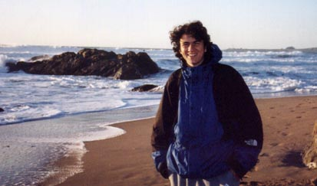
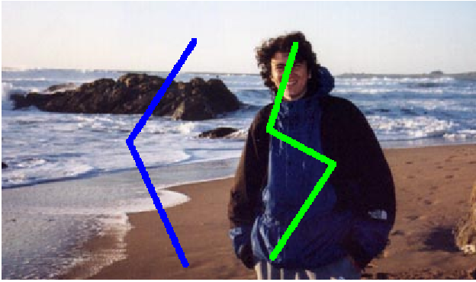
HW4
Interactive Image Segmentation

Slide 26
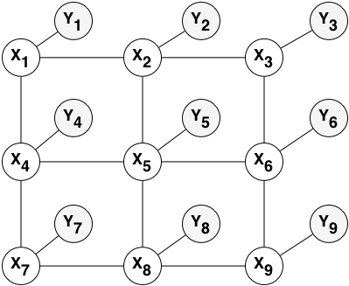
HW4
Pairwise MRF

Slide 27
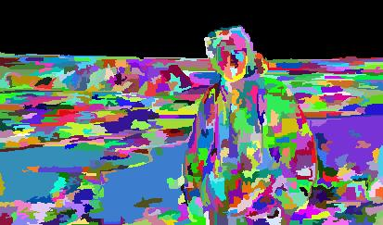
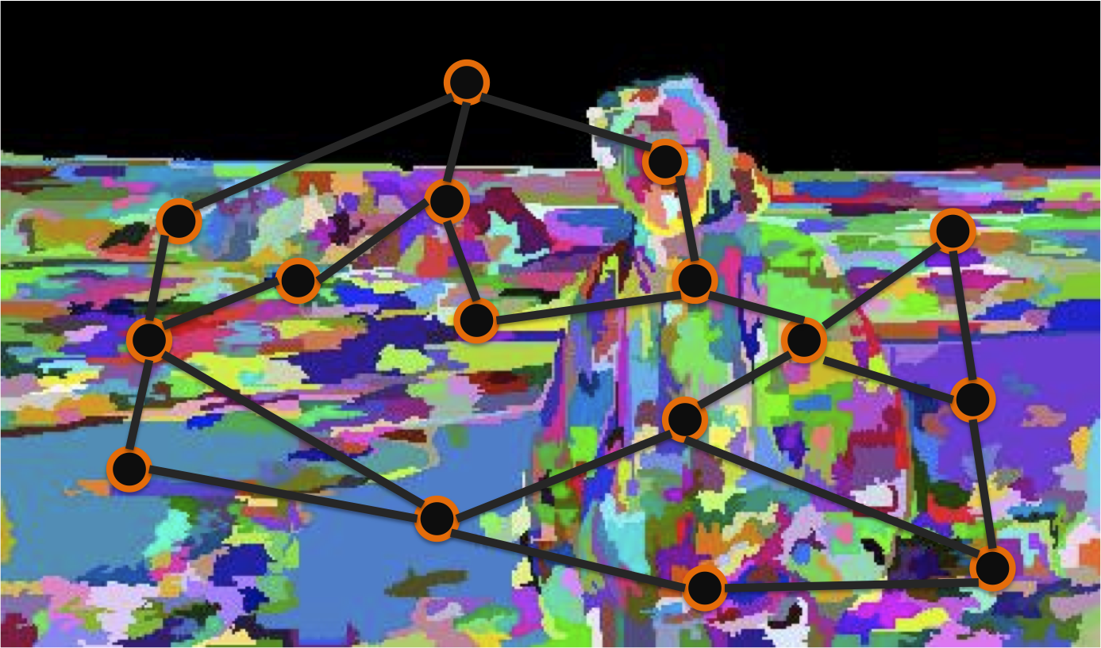
HW4

Slide 28


HW4
Step 1: GMMs
Step 2: Adjacency matrix / MRF Structure
Step 3: MRF parameters
Step 4: Loopy BP
Step 5: Segmentation Masks

Slide 29
Slide Credits
Bill Freeman, Fredo Durand, Lecture at MIT
  http://groups.csail.mit.edu/graphics/classes/CompPhoto06/html/lecturenotes/2006March21MRF.ppt
Charles A. Bouman
  https://engineering.purdue.edu/~bouman/ece641/mrf_tutorial/view.pdf
Fast Approximate Energy Minimization via Graph Cuts, Yuri Boykov, Olga Veksler and Ramin Zabih. IEEE PAMI 23(11), November 2001.
Make3D: Learning 3-D Scene Structure from a Single Still Image, Ashutosh Saxena, Min Sun, Andrew Y. Ng, To appear in IEEE PAMI 2008

Slide 30
Questions?

