Slide 1
Variable Elimination
Dhruv Batra,
10-708 Recitation
10/16/2008

Slide 2
Overview
Variable Elimination
  Example on chain networks
  Intuition
  Tools for VE, factor product, marginalization
  Implementation hints

Slide 3

Chain Networks
BN:
Goal: Need all marginals P(X)

Slide 4
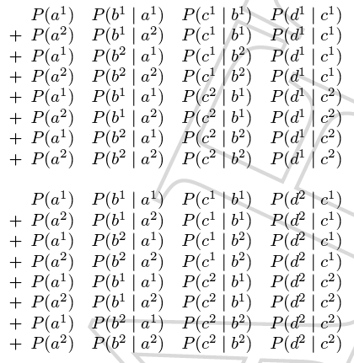
Chain Networks
Naïve solution

Slide 5





Chain Networks
A little smarter solution: Phased Computation
General Chains:
Why is this better?
vs
What’s the intuition?

Slide 6

Chain Networks
A lot of structure

Slide 7
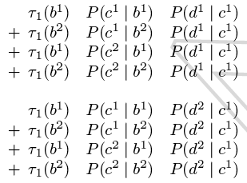


Chain Networks
Let’s cache

Slide 8
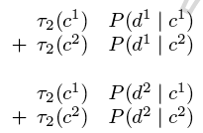

Chain Networks
Let’s cache again
Notes:
As we’re doing this, you should realize that this is VE happening on with a particular elimination ordering

Slide 9
Chain Networks
Intuitions from this process
  Group common things/terms/factors based on scope
  Dynamic programming ideas: cache computations
VE extends/formalizes these intuitions to general graphs
  but separates the elimination ordering from the process

Slide 10




Another Idea
A commonly used idea
Goal
Can forget about denominator; just renormalize when done

Slide 11


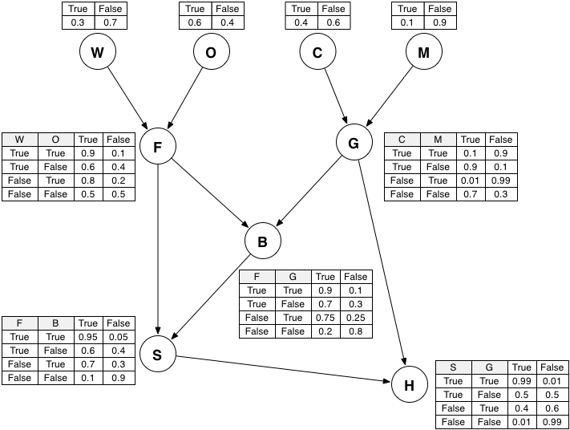
Example
Let’s do an example for general graphs

Slide 13
Implementing VE
What do you need to implement VE?
  Reuse some code from HW2

Slide 14
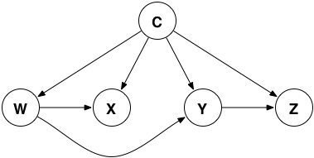
Tools for VE
Factors
Special kind of factors: CPTs

Slide 15


Operations on Factors
Factor Product
  Consider two factors
  Define factor product
  such that

Slide 16
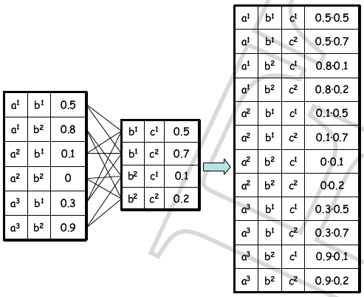
Operations on Factors
Factor Product

Slide 17




Operations on Factors
Factor Marginalization
  Consider a factor
  Define factor marginal
  such that

Slide 18
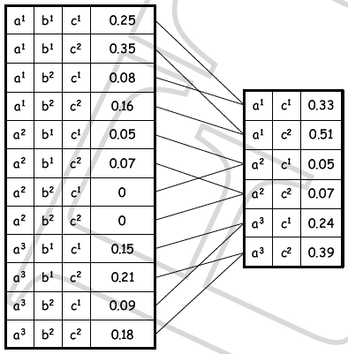
Operations on Factors
Factor Marginalization

Slide 19
Factors
Are factors always distributions?
  Obviously not
Are factors produced in VE always distributions?
  Yes, always conditional distributions
  In SOME graph, not necessarily the original graph
  HW3, prob 2. Hint: read 8.3.1.3

Slide 20
Implementing VE
What do you need to implement VE?
  Reuse some code from HW2
Representation
  BN as an array of factors
  table_factor.m
  assignment.m
VE
  multipy_factors.m
  marginalize_factor.m
  min_fill.m

Slide 21
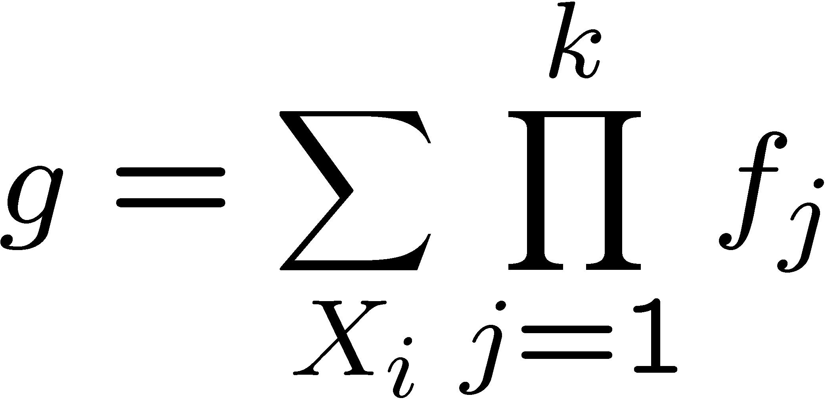
Variable elimination algorithm
Given a BN and a query P(X|e) / P(X,e)
Instantiate evidence e
Prune non-active vars for {X,e}
Choose an ordering on variables, e.g., X₁, …, X_{n}
Initial factors {f₁,…,f_{n}}: f_{i} = P(X_{i}|Pa_{Xi}) (CPT for X_{i})
For i = 1 to n, If X_{i} ∉{X,E}
  Collect factors f₁,…,f_{k} that include X_{i}
  Generate a new factor by eliminating X_{i} from these factors
  Variable X_{i} has been eliminated!
Normalize P(X,e) to obtain P(X|e)

Slide 22
Questions?

