Slide 1
Parameter Learning in Markov Nets
Dhruv Batra,
10-708 Recitation
11/13/2008

Slide 2
Contents
MRFs
  Parameter learning in MRFs
    IPF
    Gradient Descent
  HW5 implementation

Slide 3
Semantics
Priors on edges
  Ising Prior / Potts Model
  Metric MRFs

Slide 4
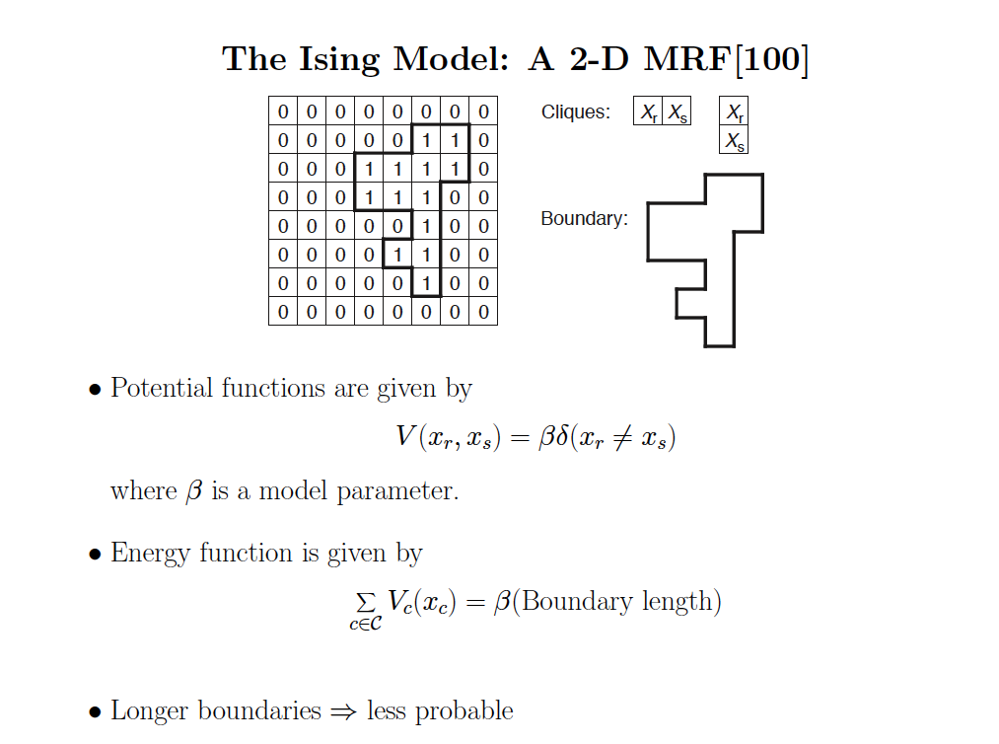

Slide 5


Metric MRFs
Energies in pairwise MRFs

Slide 6

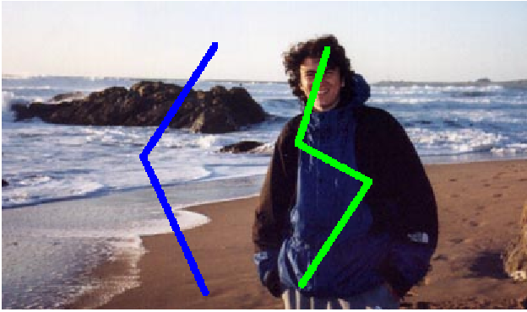
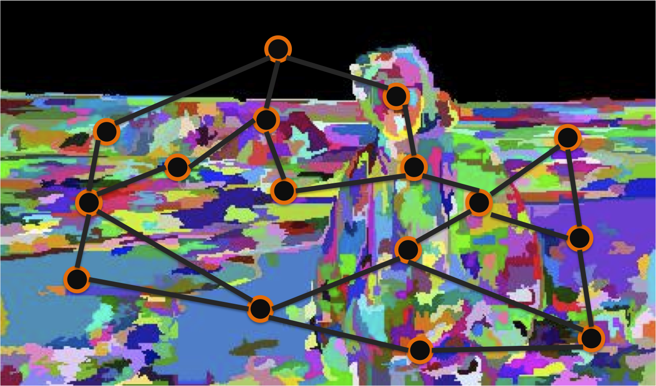
HW4
Semi-supervised image segmentation

Slide 7
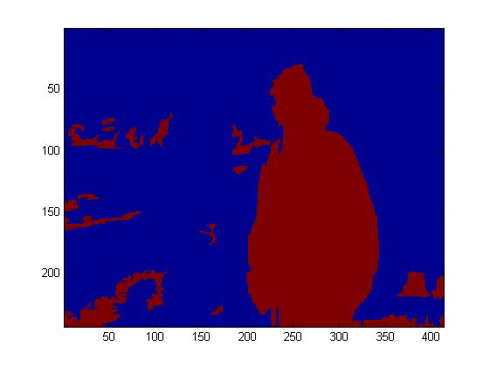
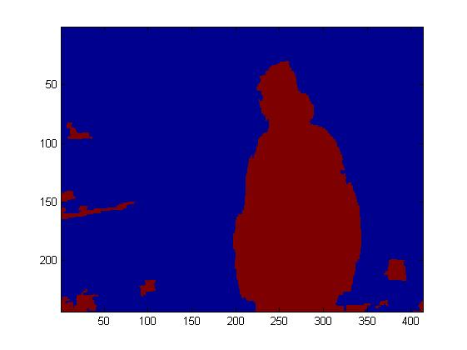
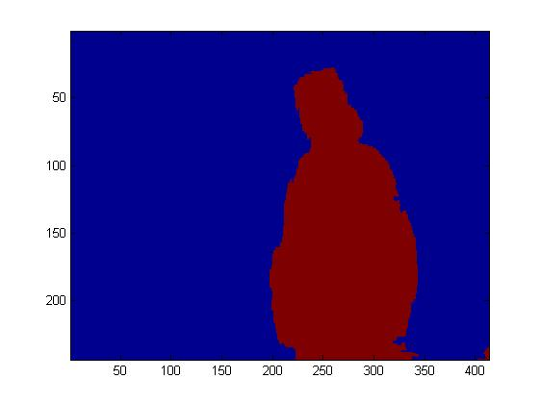
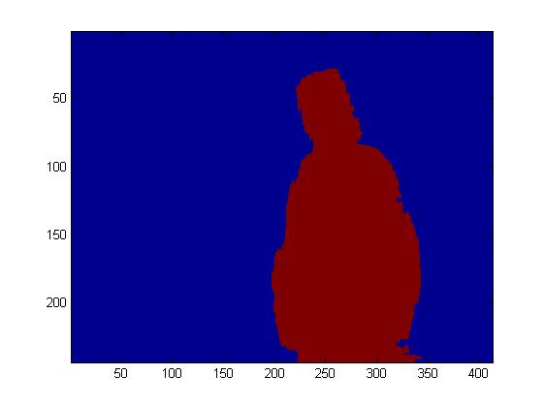
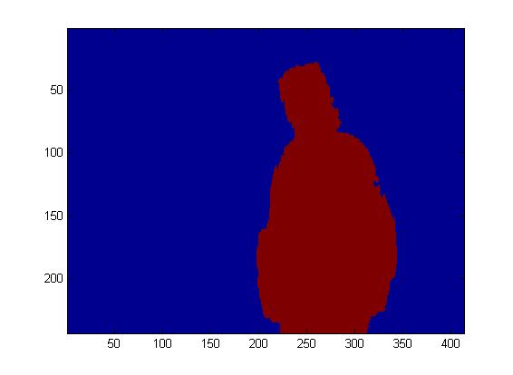
HW4
Effect of varying beta
beta = 0
beta = 2
beta = 4
beta = 6
beta = 8
beta = 10
Segmentations by Congcong Li

Slide 8


HW 5
Potts Model
More general parameters

Slide 9
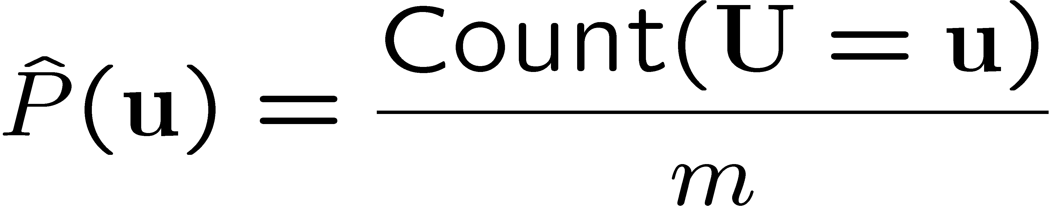
Learning Parameters of a BN
C
Log likelihood decomposes:
Learn each CPT independently
Use counts
D
I
G
S
L
H
J

Slide 10
Learning Parameters of a MN
Coherence
Difficulty
Intelligence
Grade
SAT
Letter
Happy
Job

Slide 11
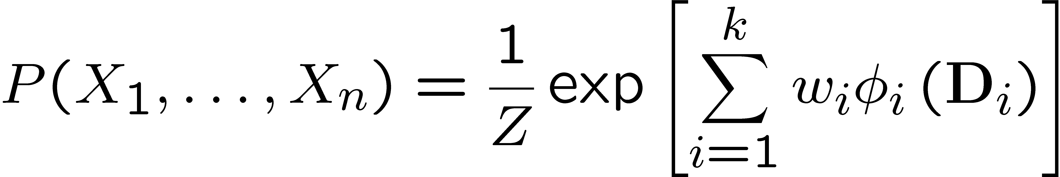
Log-linear Markov network
(most common representation)
Feature is some function φ[D] for some subset of variables D
  e.g., indicator function
Log-linear model over a Markov network H:
  a set of features φ₁[D₁],…, φ_{k}[D_{k}]
    each D_{i} is a subset of a clique in H
    two φ’s can be over the same variables
  a set of weights w₁,…,w_{k}
    usually learned from data

Slide 12
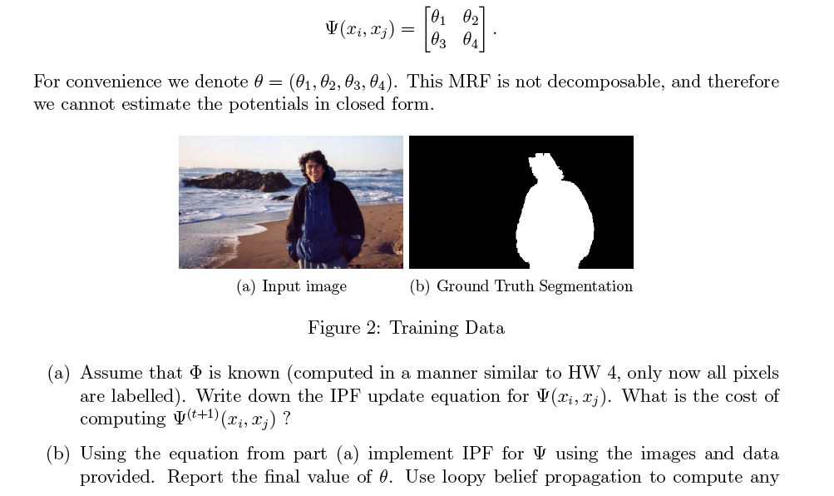
HW 5

Slide 13
Questions?

Slide 14
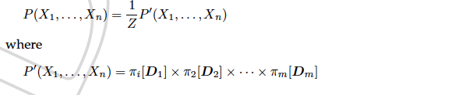


Semantics
Factorization
Energy functions
Equivalent representation

Slide 15
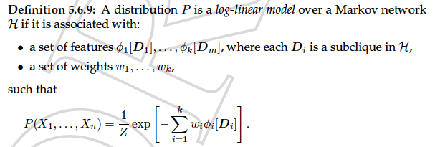
Semantics
Log Linear Models

