Slide 1

Onboard Contextual Classification of 3-D Point Clouds with Learned High-order Markov Random Fields Daniel Munoz Nicolas Vandapel Martial Hebert

Slide 2
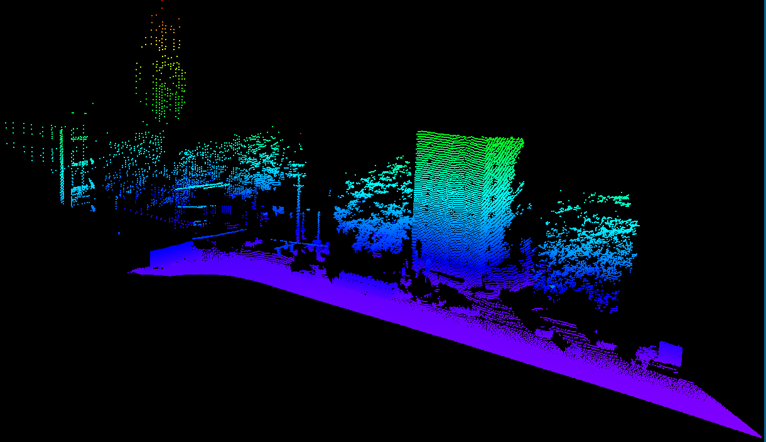
Example of 3-D point cloud

Slide 3
Problem: Automated 3-D point labeling
Assign geometric/semantic label to every 3-D point

Slide 4
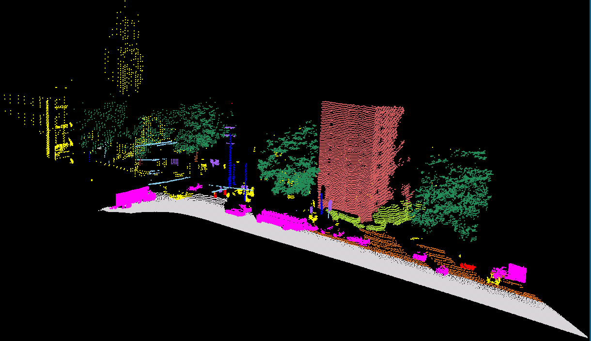
Problem: Automated 3-D point labeling
Hand labeled data

Slide 5
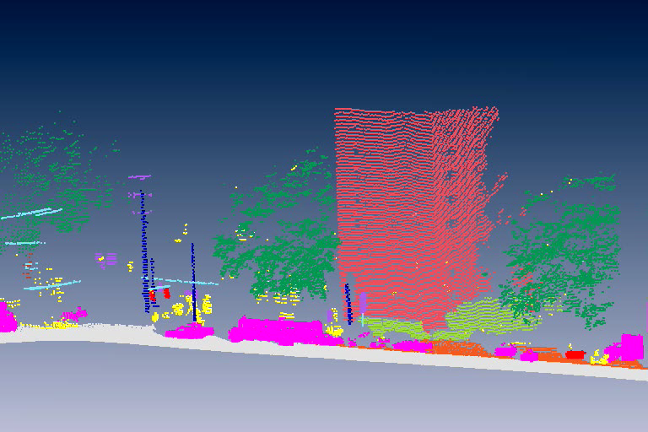
Problem: Automated 3-D point labeling
Hand labeled data

Slide 6
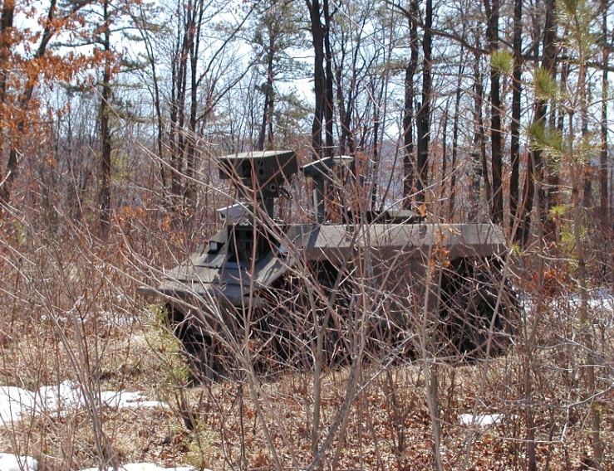
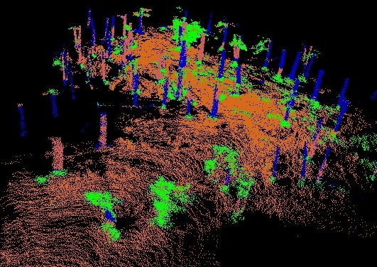
Problem: Automated 3-D point labeling
Do it onboard

Slide 7
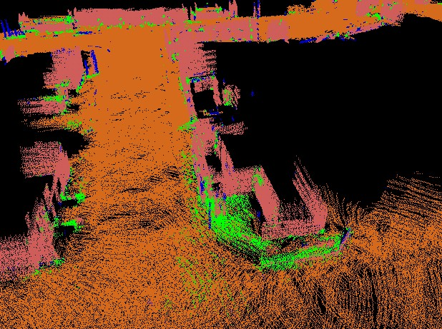
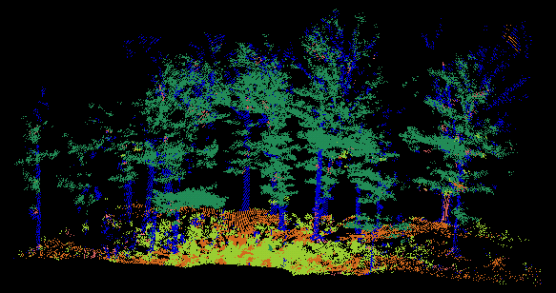
Scene understanding for autonomous vehicle navigation
Environments: urban and natural settings
Labels
Purpose: environment modeling, obstacle detection
Grass | Wire | Pole/Trunk | Ground | Shrub
Foliage | Facade | Wall | Roof

Slide 8
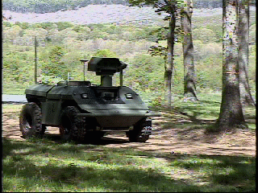
Challenges
Mobility laser data only
Onboard data processing
Process continuously streaming data, over 100 K pts/s
Real-time data processing
Vehicle speed up to 6 m/s (20 km/h)
Demo-III eXperimental Unmanned Vehicle (Demo-III XUV)

Slide 9
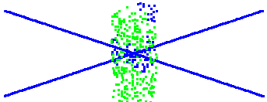
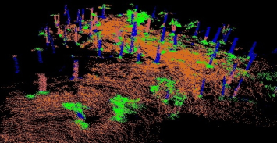
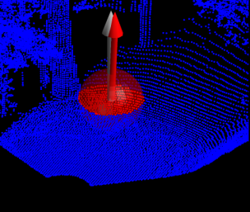
Motivation
Better
Anisotropic MRF [munoz-3dpvt-08]
High-order MRF [munoz-icra-09]
Scale selection [unnikrishnan-3dpvt-06] [lalonde-3dim-05]
Performance & # of classes
Local classification [vandapel-icra-04]
Efficient data structure [lalonde-ijrr-07]
(Off-board)
(On-board)
Better
Computational efficiency

Slide 10
Outline
Model introduction
Contributions
Onboard experiments

Slide 11



Model introduction
Local classifiers
y_{i}

Slide 12
Model introduction
Local classifiers
l_{K}
l_{K}
l_{K}
l_{K}
l₁
l_{K}
l_{K}
l_{K}
l_{K}

Slide 13
Model introduction
Markov Random Fields
Key concepts (see paper for details)
Each E_{c}( ) dependent on features x and label-specific weights w
Classification: optimal* labeling y can be found efficiently
[boykov-pami-01]
Learning: finding w is a convex optimization problem
[taskar-nips-03, ratliff-aistats-07]
y_{i}
y_{j}

Slide 14



Learning high-order interactions
High-order interactions
[kohli-cvpr-07]
Params not learned
This work: cast E_{c} under the same learning framework
y_{c}

Slide 15
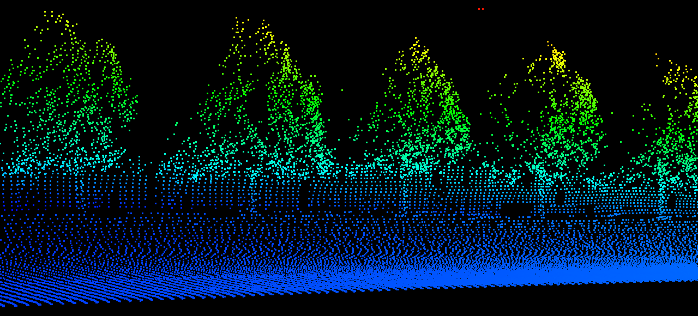
Context approximation
Are pairwise interactions necessary?
(Edge construction = k-NN)

Slide 16
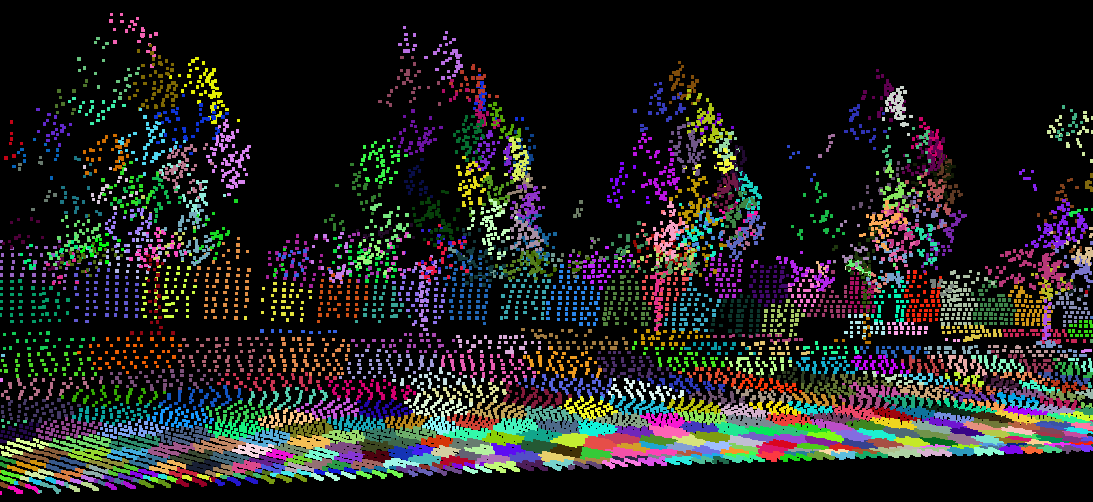
Context approximation
Are pairwise interactions necessary?
Classification comparison vs k-NN pairwise model
1.2 M ground truth points
Counter-intuitive: High-order inference is fast
(High-order clique construction = k-means clustering)
vs | Accuracy rate | Computation speedup (off-board)
5-NN | Slightly worse (87% vs 89%) | 10x faster
3-NN | Similar (87% vs 88%) | 2x faster

Slide 17
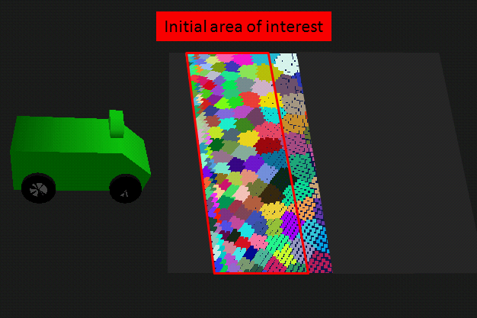
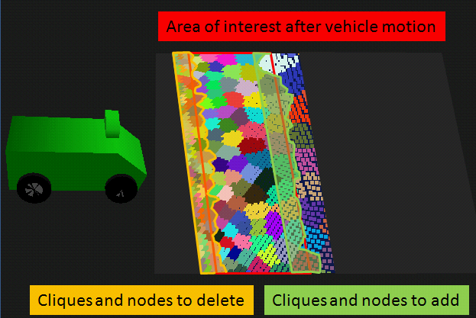
Onboard Classification
Dynamic random field structure
Simple and efficient

Slide 18
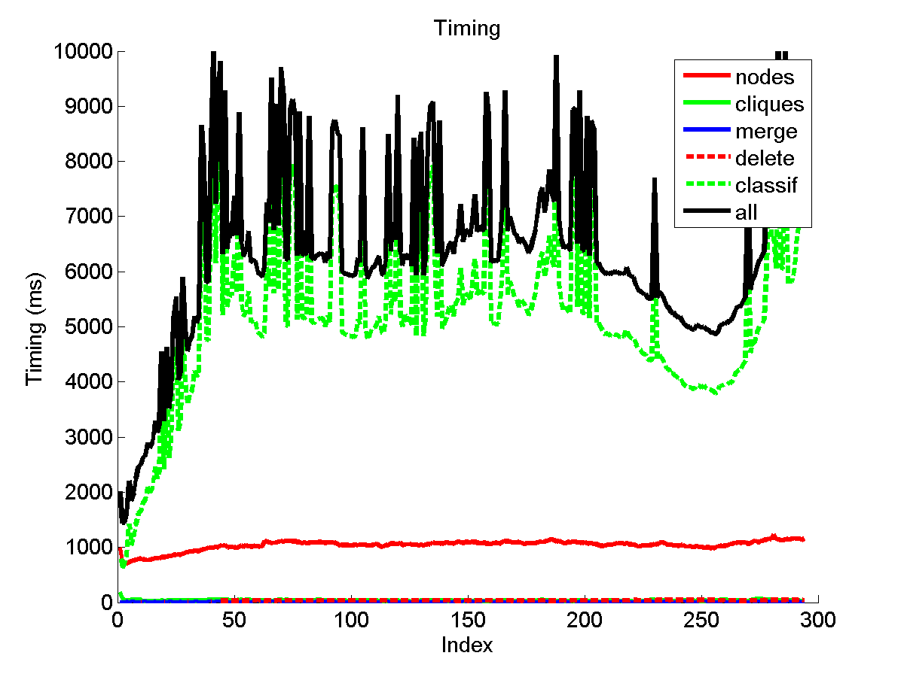
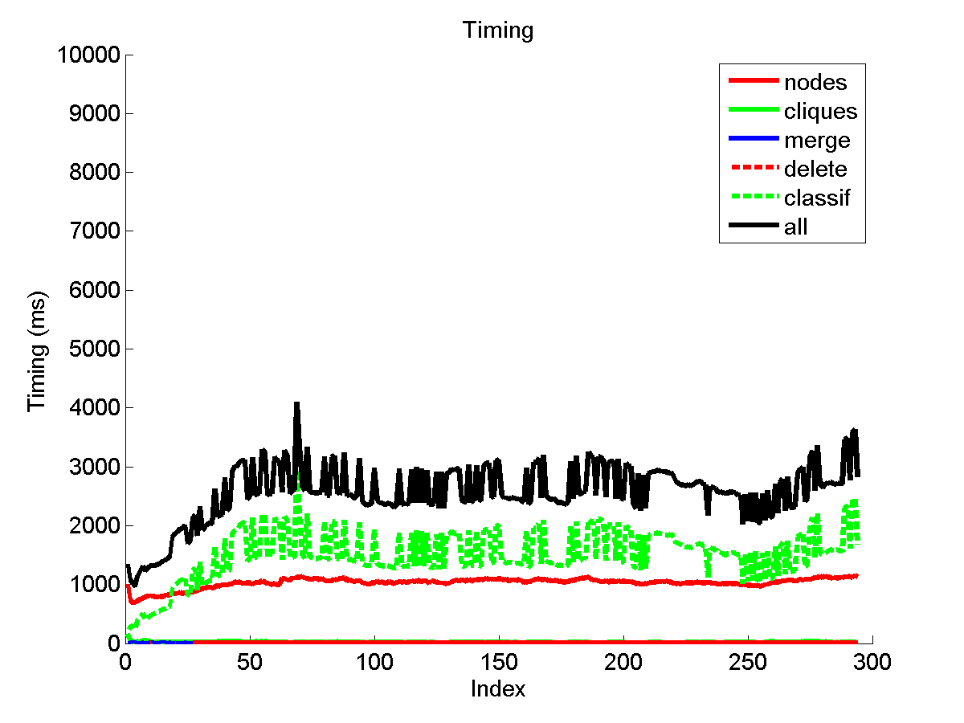
Onboard verification
Comparison
Green = Classification
Black = Total processing time (green + updating graph structure)
Onboard speedup: 3x
Better
Pairwise (3-NN)
Proposed

Slide 19
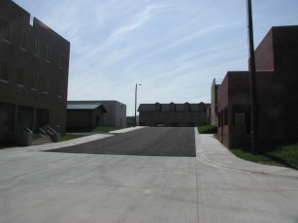
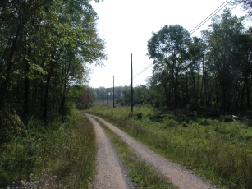
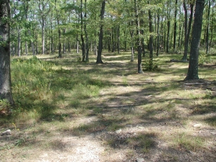
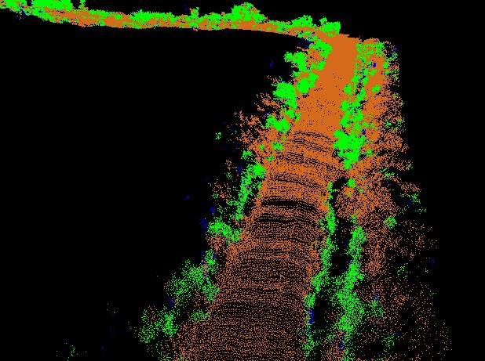
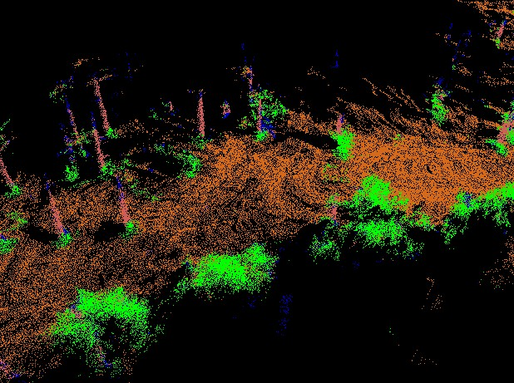
Field experimentation
Tested over 20 km of terrain, 25 x 50 m map
Urban (MOUT), trail and forest environment
Efficient onboard feature computation [lalonde-ijrr-07]

Slide 20
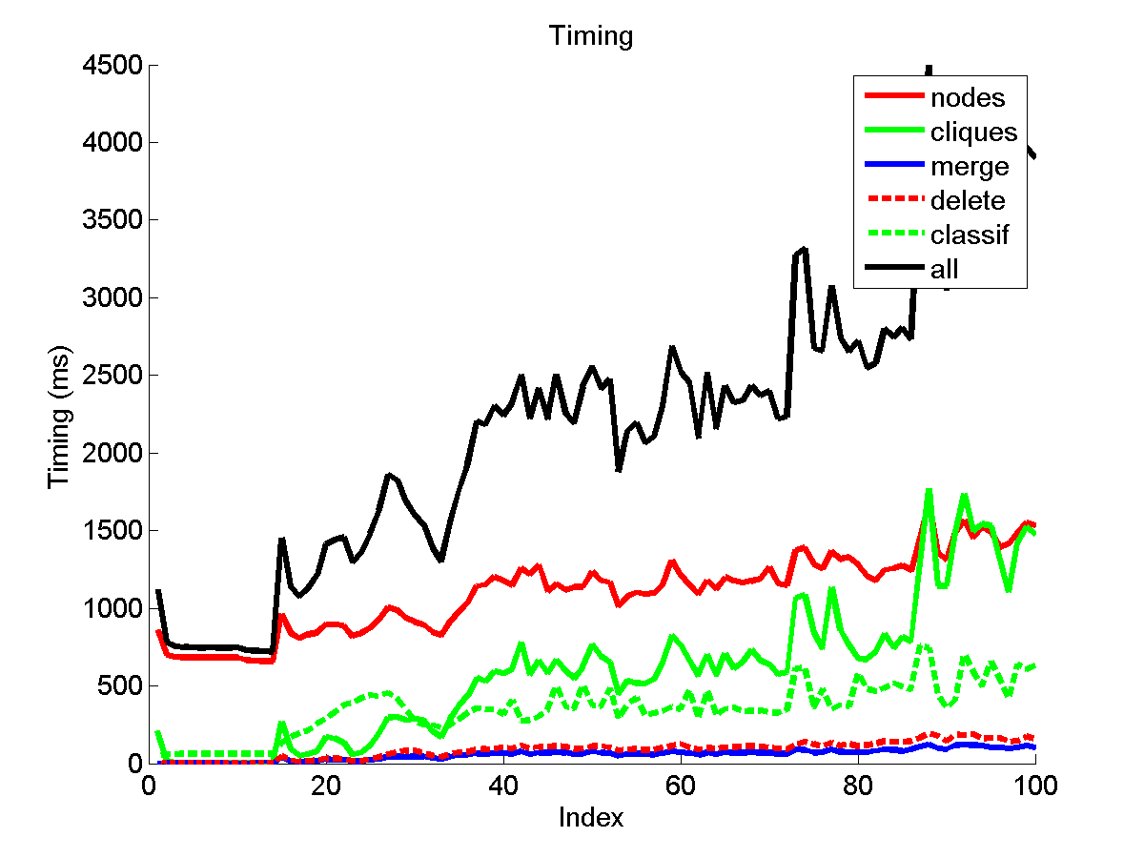
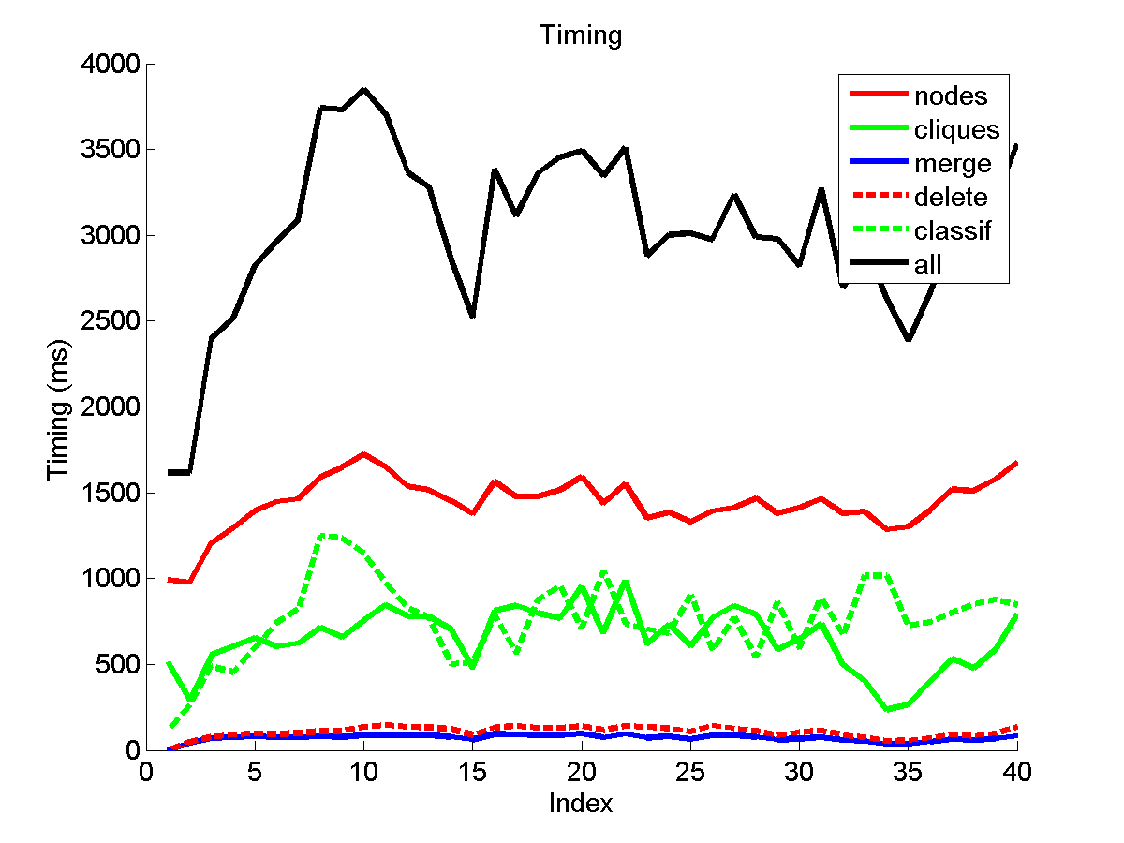
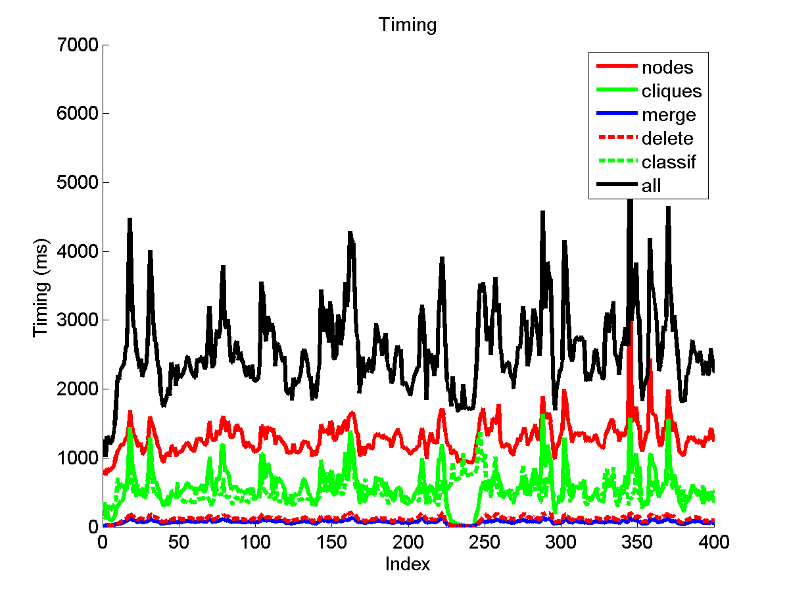
Field experimentation
Average speed: ~2 m/s

Slide 21
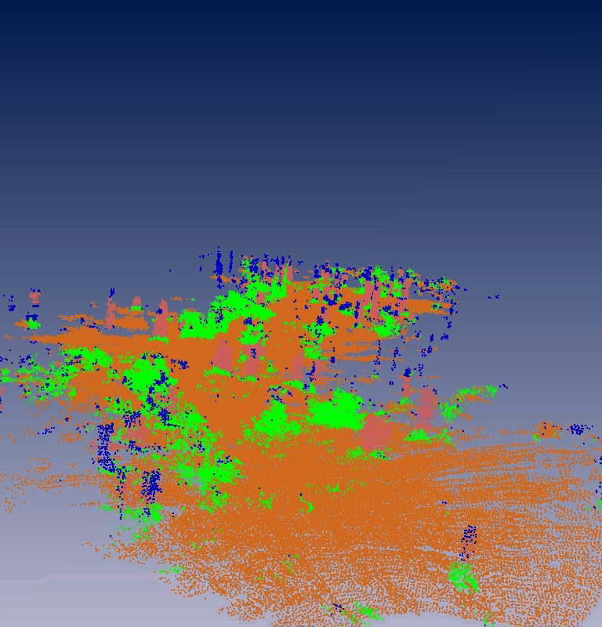
Forest Environment

Slide 22
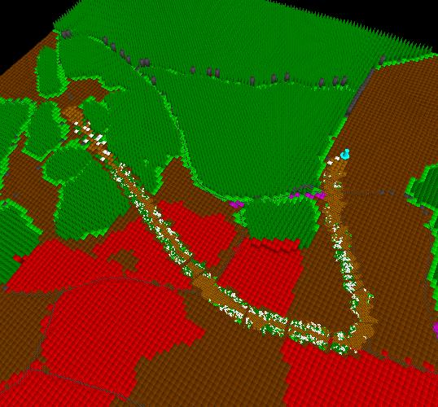
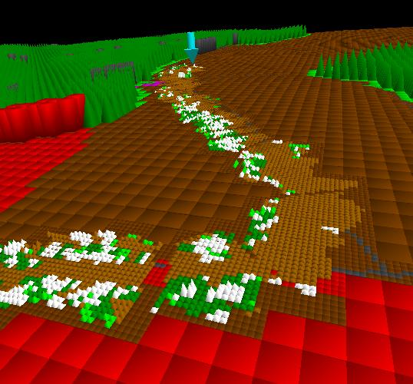
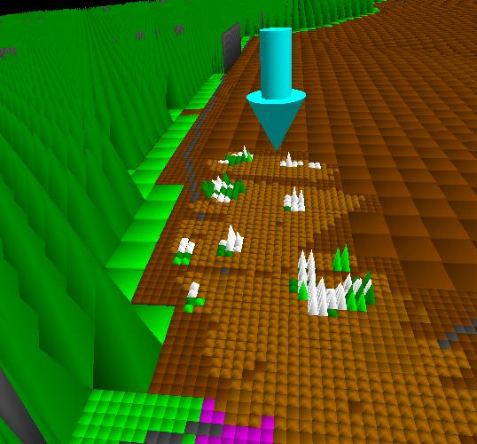
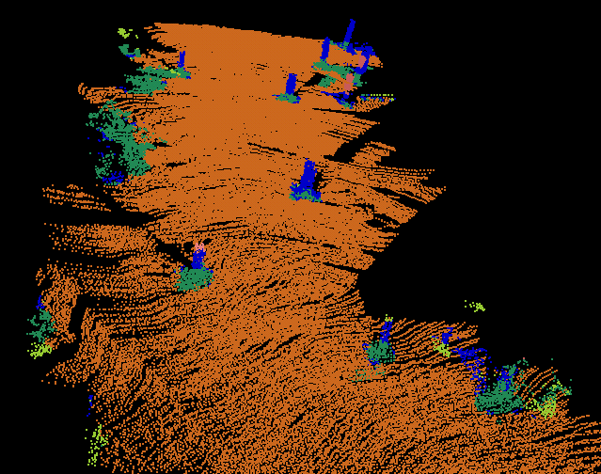
Example of integration
Updating prior map for long range planning

Slide 23

Conclusion
Contributions
Efficiently learn high-order interactions
Context approximation for onboard processing
Fast
Works well in practice
Limitations
Computation time
Clique interactions
Optimization
Functional M³N [munoz-cvpr-09]
Performance & # of classes
High-order interactions [munoz-icra-09]
Computational efficiency

Slide 24
Thank you
Acknowledgements
U.S. Army Research Laboratory
General Dynamics Robotic Systems

