Slide 1

Contextual Classification with
Functional Max-Margin Markov Networks
Dan Munoz | Drew Bagnell
Nicolas Vandapel | Martial Hebert

Slide 2
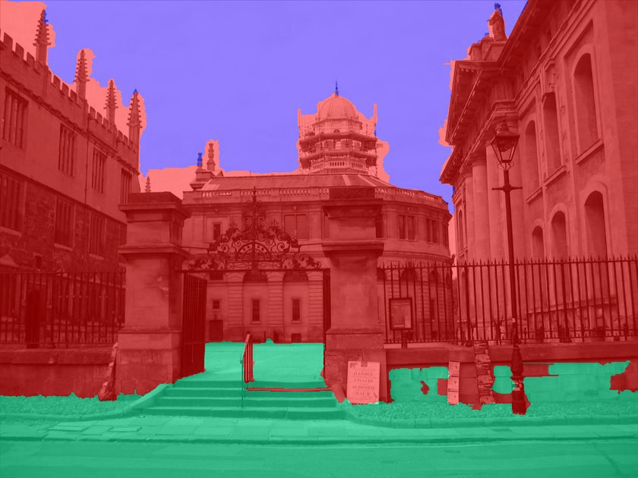
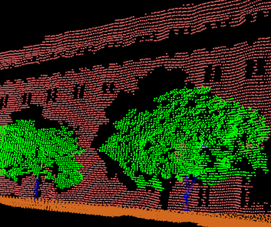
Problem
Geometry Estimation
(Hoiem et al.)
3-D Point Cloud Classification
Wall
Sky
Vertical
Vegetation
Support
Ground
Our classifications
Tree trunk

Slide 3
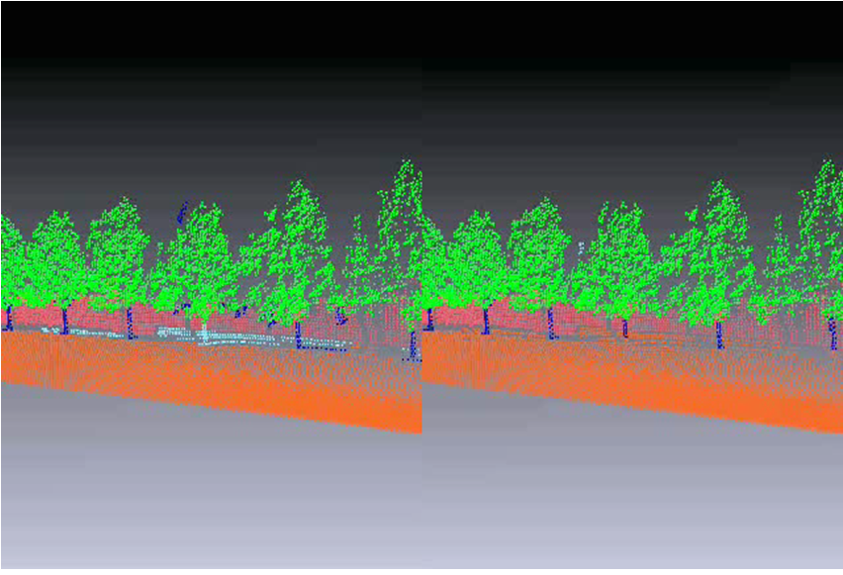
Room For Improvement

Slide 4
Approach: Improving CRF Learning
Gradient descent (w)
“Boosting” (h)
  Friedman et al. 2001, Ratliff et al. 2007
+ Better learn models with high-order interactions
+ Efficiently handle large data & feature sets
+ Enable non-linear clique potentials

Slide 5


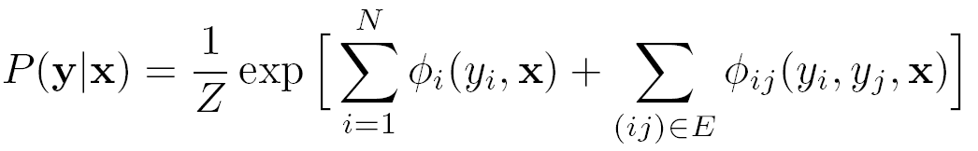
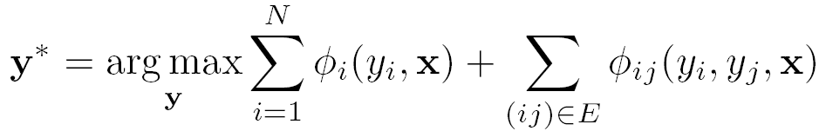
Conditional Random Fields
y_{i}
Lafferty et al. 2001
Pairwise model
MAP Inference
Labels
x

Slide 6
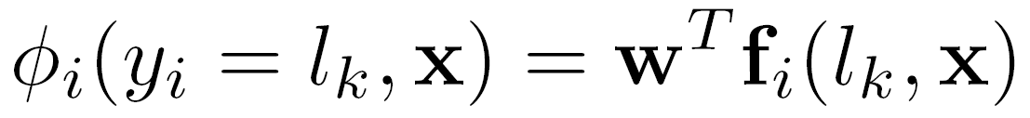
Parametric Linear Model
Weights
Local features that describe label

Slide 7

Associative/Potts Potentials
Labels Disagree

Slide 8
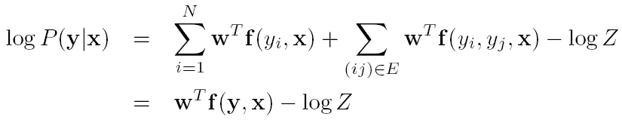
Overall Score
Overall Score for a labeling y to all nodes

Slide 9



Learning Intuition
Iterate
  Classify with current CRF model
  If (misclassified)
  (Same update with edges)
φ( ) increase score
φ( ) decrease score

Slide 10
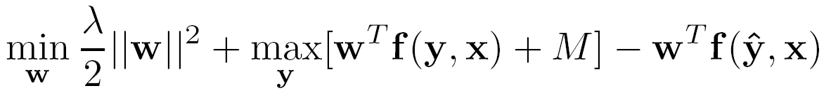
Max-Margin Structured Prediction
Taskar et al. 2003
min
Best score from
all labelings (+M)
Score with
ground truth labeling
w
Ground truth labels
Convex

Slide 11

Descending† Direction
(Objective)
Labels from MAP inference
Ground truth labels

Slide 12
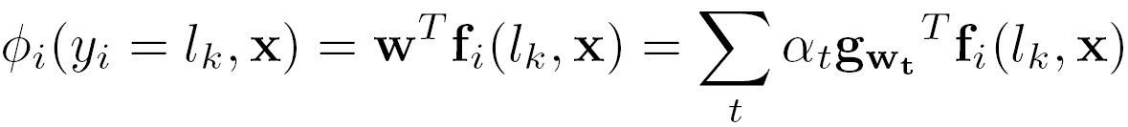
Learned Model

Slide 13






Update Rule
, and λ = 0
Unit step-size
w_{t+1}+=
-
+
-
Ground truth
Inferred

Slide 14
Verify Learning Intuition
Iterate
  If (misclassified)
w_{t+1} +=
-
+
-
φ( ) increase score
φ( ) decrease score

Slide 15
Alternative Update
Create training set: D
  From the misclassified nodes & edges
, +1
, +1
D =
, -1
, -1

Slide 16
Alternative Update
Create training set: D
Train regressor: h_{t}
h_{t}(∙)
D

Slide 17
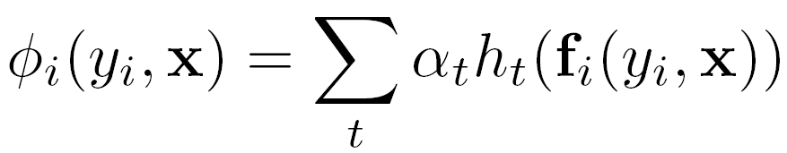
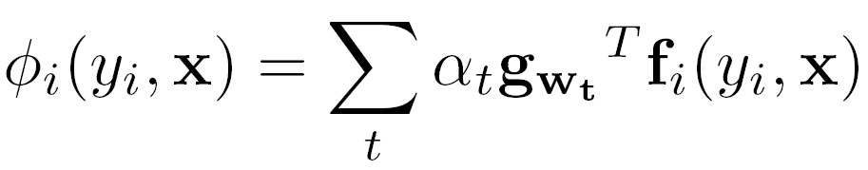
Alternative Update
Create training set: D
Train regressor: h
Augment model:
(Before)

Slide 18
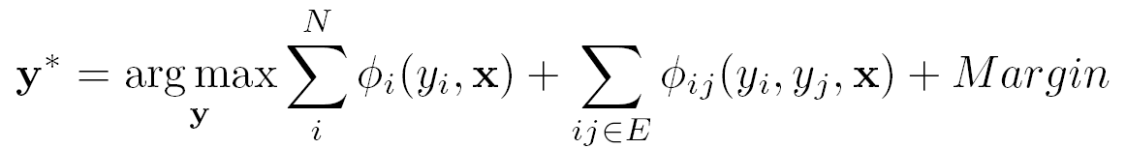

Functional M³N Summary
Given features and labels
for T iterations
  Classification with current model
  Create training set from misclassified cliques
  Train regressor/classifier h_{t}
  Augment model
D

Slide 19
Illustration
Create training set
D
+1
+1
-1
-1

Slide 20
Illustration
Train regressor h_{t}
h₁(∙)
ϕ(∙) = α₁ h₁(∙)

Slide 21
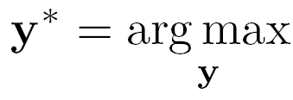
Illustration
Classification with current CRF model
ϕ(∙) = α₁ h₁(∙)

Slide 22
Illustration
Create training set
D
+1
-1
ϕ(∙) = α₁ h₁(∙)

Slide 23
Illustration
Train regressor h_{t}
h₂(∙)
ϕ(∙) = α₁ h₁(∙)+α₂ h₂(∙)

Slide 24
Illustration
Stop
ϕ(∙) = α₁ h₁(∙)+α₂ h₂(∙)

Slide 25
Boosted CRF Related Work
Gradient Tree Boosting for CRFs
  Dietterich et al. 2004
Boosted Random Fields
  Torralba et al. 2004
Virtual Evidence Boosting for CRFs
  Liao et al. 2007
Benefits of Max-Margin objective
  Do not need marginal probabilities
  (Robust) High-order interactions
    Kohli et al. 2007, 2008

Slide 26
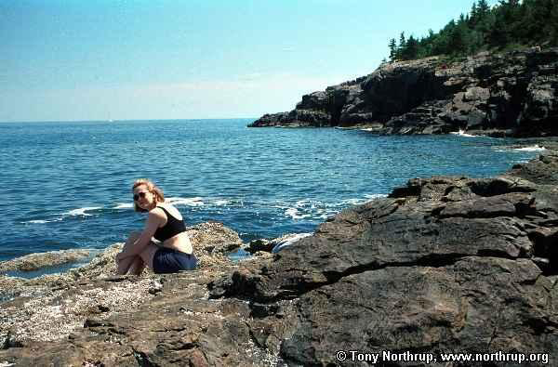
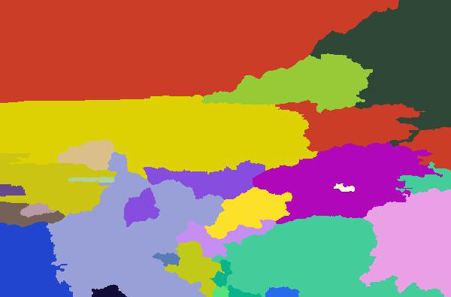
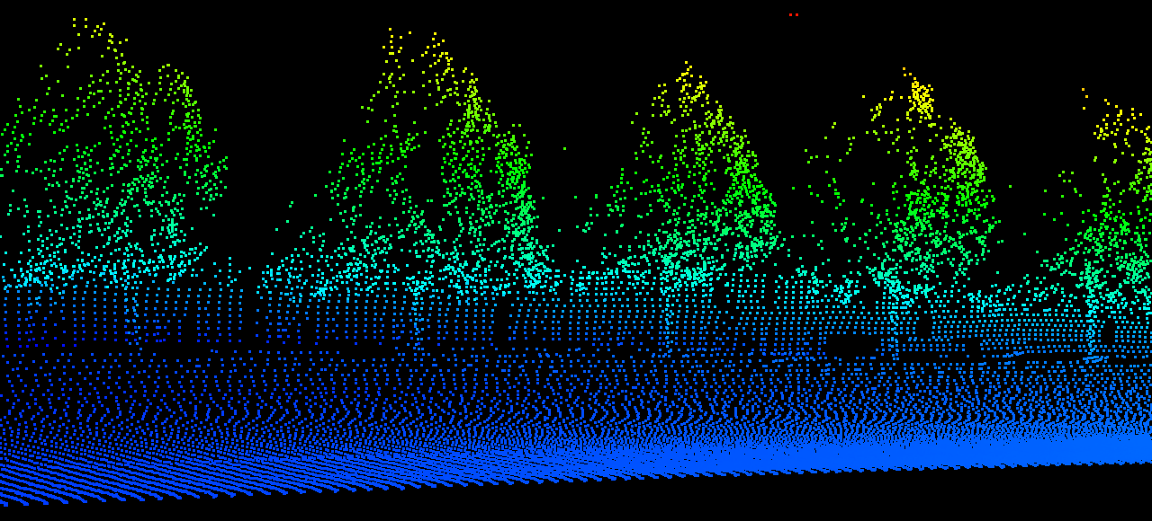
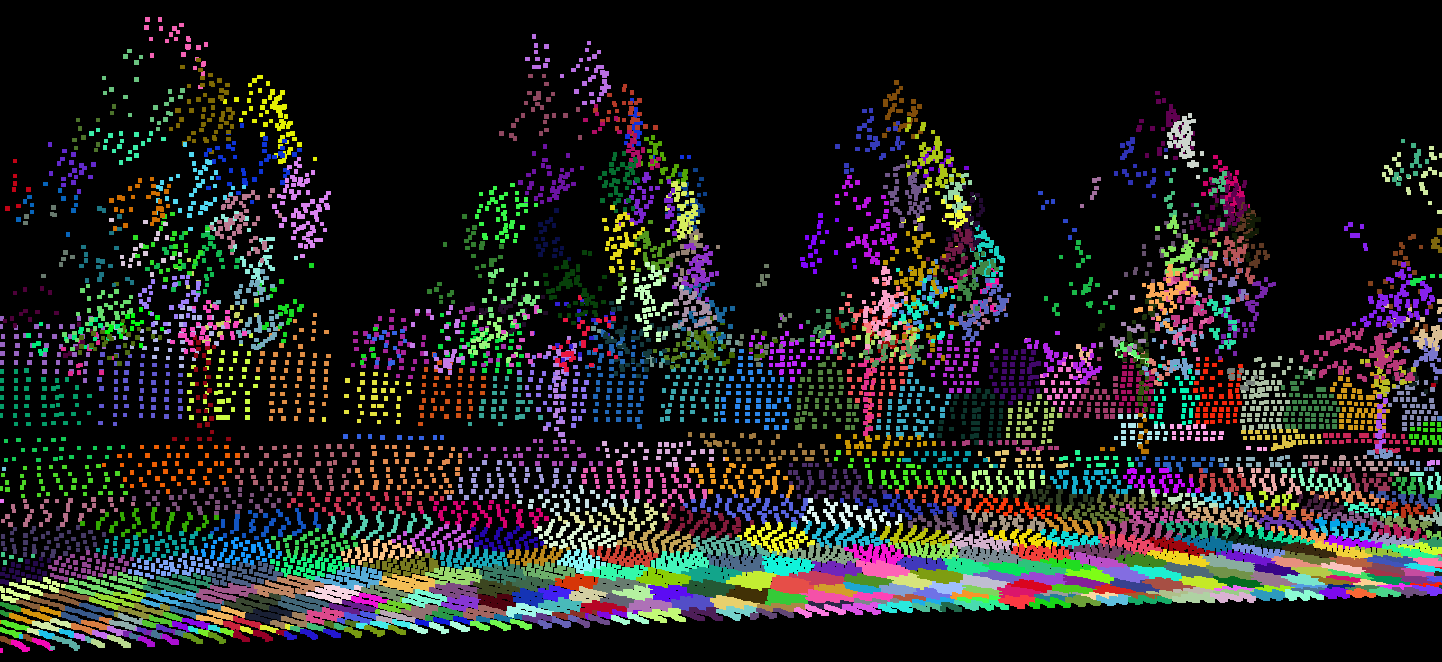
Using Higher Order Information
Colored by elevation

Slide 27
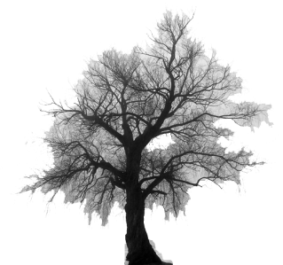
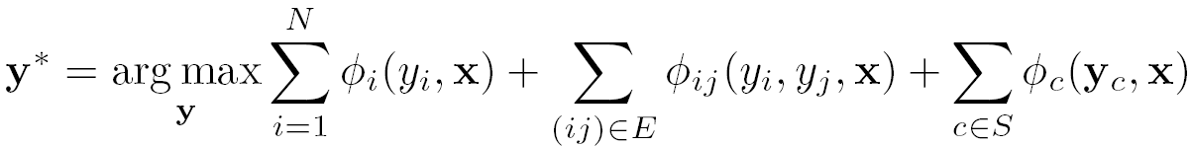
Region Based Model

Slide 28
Region Based Model

Slide 29

Region Based Model
Inference: graph-cut procedure
  P^{n} Potts model (Kohli et al. 2007)

Slide 30
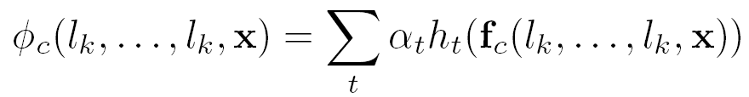

How To Train The Model
Learning
1

Slide 31

How To Train The Model
Learning
(ignores features from clique c)

Slide 32

How To Train The Model
Robust P^{n} Potts
Kohli et al. 2008
β
Learning
1
β

Slide 33
Experimental Analysis
3-D Point Cloud Classification
Geometry Surface Estimation

Slide 34
Random Field Description
Nodes: 3-D points
Edges: 5-Nearest Neighbors
Cliques: Two K-means segmentations
Features
[0,0,1]
θ
normal
Local shape
Orientation
Elevation

Slide 35
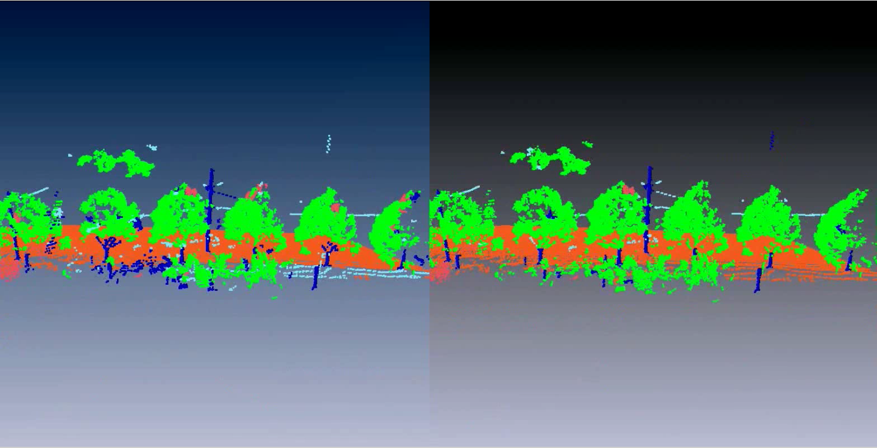
Qualitative Comparisons
Parametric
Functional (this work)

Slide 36
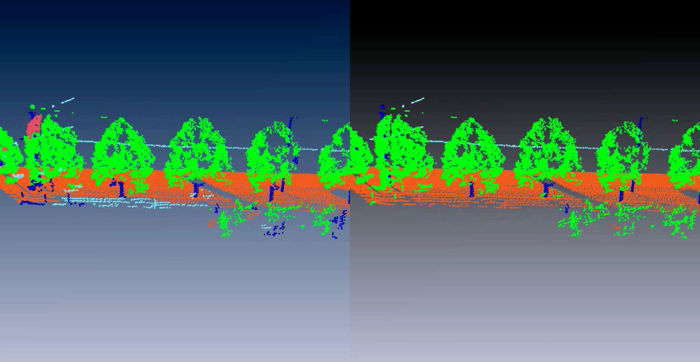
Qualitative Comparisons
Parametric
Functional (this work)

Slide 37
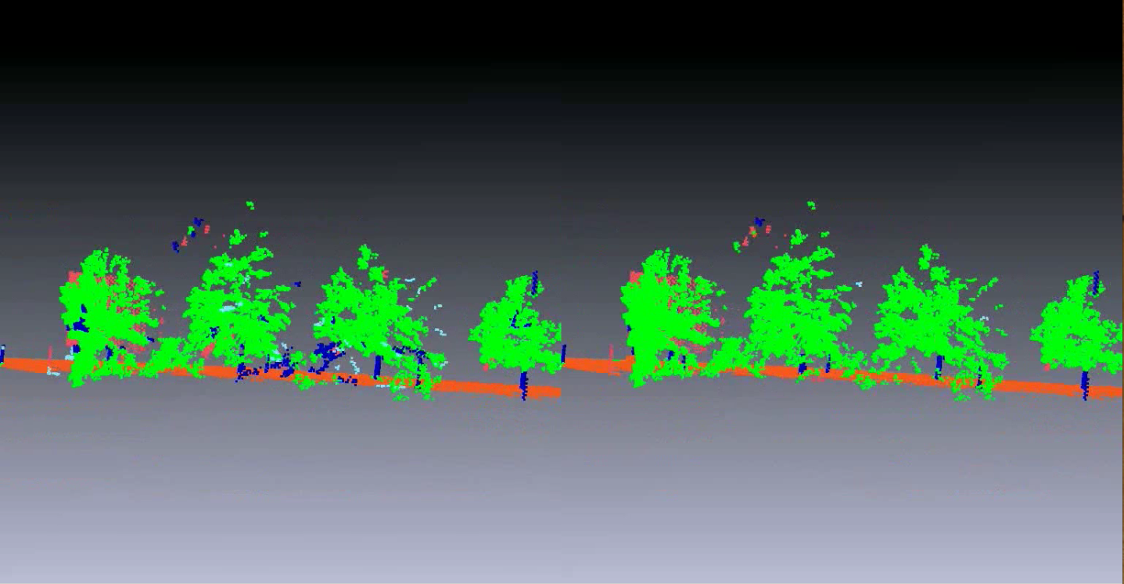
Qualitative Comparisons
Parametric
Functional (this work)

Slide 38
Quantitative Results (1.2 M pts)
Macro* AP:
Parametric 64.3%
Functional 71.5%
+3%
+24%
+4%
+5%
-1%

Slide 39
Experimental Analysis
3-D Point Cloud Classification
Geometry Surface Estimation

Slide 40
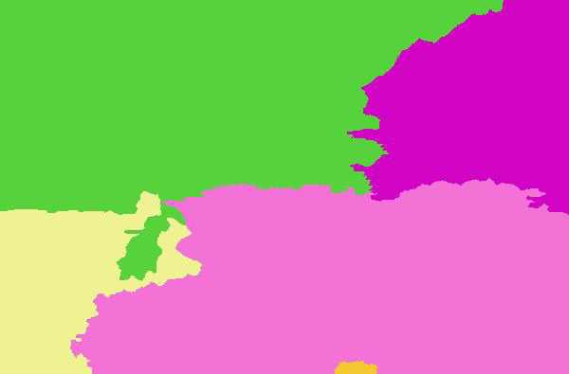
Random Field Description
Nodes: Superpixels (Hoiem et al. 2007)
Edges: (none)
Cliques: 15 segmentations (Hoiem et al. 2007)
Features (Hoiem et al. 2007)
  Perspective, color, texture, etc.
1,000 dimensional space
More Robust

Slide 41
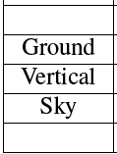
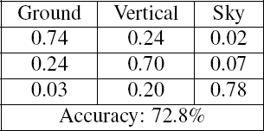
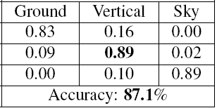
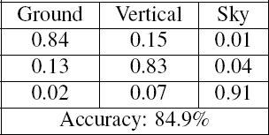
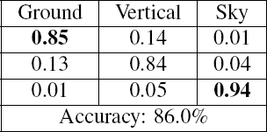
Quantitative Comparisons
Parametric (Potts)
Hoiem et al. 2007
Functional (Potts)
Functional (Robust Potts)

Slide 42
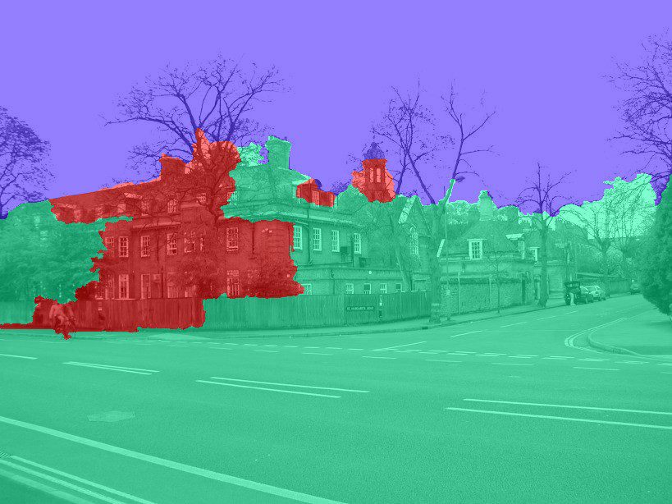
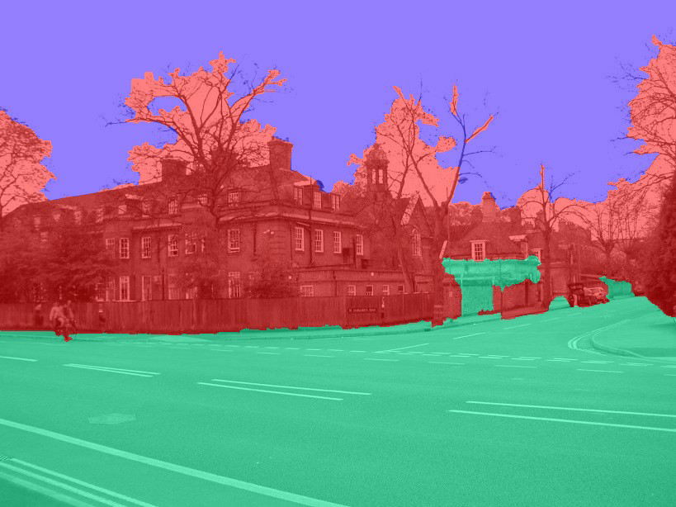
Qualitative Comparisons
Parametric (Potts)
Functional (Potts)

Slide 43
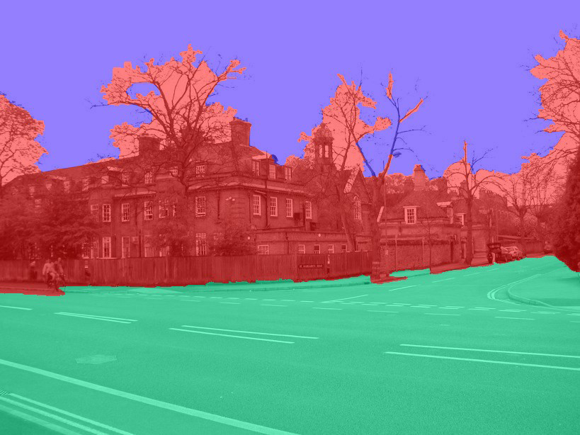
Qualitative Comparisons
Parametric (Potts)
Functional (Potts)
Functional (Robust Potts)

Slide 44
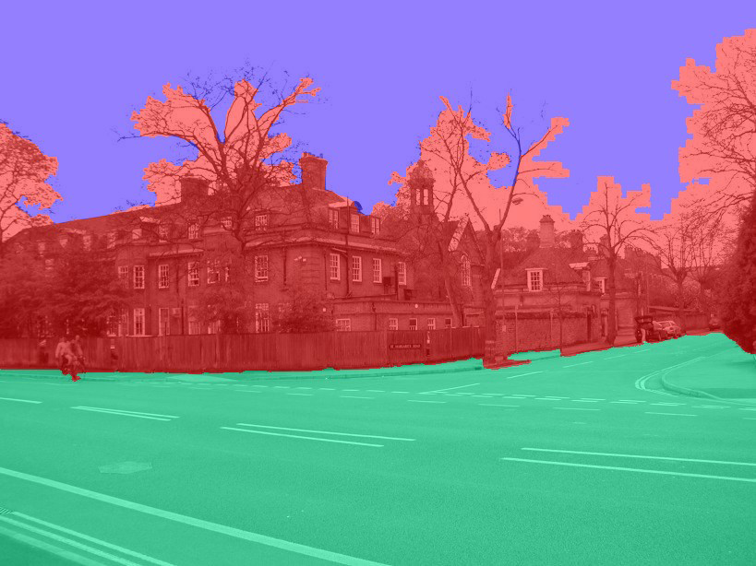
Qualitative Comparisons
Parametric (Potts)
Hoiem et al. 2007
Functional (Potts)
Functional (Robust Potts)

Slide 45

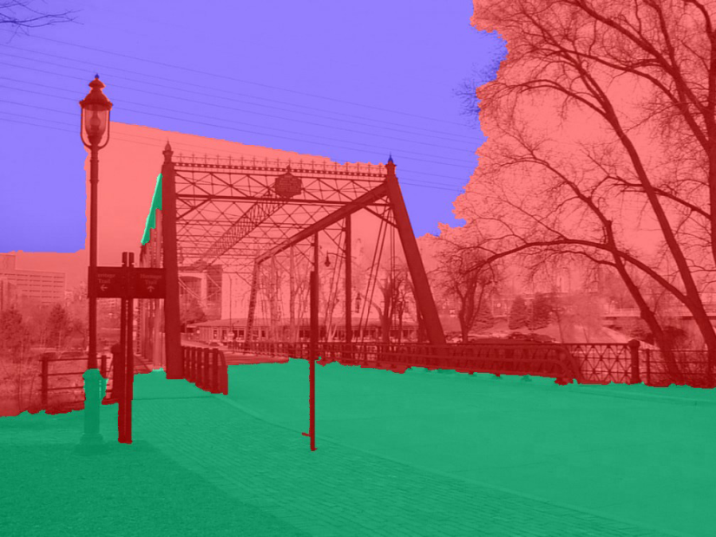

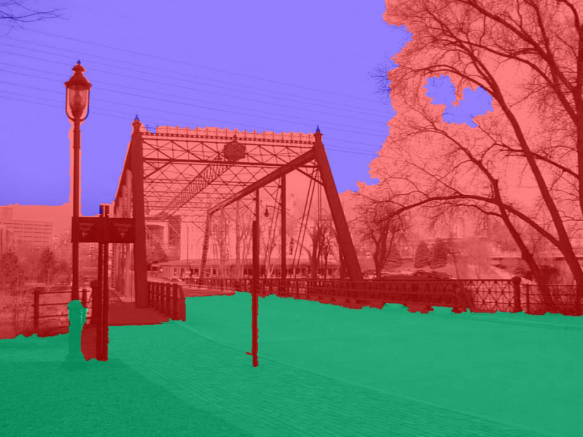
Qualitative Comparisons
Parametric (Potts)
Hoiem et al. 2007
Functional (Potts)
Functional (Robust Potts)

Slide 46
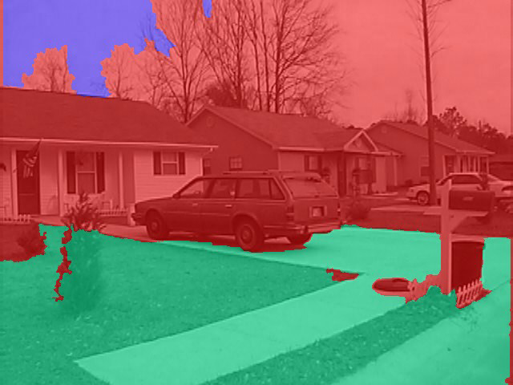
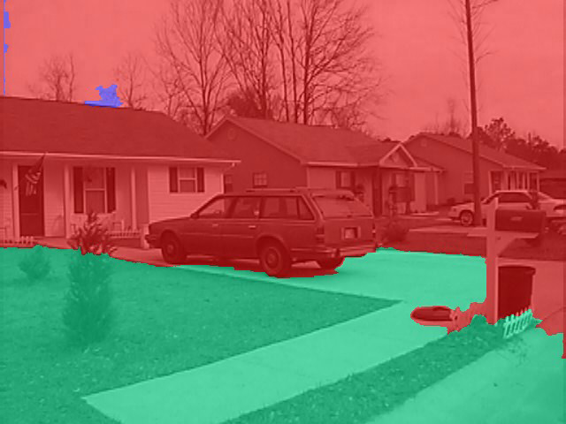
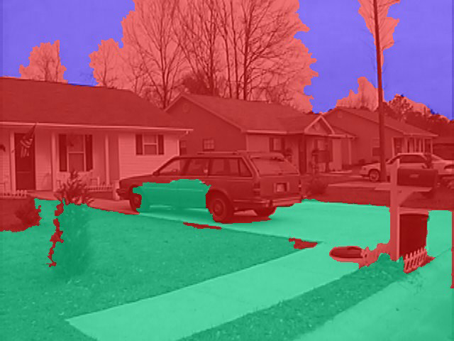
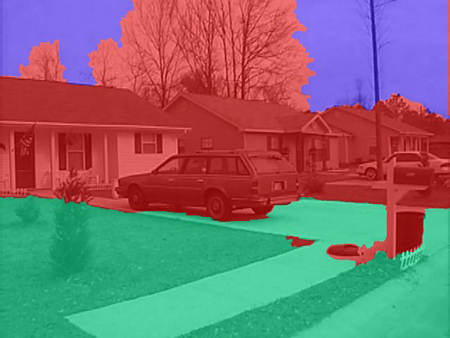
Qualitative Comparisons
Parametric (Potts)
Hoiem et al. 2007
Functional (Potts)
Functional (Robust Potts)

Slide 47
Conclusion
Effective max-margin learning of high-order CRFs
  Especially for large dimensional spaces
  Robust Potts interactions
  Easy to implement
Future work
  Non-linear potentials (decision tree/random forest)
  New inference procedures:
    Komodakisand Paragios 2009
    Ishikawa 2009
    Gould et al. 2009
    Rother et al. 2009

Slide 48
Thank you
Acknowledgements
  U. S. Army Research Laboratory
  Siebel Scholars Foundation
  S. K. Divalla, N. Ratliff, B. Becker
Questions?

