Slide 1



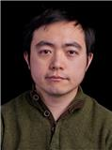

Graph and Tensor Mining for fun and profit
Luna Dong, Christos Faloutsos
Andrey Kan, Jun Ma, Subho Mukherjee

Slide 2
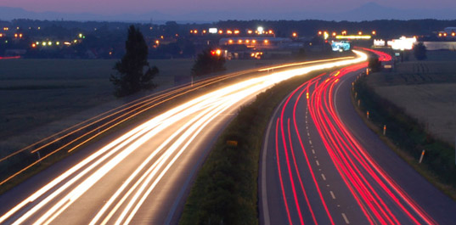
Roadmap
Introduction – Motivation
Part#1: Graphs
Part#2: Tensors and Knowledge Bases
Conclusions – Future research

Slide 3
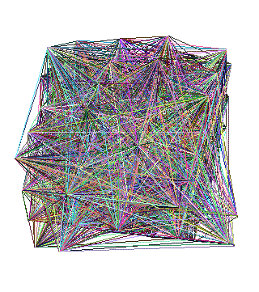
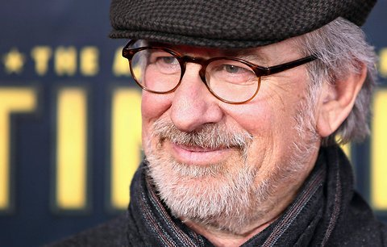






Over-arching conclusion
MANY, time-tested, algorithms for graph & tensor mining
(more, are needed)
…
directed
dates
…
Acted_in
…
born_in
produced

Slide 4
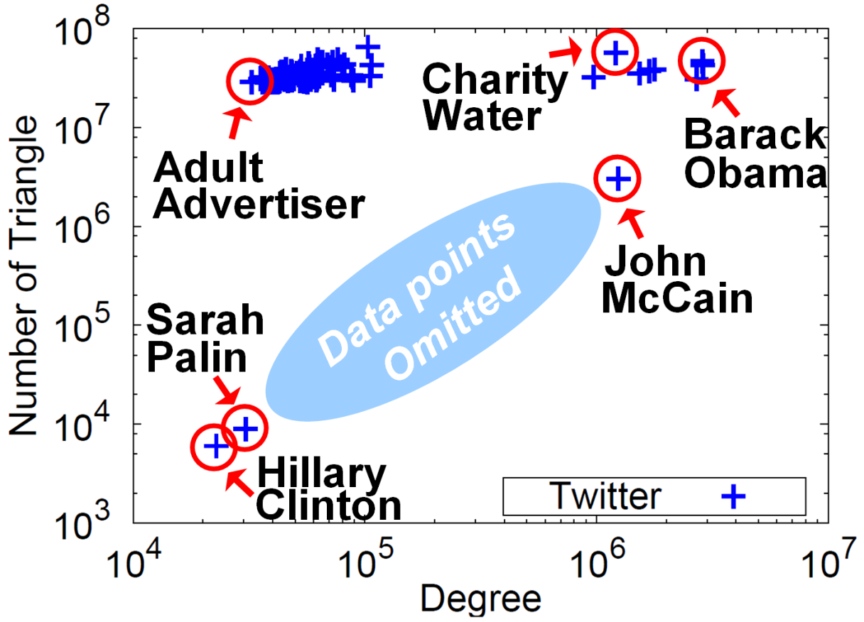
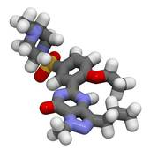

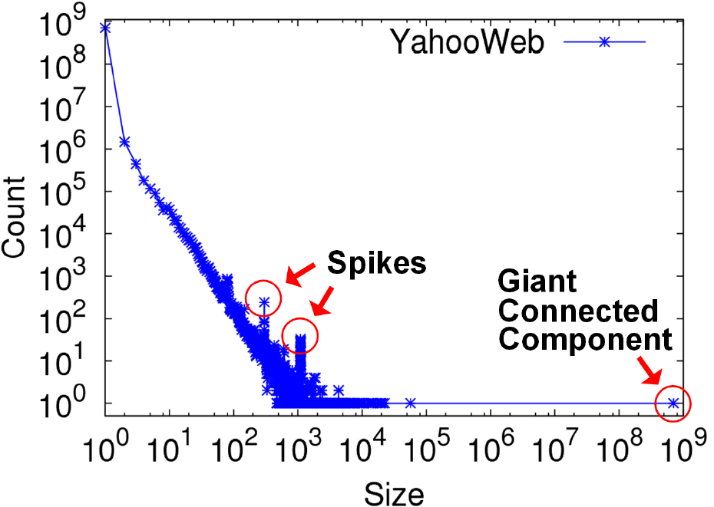


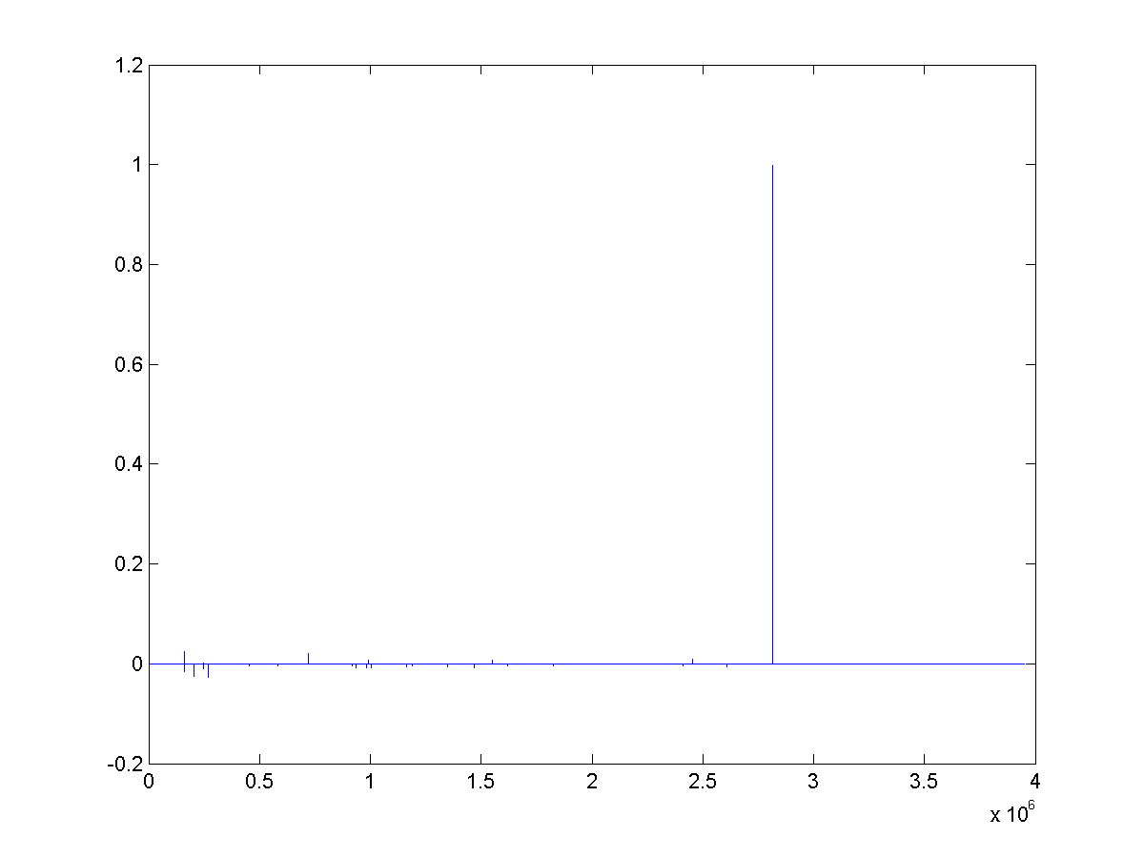
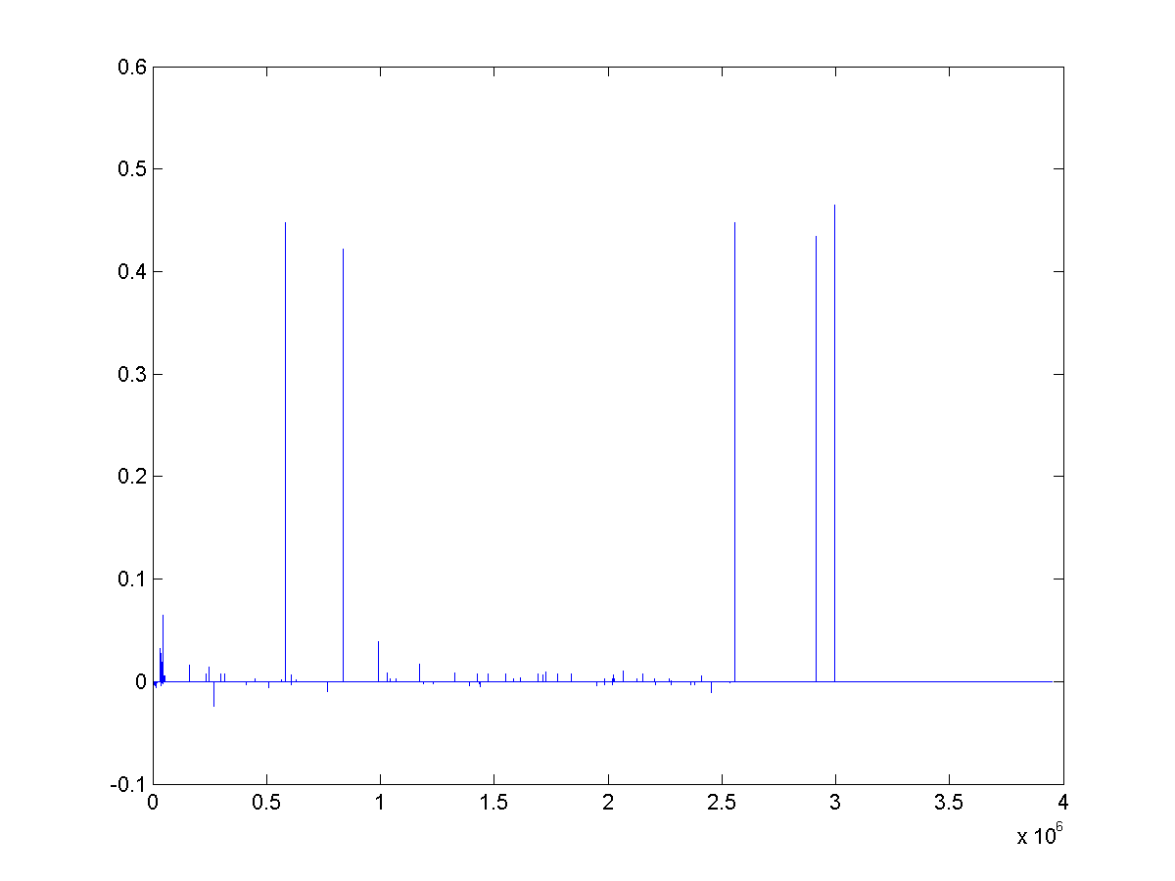
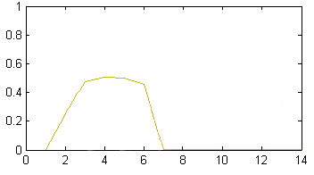
Over-arching conclusion
…
directed
dates
…
Problems
…
Acted_in
born_in
produced
=
+
+
(some) solutions

Slide 5
Roadmap
Introduction – Motivation
Part#1: Graphs
  P1.1: properties/patterns in graphs
  P1.2: node importance
  P1.3: community detection
  P1.4: fraud/anomaly detection
  P1.5: belief propagation
?
?

Slide 6

Problem definition
?
?
Are real graphs random?
  S*: what do static graphs look like?
  T*: how do graphs evolve over time?

Slide 7

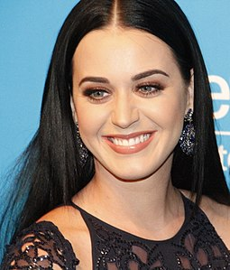
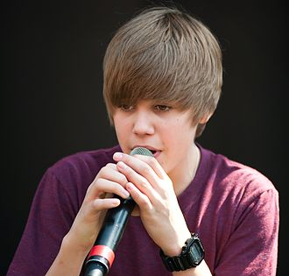
Short answer(s)
?
?
Are real graphs random?
  S*: what do static graphs look like?
    S.0: ‘six degrees’
    S.1: skewed degree distribution
    S.2: skewed eigenvalues
    S.3: triangle power-laws
    S.4: GCC; and skewed distr. of conn. comp.
  T*: how do graphs evolve over time?
    T.1: diameters
    T.2: densification

Slide 8
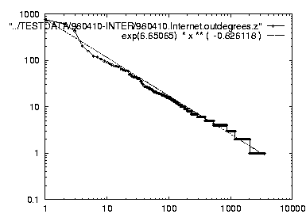
Short answer(s)
?
?
Are real graphs random?
  S*: what do static graphs look like?
    S.0: ‘six degrees’
    S.1: skewed degree distribution
    S.2: skewed eigenvalues
    S.3: triangle power-laws
    S.4: GCC; and skewed distr. of conn. comp.
  T*: how do graphs evolve over time?
    T.1: diameters
    T.2: densification
Power laws: y ~ xª
NOT Gaussians
Take logarithms
y (log scale)
a
x (log scale)

Slide 9
Roadmap
Introduction – Motivation
Part#1: Graphs
  P1.1: properties/patterns in graphs
  P1.2: node importance
  P1.3: community detection
  P1.4: fraud/anomaly detection
  P1.5: belief propagation
?

Slide 10
Node importance - Motivation:
Given a graph (eg., web pages containing the desirable query word)
Q: Which node is the most important?

Slide 11
Node importance - Motivation:
Given a graph (eg., web pages containing the desirable query word)
Q: Which node is the most important?
A1: PageRank (PR)
A2: HITS
A3: SALSA

Slide 12
Roadmap
Introduction – Motivation
Part#1: Graphs
  P1.1: properties/patterns in graphs
  P1.2: node importance
  P1.3: community detection
  P1.4: fraud/anomaly detection
  P1.5: belief propagation
?

Slide 13
Problem Definition
Given a graph, and k
Break it into k (disjoint) communities

Slide 14

Short answer
METIS [Karypis, Kumar]
(but: maybe NO good cuts exist!)

Slide 15
Roadmap
Introduction – Motivation
Part#1: Graphs
  P1.1: properties/patterns in graphs
  P1.2: node importance
  P1.3: community detection
  P1.4: fraud/anomaly detection
  P1.5: belief propagation
?

Slide 16
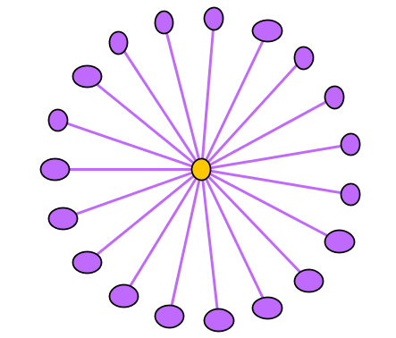
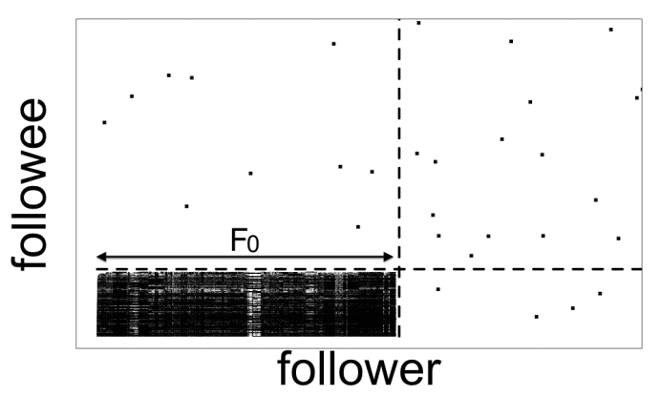
Problem
Given:
Find:
Outliers
Lock-step

Slide 17
Solution
Given:
Find:
Outliers
Lock-step
OddBall
SVD

Slide 18
Roadmap
Introduction – Motivation
Part#1: Graphs
  P1.1: properties/patterns in graphs
  P1.2: node importance
  P1.3: community detection
  P1.4: fraud/anomaly detection
  P1.5: belief propagation

Slide 19
Problem
What color, for the rest?
  Given homophily (/heterophily etc)?

Slide 20
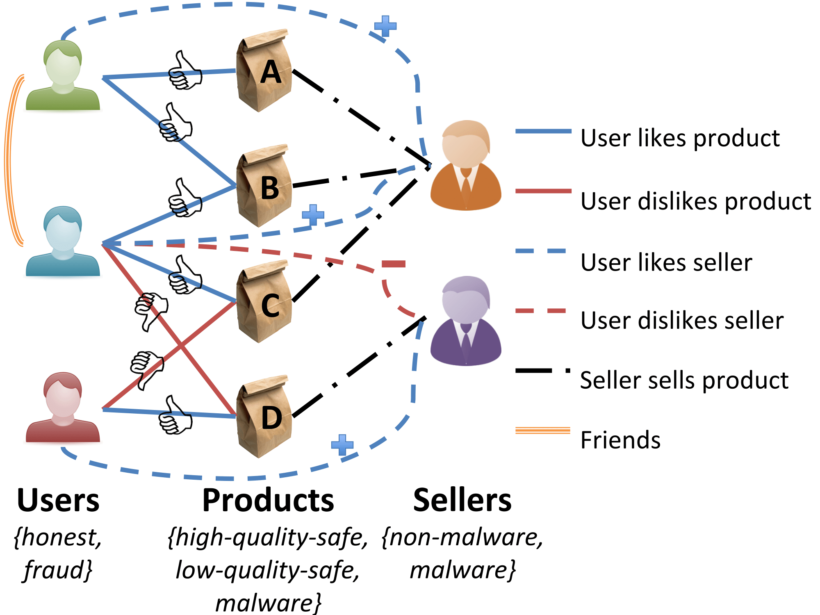
Short answer:
What color, for the rest?
A: Belief Propagation (‘zooBP’)
www.cs.cmu.edu/~deswaran/code/zoobp.zip

Slide 21
Roadmap
Introduction – Motivation
Part#1: Graphs
Part#2: Tensors
  P2.1: Basics (dfn, PARAFAC, HAR)
  P2.2: Embeddings & mining
  P2.3: Inference
Conclusions

Slide 22



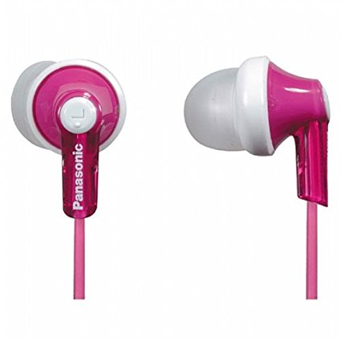


Problem dfn
What is ‘normal’? suspicious? Groups?
3am, 4/1
…
3am, 4/1
…
10pm, 4/3
11pm, 4/3

Slide 23
Recipe(s)
What is ‘normal’? suspicious? Groups?
A: tensor factorization (~ high-mode SVD)
  PARAFAC (shown here)
  Tucker
Apple
fans
3am, 4/1
…
shoes
jewelry
3am, 4/1
timestamp
…
customer
=
+
+
10pm, 4/3
11pm, 4/3
product

Slide 24
Roadmap
Introduction – Motivation
Part#1: Graphs
Part#2: Tensors
  P2.1: Basics (dfn, PARAFAC)
  P2.2: Embeddings & mining
  P2.3: Inference
Conclusions

Slide 25
P2.2: Problem: embedding
Given entities & predicates, find mappings
locations
…
directed
…
dates
Acted_in
artists
born_in
produced
relations+
directed
dates
Acted_in
Artistic-pred.

Slide 26
Short answer
S1. Two potential relationships among
sub (h), pred (r), and obj (t)?
  Addition: h + r =?= t
  Multiplication: h ⚬ r =?= t
S2. Two loss function options
  Closed-world assumption
  Open-world assumption
State-of-the-art results
Multiplication model
Open-world assumption

Slide 27
Roadmap
Introduction – Motivation
Part#1: Graphs
Part#2: Tensors
  P2.1: Basics (dfn, PARAFAC)
  P2.2: Embeddings & mining
  P2.3: Inference
Conclusions

Slide 28
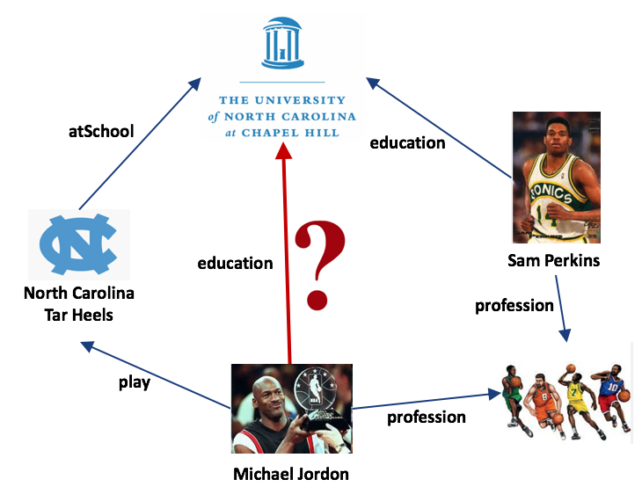
Problem Definition
Given existing triples
Q: Is a given triple correct?

Slide 29
Conclusion/Short answer
Infer from other connecting paths
Path 1
Path 2
Prec | 1
Rec | 0.01
F1 | 0.03
Weight | 2.62
Prec | 0.03
Rec | 0.33
F1 | 0.04
Weight | 2.19

Slide 30
Roadmap
Introduction – Motivation
Part#1: Graphs
Part#2: Tensors and Knowledge Bases
Conclusions – Future directions
  F1: forecasting
  F2: unifying factual info and behavior info

Slide 31
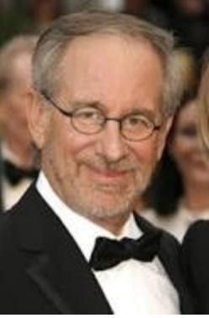
Future work – F1
Forecasting:
  Who will buy what, and when?
All of us every single year, we're a different person.
3am, 4/1
…
3am, 4/1
…
10pm, 4/3
11pm, 4/3

Slide 32
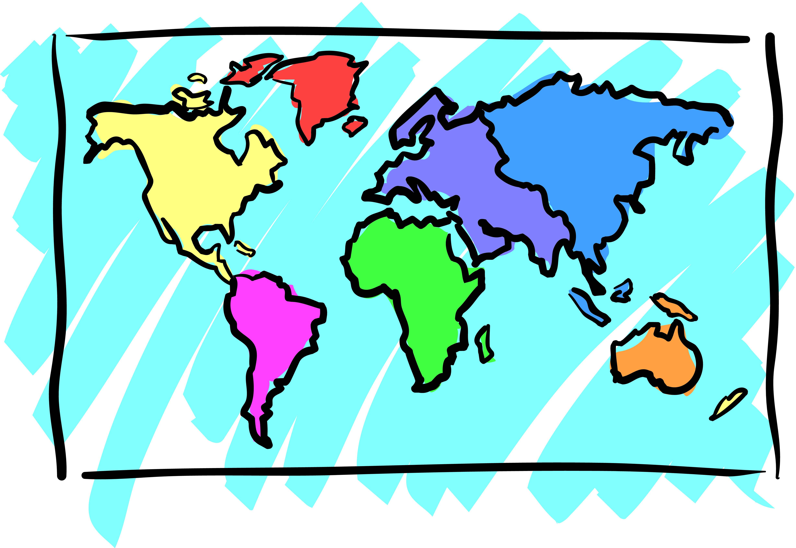
Future work – F2
Customer info + behavior + Product Graph
3am, 4/1
…
…
directed
3am, 4/1
dates
…
…
Acted_in
10pm, 4/3
…
born_in
11pm, 4/3
produced

Slide 33
Future work – F2
Customer info + behavior + Product Graph
3am, 4/1
…
…
directed
3am, 4/1
dates
…
…
Acted_in
10pm, 4/3
…
born_in
11pm, 4/3
produced

Slide 34
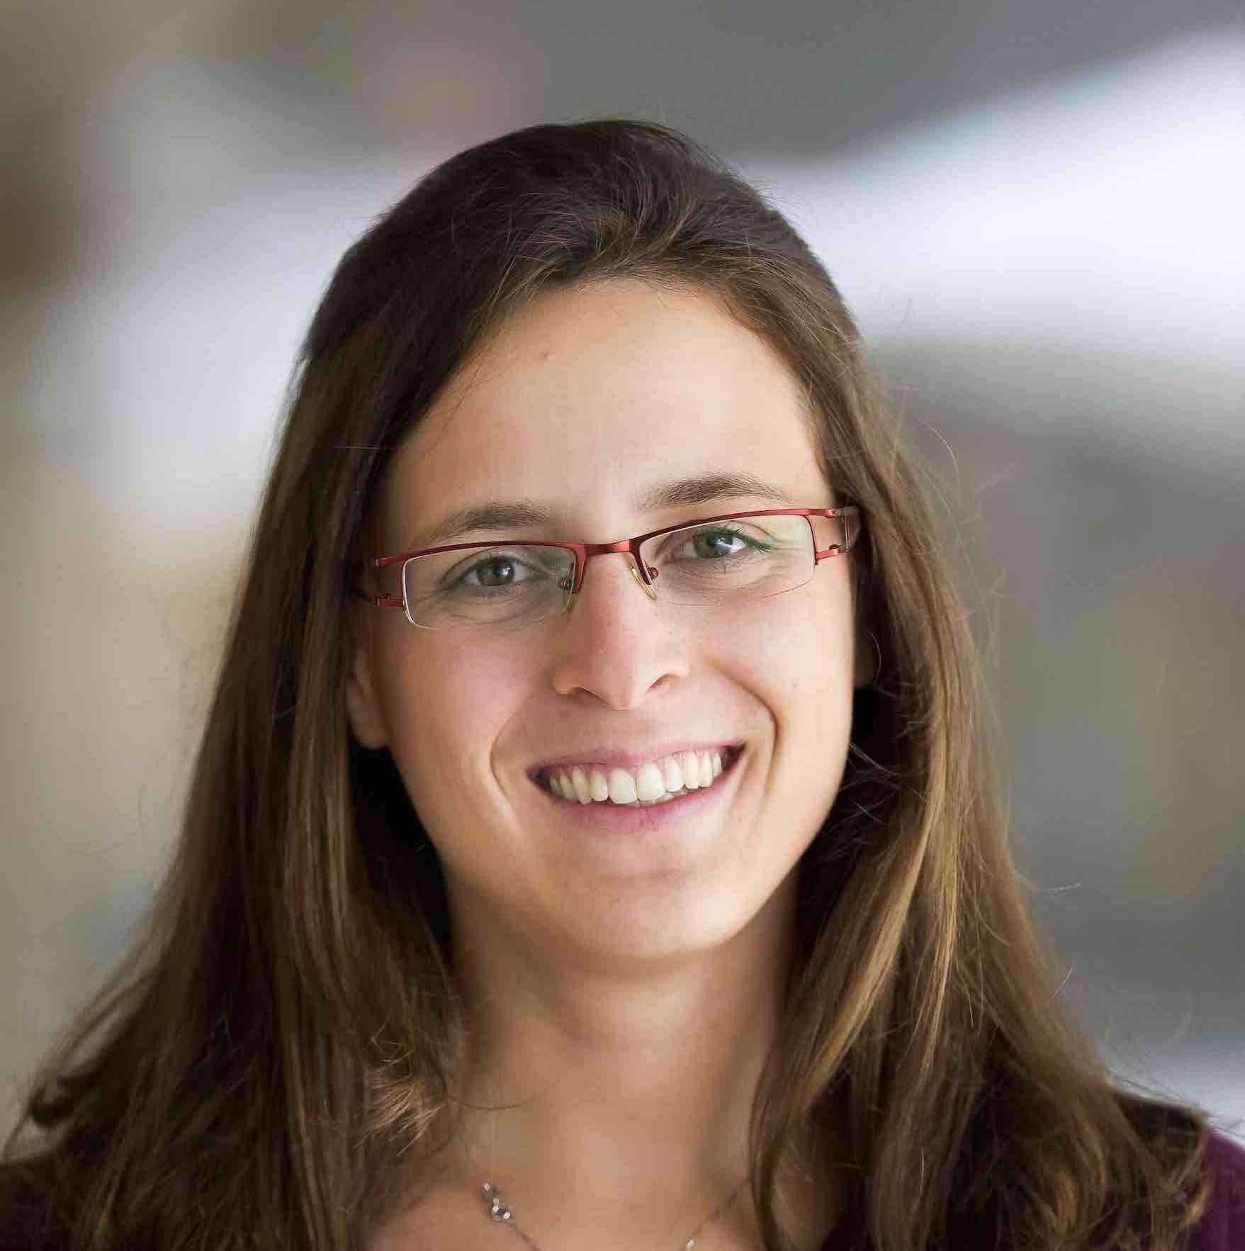

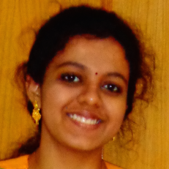

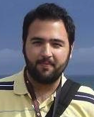

Thanks to
Danai Koutra
U. Michigan
Namyong Park
CMU
Dhivya Eswaran
CMU
Hyun Ah Song
CMU
Vagelis
Papalexakis
UCR
Rakshit Trivedi
George Tech

Slide 35
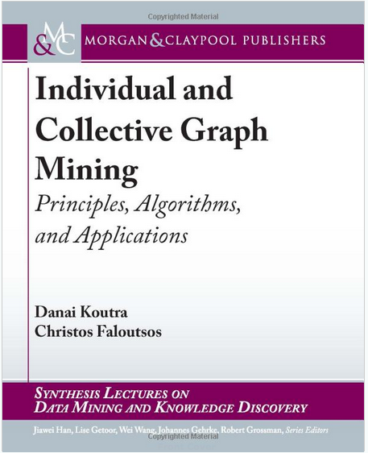
P1 – Graphs - More references
Danai Koutra and Christos Faloutsos, Individual and Collective Graph Mining: Principles, Algorithms, and Applications October 2017, Morgan Claypool

Slide 36
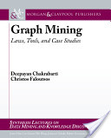

P1 – Graphs - More references
Deepayan Chakrabarti and Christos Faloutsos, Graph Mining: Laws, Tools, and Case Studies Oct. 2012, Morgan Claypool.

Slide 37
P1 – Graphs - More references
Anomaly detection
Leman Akoglu, Hanghang Tong, & Danai Koutra, Graph based anomaly detection and description: a survey Data Mining and Knowledge Discovery (2015) 29: 626.
Arxiv version: https://arxiv.org/abs/1404.4679

Slide 38
P2 – Tensors - More references
Tensor survey
Tamara G. Kolda and Brett W. Bader Tensor Decompositions and Applications SIAM Rev., 51(3), pp 455–500, 2009.

Slide 39
P2 – Tensors - More references
Tensor survey #2
Nicholas D. Sidiropoulos, Lieven De Lathauwer,, Xiao Fu,, Kejun Huang, Evangelos E. Papalexakis, and Christos Faloutsos, Tensor Decomposition for Signal Processing and Machine Learning, IEEE TSP, 65(13), July 1, 2017

Slide 40
THANK YOU!
…
directed
dates
…
Problems
…
Acted_in
born_in
produced
=
+
+
(some) solutions

