Slide 1





Graph and Tensor Mining for fun and profit
Luna Dong, Christos Faloutsos
Andrey Kan, Jun Ma, Subho Mukherjee

Slide 2

Roadmap
Introduction – Motivation
Part#1: Graphs
Part#2: Tensors
  P2.1: Basics (dfn, PARAFAC)
  P2.2: Embeddings & mining
  P2.3: Inference
Conclusions

Slide 3



‘Recipe’ Structure:
Problem definition
Short answer/solution
LONG answer – details
Conclusion/short-answer

Slide 4
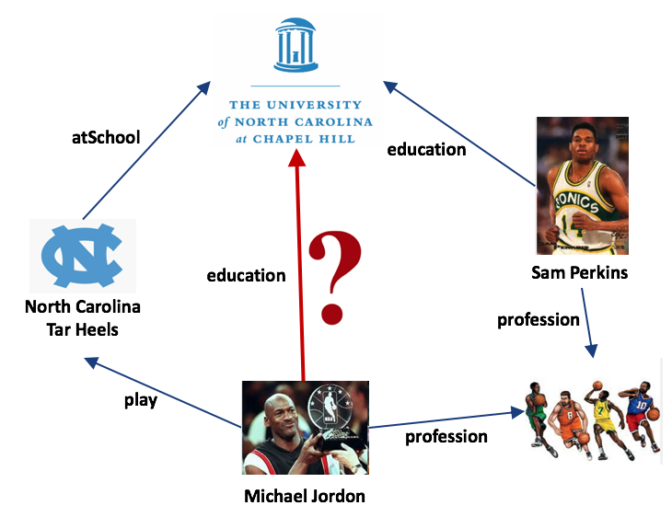
Problem Definition
Given existing triples
Q: Is a given triple correct?

Slide 5
Short Answer
Infer from other connecting paths
Path 1
Path 2
Prec | 1
Rec | 0.01
F1 | 0.03
Weight | 2.62
Prec | 0.03
Rec | 0.33
F1 | 0.04
Weight | 2.19

Slide 6
Roadmap
Part#2: Tensors
  P2.1: Basics (dfn, PARAFAC)
  P2.2: Embeddings & mining
  P2.3: Inference
    Edge-based inference
    Path-based inference
Conclusions

Slide 7
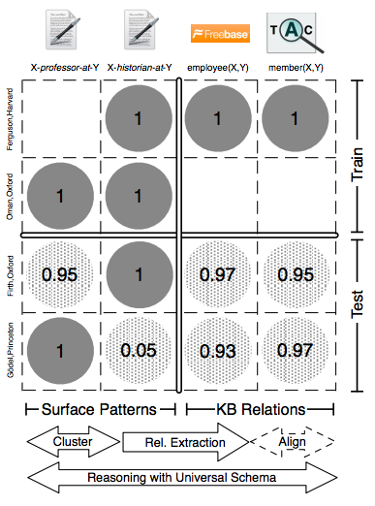
Edge-Based Inference
Universal schema
[Riedel et al., NAACL’13]
historian-at
→professor-at (0.95)
professor-at
→historian-at (0.05)
Matrix factorization

Slide 8
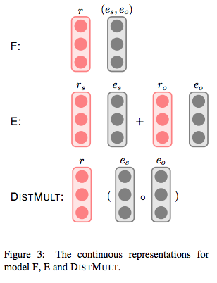
Edge-Based Inference
Feature
Model (F):
Entity
Model (E):
[Toutanova et al., EMNLP’15]

Slide 9
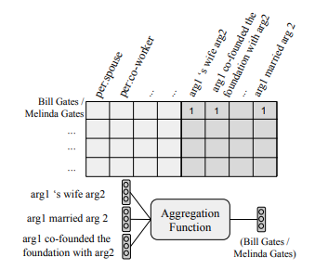
Edge-Based Inference
Infer relation from a set of observed relations
[Verga et al., ACL’16]

Slide 10
Roadmap
Part#2: Tensors
  P2.1: Basics (dfn, PARAFAC)
  P2.2: Embeddings & mining
  P2.3: Inference
    Edge-based inference
    Path-based inference
Conclusions

Slide 11
Path-Based Inference
Path Ranking Algorithm (PRA)
[Lao et al., EMNLP’11]
Path 2
Path 1
Prec | 0.03
Rec | 0.33
F1 | 0.04
Weight | 2.19
Prec | 1
Rec | 0.01
F1 | 0.03
Weight | 2.62

Slide 12
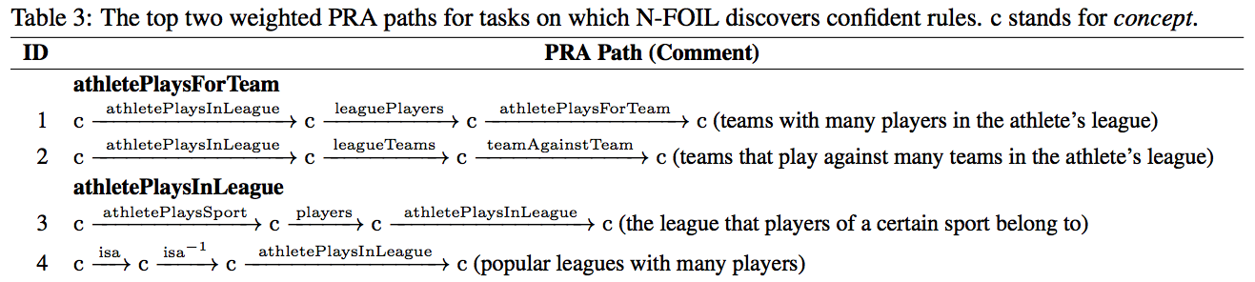
Path-Based Inference: Rule Mining
Path Ranking Algorithm (PRA)
[Lao et al., EMNLP’11]
  Features: paths
  Model: logistic regression

Slide 13
Path-Based Inference: Rule Mining
Path Ranking Algorithm (PRA)
[Lao et al., EMNLP’11]
  Features: paths
  Model: logistic regression
More rule-mining approaches see afternoon tutorial: Fact checking: Theory and Practices

Slide 14
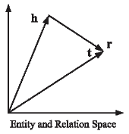
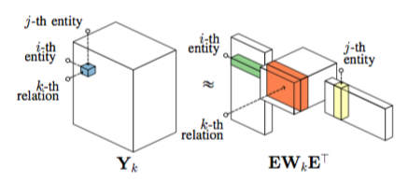
Revisit: Relation Embedding
S1. What is the relationship among
sub (h), pred (r), and obj (t)?
  Addition: h + r =?= t
  Multiplication: h ⚬ r =?= t

Slide 15
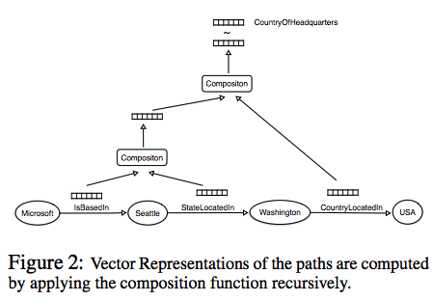
Path-Based Inference: Embedding
PathRNN: RNN to capture path
[Neelakantan et al., ACL’15][Das et al., EMNLP’11]

Slide 16
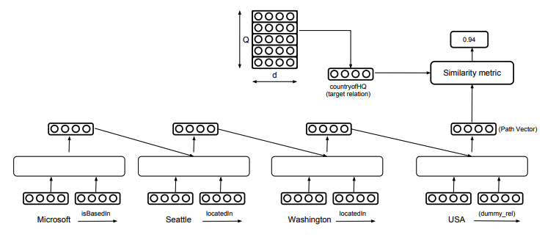
Path-Based Inference: Embedding
PathRNN: RNN to capture path
[Neelakantan et al., ACL’15][Das et al., EMNLP’11]
RNN

Slide 17
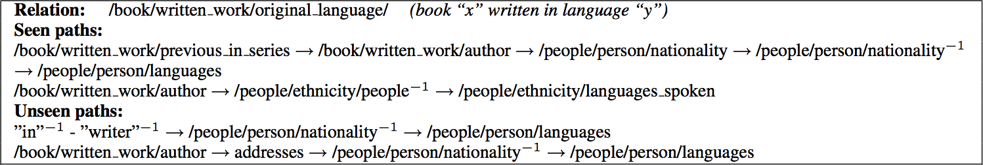
Path-Based Inference: Embedding
PathRNN: RNN to capture path
[Neelakantan et al., ACL’15][Das et al., EMNLP’11]
Learned both seen paths and unseen paths

Slide 18
Conclusion/Short answer
Infer from other connecting paths
Path 1
Path 2
Prec | 1
Rec | 0.01
F1 | 0.03
Weight | 2.62
Prec | 0.03
Rec | 0.33
F1 | 0.04
Weight | 2.19

Slide 19
Conclusion/Short answer
S1. Edge-based inference
(a.k.a., universal schema)
  Matrix factorization
  Embedding aggregation
S2. Path-based inference
  Rule mining; e.g., PRA
  Embedding composition; e.g., PathRNN

