Slide 1





Graph and Tensor Mining for fun and profit
Luna Dong, Christos Faloutsos
Andrey Kan, Jun Ma, Subho Mukherjee

Slide 2
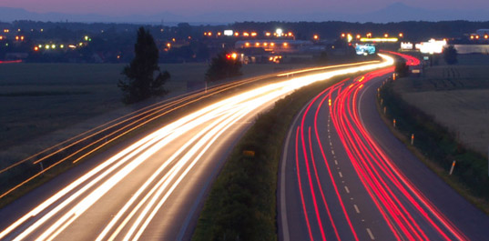
Roadmap
Introduction – Motivation
Part#1: Graphs
Part#2: Tensors
  P2.1: Basics (dfn, PARAFAC)
  P2.2: Embeddings & mining
  P2.3: Inference
Conclusions

Slide 3



‘Recipe’ Structure:
Problem definition
Short answer/solution
LONG answer – details
Conclusion/short-answer

Slide 4
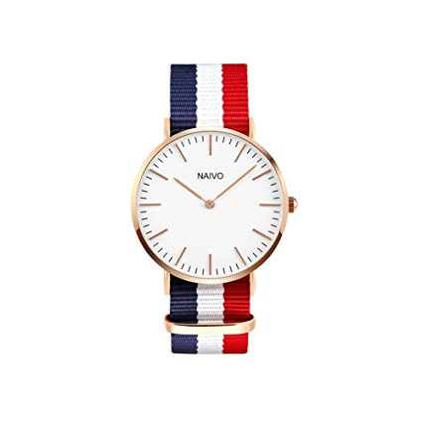


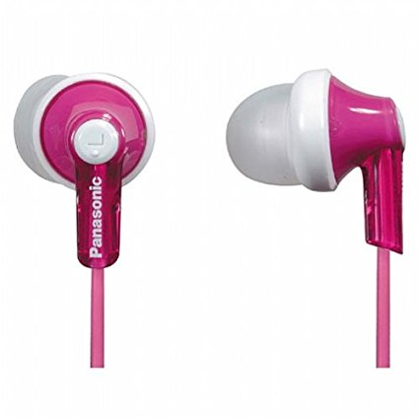


P2.2 - Problem: embedding?
Map users, and products, to low-dim space(s)
likes
…
buys
…
reviews
buys

Slide 5
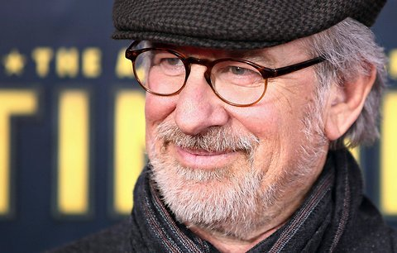






Tensors, e.g., Knowledge Graph
What is ‘normal’? Forecast? Spot errors?
…
directed
dates
…
Acted_in
born_in
…
produced

Slide 6
Graphs over time -> tensors!
Problem #1’’:
  Given subject – verb – object facts
  Find patterns / anomalies
verb
MANY more settings,
with >2 ‘modes’
subject
object

Slide 7
Graphs over time -> tensors!
Problem #1’’’:
  Given <triplets>
  Find patterns / anomalies
mode3
MANY more settings,
with >2 ‘modes’
(and 4, 5, etc modes)
mode1
mode2

Slide 8
P2.2 - Problem: embedding?
Map entities, and predicates, to low-dim space(s)
…
directed
dates
…
Acted_in
born_in
…
produced

Slide 9
‘Recipe’ Structure:
Problem definition
Short answer/solution
LONG answer – details
Conclusion/short-answer

Slide 10
P2.2: Problem: embedding
Given entities & predicates, find mappings
…
entity
emb.
directed
…
dates
Acted_in
born_in
produced
pred.
emb.

Slide 11
P2.2: Problem: embedding
Given entities & predicates, find mappings
locations
…
directed
…
dates
Acted_in
artists
born_in
produced
relations+
directed
dates
Acted_in
Artistic-pred.

Slide 12
Short answer
S1. Two potential relationships among
sub (h), pred (r), and obj (t)?
  Addition: h + r =?= t
  Multiplication: h ⚬ r =?= t
S2. Two loss function options
  Closed-world assumption
  Open-world assumption

Slide 13
Long Answer
Motivation
Graph Embedding
Tensor Embedding
Knowledge Graph Embedding

Slide 14
Long Answer
Motivation
Graph Embedding
Tensor Embedding
Knowledge Graph Embedding

Slide 15
Why embeddings (even for graphs)?

Slide 16
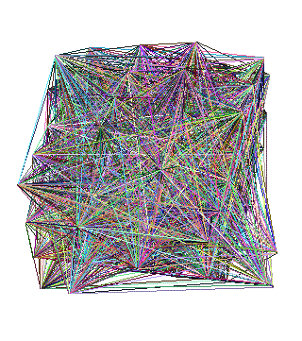
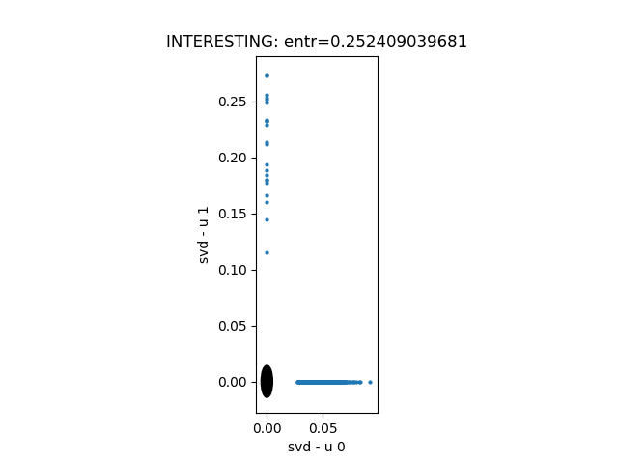
Why embeddings (even for graphs)?
Reason #1: easier to visualize / manipulate
?

Slide 17
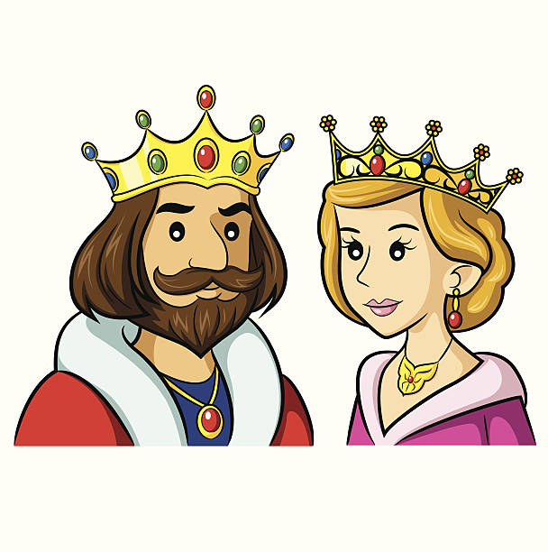

Why embeddings (even for graphs)?
Reason #2: wild success of word2vec
  ‘queen’ = ‘king’ – ‘man’ + ‘woman’
Latent
variable 2
(‘leadership’)
Latent variable 1 (‘collaborative’)

Slide 18
Long Answer
Motivation
Graph Embedding
Tensor Embedding
Knowledge Graph Embedding

Slide 19
Familiar embedding: SVD
v₁
v₂
u₁
u₂

Slide 20
Familiar embedding: SVD
v₂
v₁
u₁
u₂

Slide 21
SVD as embedding
A = U Λ V^{T} - example:
retrieval
inf.
lung
data
brain
CS
=
x
x
MD

Slide 22
SVD as embedding
A = U Λ V^{T} - example:
retrieval
CS-concept
inf.
lung
MD-concept
data
brain
CS
=
x
x
MD

Slide 23
SVD as embedding
A = U Λ V^{T} - example:
retrieval
CS-concept
inf.
lung
MD-concept
data
brain
CS
=
x
x
MD

Slide 24
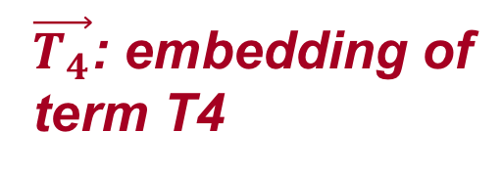
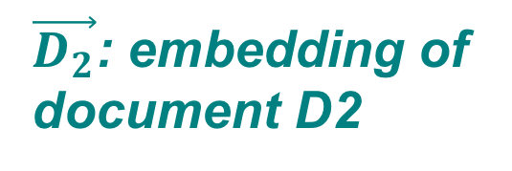
SVD as embedding
$\vec{D_{2}}$: embedding of
document D2
retrieval
inf.
lung
data
brain
$\vec{T_{4}}$: embedding of
term T4
CS
=
x
x
MD

Slide 25
Deep Graph Embeddings
DeepWalk
Node2Vec
Metapath2Vec
LINE
UltimateWalk
AutoEncoder
Struc2Vec
GraphSAGE
GCN
…
Skip-gram
Notes:
Needs methods summarization

Slide 26
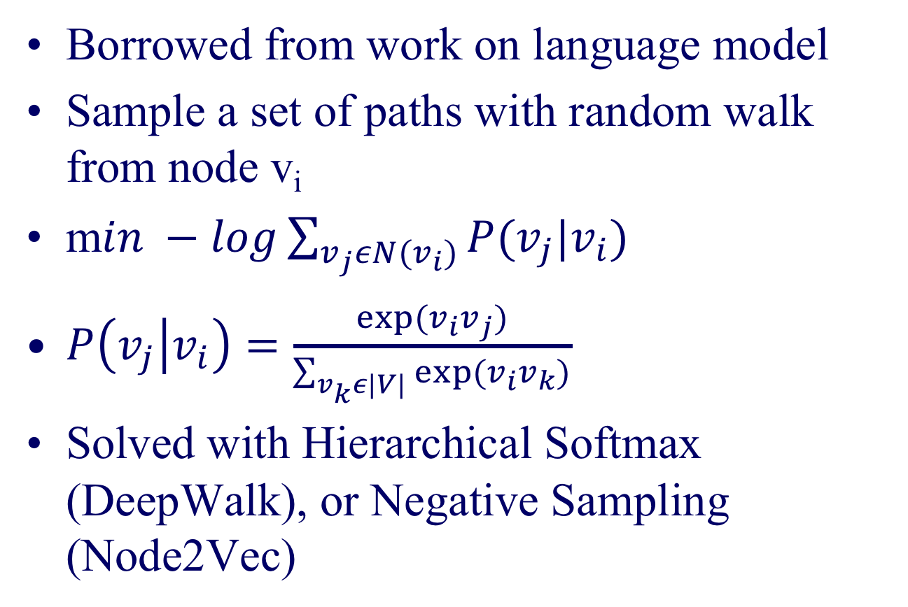
Skip-Gram
Borrowed from work on language model
Sample a set of paths with random walk from node v_{i}
m$in −log\sum_{v_{j}εN(v_{i})}{P(v_{j}|v_{i})}$
$P\left(v_{j} | v_{i}\right)=\frac{exp⁡(v_{i}v_{j})}{\sum_{v_{k}ε|V|}{{exp⁡(v}_{i}v_{k})}}$
Solved with Hierarchical Softmax (DeepWalk), or Negative Sampling (Node2Vec)

Slide 27
Deep Graph Embeddings
DeepWalk
Node2Vec
Metapath2Vec
LINE
UltimateWalk
AutoEncoder
Struc2Vec
GraphSAGE
GCN
…
Skip-gram
heterogenous graph
1st order + 2nd order proximity
closed form, unifies DeepWalk and Node2Vec
reconstruct W, similar to SVD
focuses on structural similarity
“inductive”, sample and aggregate
interesting! borrowed the idea from CNN
Notes:
Needs methods summarization

Slide 28
Embedding can help with:
Reconstruction
Fact checking
(Node classification)
(Link prediction)
(Recommendation)
…

Slide 29

Reconstruction of (2,4)
A: $\vec{D_{2}}$ x $\vec{T_{4}}$ = 0
$\vec{D_{2}}$: embedding of
document D2
retrieval
inf.
lung
data
brain
$\vec{T_{4}}$: embedding of
term T4
CS
?
=
x
x
MD

Slide 30
Fact-Checking of (2,4)
A: $\vec{D_{2}}$ x $\vec{T_{4}}$ = 0
$\vec{D_{2}}$: embedding of
document D2
retrieval
inf.
lung
data
brain
$\vec{T_{4}}$: embedding of
term T4
CS
?
=
x
x
MD

Slide 31
Long Answer
Motivation
Graph Embedding
Tensor Embedding
Knowledge Graph Embedding

Slide 32
Familiar embedding: SVD
v₁
v₂
u₁
u₂

Slide 33
Familiar embedding: SVD
v₂
v₁
u₁
u₂

Slide 34
PARAFAC: as embedding
leaders
musicians
athletes
verb
subject
+
+
=
object

Slide 35
PARAFAC: as embedding
leaders
musicians
athletes
k: ‘leader’
i: ‘Merkel’
+
+
=
j: ‘Germany’

Slide 36
PARAFAC: as embedding
leaders
musicians
athletes
k: ‘leader’
i: ‘Merkel’
+
+
=
j: ‘Germany’

Slide 37
PARAFAC: as embedding
‘Merkel’: i-th subject vector: (1,0,0)
‘Germany’: j-th object vector: (1,0,0)
‘is_leader’: k-th verb vector: (1,0,0)
leaders
musicians
athletes
k
i
+
+
=
j

Slide 38

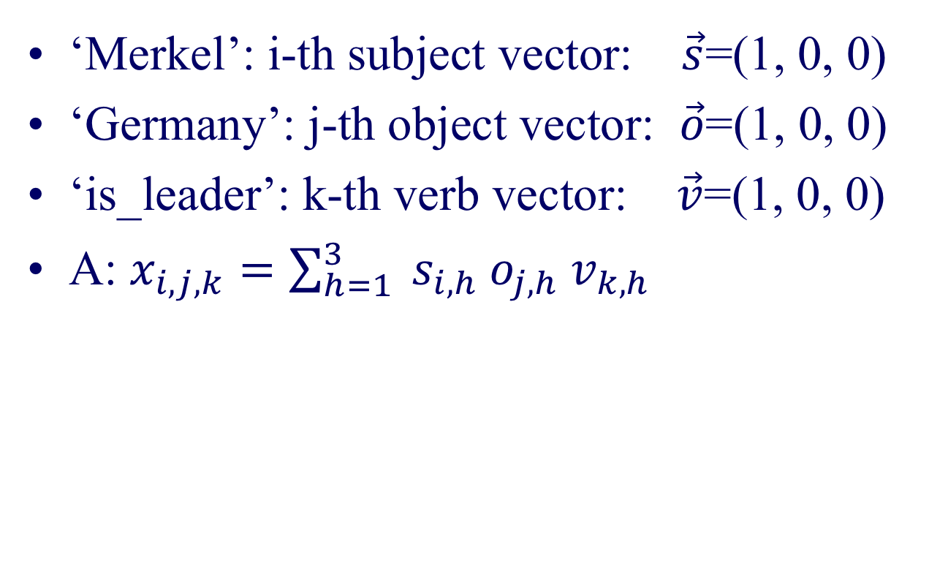
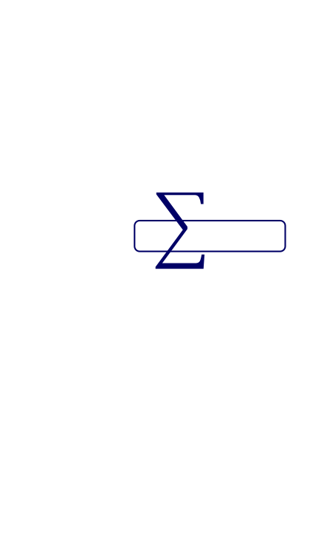


Reconstruction
$$×$$
$$×$$
$$×$$
‘Merkel’: i-th subject vector: $\vec{s}$=(1, 0, 0)
‘Germany’: j-th object vector: $\vec{o}$=(1, 0, 0)
‘is_leader’: k-th verb vector: $\vec{v}$=(1, 0, 0)
A: $x_{i,j,k}=\sum_{h=1}^{3}{ s_{i,h}{ o}_{j,h}{ v}_{k,h}}$
leaders
musicians
athletes
=
+
+

Slide 39
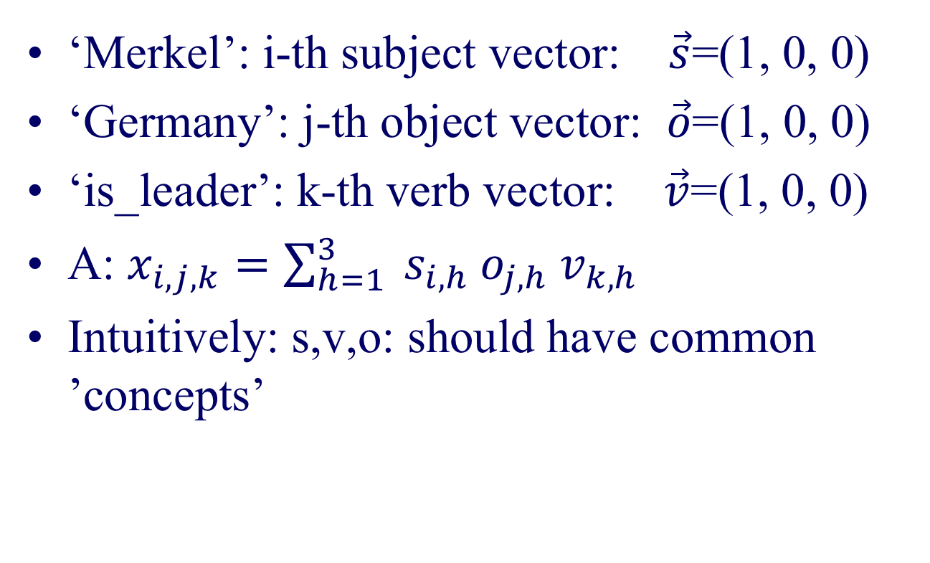
Reconstruction
$$×$$
$$×$$
$$×$$
‘Merkel’: i-th subject vector: $\vec{s}$=(1, 0, 0)
‘Germany’: j-th object vector: $\vec{o}$=(1, 0, 0)
‘is_leader’: k-th verb vector: $\vec{v}$=(1, 0, 0)
A: $x_{i,j,k}=\sum_{h=1}^{3}{ s_{i,h}{ o}_{j,h}{ v}_{k,h}}$
Intuitively: s,v,o: should have common ’concepts’
leaders
musicians
athletes
=
+
+

Slide 40
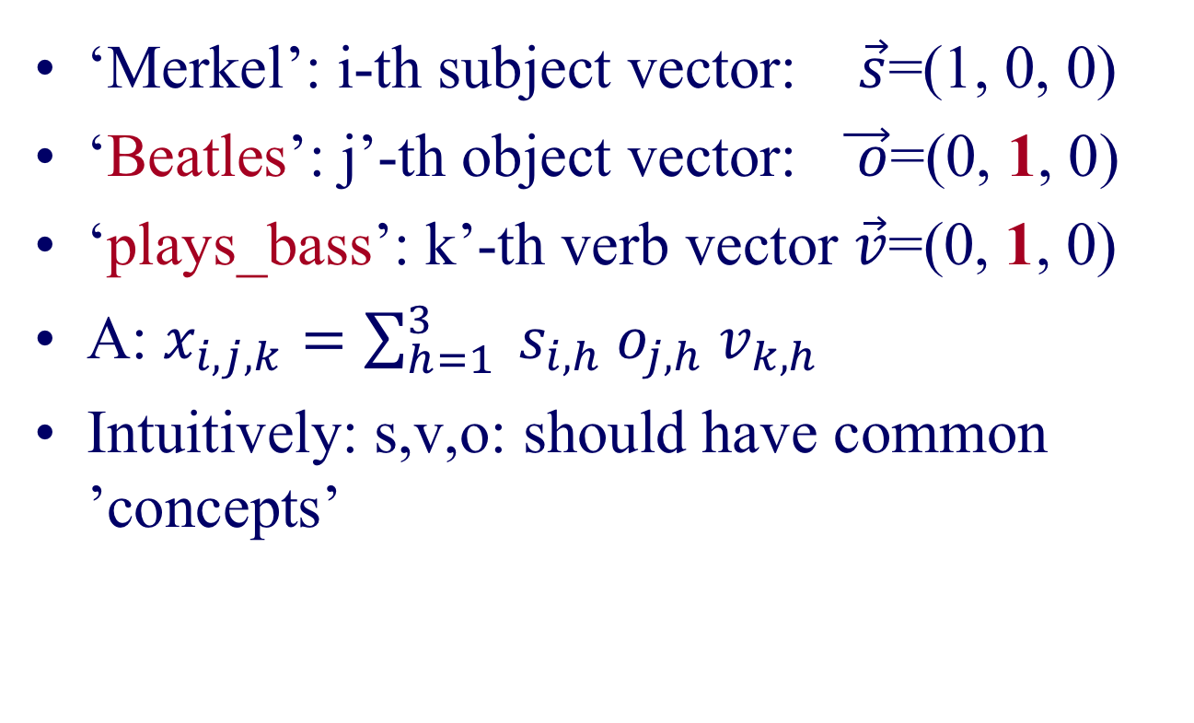
Reconstruction
$$×$$
$$×$$
$$×$$
‘Merkel’: i-th subject vector: $\vec{s}$=(1, 0, 0)
‘Beatles’: j’-th object vector: $\vec{ o}$=(0, 1, 0)
‘plays_bass’: k’-th verb vector $\vec{v}$=(0, 1, 0)
A: $x_{i,j,k}=\sum_{h=1}^{3}{ s_{i,h}{ o}_{j,h}{ v}_{k,h}}$
Intuitively: s,v,o: should have common ’concepts’
leaders
musicians
athletes
=
+
+

Slide 41
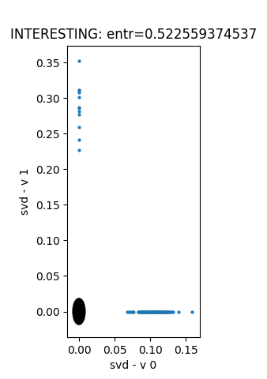
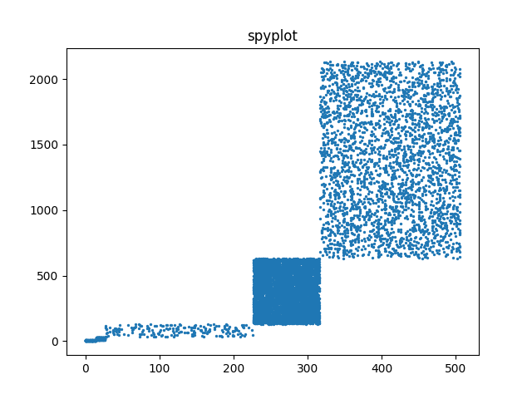
Toy example – 5 blocks
v₀
v₁
‘customers’
u₀
u₁
u₂
v₂
‘products’
u₁
v₁
EigenPlots

Slide 42
Toy example – 5 blocks
v₀
v₁
‘customers’
u₀
u₁
u₂
v₂
‘products’
u₁
v₁

Slide 43
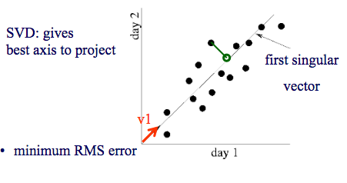
SVD - intuition
$ on socks
$ on Nike shoes

Slide 44
SVD - intuition
‘customers’
u₂
500-d vector
‘Smith’
2-d
‘Smith’
‘products’
u₁

Slide 45
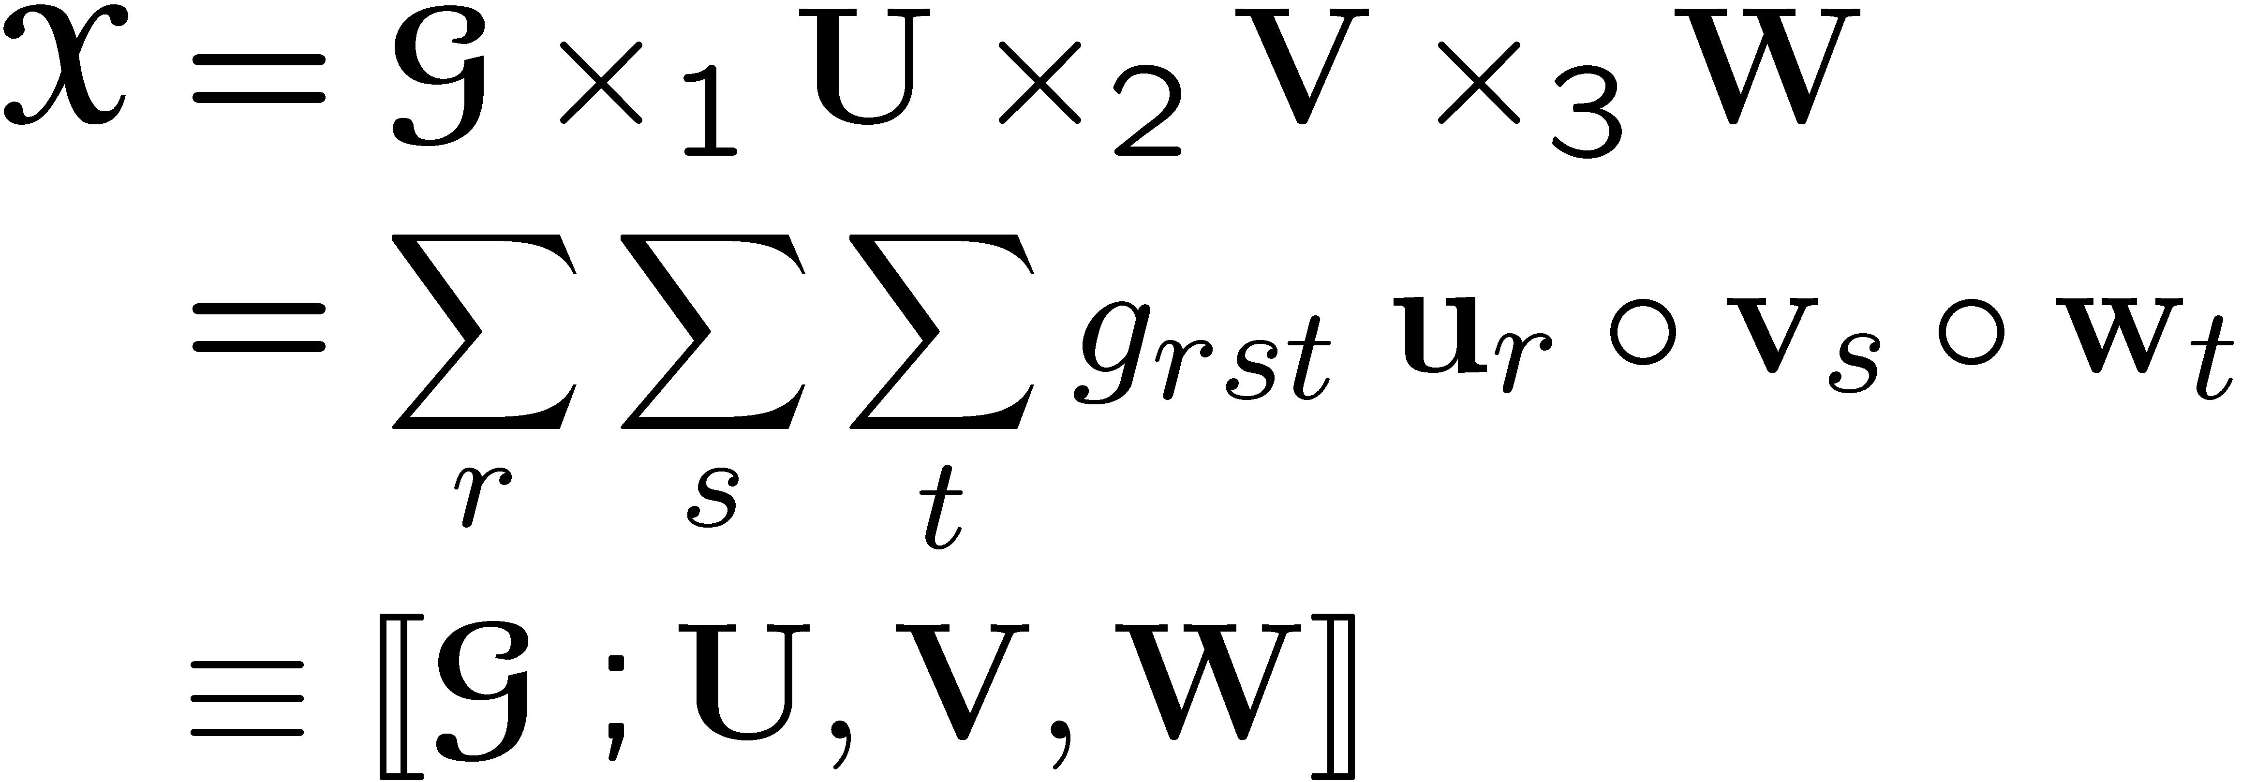
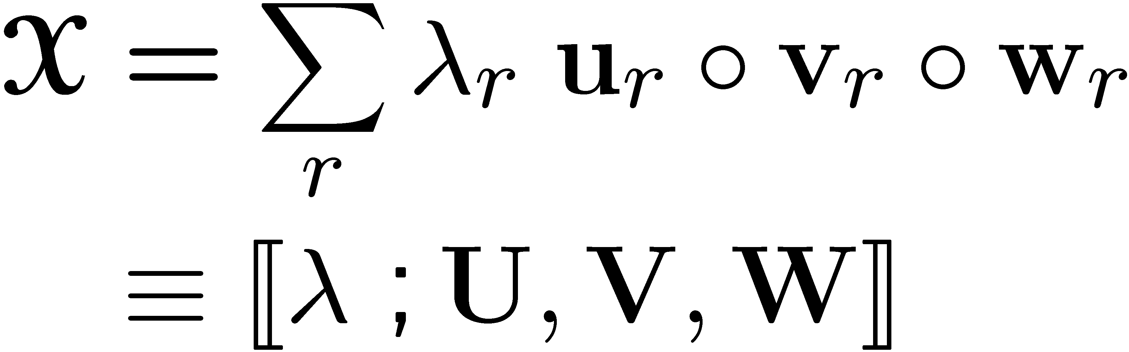
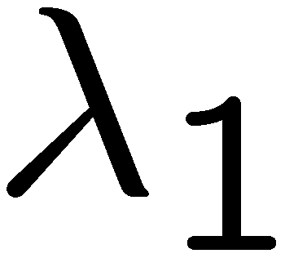
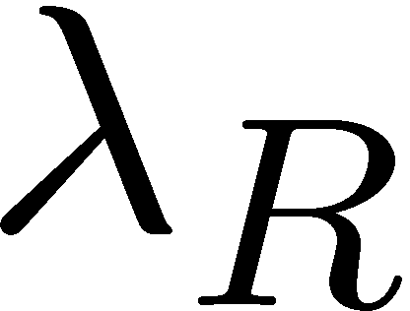


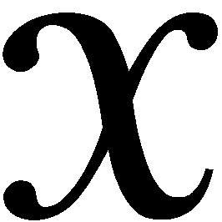
Specially Structured Tensors
Tucker Tensor
Kruskal Tensor
Our
Notation
Our
Notation
“core”
K x T
K x R
W
W
I x J x K
I x R
I x J x K
I x R
w_{R}
J x S
w₁
J x R
=
U
V
=
=
U
+…+
V
v₁
v_{R}
R x S x T
R x R x R
u₁
u_{R}

Slide 46

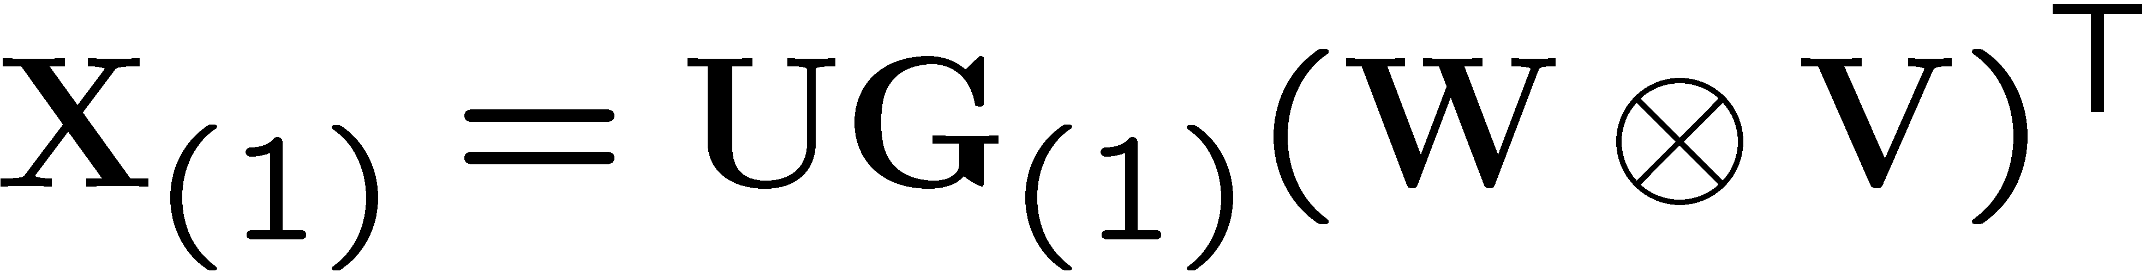
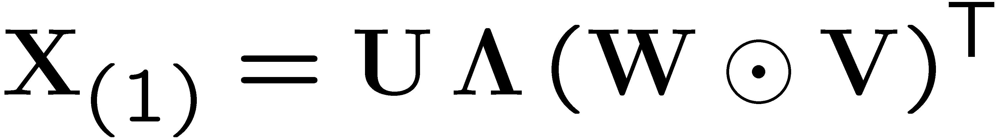
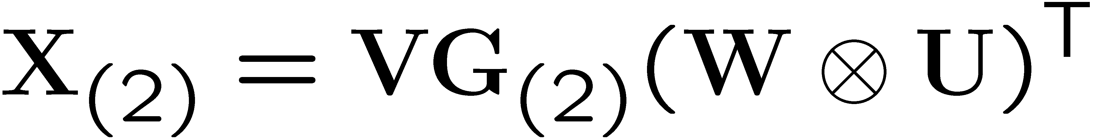
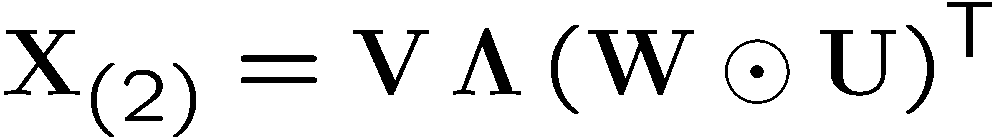
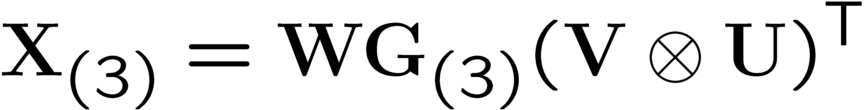
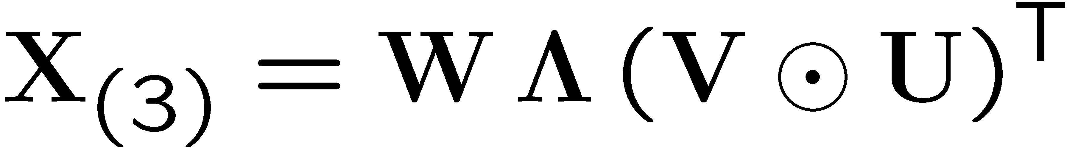
Specially Structured Tensors
details
Tucker Tensor
Kruskal Tensor
In matrix form:
In matrix form:

Slide 47
Tucker Decomposition - intuition
K x T
C
I x J x K
I x R
J x S
~
A
B
R x S x T
author x keyword x conference
A: author x author-group
B: keyword x keyword-group
C: conf. x conf-group
: how groups relate to each other
Needs elaboration!
Notes:
\cal{G}

Slide 48
Long Answer
Motivation
Graph Embedding
Tensor Embedding
Knowledge Graph Embedding

Slide 49
P2.2: Short answers
S1. What is the relationship among
sub (h), pred (r), and obj (t)?
  Addition: h + r =?= t
  Multiplication: h ⚬ r =?= t
S2. What shall we optimize?
  Closed-world assumption
  Open-world assumption

Slide 50
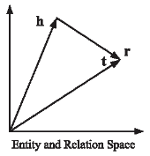
S1. Triple Scoring - Addition
Addition: h + r =?= t
  TransE
  score(h,r,t) = -||h+r-t||_{1/2}

Slide 51
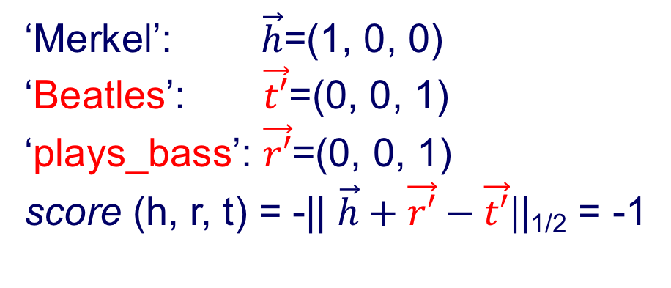
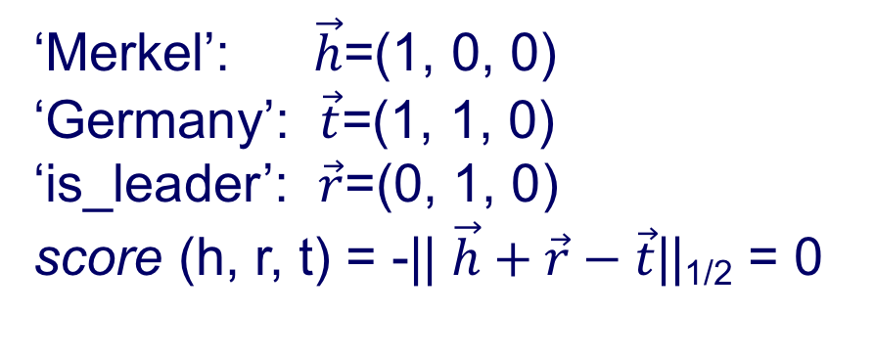
TransE
‘Merkel’: $\vec{h}$=(1, 0, 0)
‘Germany’: $\vec{t}$=(1, 1, 0)
‘is_leader’: $\vec{r}$=(0, 1, 0)
score (h, r, t) = -|| $\vec{h}+\vec{r}−\vec{t}$||_{1/2} = 0
‘Merkel’: $\vec{h}$=(1, 0, 0)
‘Beatles’: $\vec{t′}$=(0, 0, 1)
‘plays_bass’: $\vec{r′}$=(0, 0, 1)
score (h, r, t) = -|| $\vec{h}+\vec{r′}−\vec{t′}$||_{1/2} = -1

Slide 52

S1. Triple Scoring - Addition
Addition: h + r =?= t
  TransE
  score(h,r,t) = -||h+r-t||_{1/2}
  What if multiple objects apply??
directed
directed

Slide 53
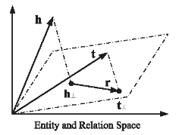
S1. Triple Scoring - Addition
Addition: h + r =?= t
  TransE
  score(h,r,t) = -||h+r-t||_{1/2}
  TransH: project to relation-specific hyperplanes

Slide 54
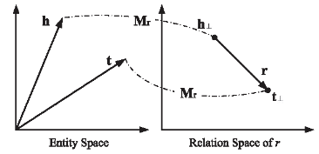
S1. Triple Scoring - Addition
Addition: h + r =?= t
  TransE
  score(h,r,t) = -||h+r-t||_{1/2}
  TransH: project to relation-specific hyperplanes
  TransR: translate to relation-specific space

Slide 55
S1. Triple Scoring - Addition
Addition: h + r =?= t
  TransE
  score(h,r,t) = -||h+r-t||_{1/2}
  TransH: project to relation-specific hyperplanes
  TransR: translate to relation-specific space
  Many simplifications of TransH and TransR
  STransE is reported to be the best in
  Dat Quoc Nguyen. An overview of embedding models of entities and relationships for knowledge base completion.

Slide 56
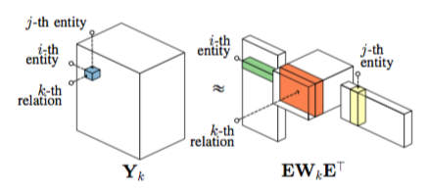
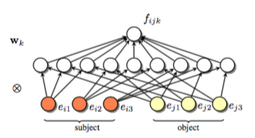
S1. Triple Scoring - Multiply
Multiplication: h ⚬ r =?= t
  RESCAL: score(h,r,t) = h⏉W_{r}t
  Too many parameters!!

Slide 57
S1. Triple Scoring - Multiply
Multiplication: h ⚬ r =?= t
  RESCAL: score(h,r,t) = h⏉W_{r}t
  DistMult: score(h,r,t) = h⏉diag(r)t
  Simplify RESCAL by using a diagonal matrix

Slide 58
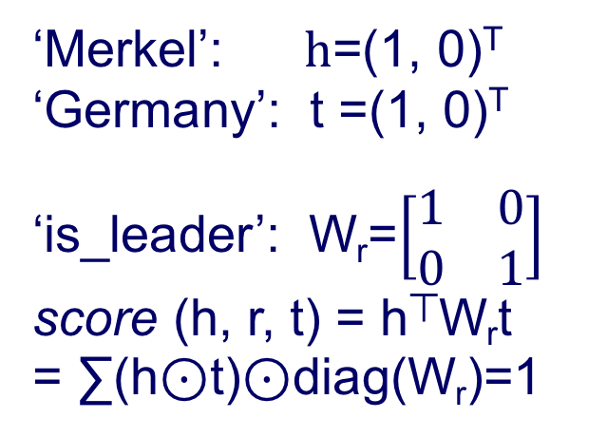
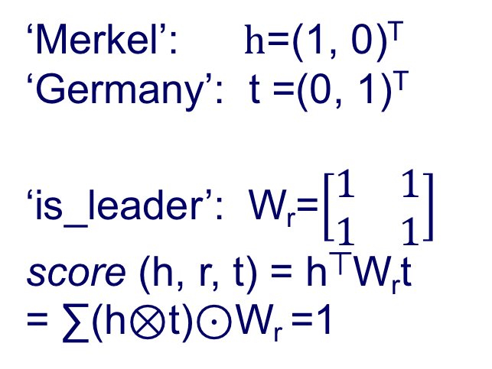
RESCAL DistMult
‘Merkel’: $h$=(1, 0)^{T}
‘Germany’: t =(0, 1)^{T}
‘is_leader’: W_{r}=$\left[\begin{matrix}1 & 1 \\ 1 & 1\end{matrix}\right]$
score (h, r, t) = h⏉W_{r}t
= ∑(h⊗t)⊙W_{r} =1
‘Merkel’: $h$=(1, 0)^{T}
‘Germany’: t =(1, 0)^{T}
‘is_leader’: W_{r}=$\left[\begin{matrix}1 & 0 \\ 0 & 1\end{matrix}\right]$
score (h, r, t) = h⏉W_{r}t
= ∑(h⊙t)⊙diag(W_{r})=1

Slide 59
S1. Triple Scoring - Multiply
Multiplication: h ⚬ r =?= t
  RESCAL: score(h,r,t) = h⏉W_{r}t
  DistMult: score(h,r,t) = h⏉diag(r)t
  Simplify RESCAL by using a diagonal matrix
  Cannot deal with asymmetric relations!!

Slide 60
S1. Triple Scoring - Multiply
Multiplication: h ⚬ r =?= t
  RESCAL: score(h,r,t) = h⏉W_{r}t
  DistMult: score(h,r,t) = h⏉diag(r)t
  Simplify RESCAL by using a diagonal matrix
  ComplEx: score(h,r,t) = Re(h⏉diag(r)t)
  Extend DistMult by introducing complex value embedding, so can handle asymmetric relations
_

Slide 61
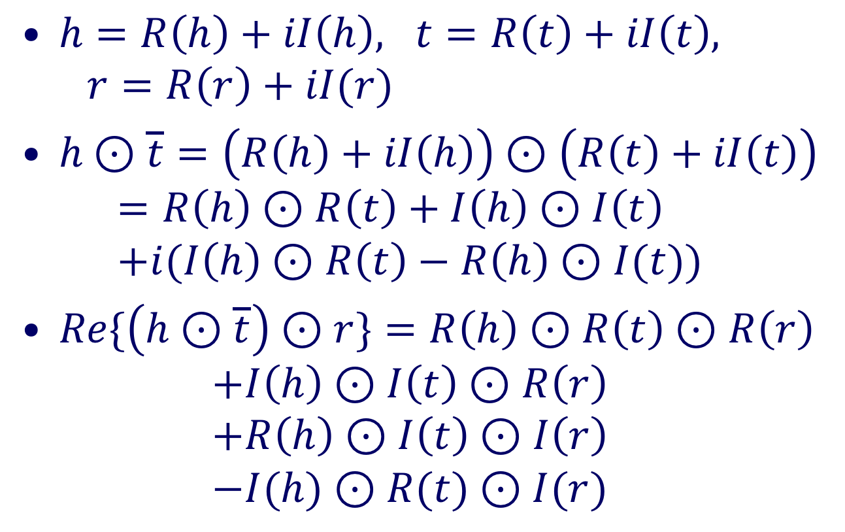
ComplEX
$h=R\left(h\right)+iI\left(h\right), t=R\left(t\right)+iI\left(t\right), r=R\left(r\right)+iI(r)$
$h⊙\overline{t}=\left(R\left(h\right)+iI\left(h\right)\right)⊙\left(R\left(t\right)+iI\left(t\right)\right)$
$=R\left(h\right)⊙R\left(t\right)+I\left(h\right)⊙I\left(t\right)$
$+i(I\left(h\right)⊙R\left(t\right)−R\left(h\right)⊙I(t))$
$Re\{\left(h⊙\overline{t}\right)⊙r\}=R\left(h\right)⊙R\left(t\right)⊙R\left(r\right)$
$+I\left(h\right)⊙I\left(t\right)⊙R\left(r\right)$
$+R\left(h\right)⊙I\left(t\right)⊙I\left(r\right)$
$−I(h)⊙R(t)⊙I(r)$

Slide 62
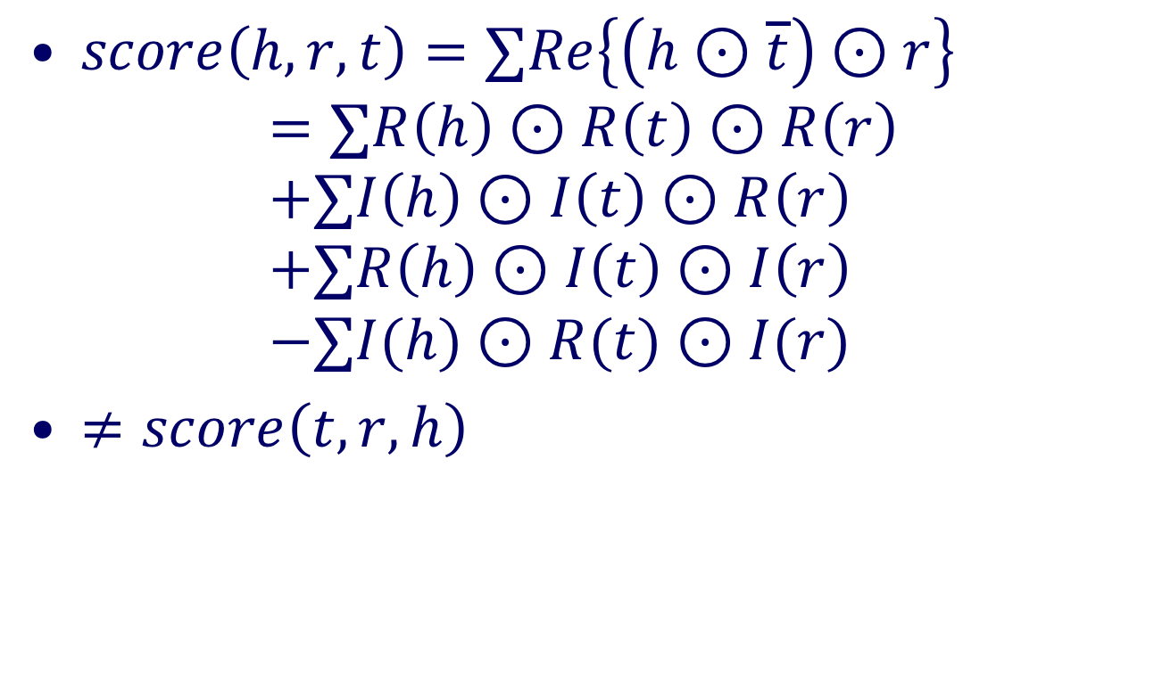
ComplEX
$score\left(h,r, t\right)=∑Re\left\{\left(h⊙\overline{t}\right)⊙r\right\}$
$=∑R\left(h\right)⊙R\left(t\right)⊙R\left(r\right)$
$+∑I\left(h\right)⊙I\left(t\right)⊙R\left(r\right)$
$+∑R\left(h\right)⊙I\left(t\right)⊙I\left(r\right)$
$−∑I(h)⊙R(t)⊙I(r)$
$≠score\left(t,r, h\right)$
DistMult
Asymmetry

Slide 63
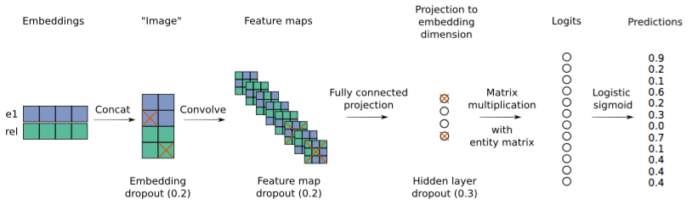
S1. Triple Scoring - Multiply
Multiplication: h ⚬ r =?= t
  RESCAL: score(h,r,t) = h⏉W_{r}t
  DistMult: score(h,r,t) = h⏉diag(r)t
  ComplEx: score(h,r,t) = Re(h⏉diag(r)t)
  ConvE: Use convolutional NN to reduce paras
_

Slide 64
S1. Triple Scoring - Multiply
Multiplication: h ⚬ r =?= t
  RESCAL: score(h,r,t) = h⏉W_{r}t
  DistMult: score(h,r,t) = h⏉diag(r)t
  ComplEx: score(h,r,t) = Re(h⏉diag(r)t)
  ConvE: Use convolutional NN to reduce paras
_
ComplEx and ConvE have
state-of-the-art results
Reduce parameters
Certain flexibility

Slide 65
S1. Triple Scoring - Multiply
Multiplication: h ⚬ r =?= t
  RESCAL: score(h,r,t) = h⏉W_{r}t
  DistMult: score(h,r,t) = h⏉diag(r)t
  ComplEx: score(h,r,t) = Re(h⏉diag(r)t)
  ConvE: Use convolutional NN to reduce paras
_
DistMult is light-weight, and good in practice.

Slide 66
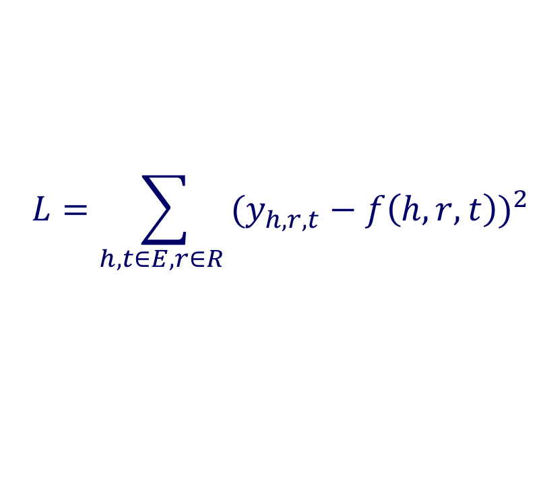
S2. Loss Function
Closed world assumption: square loss
$$L=\sum_{h,t∈E, r∈R }{{(y_{h,r,t}−f\left(h,r,t\right))}^{2}}$$

Slide 67
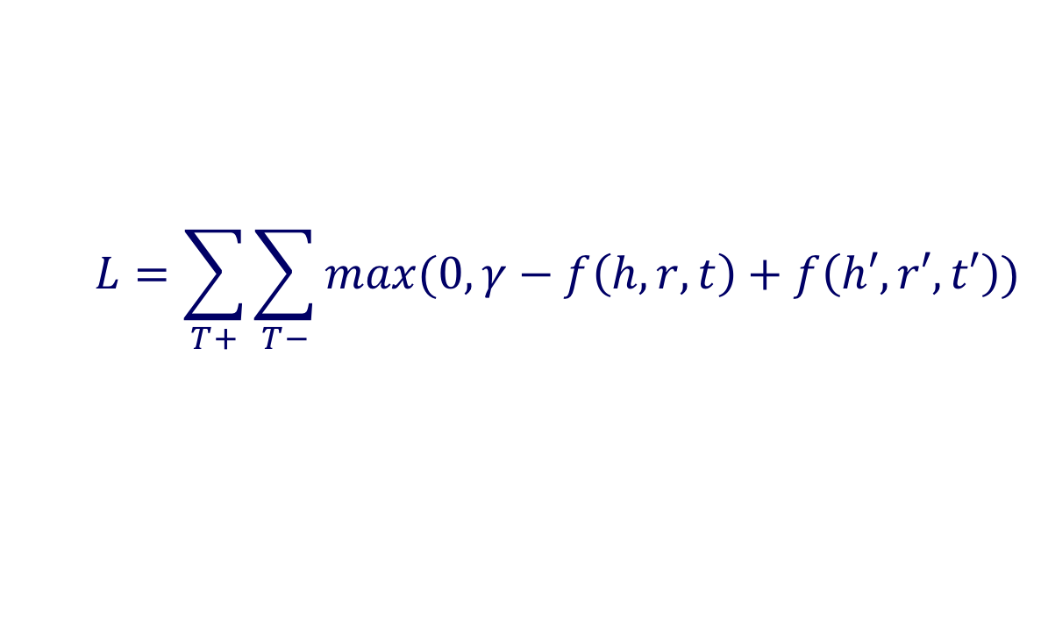
S2. Loss Function
Closed world assumption: square loss
Open world assumption: triplet loss
$$L=\sum_{h,t∈E, r∈R }{{(y_{h,r,t}−f\left(h,r,t\right))}^{2}}$$
$$L=\sum_{T+}{\sum_{T−}{max(0, γ−f\left(h,r,t\right)+f\left(h′,r′,t′\right))}}$$
Notes:
Maybe add the logistic loss

Slide 68
S2. Loss Function
Closed world assumption: square loss
Open world assumption: triplet loss
$$L=\sum_{h,t∈E, r∈R }{{(y_{h,r,t}−f\left(h,r,t\right))}^{2}}$$
$$L=\sum_{T+}{\sum_{T−}{max(0, γ−f\left(h,r,t\right)+f\left(h′,r′,t′\right))}}$$
OWA works best
Notes:
Not necessarily true

Slide 69
Embedding Applications
Learn embeddings from IMDb data and identify WikiData errors, using DistMult
Subject | Relation | Target | Reason
The Moises Padilla Story | writtenBy | César Ámigo Aguilar | Linkage error
Bajrangi Bhaijaan | writtenBy | Yo Yo Honey Singh | Wrong relationship
Piste noire | writtenBy | Jalil Naciri | Wrong relationship
Enter the Ninja | musicComposedBy | Michael Lewis | Linkage error
The Secret Life of Words | musicComposedBy | Hal Hartley | Cannot confirm
… | … | … | …

Slide 70
Long Answer
Motivation
Graph Embedding
Tensor Embedding
Knowledge Graph Embedding

Slide 71
Conclusion/Short answer
S1. Two potential relationships among
sub (h), pred (r), and obj (t)?
  Addition: h + r =?= t
  Multiplication: h ⚬ r =?= t
S2. Two loss function options
  Closed-world assumption
  Open-world assumption

Slide 72
Conclusion/Short answer
S1. Two potential relationships among
sub (h), pred (r), and obj (t)?
  Addition: h + r =?= t
  Multiplication: h ⚬ r =?= t
S2. Two loss function options
  Closed-world assumption
  Open-world assumption
State-of-the-art results
Multiplication model
Open-world assumption

