Slide 1
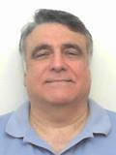
Graph and Tensor Mining for fun and profit
Luna Dong, Christos Faloutsos
Andrey Kan, Jun Ma, Subho Mukherjee

Slide 2
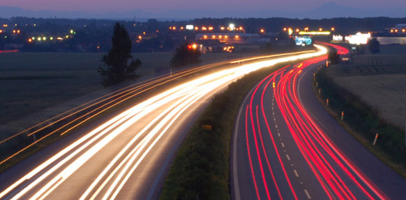
Roadmap
Introduction – Motivation
Part#1: Graphs
[break]
Part#2: Tensors
Conclusions

Slide 3
Roadmap
Introduction – Motivation
Part#1: Graphs
P1.1: properties/patterns in graphs
P1.2: node importance
P1.3: community detection
P1.4: fraud/anomaly detection
P1.5: belief propagation

Slide 4
Problem
What color, for the rest?
Given homophily (/heterophily etc)?

Slide 5
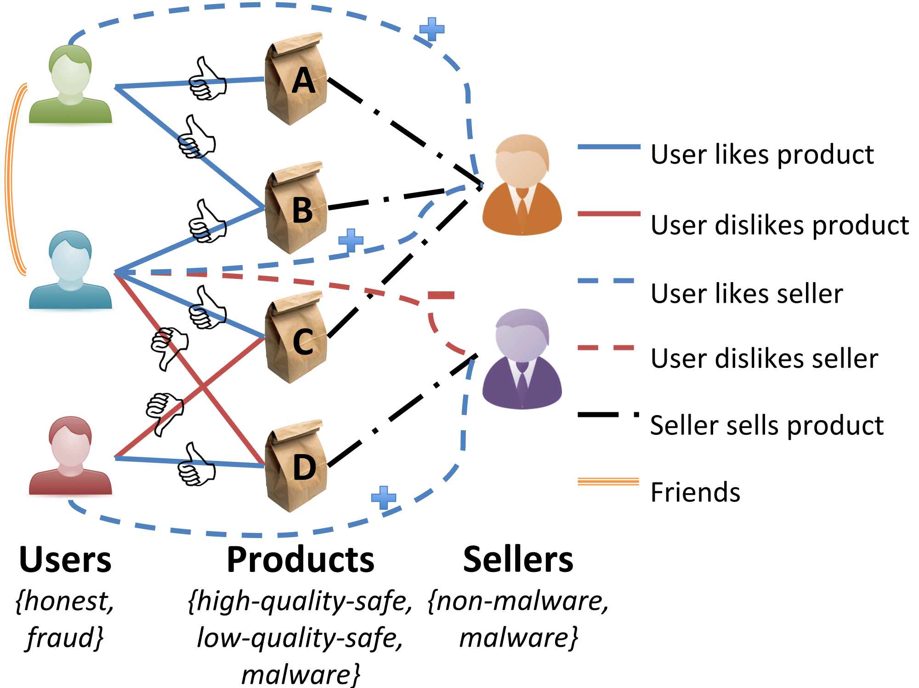
Short answer:
What color, for the rest?
A: Belief Propagation (‘zooBP’)
www.cs.cmu.edu/~deswaran/code/zoobp.zip

Slide 6
Roadmap
Introduction – Motivation
Part#1: Graphs
…
P1.5: belief propagation
Basics
Fast, linear approximation (FaBP)
Latest: zooBP

Slide 7
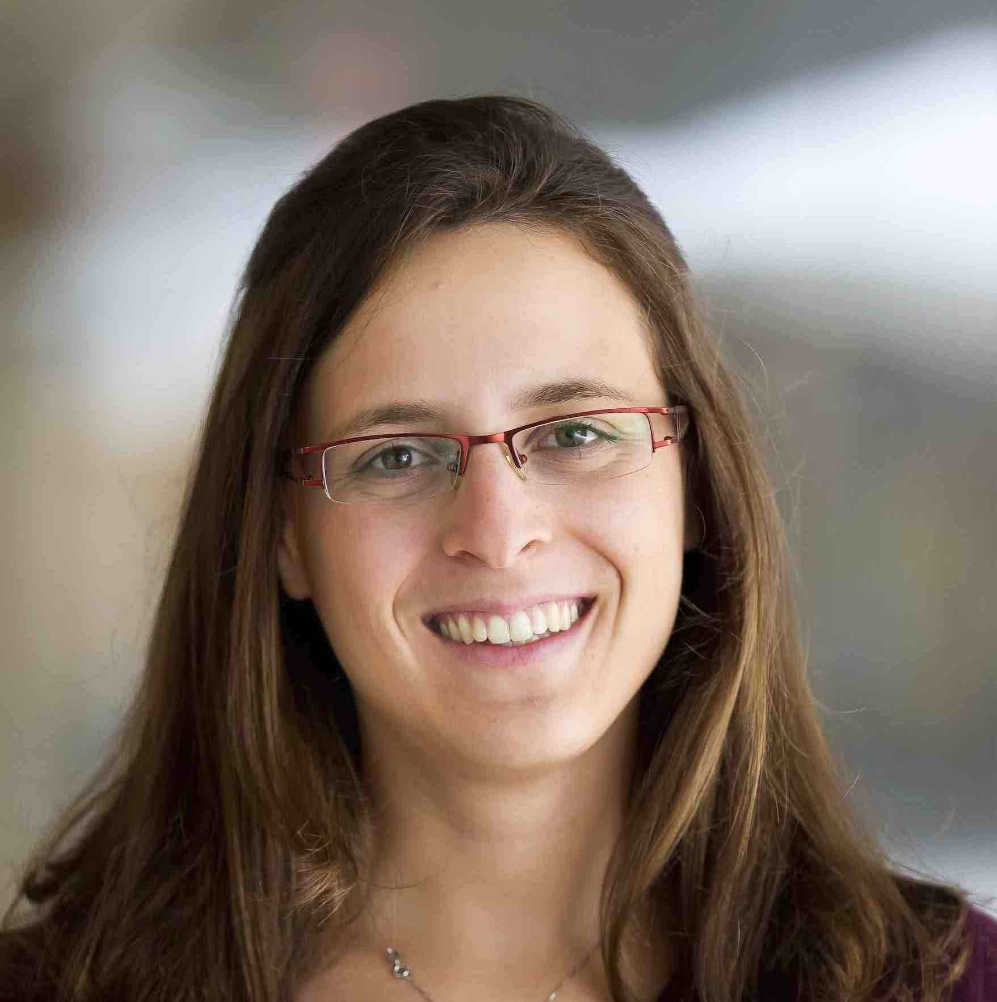
Background
Prof. Danai Koutra
U. Michigan

Slide 8
Belief Propagation
“Propagation matrix”:
Homophily
Iterative message-based method
AI
class of receiver
class of
sender
0.9 | 0.1
0.1 | 0.9
...
until stop criterion fulfilled
1st round
2nd round
PL
[Pearl ‘82][Yedidia+ ’02] … [Gonzalez+ ‘09][Chechetka+ ‘10]
Notes:
Class of receiver / class of sender : without bubbles

Slide 9
Belief Propagation Equations
message(i −> j) ≈ belief(i) • homophily strength
0.9 | 0.1
0.2 | 0.8
…
…
i
j
Notes:
Equations of original BP: “Notice non-linearity” + grey background + citations →na xwrisw sta 2 + zwgrafia sto xarti (prior belief san tou ukang, + mhnymata geitonwn
NOTATION for messages etc - this is non-linear

Slide 10
Belief Propagation Equations
belief of i
prior
belief
messages from neighbors
…
i
j
Notes:
Equations of original BP: “Notice non-linearity” + grey background + citations →na xwrisw sta 2 + zwgrafia sto xarti (prior belief san tou ukang, + mhnymata geitonwn
NOTATION for messages etc - this is non-linear

Slide 11
Background

Slide 12
Roadmap
Introduction – Motivation
Part#1: Graphs
…
P1.5: belief propagation
Basics
Fast, linear approximation (FaBP)
Latest: zooBP

Slide 13
Unifying Guilt-by-Association Approaches: Theorems and Fast Algorithms
Danai Koutra
U Kang
Hsing-Kuo Kenneth Pao
Tai-You Ke
Duen Horng (Polo) Chau
Christos Faloutsos
ECML PKDD, 5-9 September 2011, Athens, Greece
Notes:
Work in collaboration with National Taiwan University

Slide 14
Problem Definition: GBA techniques
?
Given: Graph; &
few labeled nodes
Find: labels of rest
(assuming network effects)
?
?
?
Notes:
Classification problem where we assume that neighboring nodes are related
Network effects – birds of a feather flock together

Slide 15
Problem Definition: GBA techniques
?
Given: Graph; &
few labeled nodes
Find: labels of rest
(assuming network effects)
?
?
?
Notes:
Classification problem where we assume that neighboring nodes are related
Network effects – birds of a feather flock together

Slide 16
BP vs. Linearized BP
DETAILS
Original [Yedidia+]:
Our proposal:
Belief Propagation
BP is approximated by
Linearized BP
1
1
1
d1
d2
d3
0 1 0
1 0 1
0 1 0
?
0
-10⁻²
10⁻²
non-linear
linear
Closed-form formula?
Convergence?
Notes:
Half: yedidia equations → non-linear equations
Half: theorem -→ linear
Swap!

Slide 17
BP vs. Linearized BP
DETAILS
Original [Yedidia+]:
Our proposal:
Belief Propagation
BP is approximated by
Linearized BP
1
1
1
d1
d2
d3
0 1 0
1 0 1
0 1 0
?
0
-10⁻²
10⁻²
non-linear
linear
Closed-form formula?
Convergence?
Notes:
Half: yedidia equations → non-linear equations
Half: theorem -→ linear
Swap!

Slide 18
Are they related?
RWR (Random Walk with Restarts)
google’s pageRank (‘if my parents are important, I’m important, too’)
SSL (Semi-supervised learning)
minimize the differences among neighbors
BP (Belief propagation)
send messages to neighbors, on what you believe about them

Slide 19
Are they related?
YES!
RWR (Random Walk with Restarts)
google’s pageRank (‘if my parents are important, I’m important, too’)
SSL (Semi-supervised learning)
minimize the differences among neighbors
BP (Belief propagation)
send messages to neighbors, on what you believe about them

Slide 20
Correspondence of Methods
DETAILS
p = (1-c)/n [I - c B] ⁻¹ $\vec{e}$
Method | Matrix |  | Unknown |  | known
RWR | [I – c AD⁻¹] | × | x | = | (1-c)y
SSL | [I + a(D - A)] | × | x | = | y
FABP | [I + a D - c’A] | × | b_{h} | = | φ_{h}
1
1
1
d1
d2
d3
0 1 0
1 0 1
0 1 0
?
0
1
1
adjacency matrix
final labels/ beliefs
prior labels/ beliefs

Slide 21
Generalization: zooBP
FastBP: for uni-partite graph
1 type of nodes (eg., humans)
1 type of edge (eg., ‘friends’)
2 classes (’red’/’green’)
zooBP: for tensor / KB
many types of nodes (humans, products, factories)
many types of edges
many classes per node-type

Slide 22
Problem: e-commerce ratings fraud
Given a heterogeneous graph on users, products, sellers and positive/negative ratings with “seed labels”
Find the top k most fraudulent users, products and sellers

Slide 23
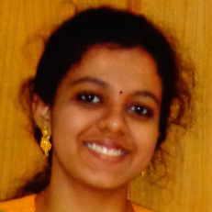
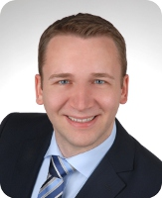
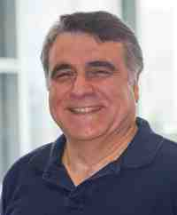
Problem: e-commerce ratings fraud
Given a heterogeneous graph on users, products, sellers and positive/negative ratings with “seed labels”
Find the top k most fraudulent users, products and sellers
Dhivya Eswaran, Stephan Günnemann, Christos Faloutsos, “ZooBP: Belief Propagation for Heterogeneous Networks”, VLDB 2017

Slide 24
Problem: e-commerce ratings fraud
DETAILS
Dhivya Eswaran, Stephan Günnemann, Christos Faloutsos, “ZooBP: Belief Propagation for Heterogeneous Networks”, VLDB 2017

Slide 25
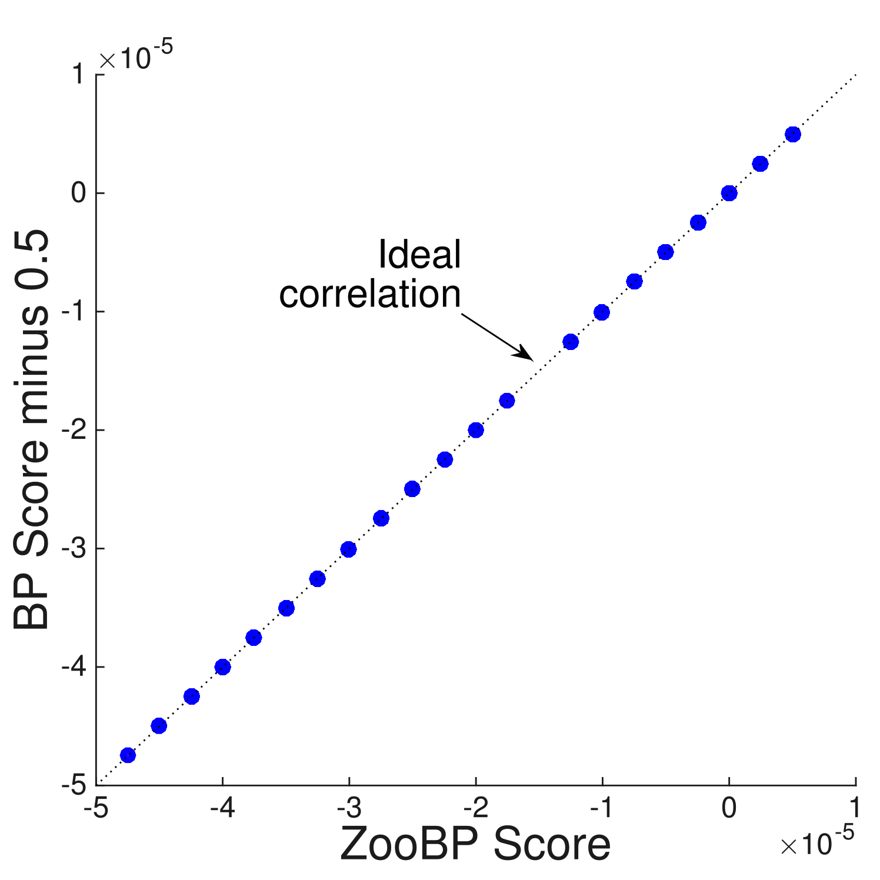
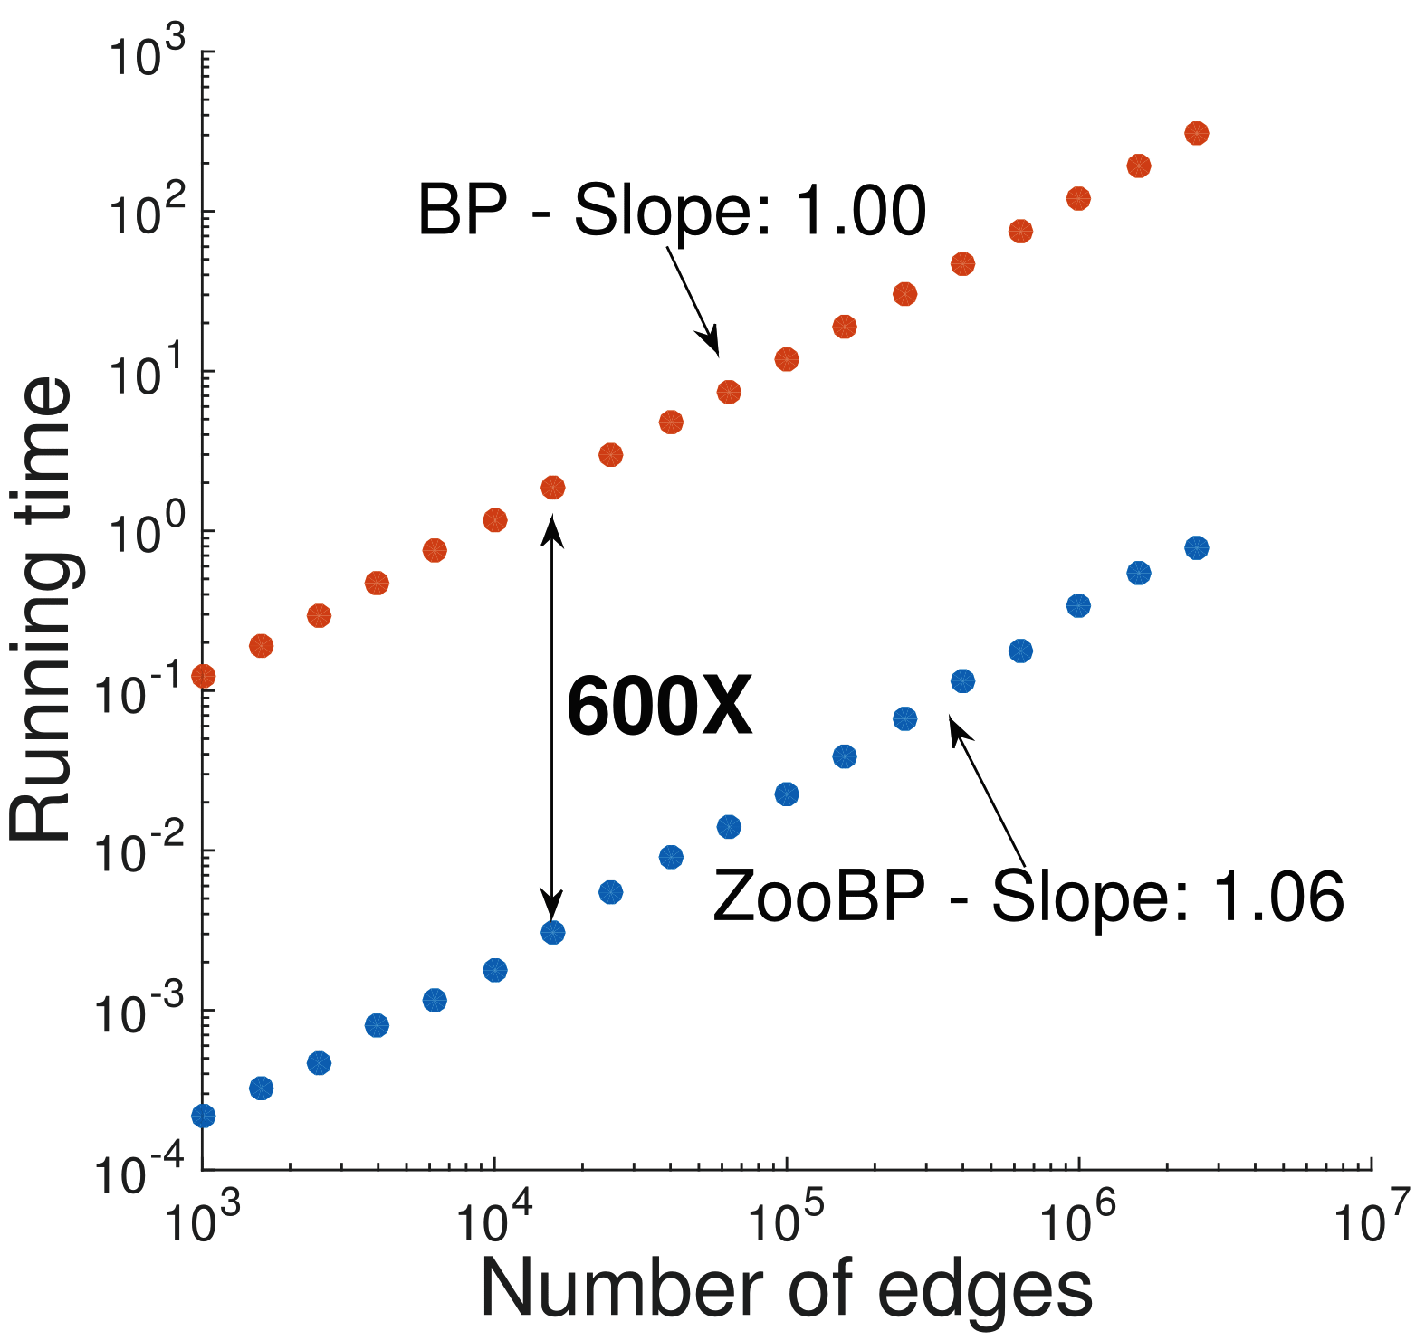
ZooBP: features
Fast; convergence guarantees.
600x (matlab)
3x (C++)
ideal
Near-perfect accuracy
linear in graph size
Dhivya Eswaran, Stephan Günnemann, Christos Faloutsos, “ZooBP: Belief Propagation for Heterogeneous Networks”, VLDB 2017

Slide 26
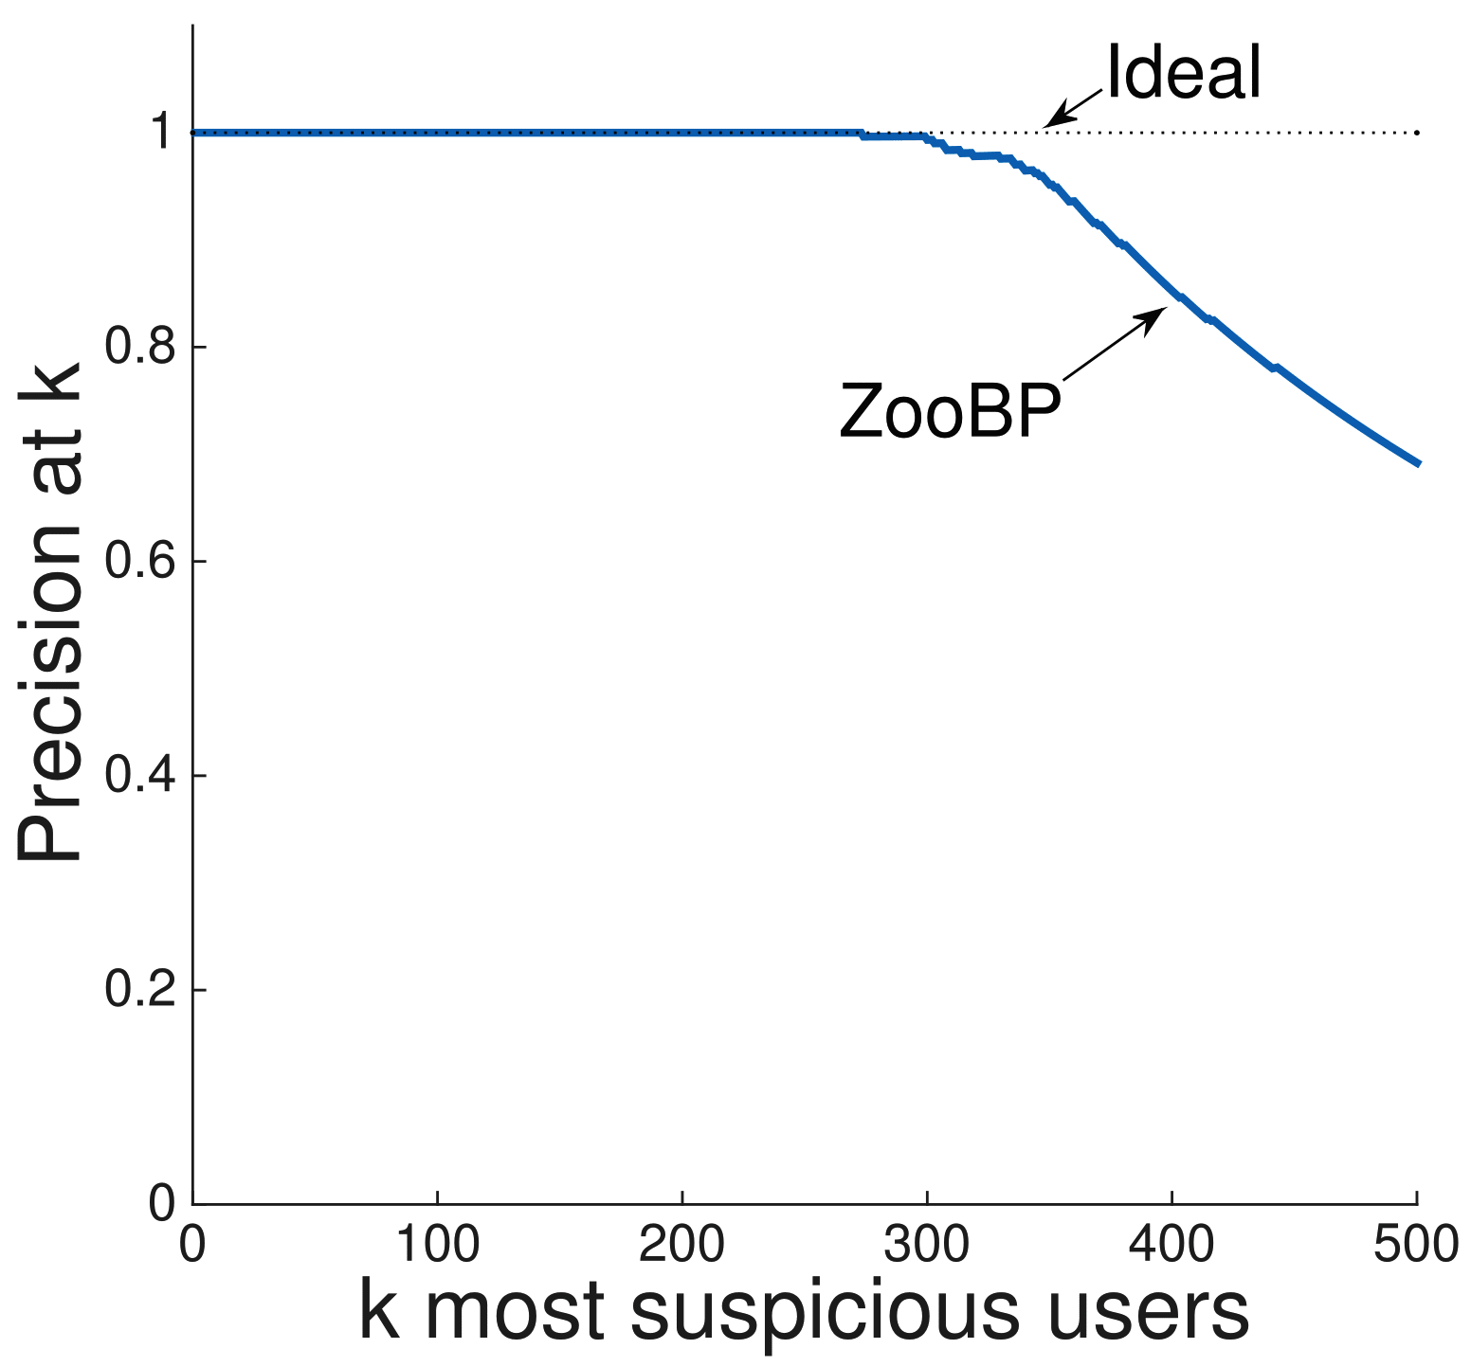
ZooBP in the real world
Near 100% precision on top 300 users (Flipkart)
Flagged users: suspicious
400 ratings in 1 sec
5000 good ratings and no bad ratings
Dhivya Eswaran, Stephan Günnemann, Christos Faloutsos, “ZooBP: Belief Propagation for Heterogeneous Networks”, VLDB 2017

Slide 27
ZooBP: code etc
http://www.cs.cmu.edu/~deswaran/code/zoobp.zip
Dhivya Eswaran, Stephan Günnemann, Christos Faloutsos, “ZooBP: Belief Propagation for Heterogeneous Networks”, VLDB 2017

Slide 28
Short answer:
What color, for the rest?
A: Belief Propagation (‘zooBP’)
www.cs.cmu.edu/~deswaran/code/zoobp.zip

Slide 29
Roadmap
Introduction – Motivation
Part#1: Graphs
[break]
Part#2: Tensors
Conclusions

