Slide 1





Graph and Tensor Mining for fun and profit
Luna Dong, Christos Faloutsos
Andrey Kan, Jun Ma, Subho Mukherjee

Slide 2
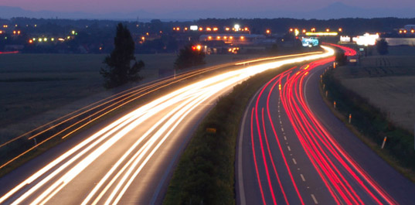
Roadmap
Introduction – Motivation
Part#1: Graphs
[break]
Part#2: Tensors
Conclusions

Slide 3
Roadmap
Introduction – Motivation
Part#1: Graphs
  …
  P1.3: community detection
  P1.4: fraud/anomaly detection
    Outliers
    Lock-step behavior
  P1.5: belief propagation
?

Slide 4
Roadmap
Introduction – Motivation
Part#1: Graphs
  …
  P1.3: community detection
  P1.4: fraud/anomaly detection
  P1.5: belief propagation
un-supervised
?
semi-supervised

Slide 5
Roadmap
Introduction – Motivation
Part#1: Graphs
  …
  P1.3: community detection
  P1.4: fraud/anomaly detection
    P1.4.1. Outliers
    P1.4.2. Lock-step behavior
  P1.5: belief propagation
un-supervised
?

Slide 6
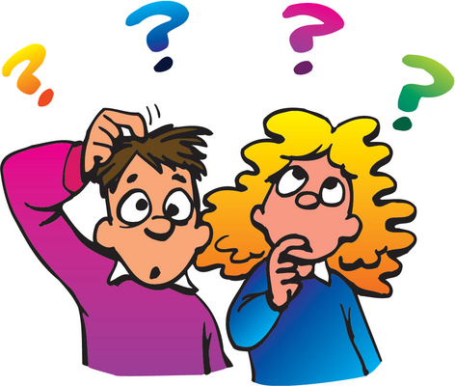


‘Recipe’ Structure:
Problem definition
Short answer/solution
LONG answer – details
Conclusion/short-answer

Slide 7
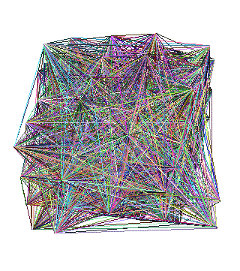
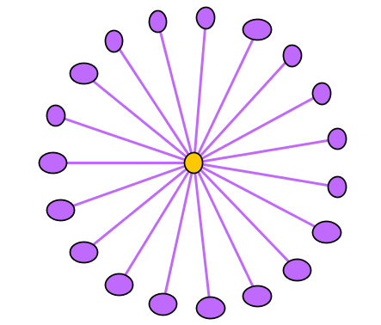
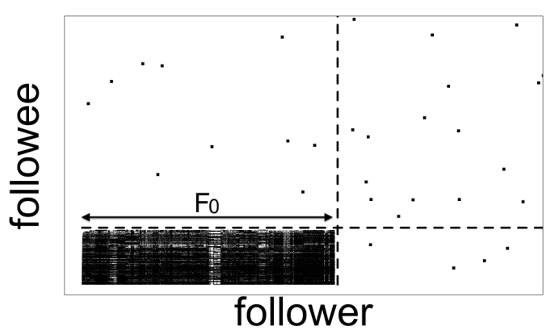
Problem
Given:
Find:
Outliers
Lock-step

Slide 8
Solution
Given:
Find:
Outliers
Lock-step
OddBall
SVD

Slide 9
P1.4.1. Outliers
Which node(s) are strange?
  Q: How to start?

Slide 10
P1.4.1. Outliers
Which node(s) are strange?
  Q: How to start?
  A1: egonet; and extract node features

Slide 11
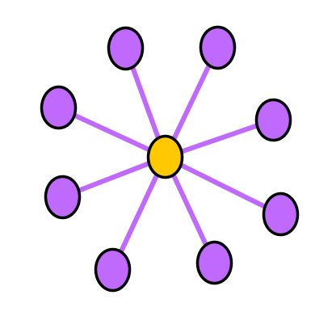
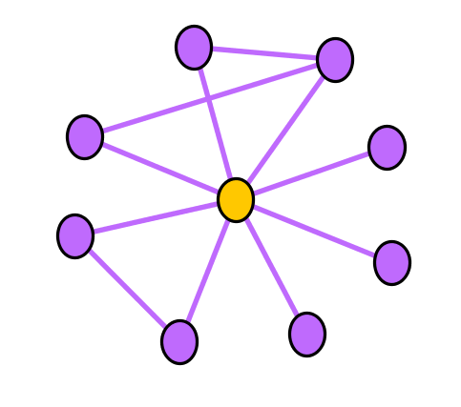
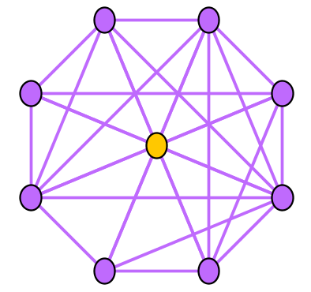
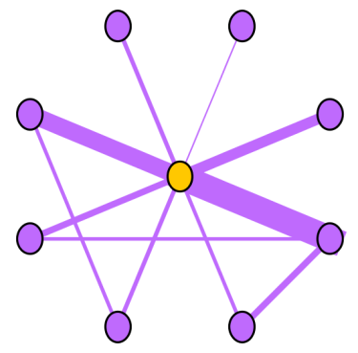
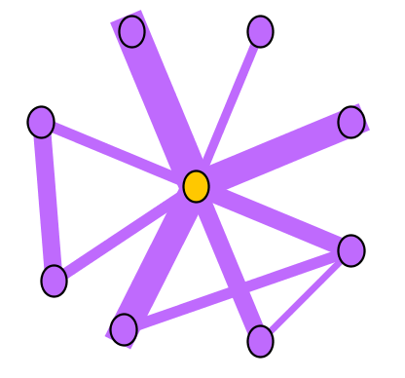
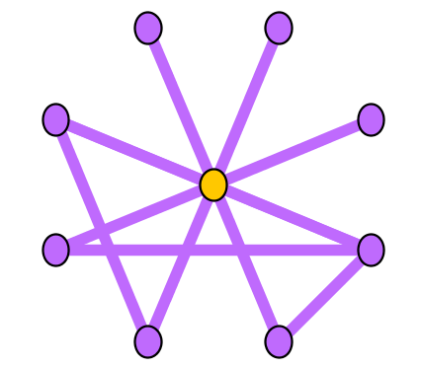
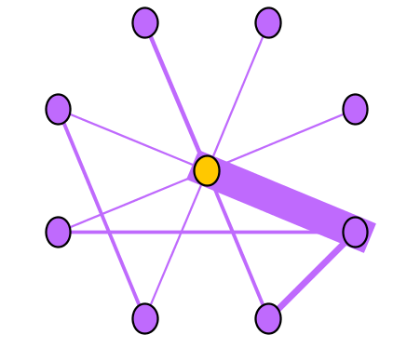
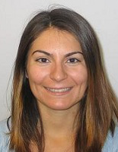
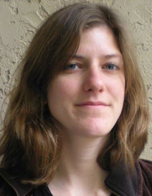
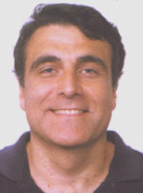
Ego-net Patterns: Which is strange?
Oddball: Spotting anomalies in weighted graphs, Leman Akoglu, Mary McGlohon, Christos Faloutsos, PAKDD 2010

Slide 12
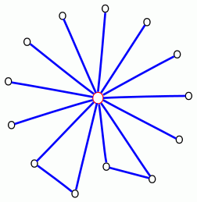
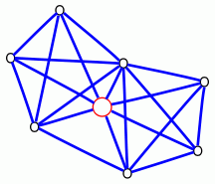
Ego-net Patterns: Which is strange?
telemarketer, port scanner,
people adding friends
indiscriminatively, etc.
Near-star
Near-clique
tightly connected people,
terrorist groups?, discussion
group, etc.
Oddball: Spotting anomalies in weighted graphs
Leman Akoglu, Mary McGlohon, Christos Faloutsos
PAKDD 2010

Slide 13
P1.4.1. Outliers
Which node(s) are strange?
  Q: How to start?
  A: egonet; and extract node features
  Q’: which features?
  A’: ART! Infinite! Pick a few, e.g.:

Slide 14

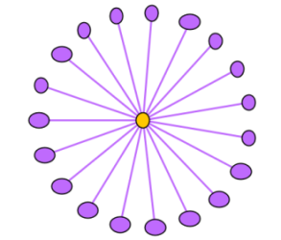



Ego-net Patterns
N_{i}: number of neighbors (degree) of ego i
E_{i}: number of edges in egonet i
W_{i}: total weight of egonet i
λ_{w,i}: principal eigenvalue of the weighted adjacency matrix of egonet i
Oddball: Spotting anomalies in weighted graphs
Leman Akoglu, Mary McGlohon, Christos Faloutsos
PAKDD 2010
Oddball: Spotting anomalies in weighted graphs, Leman Akoglu, Mary McGlohon, Christos Faloutsos, PAKDD 2010

Slide 15
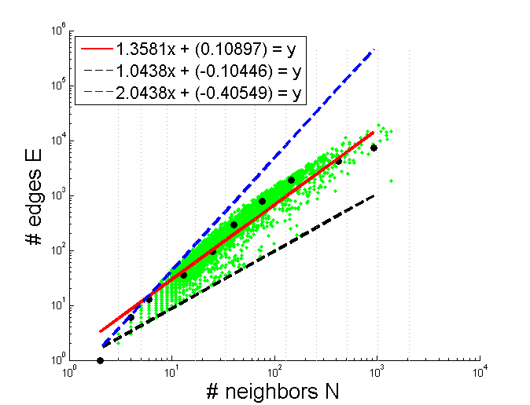
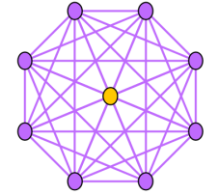
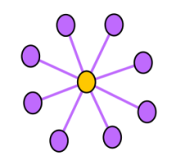
Pattern: Ego-net Power Law Density
E_{i} ∝ N_{i}^{α}
1 ≤ α ≤ 2
Enron CEO
Oddball: Spotting anomalies in weighted graphs
Leman Akoglu, Mary McGlohon, Christos Faloutsos
PAKDD 2010
Oddball: Spotting anomalies in weighted graphs, Leman Akoglu, Mary McGlohon, Christos Faloutsos, PAKDD 2010

Slide 16
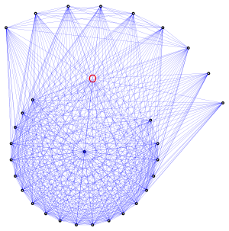
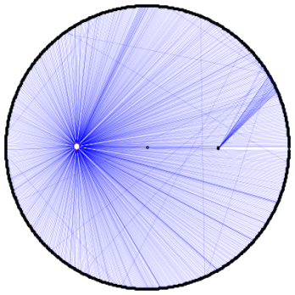
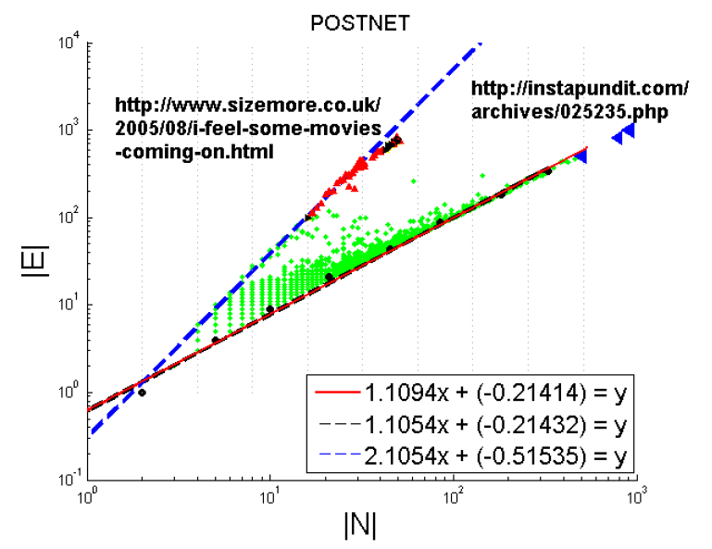
Pattern: Ego-net Power Law Density
Oddball: Spotting anomalies in weighted graphs
Leman Akoglu, Mary McGlohon, Christos Faloutsos
PAKDD 2010
Oddball: Spotting anomalies in weighted graphs, Leman Akoglu, Mary McGlohon, Christos Faloutsos, PAKDD 2010

Slide 17
Roadmap
Introduction – Motivation
Part#1: Graphs
  …
  P1.3: community detection
  P1.4: fraud/anomaly detection
    Outliers
    Lock-step behavior
  P1.5: belief propagation
?

Slide 18
Problem
Given:
Find:
Outliers
Lock-step

Slide 19

P1.4.1. How to find ‘suspicious’ groups?
‘blocks’ are normal, right?
idols
fans

Slide 20

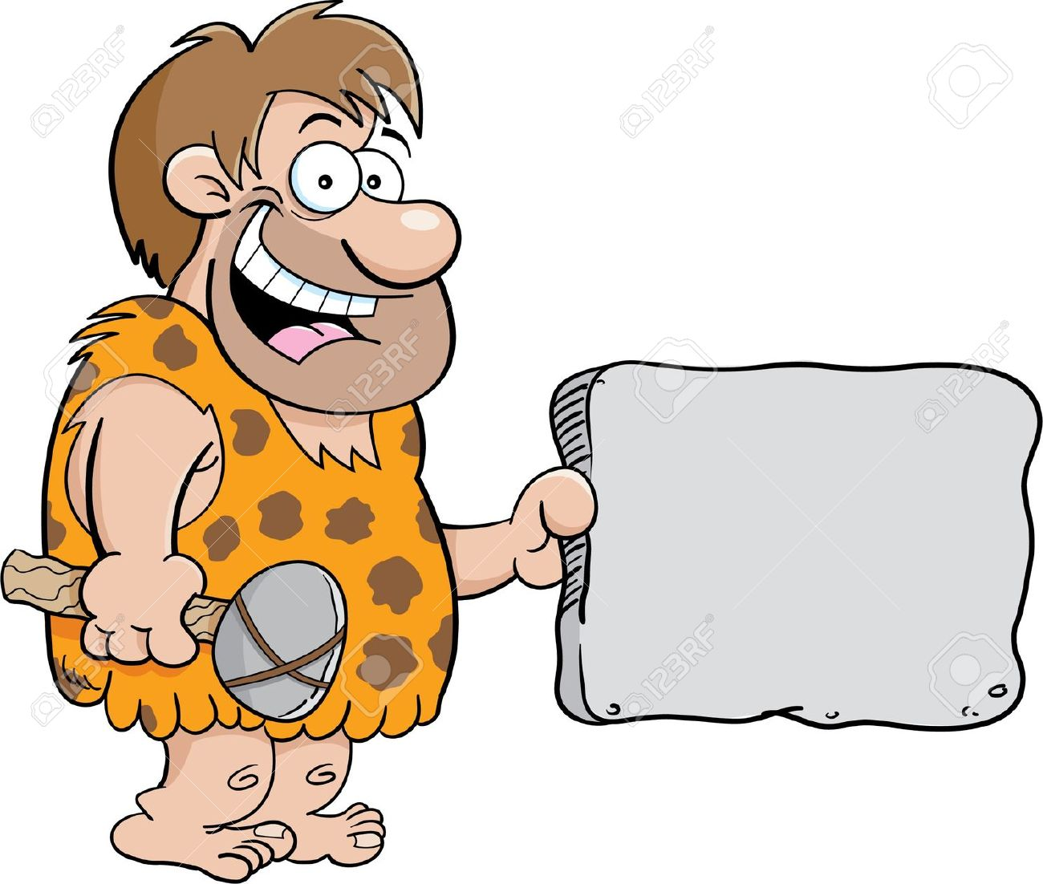

P1.4.1. How to find ‘suspicious’ groups?
‘blocks’ are normal, right?
idols
fans

Slide 21

Except that:
‘blocks’ are normal, right?
‘hyperbolic’ communities are more realistic [Araujo+, PKDD’14]

Slide 22
Except that:
‘blocks’ are usually suspicious
‘hyperbolic’ communities are more realistic [Araujo+, PKDD’14]
Q: Can we spot blocks, easily?

Slide 23
Except that:
‘blocks’ are usually suspicious
‘hyperbolic’ communities are more realistic [Araujo+, PKDD’14]
Q: Can we spot blocks, easily?
A: Silver bullet: SVD!

Slide 24
Why
From: SALSA
HITS fixates on dense blocks (‘Tightly Knit Community’ TKC - often link farms)
Should win, but doesn’t
under HITS

Slide 25




Crush intro to SVD
From: HITS
Recall: (SVD) matrix factorization: finds blocks
‘music lovers’
‘singers’
‘sports lovers’
‘athletes’
‘citizens’
‘politicians’
M
idols
N
fans
+
+
~

Slide 26
Crush intro to SVD
(SVD) matrix factorization: finds blocks
A) Even if shuffled!
‘music lovers’
‘singers’
‘sports lovers’
‘athletes’
‘citizens’
‘politicians’
M
idols
N
fans
+
+
~

Slide 27
Crush intro to SVD
(SVD) matrix factorization: finds blocks
B) Even if ‘salt+pepper’ noise
‘music lovers’
‘singers’
‘sports lovers’
‘athletes’
‘citizens’
‘politicians’
M
idols
N
fans
+
+
~

Slide 28
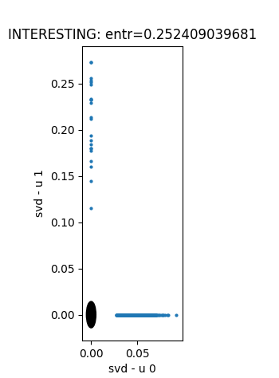
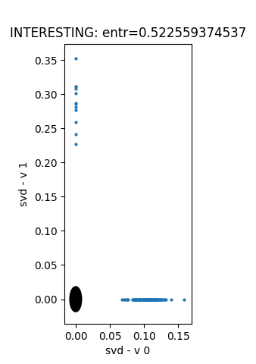
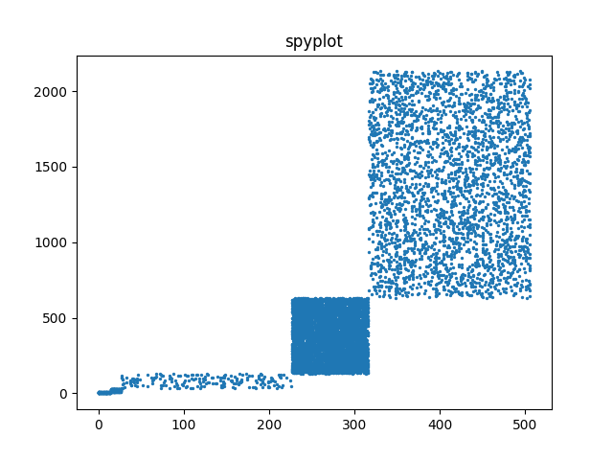
Toy example – 5 blocks
From: HITS
v₀
v₁
‘idols’
u₀
u₁
‘fans’
u₁
v₁
u₀
v₀
EigenPlots

Slide 29
Toy example – 5 blocks
From: HITS
v₀
v₁
‘idols’
u₀
u₁
‘fans’
u₁
v₁
u₀
v₀

Slide 30





Inferring Strange Behavior from Connectivity Pattern in Social Networks
PAKDD’14
Meng Jiang, Peng Cui, Shiqiang Yang (Tsinghua)
Alex Beutel, Christos Faloutsos (CMU)

Slide 31

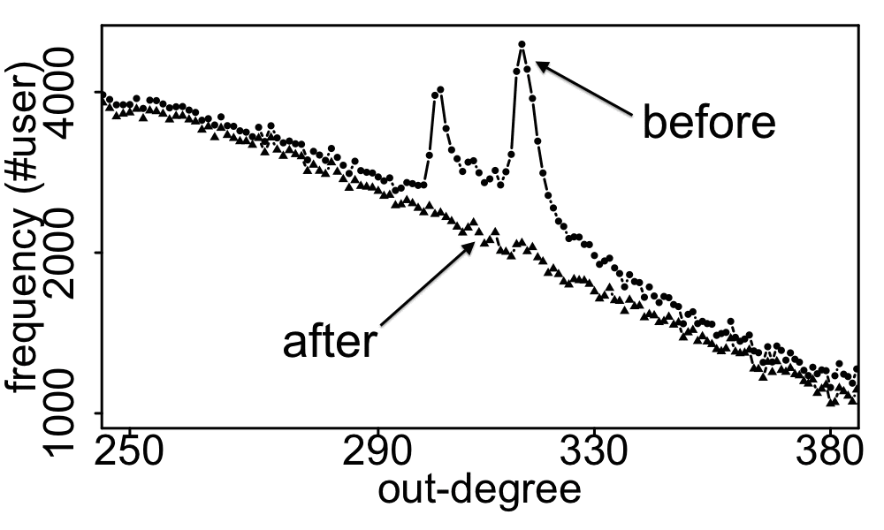
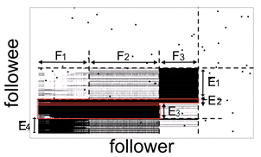
Real Data
Spikes on the out-degree distribution
×
×

Slide 32


MLG’18 Workshop
08/20/2018 (Tomorrow 4:00 pm)
ICC Capital Suit Room 8
GraphRAD: A Graph-based Risky Account Detection System
Jun Ma,
Danqing Zhang,
Yun Wang,
Yan Zhang,
Alexey Pozdnoukhov

Slide 33
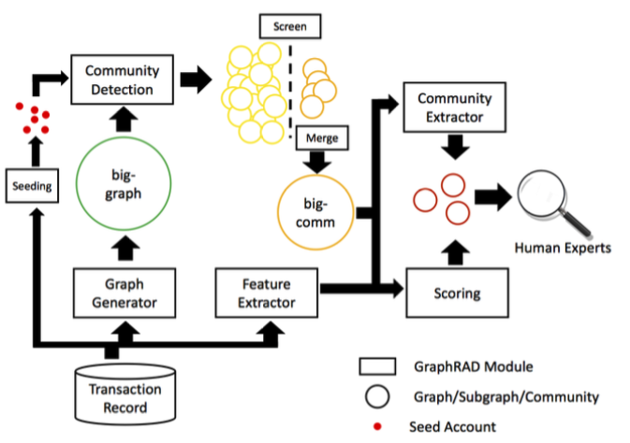
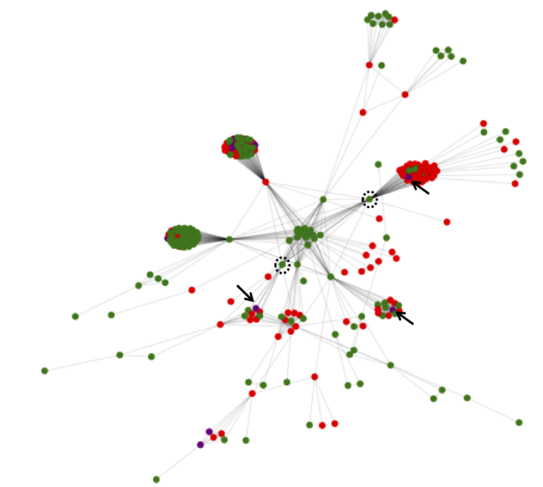
Input: Gigantic account link graph
Community Detection
Semi-supervised Suspicious Detection
Output: small candidate graphs for manual check

Slide 34
Solution
Given:
Find:
Outliers
Lock-step
OddBall
SVD

Slide 35
Roadmap
Introduction – Motivation
Part#1: Graphs
  …
  P1.3: community detection
  P1.4: fraud/anomaly detection
  P1.5: belief propagation
un-supervised
?
semi-supervised

