Slide 1

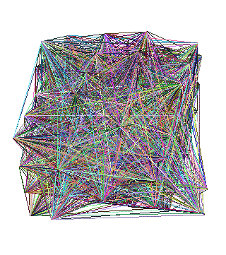
Roadmap
Introduction – Motivation
Part#1: Graphs
  P1.1: properties/patterns in graphs
  P1.2: node importance
  P1.3: community detection
  P1.4: fraud/anomaly detection
  P1.5: belief propagation
?
Notes:
Hello, everyone, my name is Andrey.
I’m an applied scientist at Amazon, and in this section of tutorial,
I’m going to talk about node importance in graphs.

Slide 2

Roadmap
Introduction – Motivation
Part#1: Graphs
  P1.1: properties/patterns in graphs
  P1.2: node importance
    PageRank and Personalized PR
    HITS
    (SVD)
    SALSA
?
Notes:
We will cover several algorithms, such as PageRank, HITS and SALSA,
and we will also have a look at a special technique called
Singular Value Decomposition (SVD).

Slide 3



‘Recipe’ Structure:
Problem definition
Short answer/solution
LONG answer – details
Conclusion/short-answer
Notes:
Following the convention of our tutorial, yellow slides indicate highlights.

Slide 4
Node importance - Motivation:
Given a graph (eg., web pages containing the desirable query word)
Q1: Which node is the most important?
Q2: How close is node ‘A’ to node ‘B’?
Notes:
This section focuses on the following questions. Given a graph (for example,
web pages containing the desirable query word), first, we want to find which
node is the most important. Second, we want to measure how close is node
A to node B.

Slide 5
Node importance - Motivation:
Given a graph (eg., web pages containing the desirable query word)
Q1: Which node is the most important?
  PageRank (PR = RWR), HITS, SALSA
Q2: How close is node ‘A’ to node ‘B’?
  Personalized P.R. (/SALSA)
Notes:
We will present PageRank, HITS and SALSA algorithms to address the first
question. We will present Personalized Page Rank to address the second
question.

Slide 6
SVD properties
Hidden/latent variable detection
Compute node importance (HITS)
Block detection
Dimensionality reduction
Embedding (linear)
  SVD is a special case of ’deep neural net’
v₀
v₁
u₀
u₁
Notes:
As I mentioned, we will also have a look at SVD and see how it
can be used for various applications.

Slide 7
Roadmap
Introduction – Motivation
Part#1: Graphs
  P1.1: properties/patterns in graphs
  P1.2: node importance
    PageRank and Personalized PR
    HITS
    SALSA
?
Notes:
Let’s begin with the famous PageRank algorithm

Slide 8
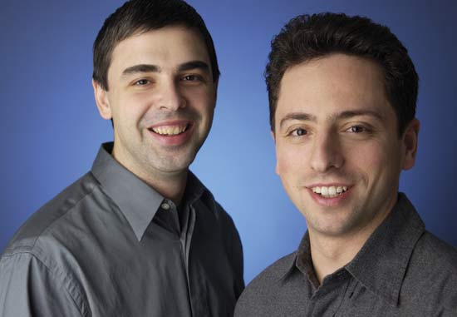
PageRank (google)
Brin, Sergey and Lawrence Page (1998). Anatomy of a Large-Scale Hypertextual Web Search Engine. 7th Intl World Wide Web Conf.
Page, Brin, Motwani, and Winograd (1999). The PageRank citation ranking: Bringing order to the web. Technical Report
Larry
Page
Sergey
Brin

Slide 9
Problem: PageRank
Given a directed graph, find its most interesting/central node
A node is important,
if its parents are important
(recursive, but OK!)
Notes:
Our question is how to identify important nodes. The PageRank answer to
this question is that a node is important if its parents are important. This is
a recursive definition, but as we will see, it turns out to be a well defined
quantity.

Slide 10

Problem: PageRank - solution
Given a directed graph, find its most interesting/central node
Proposed solution: Random walk; spot most ‘popular’ node (-> steady state prob. (ssp))
A node high ssp,
if its parents have high ssp
(recursive, but OK!)
Notes:
More specifically, imagine a random surfer traversing from node to node.
At each step, there is going to be a certain probability of the surfer locating
at each particular node. Under some mild assumptions, as the number of
steps goes to infinity, these probabilities will stabilize to some values called
steady state probabilities or SSP. Note that the more central a node is, the
more likely it is to be visited, the higher the SSP. Also note that a node will
have high SSP if its parents have high SSP.

Slide 11
(Simplified) PageRank algorithm
DETAILS
Let A be the adjacency matrix;
let B be the transition matrix: transpose, column-normalized - then
From
B
To
2
1
3
=
4
5
Notes:
The PageRank importance scores are defined to be these SSP. This random
walk is a Markov process characterized with a transition equation. Here, this
vector contains probabilities of being at a particular node before making a
step, and this vector contains the probabilities after the random step. The
transition matrix is closely related to graph adjacency matrix. For example,
this element equals to one, because transition from node 3 (column 3 here)
will end up in node 1 (row 1 here) with probability one. On the other hand,
this value equals to 0.5, because starting from node 2, the probability of
ending up in node 3 is 0.5.

Slide 12
(Simplified) PageRank algorithm
DETAILS
B p = p
B p = p
2
1
3
=
4
5
Notes:
Since, at steady state, probabilities do not change any more, we have that [p]
before transition equals to [p] after transition. That is, our PageRank scores is
a vector that satisfies this equation.

Slide 13
Definitions
DETAILS
A Adjacency matrix (from-to)
D Degree matrix = (diag ( d1, d2, …, dn) )
B Transition matrix: to-from, column normalized
B = A^{T} D⁻¹
Notes:
Transition matrix B is closely related to adjacency matrix, and can be
expressed like this. Here, D is the diagonal matrix of node degrees.

Slide 14
(Simplified) PageRank algorithm
DETAILS
B p = 1 * p
thus, p is the eigenvector that corresponds to the highest eigenvalue (=1, since the matrix is column-normalized)
Why does such a p exist?
  p exists if B is nxn, nonnegative, irreducible [Perron–Frobenius theorem]
Notes:
Let’s return to our PageRank equation. Notice that this is an eigenvector
equation, where p is the eigenvector that corresponds to the highest
eigenvalue. The highest eigenvalue equals to one, because our matrix B has
a special property being column normalized. According to Perron-Frobenius
theorem, such a vector exists if matrix B is square, nonnegative and irreducible.
Naturally, B is square and non-negative.

Slide 15

(Simplified) PageRank algorithm
In short: imagine a particle randomly moving along the edges
compute its steady-state probabilities (ssp)
Full version of algo: with occasional random jumps
Why? To make the matrix irreducible
Notes:
Let’s modify our random surfing process. We perform a random walk, but
now we are going to make occasional random jumps. This is going to make
the transition matrix irreducible. As an example, suppose we are here, we toss
a coin and decide to continue the walk, …

Slide 16
(Simplified) PageRank algorithm
In short: imagine a particle randomly moving along the edges
compute its steady-state probabilities (ssp)
Full version of algo: with occasional random jumps
Why? To make the matrix irreducible
Notes:
we are making a random step, …

Slide 17
(Simplified) PageRank algorithm
In short: imagine a particle randomly moving along the edges
compute its steady-state probabilities (ssp)
Full version of algo: with occasional random jumps
Why? To make the matrix irreducible

Slide 18
(Simplified) PageRank algorithm
In short: imagine a particle randomly moving along the edges
compute its steady-state probabilities (ssp)
Full version of algo: with occasional random jumps
Why? To make the matrix irreducible
Notes:
we toss a coin again, but this time we decide to terminate this walk, …

Slide 19
(Simplified) PageRank algorithm
In short: imagine a particle randomly moving along the edges
compute its steady-state probabilities (ssp)
Full version of algo: with occasional random jumps
Why? To make the matrix irreducible
Notes:
and restart to a random node.

Slide 20
(Simplified) PageRank algorithm
In short: imagine a particle randomly moving along the edges
compute its steady-state probabilities (ssp)
PageRank = PR
= Random Walk with Restarts = RWR
= Random surfer
Notes:
In summary, the PageRank algorithm is a random walk with restarts model.

Slide 21
Full Algorithm
DETAILS
With probability 1-c, fly-out to a random node
Then, we have
  p = c B p + (1-c)/n 1 =>
  p = (1-c)/n [I - c B] ⁻¹ 1
Notes:
Formally, let (1-c) be the probability of fly-out. We have that with probability c,
we follow the random walk using transition B from before, and with probability
(1-c) we go to a random node. We can rearrange the terms to derive an analytic
expression for PageRank scores.

Slide 22
Full Algorithm
DETAILS
With probability 1-c, fly-out to a random node
Then, we have
  p = c B p + (1-c)/n 1 =>
  p = (1-c)/n [I - c B] ⁻¹ 1
Notes:
This is a vector of PageRank scores, this is a matrix, and this is a vector of
ones. […]

Slide 23
Notice:
pageRank ~ in-degree
(and HITS, SALSA, also: ~ in-degree)
Notes:
Interestingly, there has been some studies, that show close relation between
PageRank scores and in-degree.

Slide 24
Roadmap
Introduction – Motivation
Part#1: Graphs
  P1.1: properties/patterns in graphs
  P1.2: node importance
    PageRank and Personalized PR
    HITS
    SALSA
?
Notes:
That was PageRank.

Slide 25
Node importance - Motivation:
Given a graph (eg., web pages containing the desirable query word)
Q1: Which node is the most important?
Q2: How close is node ‘A’ to node ‘B’?
A
B
Notes:
Let’s now consider the second question: how close is node A to node B

Slide 26
Personalized P.R.
Taher H. Haveliwala. 2002. Topic-sensitive PageRank. (WWW '02). 517-526. http://dx.doi.org/10.1145/511446.511513
Page L., Brin S., Motwani R., and Winograd T. (1999). The PageRank citation ranking: Bringing order to the web. Technical Report
Notes:
The solution to this questions is going to be personalized PageRank or PPR

Slide 27
Extension: Personalized P.R.
How close is ‘4’ to ‘2’?
(or: if I like page/node ‘2’, what else would you recommend?)
2
1
3
4
5
Notes:
Such a question can arise, e.g., in the recommendation context: If a user likes
page/node 2, what else would you recommend?

Slide 28
Extension: Personalized P.R.
How close is ‘4’ to ‘2’?
(or: if I like page/node ‘2’, what else would you recommend?)
2
1
3
4
5
Notes:
The idea here is that one node 4 is similar to 2, if it is easy to reach node 4
from node 2. Here’s one path.

Slide 29
Extension: Personalized P.R.
How close is ‘4’ to ‘2’?
(or: if I like page/node ‘2’, what else would you recommend?)
2
1
3
4
5
Notes:
Here’s another path.

Slide 30
Extension: Personalized P.R.
How close is ‘4’ to ‘2’?
(or: if I like page/node ‘2’, what else would you recommend?)
High score (A -> B) if
Many
Short
Heavy
paths A->B
2
1
3
4
5
Notes:
We say that node 4 is highly relevant to node 2, if there are many short and
heavy paths between 2 and 4. In other words, if it is easy to reach node 4
from node 2. We are going to measure this using PPR (Personalized PageRank).

Slide 31



Extension: Personalized P.R.
your favorite
With probability 1-c, fly-out to a random node(s)
Then, we have
  p = c B p + (1-c)/n 1 =>
  p = (1-c)/n [I - c B] ⁻¹ 1
$$\vec{e}$$
$$\vec{e}$$
$$\vec{e}$$
Notes:
Remember those random fly-outs in PageRank? Well, in PPR, the fly-out is
to the origin node rather than to the random node. If we want to know how
relevant is each node to node 2, we fly-out to node two. Mathematically,
this comes down to replacing the all-one vector in the fly-out term with
node 2-specific restart vector. PageRank and PPR have very similar equations.

Slide 32
Extension: Personalized P.R.
How close is ‘4’ to ‘2’?
A: compute Personalized P.R. of ‘4’, restarting from ‘2’
2
1
3
4
5
Notes:
So, to answer the question of how close if node 4 to node 2, compute PPR
of node 4, when restarting to node 2. […]

Slide 33
Extension: Personalized P.R.
How close is ‘4’ to ‘2’?
A: compute Personalized P.R. of ‘4’, restarting from ‘2’ – Related to
  ‘escape’ probability
  ‘round trip’ probability
  …
Notes:
As a side note, PPR probabilities are related to escape and
round trip probabilities.

Slide 34
Roadmap
Introduction – Motivation
Part#1: Graphs
  P1.1: properties/patterns in graphs
  P1.2: node importance
    PageRank and Personalized PR
      Fast computation - ‘Pixie’
    HITS
    SALSA
?
Notes:
OK, that is the idea behind PPR. Now, I would like to mention an approach
to fast computation of PPR scores

Slide 35
Extension: Personalized P.R.
DETAILS
Q: Faster computation than:
  p = (1-c)/n [I - c B] ⁻¹ 1
Notes:
A nice property of PPR is the ability to write down the scores analytically.
In order to find PPR scores p, compute expression on the right. This
expression involves matrices that are going to be large for large graphs. It is
then natural to ask if there is a more efficient way to compute PPR scores.

Slide 36

Pixie algorithm
Chantat Eksombatchai, Pranav Jindal, Jerry Zitao Liu, Yuchen Liu, Rahul Sharma, Charles Sugnet, Mark Ulrich, Jure Leskovec:
Pixie: A System for Recommending 3+ Billion Items to 200+ Million Users in Real-Time. WWW 2018: 1775-1784
https://dl.acm.org/citation.cfm?doid=3178876.3186183
Notes:
As it turns out, there is. In a recent paper, authors were using PPR for making
recommendations at Pinterest. Their graph is very large, it contains billions
of edges. Therefore, the authors proposed a new algorithm called Pixie that
computes approximate PPR scores faster than the analytical method.

Slide 37
Pixie algorithm
Q: Faster computation than:
  p = (1-c)/n [I - c B] ⁻¹ 1
A: simulate a few R.W.
  keep visit counts C_{i}
  fast and nimble
Notes:
Instead of using analytic expression, Pixie proposes to simulate random walks.
Suppose, we are looking for recommendations for this. The idea of PPR is
to recommend nodes easily reachable from this node. The idea of Pixie, is
to find such nodes, but simulating random walks starting here, and keeping
visit counts for every other nodes. Fast and easy!

Slide 38
Personalized PageRank algorithm
Notes:
Here’s an illustration. We start random walk here, …

Slide 39

Personalized PageRank algorithm
Notes:
we keep track of visit counts, …

Slide 40
Personalized PageRank algorithm

Slide 41
Personalized PageRank algorithm
Notes:
visiting another node, recording.

Slide 42
Personalized PageRank algorithm
Notes:
With some probability, we restart to the origin, and repeat the process.

Slide 43
Personalized PageRank algorithm

Slide 44
Personalized PageRank algorithm
..
…
..
…
Notes:
After a pre-defined number of walks, we identify most visited nodes, as
recommendations for the original node.

Slide 45
Roadmap
Introduction – Motivation
Part#1: Graphs
  P1.1: properties/patterns in graphs
  P1.2: node importance
    PageRank and Personalized PR
      Fast computation - ‘Pixie’
      Other applications
    HITS
    SALSA
?
Notes:
PPR has other interesting applications, and you can check out this example
with reference after the tutorial.

Slide 46



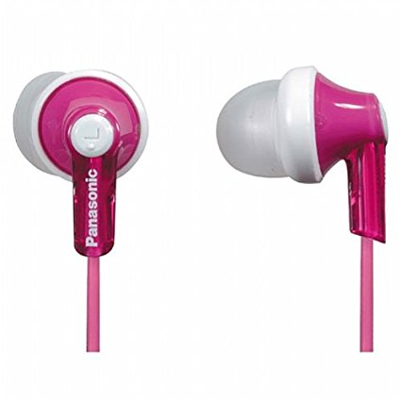


Applications of node proximity
Recommendation
Link prediction
‘Center Piece Subgraphs’
…
…
…
?

Slide 47



Applications of node proximity
Recommendation
Link prediction
‘Center Piece Subgraphs’
…
…
…
?

Slide 48
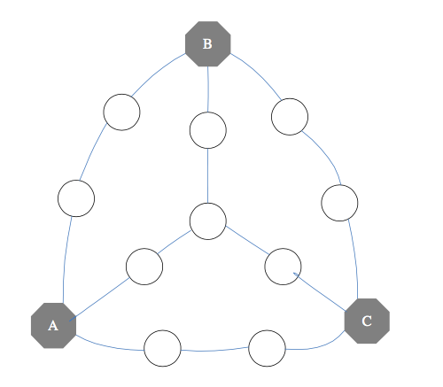
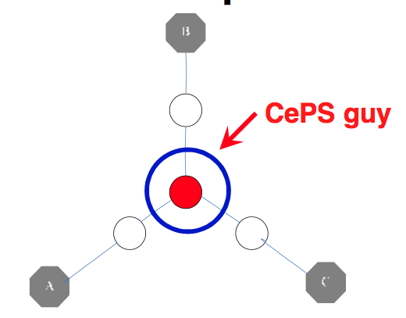
Applications of node proximity
Recommendation
Link prediction
‘Center Piece Subgraphs’
…

Slide 49



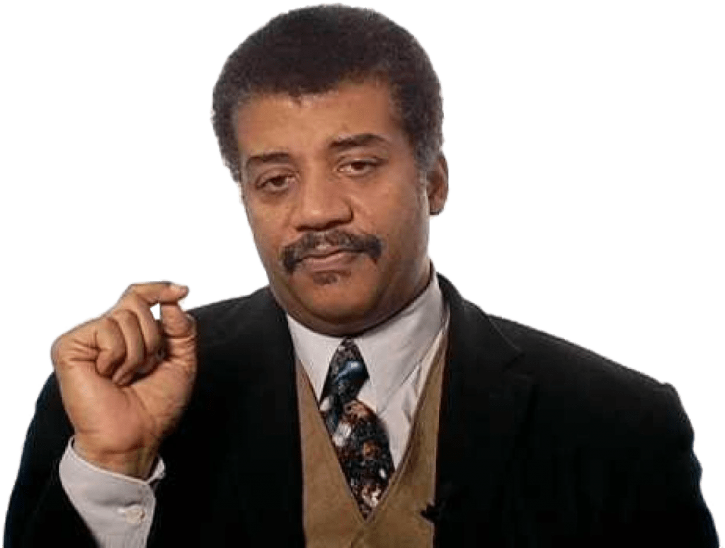
Applications of node proximity
Recommendation
Link prediction
‘Center Piece Subgraphs’
…

Slide 50

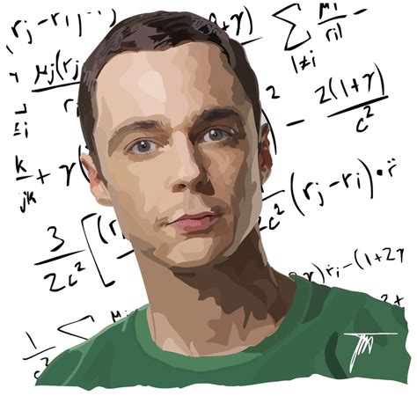
Applications of node proximity
Recommendation
Link prediction
‘Center Piece Subgraphs’
…

Slide 51

Applications of node proximity
Recommendation
Link prediction
‘Center Piece Subgraphs’
…
Fast Algorithms for Querying and Mining Large Graphs
Hanghang Tong, PhD dissertation, CMU, 2009. TR: CMU-ML-09-112.

Slide 52
Roadmap
Introduction – Motivation
Part#1: Graphs
  P1.1: properties/patterns in graphs
  P1.2: node importance
    PageRank and Personalized PR
    HITS
    SVD
    SALSA
?
Notes:
We now move on to a related, but different approach to the node
importance question.

Slide 53

Kleinberg’s algo (HITS)
Kleinberg, Jon (1998). Authoritative sources in a hyperlinked environment. Proc. 9th ACM-SIAM Symposium on Discrete Algorithms.
Notes:
We are going to consider an algorithm called HITS proposed by Jon Kleinberg.
Here’s the original paper.

Slide 54
Recall: problem dfn
Given a graph (eg., web pages containing the desirable query word)
Q1: Which node is the most important?
Notes:
We return to our Q1: Which node is the most important in the graph.

Slide 55

Why not just PageRank?
HITS (and its derivative, SALSA), differentiate between “hubs” and “authorities”
HITS can help to find the largest community
(SVD: powerful tool)
idols
fans
Notes:
Why HITS? Well, unlike PR, HITS (and a related algorithm called SALSA) takes
into account different roles each node may play. HITS is also linked to
Singular Value Decomposition (SVD) and community finding. SVD is
a powerful technique that we are going to cover shortly.

Slide 56
Kleinberg’s algorithm
Problem dfn: given the web and a query
find the most ‘authoritative’ web pages for this query
Notes:
Given a Web and a query, the aim of the algorithm is to find the most
“authoritative” web pages for this query.

Slide 57
Problem: PageRank
Given a directed graph, find its most interesting/central node
A node is important,
if its parents are important
(recursive, but OK!)
Notes:
Green background indicates a slide from before. Recall the PR approach:
A node is important, if its parents are important.

Slide 58
Problem: PageRank
HITS
Given a directed graph, find its most interesting/central node
``wise’’
A node is important,
if its parents are important
(recursive, but OK!)
AND: A node is ``wise’’
if its children are important
Notes:
In HITS, the idea is revised: A node is important, if its parents are “wise”,
and a node is “wise” if its children are important. A node is important,
if its parents are “wise”, and a node is “wise” if its children are important.
This is still a recursive definition, but it now involves two quantities:
importance and “wise-ness”.

Slide 59
Kleinberg’s algorithm
Step 0: find nodes with query word(s)
Step 1: expand by one move forward and backward
Notes:
We will return to importance and wise-ness in a minute. Here, I’d like to
point out that Kelinberg’s algorithm, does not work with the entire Web
graph. Instead, the algorithm finds nodes (i.e., webpages) that contain query
words, identifies induced subgraph, and expands the subgraph by including
backwards and forwards neighbors. The resulting expanded subgraph is then
the input to the scoring procedure.

Slide 60
Kleinberg’s algorithm
on the resulting graph, give high score (= ‘authorities’) to nodes that many ``wise’’ nodes point to
give high wisdom score (‘hubs’) to nodes that point to good ‘authorities’
hubs
authorities
Notes:
The scoring procedure distinguishes between being important (authoritative
as HITS calls it) and being wise, which means being good hub. Each node
receives two scores. A node gets a high authority score if it is pointed to by
many hubs. A node gets a high hub score if it points to many good authorities.

Slide 61
Kleinberg’s algorithm
Then:
a_{i} = h_{k} + h_{l} + h_{m}
that is
a_{i} = Sum (h_{j}) over all j that (j,i) edge exists
or
a = A^{T} h
k
l
i
m
=
Notes:
In this example, let green circles represent a unit of hub-ness. Then the
authority of node i is the sum of hub-scores of nodes that point to it. Recall
that A denotes the adjacency matrix, and so we can express a vector of all
authority scores as a function of all hub-scores.

Slide 62
Kleinberg’s algorithm
Then:
a_{i} = h_{k} + h_{l} + h_{m}
that is
a_{i} = Sum (h_{j}) over all j that (j,i) edge exists
or
a = A^{T} h
k
l
i
m
=
Notes:
In this example, node i gets four units of authority.

Slide 63
Kleinberg’s algorithm
symmetrically, for the ‘hubness’:
h_{i} = a_{n} + a_{p} + a_{q}
that is
h_{i} = Sum (q_{j}) over all j that (i,j) edge exists
or
h = A a
n
i
p
q
=
Notes:
On the other hand, a hub-score is a sum of all authority score of nodes it
points to. Thus, we have this expression here.

Slide 64
Kleinberg’s algorithm
symmetrically, for the ‘hubness’:
h_{i} = a_{n} + a_{p} + a_{q}
that is
h_{i} = Sum (q_{j}) over all j that (i,j) edge exists
or
h = A a
n
i
p
q
=
Notes:
This node gets a lot of hub-ness.

Slide 65
Kleinberg’s algorithm
In conclusion, we want vectors h and a such that:
h = A a
a = A^{T} h
=
Notes:
In conclusion, we want hub-ness and authority vectors, such that ... Authority
scores confer hub-ness ...

Slide 66
Kleinberg’s algorithm
In conclusion, we want vectors h and a such that:
h = A a
a = A^{T} h
=
Notes:
… and hub-ness scores confer authority.

Slide 67
Kleinberg’s algorithm
In conclusion, we want vectors h and a such that:
h = A a
a = A^{T} h
=

Slide 68
Kleinberg’s algorithm
In conclusion, we want vectors h and a such that:
h = A a
a = A^{T} h
=
Notes:
Recursively, authority scores confer hub-ness ... and so on

Slide 69
Kleinberg’s algorithm
In short, the solutions to
h = A a
a = A^{T} h
are the left- and right- singular-vectors of the adjacency matrix A.
Starting from random a’ and iterating, we’ll eventually converge
… to the vector of strongest singular value.
Dfn: in +2
Notes:
This turns out to be a well-defined system, and in short, the solution to these
system are the left- and right- singular vectors of the adjacency matrix. We
are going to talk about singular value decomposition shortly. Such a solution,
can be found by iterating: start from random authorities, compute hub-ness,
re-compute authorities, etc.

Slide 70
Kleinberg’s algorithm - results
Eg., for the query ‘java’:
0.328 www.gamelan.com
0.251 java.sun.com
0.190 www.digitalfocus.com (“the java developer”)
Notes:
Kleinberg has provided an extensive evaluation, please refer to his paper
for details.

Slide 71
Roadmap
Introduction – Motivation
Part#1: Graphs
  P1.1: properties/patterns in graphs
  P1.2: node importance
    PageRank and Personalized PR
    HITS
    (SVD)
    SALSA
?
Notes:
We saw that solution to HITS is given by Singular Value Decomposition
or SVD, and in our next topic, I’d like to introduce the SVD technique.

Slide 72
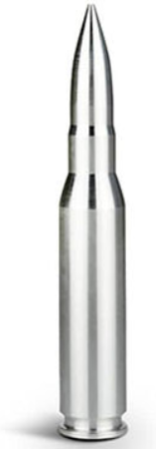
SVD properties
Hidden/latent variable detection
Compute node importance (HITS)
Block detection
Dimensionality reduction
Embedding
Notes:
As I mentioned before, SVD is a powerful tool that we are going to refer to
several times in this tutorial. In addition to node importance, SVD can be
used for latent variable detection, block detection, dimensionality
reduction and embeddings.

Slide 73


Crush intro to SVD
(SVD) matrix factorization: finds blocks
‘music lovers’
‘singers’
‘sports lovers’
‘athletes’
‘citizens’
‘politicians’
M
idols
N
fans
+
+
~
Notes:
SVD is a matrix decomposition method by finding blocks. As an example,
consider this who-follow-whom matrix between idols and fans. This matrix,
can be represented as a sum of several matrices, each representing a hidden
factor, such as “music”, “sports” or “politics”. Here, v represent vectors for idols
and u represent vectors for fans. Elements of v1 show whether each particular
idol is a musician, elements of v2 show whether each particular idol is an
athlete and so on. All these guys are musicians. Similarly, vector u1 indicates
music lovers, and all these guys here are music lovers.

Slide 74
Crush intro to SVD
(SVD) matrix factorization: finds blocks
‘music lovers’
‘singers’
‘sports lovers’
‘athletes’
‘citizens’
‘politicians’
M
idols
N
fans
+
+
~
Notes:
For example, here’s a particular idol who is a singer. We know it’s a singe
because this element is one. Here’s a particular music lover, and we know
this person is a music lover because this element is one. As can be seen, the
music lover follows the singer. You can see a block because music lovers
predominantly follow musicians, but not athletes or politician. Similarly, we
have a other vectors indicating athletes and politicians, and our original matrix
is a sum of everything. In summary, given a matrix such as this, SVD identifies
latent factors (such as music or sports), and decomposes the matrix by blocks.

Slide 75
Crush intro to SVD
(SVD) matrix factorization: finds blocks
‘music lovers’
‘singers’
‘sports lovers’
‘athletes’
‘citizens’
‘politicians’
M
idols
N
fans
+
+
~
Notes:
What is the relation between SVD and node importance algorithm HITS
Well, first, think of this input matrix as graph adjacency matrix.

Slide 76
Crush intro to SVD
(SVD) matrix factorization: finds blocks
HITS: first singular vector, ie, fixates on largest group
‘music lovers’
‘singers’
‘citizens’
‘politicians’
Authority scores
‘sports lovers’
‘athletes’
M
idols
N
fans
+
+
~
Hub scores
Notes:
HITS decomposes the adjacency matrix, but considers only the largest
block (i.e., the first latent factor). Vectors v and u in this case, indicate
hubs and authorities.
PAUSE

Slide 77
Crush intro to SVD
Basis for anomaly detection – P1.4
Basis for tensor/PARAFAC – P2.1
‘music lovers’
‘singers’
‘sports lovers’
‘athletes’
‘citizens’
‘politicians’
M
idols
N
fans
+
+
~
Notes:
You will see more applications of SVD in this tutorial.

Slide 78
SVD properties
Hidden/latent variable detection
Compute node importance (HITS)
Block detection
Dimensionality reduction
Embedding
v₀
v₁
u₀
u₁
Notes:
Now, let me just briefly introduce SVD for related tasks of dimensionality
reduction and embedding.

Slide 79

Crush intro to SVD
Original representation $N×M$
  e.g., $500$-dimensional vector for each fan
M
idols
N
fans
Notes:
Return to our original input matrix, and for now let’s focus on fans. Here
each fan is represented by a row vector from the matrix, e.g.,
500-dimensional vector.

Slide 80
Crush intro to SVD
(SVD) matrix factorization: finds blocks
‘music lovers’
‘singers’
‘sports lovers’
‘athletes’
‘citizens’
‘politicians’
M
idols
N
fans
+
+
~
Notes:
As we’ve just discussed, SVD decomposes the matrix. Here, for each fan,
elements of u1 show whether this person is a music lover, elements of u2
indicate whether the person is a sports lover, and so on.

Slide 81

Crush intro to SVD
Approximate each person with a $3$d vector
  [“music score”, “sport score”, “politics score”]
‘music lovers’
‘singers’
‘sports lovers’
‘athletes’
‘citizens’
‘politicians’
M
idols
N
fans
+
+
~
Notes:
That is, each fan can now be represented with a 3D vector: music score,
sports score, politics score. And the same applies to idols.

Slide 82
Crush intro to SVD
Approximate each person with a $3$d vector
  [“music score”, “sport score”, “politics score”]
M idols
N fans
3 scores
N
fans
~
M idols
3 scores
Notes:
The idea is that, each of N fans and each of M idols, can be represented
using only 3 dimensions.

Slide 83
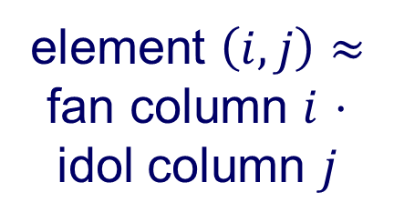
Crush intro to SVD
Approximate each person with a $3$d vector
  [“music score”, “sport score”, “politics score”]
N fans
3 scores
element $\left(i,j\right)≈$ fan column $i$ $⋅$ idol column $j$
~
M idols
3 scores
Notes:
And the original who-follows-whom matrix, contains dot products between
each fan and each idol.

Slide 84


Crush intro to SVD
SVD compression is a linear autoencoder
M idols
reconstructed row $i$
N
fans
…
…
row $i$ ($500$ dim)
Notes:
What I’d like to highlight though is that SVD can be viewed as a linear
autoencoder, i.e., the transfer function is linear. If we focus on fans, original
representation of each fan is provided as input to the autoencoder.

Slide 85
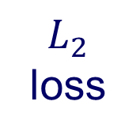
Crush intro to SVD
SVD compression is a linear autoencoder
M idols
reconstructed row $i$
N
fans
…
$L_{2}$ loss
…
row $i$ ($500$ dim)
Notes:
And the task is to find a 3-dimensional representation that best reconstructs
the original input.

Slide 86
Crush intro to SVD
SVD compression is a linear autoencoder
M idols
reconstructed row $i$
N
fans
…
scores
…
row $i$ ($500$ dim)
Notes:
Recall, that in our example, these elements correspond to music, sport and
politics score.

Slide 87
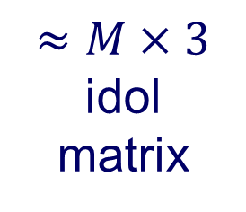
Crush intro to SVD
SVD compression is a linear autoencoder
M idols
reconstructed row $i$
N
fans
…
scores
$≈M×3$ idol matrix
…
row $i$ ($500$ dim)
Notes:
In this example, weights on edges will represent

Slide 88
SVD properties
Hidden/latent variable detection
Compute node importance (HITS)
Block detection
Dimensionality reduction
Embedding (linear)
  SVD is a special case of ’deep neural net’
v₀
v₁
u₀
u₁
Notes:
We have now covered basics of SVD, and its applications. We will use SVD
later in the tutorial.

Slide 89
Roadmap
Introduction – Motivation
Part#1: Graphs
  P1.1: properties/patterns in graphs
  P1.2: node importance
    PageRank and Personalized PR
    HITS
    (SVD)
    SALSA
?
Notes:
The last algorithm, we are going to cover in this tutorial section is called SALSA.

Slide 90
SALSA
R. Lempel and S. Moran. SALSA: the stochastic approach for link-structure analysis. ACM Trans. Inf. Syst. 19, 2 (April 2001), 131-160.
Goal: avoid HITS’ fixation on largest block
Notes:
Reference to the original paper …

Slide 91
Crush intro to SVD
(SVD) matrix factorization: finds blocks
HITS: first singular vector, ie, fixates on largest group
‘music lovers’
‘singers’
‘citizens’
‘politicians’
Authority scores
‘sports lovers’
‘athletes’
M
idols
N
fans
+
+
~
Hub scores
Notes:
Recall that HITS uses the first singular vector, that is, fixates on the largest
block in the adjacency matrix.

Slide 92
Why SALSA?
HITS fixates on dense blocks (‘Tightly Knit Community’ TKC - often link farms)
Should win, but doesn’t
under HITS
Notes:
Such block are called tightly knit communities, and are often link farms.
The motivation for SALSA has been to avoid fixating on TKC. For example,
in this case, one might want this guy to win, but it does not under HITS.

Slide 93
SALSA motivation
Q: how to avoid fixation on largest block
  (which may be a link-farm)
A: *divide* authority (/ hubness) score, instead of *copying* it.
HITS
SALSA
Notes:
The SALSA solution is to divide authority and hub-ness scores instead of
copying it. Remember, in HITS, a node confers it’s hub-ness units to
everyone it points to..

Slide 94
SALSA vs HITS
Like HITS, has two scores per node (hub./auth.)
BUT:
Downplays TKC (eg., link-farms)
Modeled as random walk (back-forth)
  Can do personalization (w/ fly-out)
  Can use fast, ‘Pixie’ algo
Notes:
So both HITS and SALSA has two scores per node. However, SALSA
downplays this TKC effect. Importantly, SALSA can also be modelled as a
random walk that interleaves following direction of arrows with going in
reverse direcaiont. As such, SALSA can also be personalized, much like
PageRank, and the Pixie algorithm can also be applied.

Slide 95
Vs HITS, PageRank
DETAILS
a = c A^{T} D_{out}⁻¹ a + (1-c)/N 1
RWR
a = A^{T} D_{out}⁻¹ h
=
SALSA
h = A D_{in}⁻¹ a
a = A^{T} D_{out}⁻¹ h
HITS
h = A D_{in}⁻¹ a
Notes:
Mathematically, all three algorithms are similar. Going from the bottom, in
HITS, hub-ness confers authority, and authority confers hub-ness. In SALSA,
hub-ness scores are divided by out-degree first, authority scores are divided
by in-degree. Finally, PageRank, considers only one type of score, and fly-out
to a random node with probability (1-c).

Slide 96
Node importance - Motivation:
Given a graph (eg., web pages containing the desirable query word)
Q1: Which node is the most important?
  PageRank (PR = RWR), HITS, SALSA
Q2: How close is node ‘A’ to node ‘B’?
  Personalized P.R. (/SALSA)
Notes:
To summarize this section, we have considered two questions. First, which
node is the most important, and we introduced PageRank, HITS and SALSA
algorithms to address this question. The second question has been how
close is node ‘a’ to node ‘b’. This question can be addressed with
Personalized PR. SALSA can also be personalized.

Slide 97
SVD properties
Hidden/latent variable detection
Compute node importance (HITS)
Block detection
Dimensionality reduction
Embedding (linear)
  SVD is a special case of ’deep neural net’
v₀
v₁
u₀
u₁
Notes:
We have also discussed SVD which is a powerful technic. We saw how SVD
can be used for latent variables detection, computing node importance,
block detection, and dimensionality reduction. We also saw that SVD can
be considered as a special case of a deep neural network.

Slide 98
SVD properties
Hidden/latent variable detection
Compute node importance (HITS)
Block detection
Dimensionality reduction
Embedding (linear)
  SVD is a special case of ’deep neural net’
Matrix? SVD!
v₀
v₁
u₀
u₁
Notes:
Whenever you are dealing with matrix analysis, chances are that SVD
is the way to go.

