Slide 1


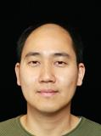
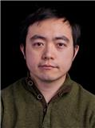

Graph and Tensor Mining for fun and profit
Luna Dong, Christos Faloutsos
Andrey Kan, Jun Ma, Subho Mukherjee

Slide 2
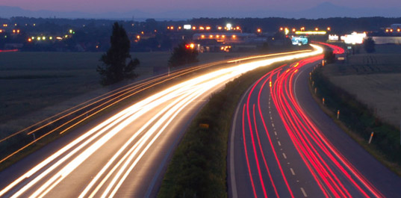
Roadmap
Introduction – Motivation
Part#1: Graphs
Part#2: Tensors and Knowledge Bases
Conclusions

Slide 3
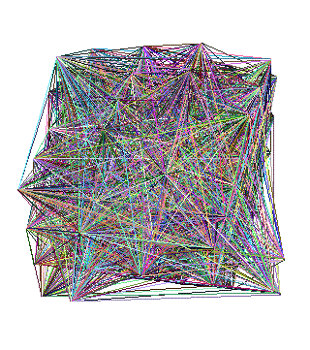
Roadmap
Introduction – Motivation
Part#1: Graphs
  P1.1: properties/patterns in graphs
  P1.2: node importance
  P1.3: community detection
  P1.4: fraud/anomaly detection
  P1.5: belief propagation
?
?

Slide 4
Why care about patterns?

Slide 5
Why care about patterns?
Anomalies
Faster algorithms
Graph generators (‘what if’ scenarios)

Slide 6

Why care about patterns?
Anomalies
Faster algorithms
Graph generators (‘what if’ scenarios)
Patterns anomalies

Slide 7
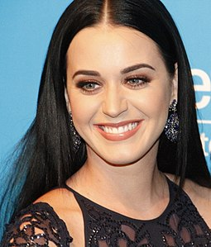
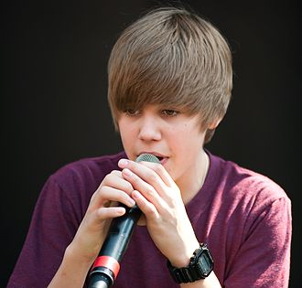
Why care about patterns?
Anomalies
Faster algorithms
Graph generators (‘what if’ scenarios)
Patterns anomalies

Slide 8
Why care about patterns?
Anomalies
Faster algorithms
Graph generators (‘what if’ scenarios)
  Graph500.org
Patterns anomalies

Slide 9
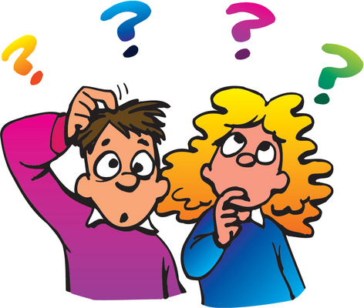


‘Recipe’ Structure:
Problem definition
Short answer/solution
LONG answer – details
Conclusion/short-answer

Slide 10
Problem definition
?
?
Are real graphs random?
  S*: what do static graphs look like?
  T*: how do graphs evolve over time?

Slide 11
Short answer(s)
?
?
Are real graphs random?
  S*: what do static graphs look like?
    S.0: ‘six degrees’
    S.1: skewed degree distribution
    S.2: skewed eigenvalues
    S.3: triangle power-laws
    S.4: GCC; and skewed distr. of conn. comp.
  T*: how do graphs evolve over time?
    T.1: diameters
    T.2: densification

Slide 12
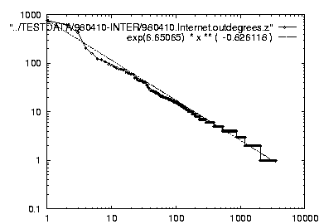
Short answer(s)
?
?
Are real graphs random?
  S*: what do static graphs look like?
    S.0: ‘six degrees’
    S.1: skewed degree distribution
    S.2: skewed eigenvalues
    S.3: triangle power-laws
    S.4: GCC; and skewed distr. of conn. comp.
  T*: how do graphs evolve over time?
    T.1: diameters
    T.2: densification
Power laws: y ~ xª
NOT Gaussians
Take logarithms
y (log scale)
a
x (log scale)

Slide 13
Graph mining
Are real graphs random?

Slide 14
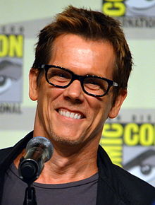
Laws and patterns
Q: Are real graphs random?
A: NO!!
  S.0: Diameter (‘6 degrees’; ‘Kevin Bacon’)
  in- and out- degree distributions
  other (surprising) patterns
So, let’s look at the data

Slide 15
Short answer(s)
?
?
Are real graphs random?
  S*: what do static graphs look like?
    S.0: ‘six degrees’
    S.1: degree distribution
    S.2: skewed eigenvalues
    S.3: triangle power-laws
    S.4: GCC; and skewed distr. of conn. comp.
  T*: how do graphs evolve over time?
    T.1: diameters
    T.2: densification

Slide 16
S.1 - degree distributions
Q: avg degree is ~2 - what is the most probable degree?
count
??
2
degree

Slide 17
S.1 - degree distributions
Q: avg degree is ~2 - what is the most probable degree?
WRONG !
count
??
count
2
degree
2
degree

Slide 18
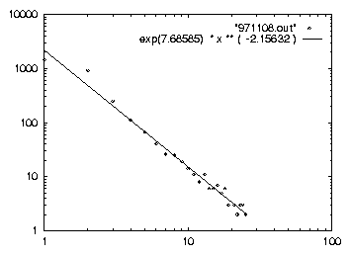
S.1 .Power-law: outdegree O
Frequency
Exponent = slope
O = -2.15
-2.15
Nov’97
Outdegree
The plot is linear in log-log scale [FFF’99]
freq = degree ^{(-2.15)}

Slide 19
S.1 - rank-degree plot
Any pattern?

Slide 20
S.1 - rank-degree plot
Power law in the degree distribution [SIGCOMM99]
internet domains
att.com
log(degree)
ibm.com
-0.82
log(rank)

Slide 21
S.1 - rank-degree plot
Power law in the degree distribution [SIGCOMM99]
internet domains
att.com
log(degree)
ibm.com
-0.82
log(rank)

Slide 22
S.1 - Skewed distributions
Zipf
80-20
Pareto
Rich-get-richer
Preferential attachment
Matthew effect
CRP
…
att.com
ibm.com
-0.82

Slide 23
Short answer(s)
?
?
Are real graphs random?
  S*: what do static graphs look like?
    S.0: ‘six degrees’
    S.1: skewed degree distribution
    S.2: skewed eigenvalues
    S.3: triangle power-laws
    S.4: GCC; and skewed distr. of conn. comp.
  T*: how do graphs evolve over time?
    T.1: diameters
    T.2: densification

Slide 24
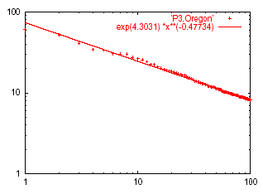
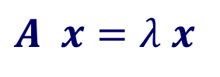
S.2: Eigen Exponent E
Eigenvalue
Exponent = slope
E = -0.48
May 2001
$$A x=λ x$$
Rank of decreasing eigenvalue
A2: power law in the eigenvalues of the adjacency matrix

Slide 25
Short answer(s)
?
?
Are real graphs random?
  S*: what do static graphs look like?
    S.0: ‘six degrees’
    S.1: skewed degree distribution
    S.2: skewed eigenvalues
    S.3: triangle power-laws
    S.4: GCC; and skewed distr. of conn. comp.
  T*: how do graphs evolve over time?
    T.1: diameters
    T.2: densification

Slide 26
S.3: Triangle ‘Law’
Real social networks have a lot of triangles

Slide 27
S.3: Triangle ‘Law’
Real social networks have a lot of triangles
  Friends of friends are friends
Any patterns? 2x friends -> 2x triangles ?

Slide 28
S.3: Triangle ‘Law’
Real social networks have a lot of triangles
  Friends of friends are friends
Any patterns? 2x friends -> 2x triangles ?
3x

Slide 29

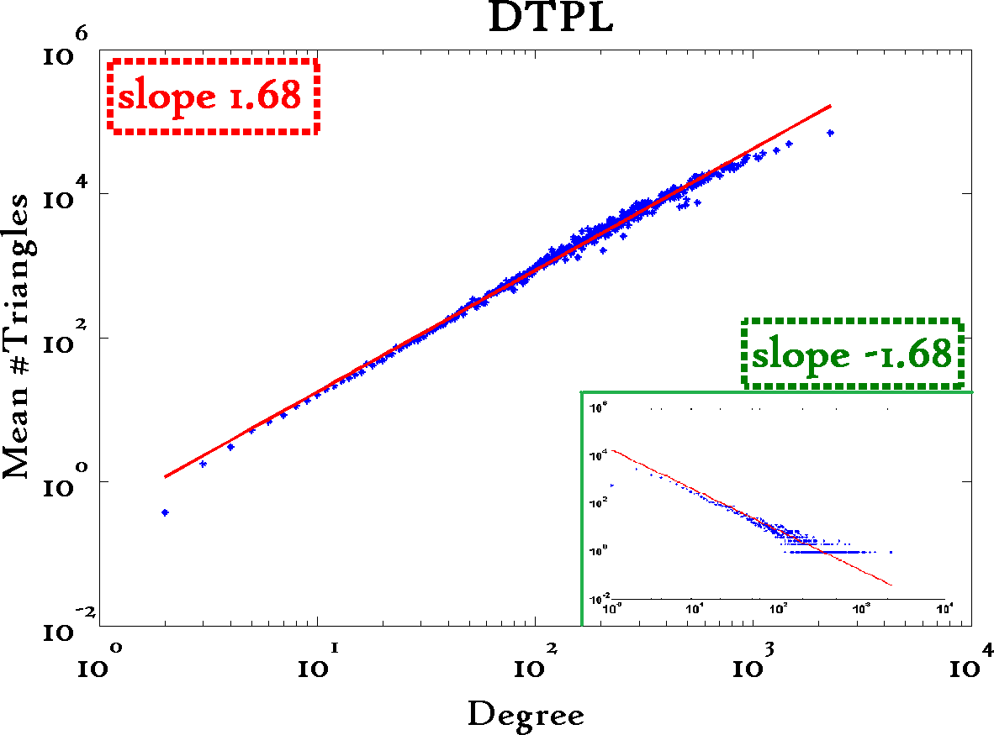
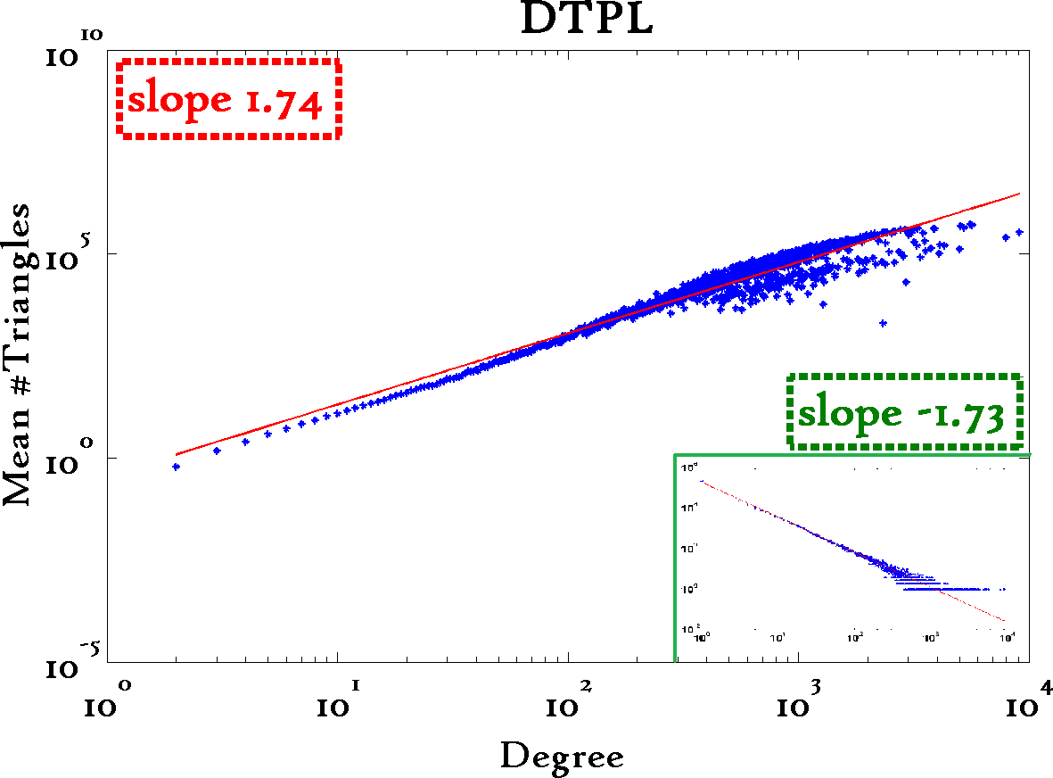
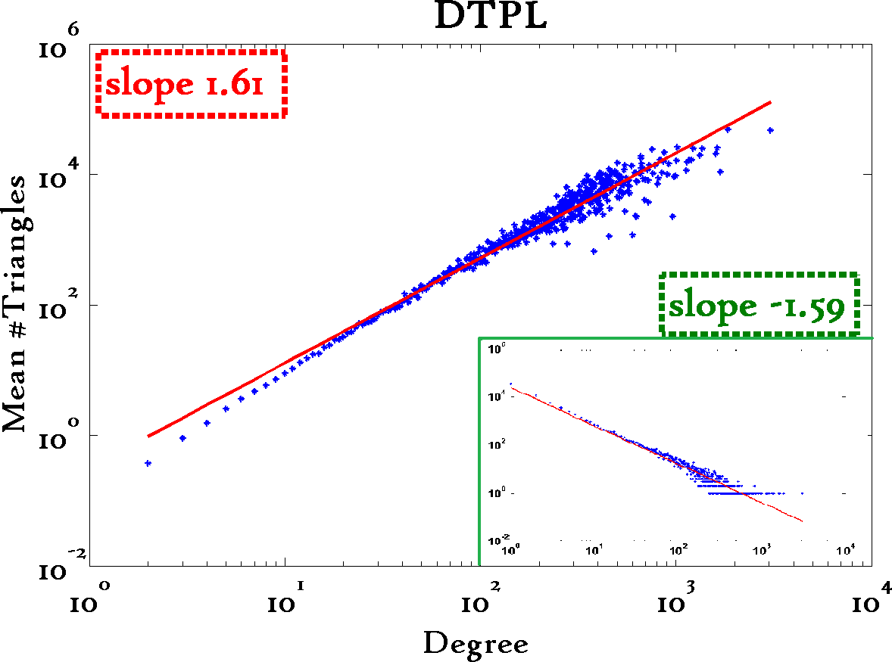
Triangle Law: S.3
[Tsourakakis ICDM 2008]
Reuters
SN
X-axis: degree
Y-axis: mean # triangles
n friends -> ~n^{1.6} triangles
Epinions

Slide 30
Anomalies?
Patterns anomalies

Slide 31
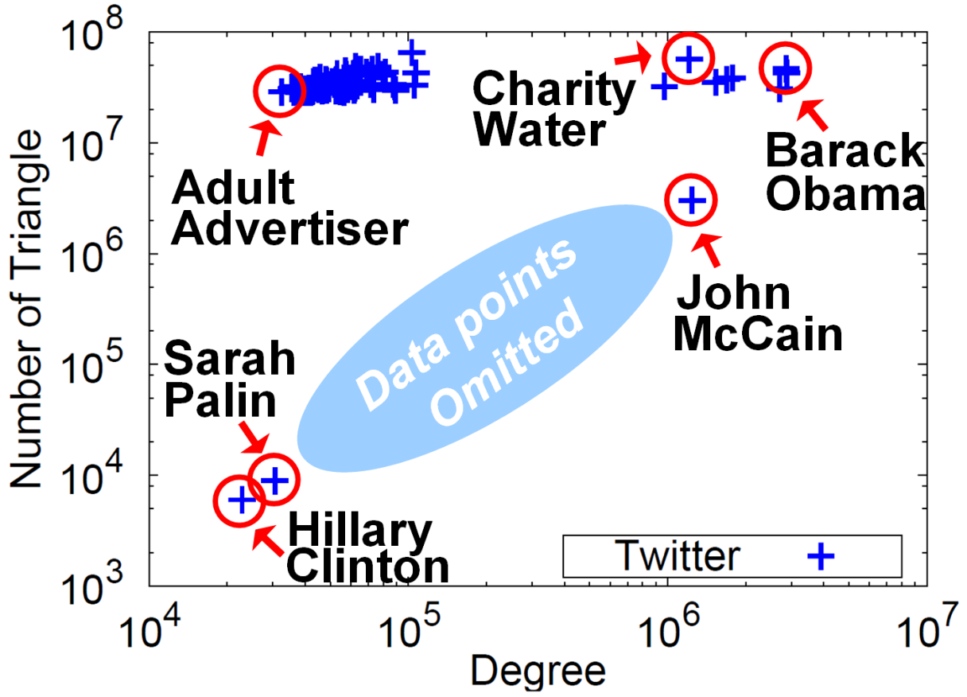

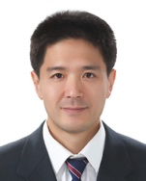

Triangle counting for large graphs?
Anomalous nodes in Twitter(~ 3 billion edges)
[U Kang, Brendan Meeder, +, PAKDD’11]
?
?
?
31

Slide 32
Triangle counting for large graphs?
Anomalous nodes in Twitter(~ 3 billion edges)
[U Kang, Brendan Meeder, +, PAKDD’11]
32

Slide 33
Triangle counting for large graphs?
Anomalous nodes in Twitter(~ 3 billion edges)
[U Kang, Brendan Meeder, +, PAKDD’11]
33

Slide 34
Triangle counting for large graphs?
Anomalous nodes in Twitter(~ 3 billion edges)
[U Kang, Brendan Meeder, +, PAKDD’11]
34

Slide 35
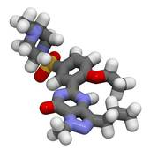
Triangle counting for large graphs?
Anomalous nodes in Twitter(~ 3 billion edges)
[U Kang, Brendan Meeder, +, PAKDD’11]
35

Slide 36
Short answer(s)
?
?
Are real graphs random?
  S*: what do static graphs look like?
    S.0: ‘six degrees’
    S.1: skewed degree distribution
    S.2: skewed eigenvalues
    S.3: triangle power-laws
    S.4: GCC; and skewed distr. of conn. comp.
  T*: how do graphs evolve over time?
    T.1: diameters
    T.2: densification

Slide 37
Generalized Iterated Matrix Vector Multiplication (GIMV)
PEGASUS: A Peta-Scale Graph Mining
System - Implementation and Observations.
U Kang, Charalampos E. Tsourakakis,
and Christos Faloutsos.
(ICDM) 2009, Miami, Florida, USA.
Best Application Paper (runner-up).

Slide 38
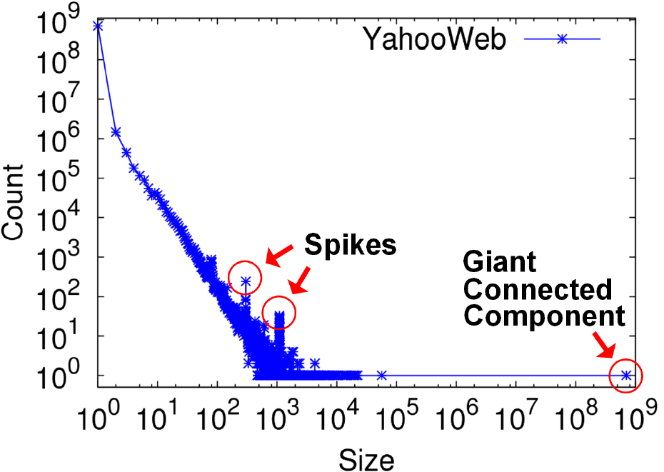
S.4: Conn. components
Connected Components
Count
Size

Slide 39
S.4: Conn. components
Connected Components
Count
~0.7B
singleton
nodes
Size

Slide 40
S.4: Conn. components
Connected Components
Count
Size

Slide 41
S.4: Conn. components
Connected Components
Count
300-size cmpt
X 500.
Why?
1100-size cmpt
X 65.
Why?
Size

Slide 42

S.4: Conn. components
Connected Components
Count
suspicious
financial-advice sites
(not existing now)
Size

Slide 43
Short answer(s)
?
?
Are real graphs random?
  S*: what do static graphs look like?
    S.0: ‘six degrees’
    S.1: skewed degree distribution
    S.2: skewed eigenvalues
    S.3: triangle power-laws
    S.4: GCC; and skewed distr. of conn. comp.
  T*: how do graphs evolve over time?
    T.1: diameters
    T.2: densification

Slide 44
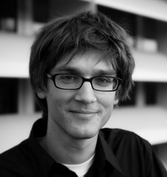
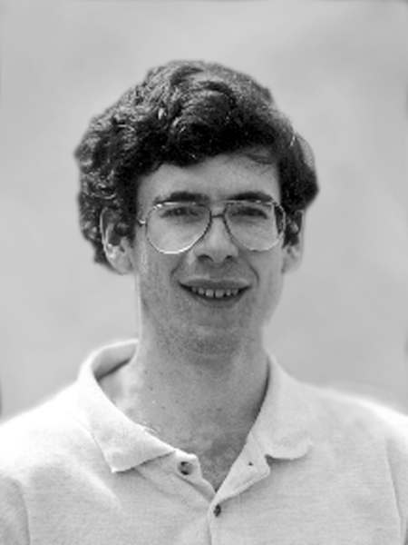
Problem: Time evolution
with Jure Leskovec (CMU -> Stanford)
and Jon Kleinberg (Cornell – sabb. @ CMU)
Jure Leskovec, Jon Kleinberg and Christos Faloutsos, Graphs over Time: Densification Laws, Shrinking Diameters and Possible Explanations, KDD 2005 (Best Research paper award; test-of-time award).

Slide 45

T.1 Evolution of the Diameter
Prior work on Power Law graphs hints at slowly growing diameter:
  diameter ~ O(N ^{1/3} )
  diameter ~ O(log N)
  diameter ~ O(log log N)
What is happening in real data?
4
Notes:
Diameter first, DPL second
Check diameter formulas
As the network grows the distances between nodes slowly grow

Slide 46
T.1 Evolution of the Diameter
Prior work on Power Law graphs hints at slowly growing diameter:
  diameter ~ O(N ^{1/3} )
  diameter ~ O(log N)
  diameter ~ O(log log N)
What is happening in real data?
Diameter shrinks over time
Notes:
Diameter first, DPL second
Check diameter formulas
As the network grows the distances between nodes slowly grow

Slide 47
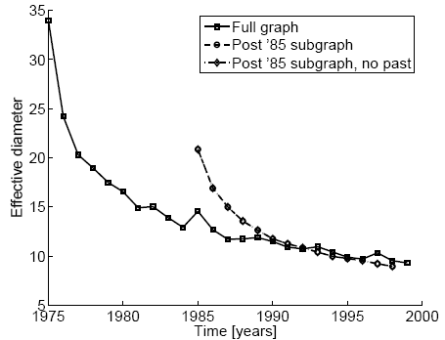
T.1 Diameter – “Patents”
diameter
Patent citation network
25 years of data
@1999
  2.9 M nodes
  16.5 M edges
time [years]

Slide 48
T.2 Temporal Evolution of the Graphs
N(t) … nodes at time t
E(t) … edges at time t
Suppose that
  N(t+1) = 2 * N(t)
Q: what is your guess for
  E(t+1) =? 2 * E(t)

Slide 49
T.2 Temporal Evolution of the Graphs
N(t) … nodes at time t
E(t) … edges at time t
Suppose that
  N(t+1) = 2 * N(t)
Q: what is your guess for
  E(t+1) =? 2 * E(t)
A: over-doubled!
  But obeying the ``Densification Power Law’’

Slide 50
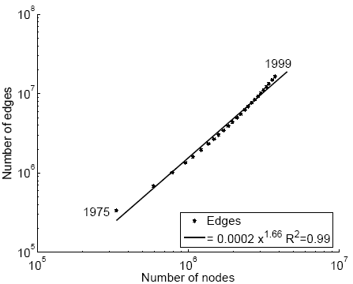
T.2 Densification – Patent Citations
Citations among patents granted
@1999
  2.9 M nodes
  16.5 M edges
Each year is a datapoint
E(t)
1.66
N(t)

Slide 51
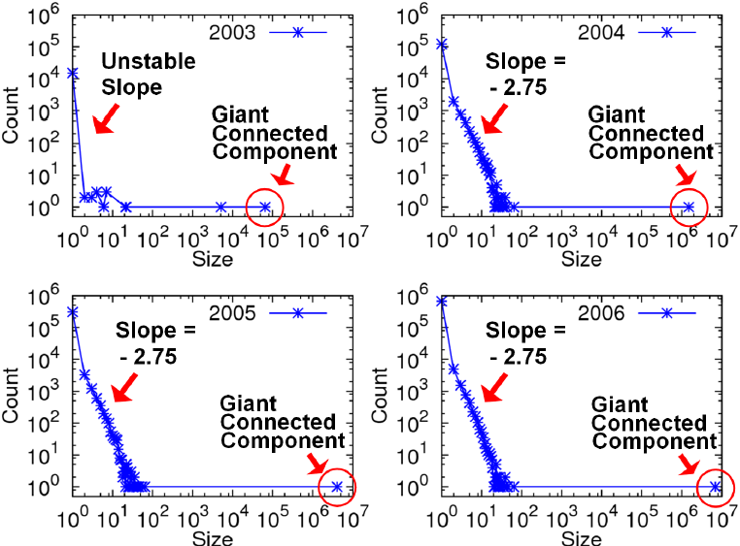
GIM-V At Work
Connected Components over Time
LinkedIn: 7.5M nodes and 58M edges
Stable tail slope
after the gelling point

Slide 52
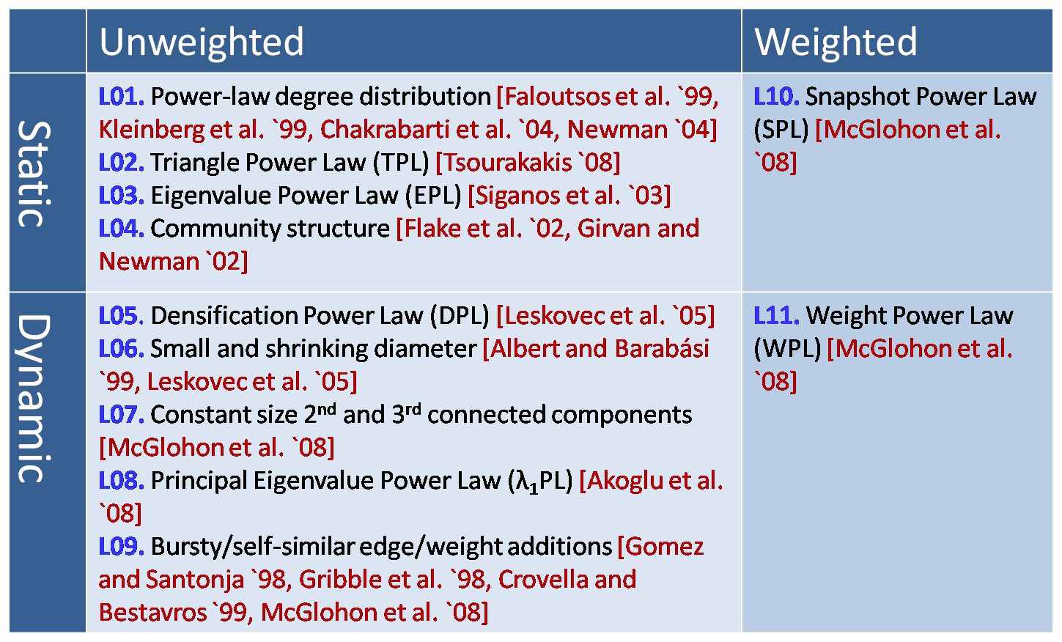
MORE Graph Patterns
✔
✔
✔
✔
✔
✔
RTG: A Recursive Realistic Graph Generator using Random Typing Leman Akoglu and Christos Faloutsos. PKDD’09.

Slide 53

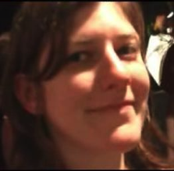

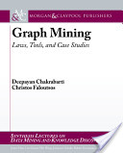
MORE Graph Patterns
Mary McGlohon, Leman Akoglu, Christos Faloutsos. Statistical Properties of Social Networks. in "Social Network Data Analytics” (Ed.: Charu Aggarwal)
Deepayan Chakrabarti and Christos Faloutsos, Graph Mining: Laws, Tools, and Case Studies Oct. 2012, Morgan Claypool.

Slide 54

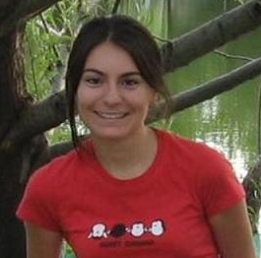

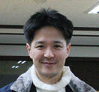
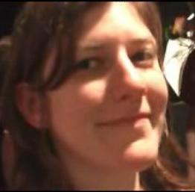

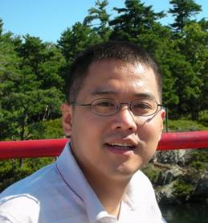
Project info
www.cs.cmu.edu/~pegasus
Chau,
Polo
McGlohon,
Mary
Tsourakakis,
Babis
Akoglu,
Leman
Kang, U
Prakash,
Aditya
Tong,
Hanghang
Thanks to: NSF IIS-0705359, IIS-0534205,
CTA-INARC; Yahoo (M45), LLNL, IBM, SPRINT, INTEL, HP

Slide 55
Short answer(s)
?
?
Are real graphs random?
  S*: what do static graphs look like?
    S.0: ‘six degrees’
    S.1: skewed degree distribution
    S.2: skewed eigenvalues
    S.3: triangle power-laws
    S.4: GCC; and skewed distr. of conn. comp.
  T*: how do graphs evolve over time?
    T.1: diameters
    T.2: densification

Slide 56
Short answer(s)
?
?
Are real graphs random?
  S*: what do static graphs look like?
    S.0: ‘six degrees’
    S.1: skewed degree distribution
    S.2: skewed eigenvalues
    S.3: triangle power-laws
    S.4: GCC; and skewed distr. of conn. comp.
  T*: how do graphs evolve over time?
    T.1: diameters
    T.2: densification
Power laws: y ~ xª
NOT Gaussians
Take logarithms
y (log scale)
a
x (log scale)

Slide 57
Roadmap
Introduction – Motivation
Part#1: Graphs
  P1.1: properties/patterns in graphs
  P1.2: node importance
  P1.3: community detection
  P1.4: fraud/anomaly detection
  P1.5: belief propagation
?

