Slide 1

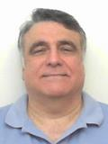
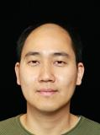
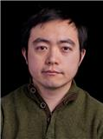

Graph and Tensor Mining for fun and profit
Luna Dong, Christos Faloutsos
Andrey Kan, Jun Ma, Subho Mukherjee
Amazon - CMU

Slide 2
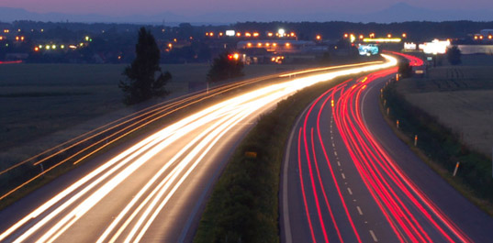
Roadmap
Introduction – Motivation
Part#1: Graphs
[break]
Part#2: Tensors
Conclusions

Slide 3
Roadmap
Introduction – Motivation
Part#1: Graphs
  P1.1: properties/patterns in graphs
  P1.2: node importance
  P1.3: community detection
  P1.4: fraud/anomaly detection
  P1.5: belief propagation

Slide 4





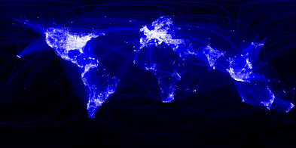
Why study graphs?
fb>$10B; ~1B users

Slide 5
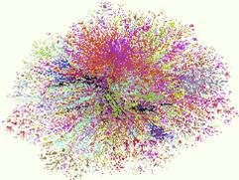
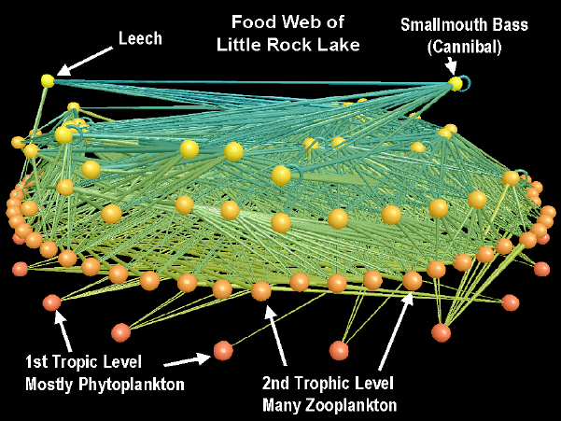
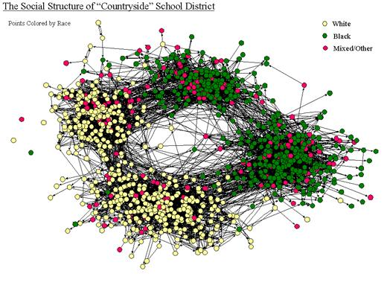
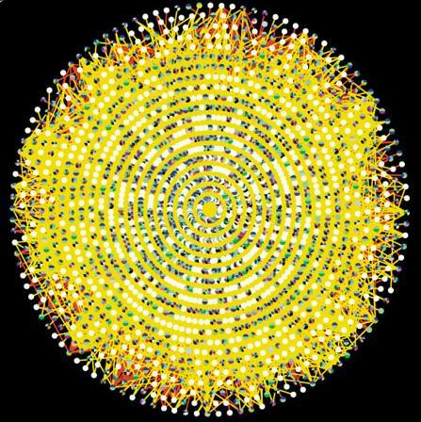
Why study graphs?
Internet Map [lumeta.com]
Food Web [Martinez ’91]
Friendship Network [Moody ’01]
Protein Interactions [genomebiology.com]

Slide 6



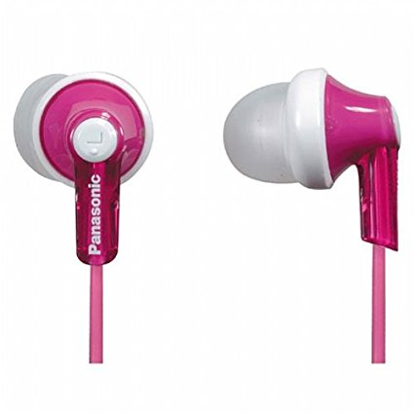


e-commerce examples
Recommendation systems
....
…
…

Slide 7
e-commerce examples
Who-buys-what
…
…

Slide 8
e-commerce examples
Who-buys-what
Who-sells-what
…
…

Slide 9
e-commerce examples
Who-buys-what
Who-sells-what
Who-reviews-what
…
…

Slide 10

More examples
Who-buys-what
Who-sells-what
Who-reviews-what
Who-queries-what
Which_machine - connects_to - what
…
<subject> related-to <object> : graph
…
…

Slide 11
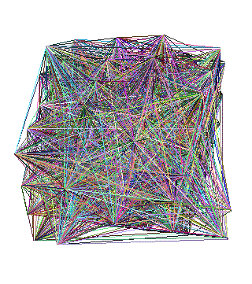
Roadmap
Introduction – Motivation
Part#1: Graphs
  P1.1: properties/patterns in graphs
  P1.2: node importance
  P1.3: community detection
  P1.4: fraud/anomaly detection
  P1.5: belief propagation
?
?

Slide 12
Roadmap
Introduction – Motivation
Part#1: Graphs
  P1.1: properties/patterns in graphs
  P1.2: node importance
  P1.3: community detection
  P1.4: fraud/anomaly detection
  P1.5: belief propagation
?

Slide 13
Roadmap
Introduction – Motivation
Part#1: Graphs
  P1.1: properties/patterns in graphs
  P1.2: node importance
  P1.3: community detection
  P1.4: fraud/anomaly detection
  P1.5: belief propagation

Slide 14
Roadmap
Introduction – Motivation
Part#1: Graphs
  P1.1: properties/patterns in graphs
  P1.2: node importance
  P1.3: community detection
  P1.4: fraud/anomaly detection
  P1.5: belief propagation
?

Slide 15
Roadmap
Introduction – Motivation
Part#1: Graphs
  P1.1: properties/patterns in graphs
  P1.2: node importance
  P1.3: community detection
  P1.4: fraud/anomaly detection
  P1.5: belief propagation
?

Slide 16
Roadmap
Introduction – Motivation
Part#1: Graphs
  P1.1: properties/patterns in graphs
  P1.2: node importance
  P1.3: community detection
  P1.4: fraud/anomaly detection
  P1.5: belief propagation

Slide 17
Roadmap
Introduction – Motivation
Part#1: Graphs
[break]
Part#2: Tensors
Conclusions

Slide 18
Tensors, e.g., time-evolving graphs
What is ‘normal’? suspicious? Groups?
3am, 4/1
…
3am, 4/1
…
10pm, 4/3
11pm, 4/3

Slide 19
Tensors, e.g., MultiView Graph
What is ‘normal’? suspicious? Groups?
likes
…
buys
…
reviews
buys

Slide 20







Tensors, e.g., Knowledge Graph
What is ‘normal’? Forecast? Spot errors?
…
directed
dates
…
Acted_in
born_in
…
produced

Slide 21



‘Recipe’ Structure:
Problem definition
Short answer/solution
LONG answer – details
Conclusion/short-answer

Slide 22

‘Recipe’ Structure:
Problem definition
Short answer/solution
LONG answer – details
Conclusion/short-answer

Slide 23
Roadmap
Introduction – Motivation
Part#1: Graphs
  P1.1: properties/patterns in graphs
  P1.2: node importance
  P1.3: community detection
  P1.4: fraud/anomaly detection
  P1.5: belief propagation
?
?

