Slide 1
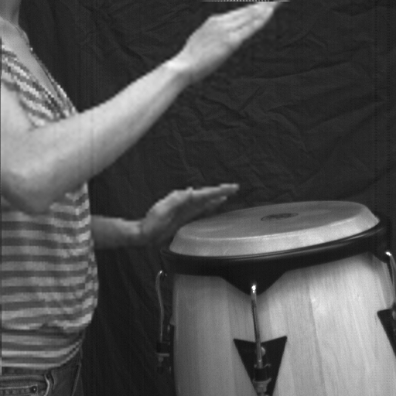
Flexible Voxels for Motion-Aware Videography
Poster ID: M1.002
High Frame Rate (500 fps) for Fast Moving Regions
High Spatial Resolution (1 MP) for Static Regions
Post Capture Control of Frame-Rate and Spatial-Resolution
Mohit Gupta¹, Amit Agrawal², Ashok Veeraraghavan² and Srinivasa Narasimhan¹
¹Robotics Institute, Carnegie Mellon University ²Mitsubishi Electric Research Labs (MERL)

