Slide 1



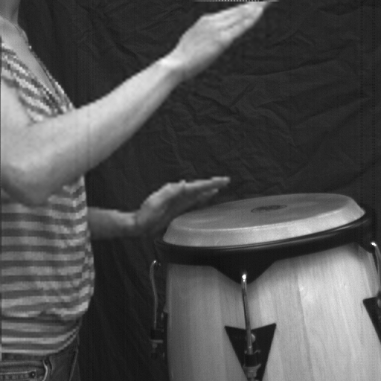
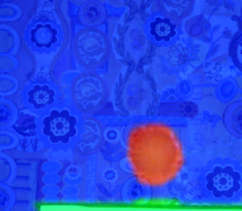
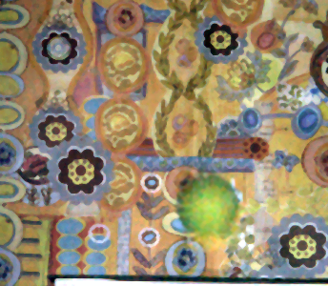
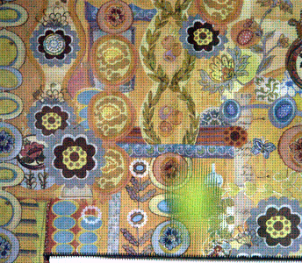

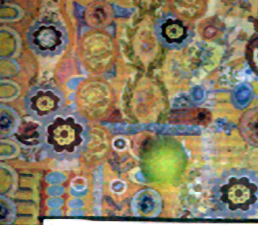
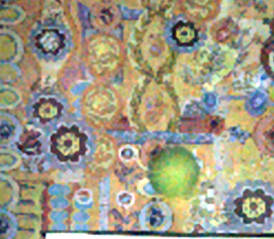
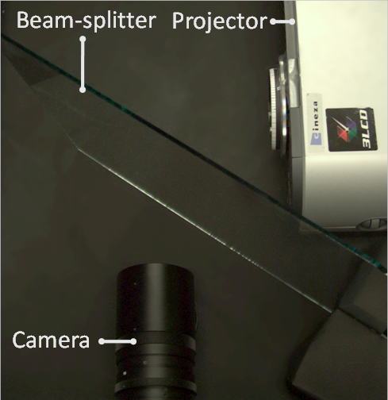
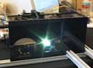
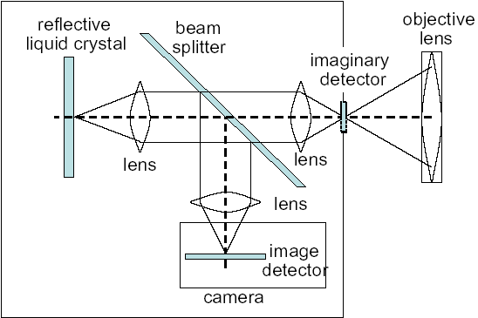
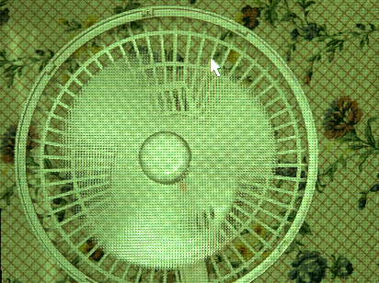
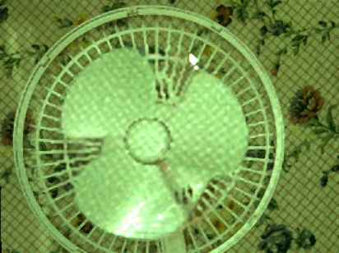
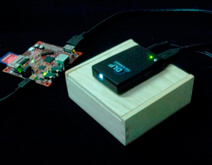
Flexible Voxels for Motion-Aware Videography
Mohit Gupta
Amit Agrawal
Ashok Veeraraghavan
Srinivasa G. Narasimhan
Motion-Aware Camera
Why is Building Such a Camera Hard?
Sampling of the Space-Time Volume
High Frame Rate (500 fps) for Fast Moving Regions
High SR, Low TR
Low SR, High TR
Motion Aware Video
Conventional Sampling Scheme:
Sensor Plane
Frame 1
Frame 2
Frame N
High Spatial Resolution (1 MP) for Static Regions
y
t
Camera
x
Integration Time
Time
Our Sampling Scheme:
Sensor Plane
Frame 1
Frame 2
Frame N
Thin and long voxels
Fat and short voxels
Flexible voxels
Pixel on
Post-Capture control of frame rate and spatial resolution
Motion-Aware video requires flexible voxels and a priori knowledge of the scene
Camera
Pixel off
Integration Time
Time
Post Capture Motion-Aware Interpretation of Data
Captured Data
Different Spatio-temporal Interpretations
Diffusion Kernels
High SR
High TR
Space
Time
Re-binning
TR = 1X SR = 1X
TR = 2X SR = ½ X
TR = 4X SR = ¼X
High SR
High TR
Optical Flow Red = Fast, Green = Slow, Blue = Stationary
Diffusion Kernels Aligned Along Flow Directions
Motion-Aware Reconstruction
Captured Frame
Increasing Temporal Resolution
Reduced Aliasing
Simple re-binning results in aliasing artifacts
Anisotropic diffusion
Motion-Aware reconstruction using motion information
Hardware Implementation: Fast Per-pixel Shutter
Motion-Aware Video Results Fan Rotating (‘Wagon-wheel effect’)
Scene
Camera Integration
Projector Pattern
Coded Motion Blur
High TR
High SR
Beam Splitter
Image Plane
Multi-Use Light Engine (MULE)
Pixel 1
Projector
Pixel 2
Image Plane
Camera
Pico-Projector (1440Hz.) ($350)
Pixel K
[Mukaigawa et al]
Time
Input Frame (Captured at 7.5 FPS)
Reconstructed Frame (60 FPS) (1 out of 8)
Co-located projector camera setup
Fast optical modulation
Future work: Passive implementation using LCoS

