Slide 1
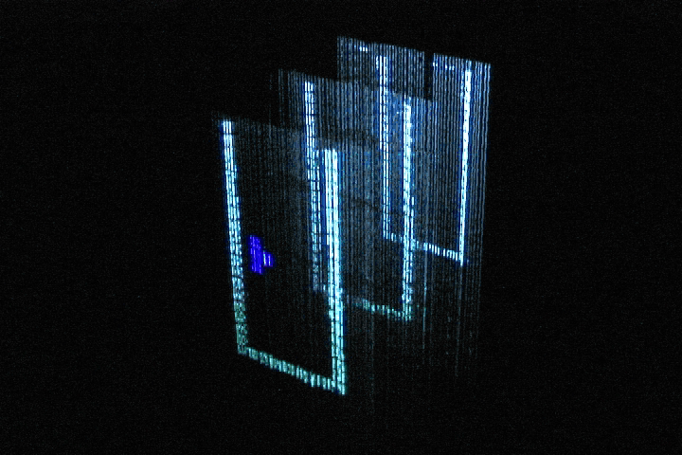
A Multi-Layered Display with Water Drops
Peter Barnum Srinivasa Narasimhan Takeo Kanade
Robotics Institute, Carnegie Mellon University
SIGGRAPH 2010
July 27, 2010
Notes:
0:00 <- (The number is the approximate time I intended to start each slide. The text is paraphrased from what I said.)
We have displays all around us. Our computer monitor show us the contents of our spreadsheet. Our TV shows us entertaining sitcoms and the latest detective drama. In this talk, I’ll show you a water drop display that uses a single projector and multiple planes of tiny water drops. As you can see from this example with three planes, we can use our display to create things like this multi-layer version of Tetris. But let's start our discussion by looking at the different types of displays.

Slide 2

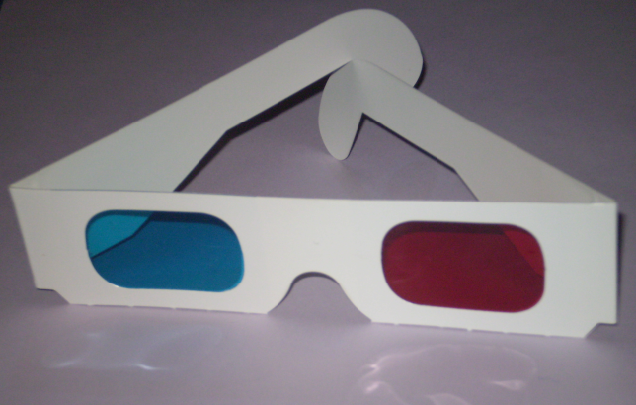

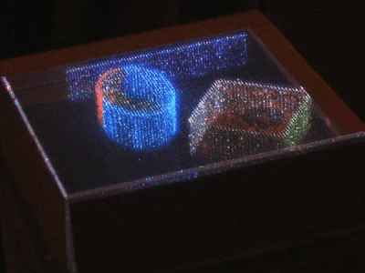
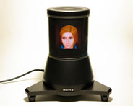
Types of Displays
2D with an LCD monitor
3D with Anaglyph glasses
3D with an etched glass cube
Nayar 2007
3D with auto-stereoscopy
Sony 2009
Notes:
0:15
LCD monitors are the gold standard, but are only 2D. The oldest but probably still most popular method of 3D is to use glasses. Other options are to use a glass cube or a spinning LED array.

Slide 3
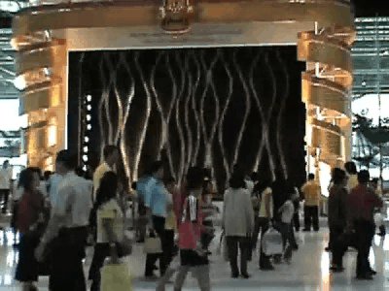
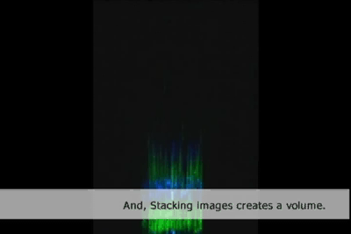
Water Drops Displays
Pevnick et al. 1979-present
Eitoku et al. 2006
Notes:
1:15
Pevnick’s group uses an array of solenoid valves to print out an image that falls in midair. Eitoku added a LCD projector to show color.

Slide 4
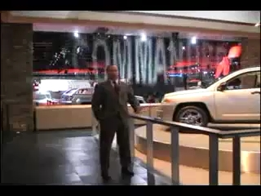
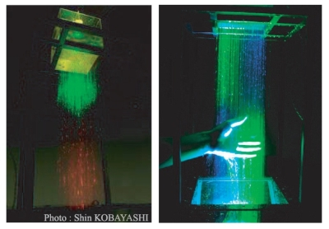
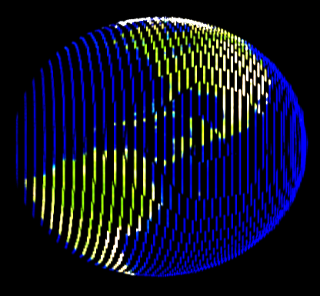
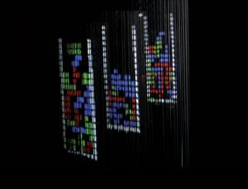
Applications of Water Drop Displays
Car show advertising
Art exhibits
Interactive games
3D touchable display
Notes:
2:15
Here are some applications of water drop displays. Our work allows for interactive games, and at the end of the talk, I’ll discuss what it would take to extend our multi-layer display to become a true 3D touchable display.

Slide 5

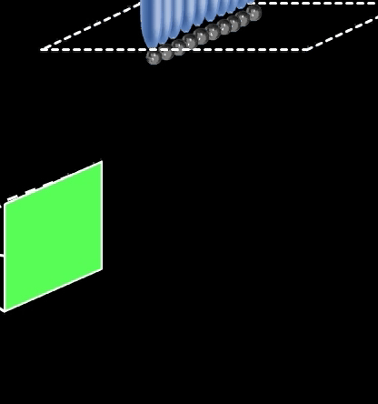
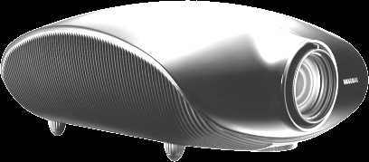
Water Drop Display 101
Notes:
3:00
Water drops are like tofu. They don’t have much character by themselves, but they tend to acquire the character of their surroundings.

Slide 6
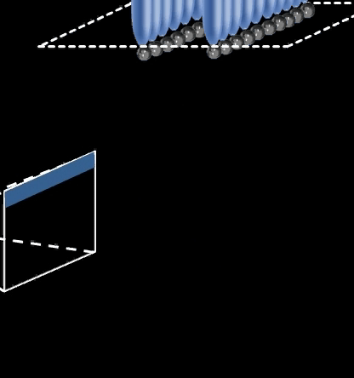
Water Drop Display 101
Notes:
3:30
If we add a second layer, we need to offset the timing of the drop emission, and display a time varying pattern on the projector.

Slide 7
Water Drop Display 101
Notes:
3:45
As the eye integrates the falling drops over time, they appear as solid screens.

Slide 8
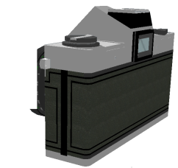
How to Assemble a Water Drop Display
Step 1:
Create the drops
Step 3:
Project on the
drops
Step 2:
Find the
drops
Notes:
4:00
There are three steps to create a drop display.

Slide 9
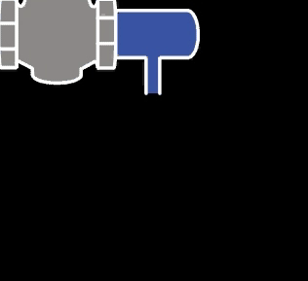
Drop on Demand
Notes:
4:15
When you open the valve for a short time, a little water is let through, and a drop is created. We want the drops to fall at a set frequency.

Slide 10
Challenges With Drop on Demand
Desired
result
Varying
timing
Satellite
drops
Notes:
5:00
We need to create drops cleaning, at a given frequency. Some things that can go wrong are variations in the timing and satellite drops. Or worse, streams of water or nothing at all.

Slide 11
Fluid Mechanics of Drop on Demand
1. The emitter diameter: 1 mm
2. The pressure differential: 10 kPa
3. The feed diameter: 19 mm
Feed
Emitter
Ambravaneswaran et al.2002
Munson et al. 2009
Notes:
5:30
1. A 1mm emitter diameter will cause about a 2mm drop. This is a good size, because it is big enough to have simple dynamics, but small enough that it won’t break apart.
2. The bathroom faucet is about 200 kPa
3. The feed diameter is much bigger than the emitter diameter, that is because we don’t just want one emitter,

Slide 12
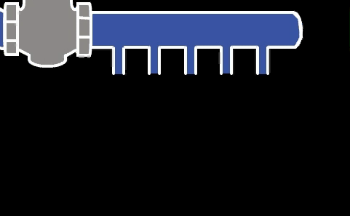
Drop on Demand With a Linear Manifold
Notes:
6:15
We want a row of emitters. But the idea is the same: lots of water in, and a little water out of each emitter.

Slide 13
Detecting Drop Locations
Drop hz = 30
Refresh hz = 60
FPS = 60
Notes:
7:00
This example has one layer, projector and camera. Everything is synchronized.
For simplicity, camera and projector same hz, although this is not true in our implementation
Since everything is synchronized, the drops repeat their state every 1/30th of a second
In the first sixtieth of a second, the drops fall. In the second sixtieth, they fall some more, but then the state repeats. Again,

Slide 14
Detecting Drop Locations
Drop hz = 30
Refresh hz = 60
FPS = 60
Notes:
7:30
First 16ms…And the second 16ms.

Slide 15
Detecting Drop Locations
Drop hz = 30
Refresh hz = 60
FPS = 60
Notes:
7:30
The synchronized camera will see this…then this.

Slide 16
How to Illuminate the Layer of Drops
Drop hz = 30
Refresh hz = 60
FPS = 60
Notes:
8:00
There is a simple geometric mapping between the camera and projector for this layer (a homography). Projecting this for the first 60th of a second will illuminate the drops as they fall, then projecting this for the second 60th of a second will again illuminate the drops as they fall. We do not constantly capture images with the camera. This is done only at the beginning, then we can loop the same two projector images and keep hitting the drops.

Slide 17
Illuminating Multiple 2D Layers
Number of layers = M
Drop hz = N
Refresh hz ≥ NM
Notes:
8:30
Multiple layers can be done with the same idea: we use the camera to find drops of each layer. The limit is for M layers at N drops per second, the projector must refresh faster than N times M. This is a lower bound for the ideal case, and we show a tighter bound in the paper.

Slide 18
Control and Data Flow
Valve control
Duemilanove
Camera
PG Firefly MV
Graphics card
Quadro 4600
Projector
Sony 3-LCD
Computer
Quad-Xeon
Notes:
8:45
The parts in grey are for the hardware geeks in the audience, though the important point here is that they’re all off-the-shelf components.

Slide 19
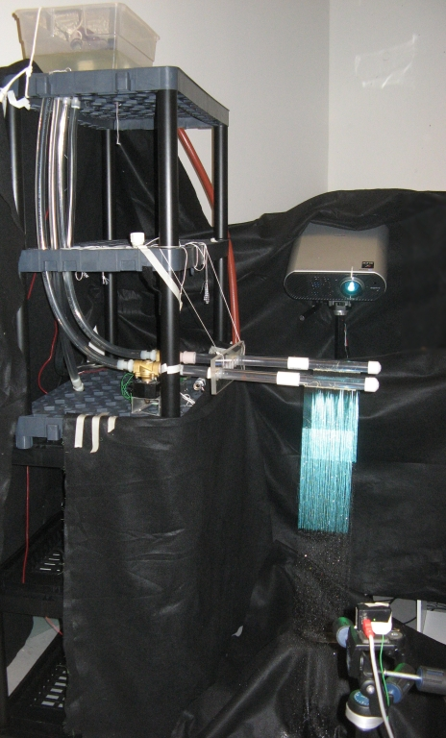
Projector
Drop
Emitters
Camera
Notes:
9:45

Slide 20
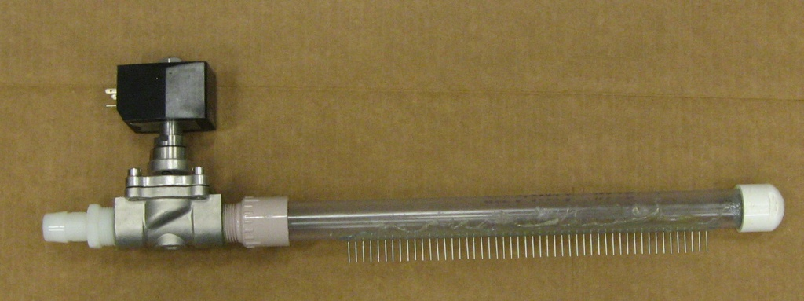
A Single Emitter Manifold
Solenoid
Plastic pipe
Diaphragm valve
50 metal needles
Notes:
10:15

Slide 21
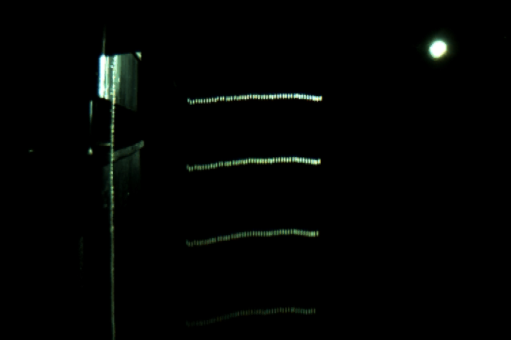
Synchronized Drops, Camera, and Projector
Notes:
10:30
This is the view from the camera. Because everything is synchronized, the drops appear floating in midair.

Slide 22
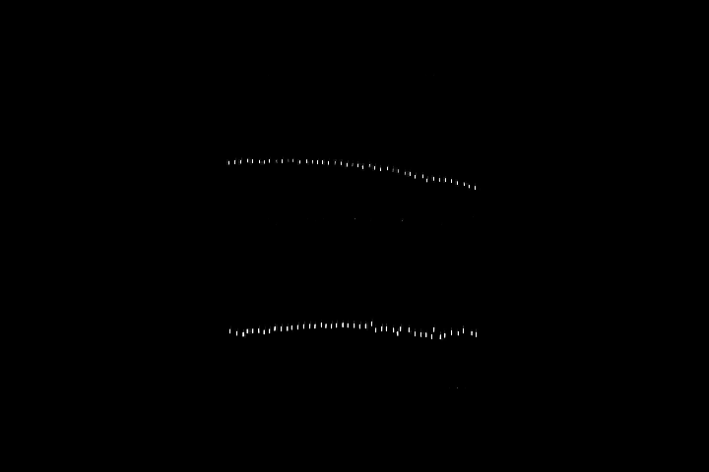
High-Speed Video of the Emitted Drops
Notes:
10:45
This is a 1000 FPS video with two layers. Now we’ve detected these drops with the camera, what is projected?

Slide 23
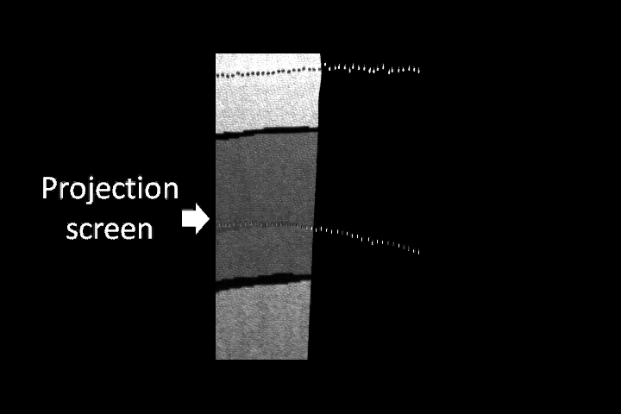
High-Speed Video of the Emitted Drops
Notes:
11:00
We place a rear projection screen, so we can see what the projector is showing. We want to project white on one layer and dark grey on another

Slide 24
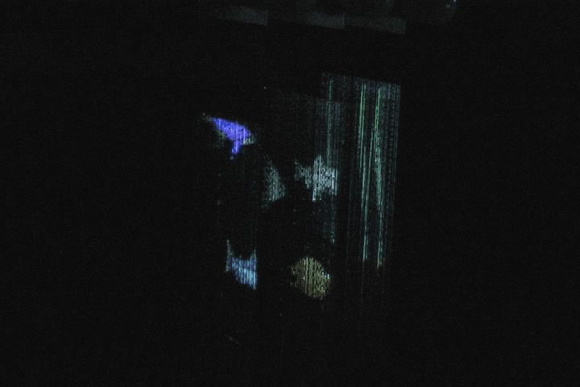
Aquarium Simulator
Notes:
11:30
Aquarium simulator. The fish images are generated in real time.

Slide 25
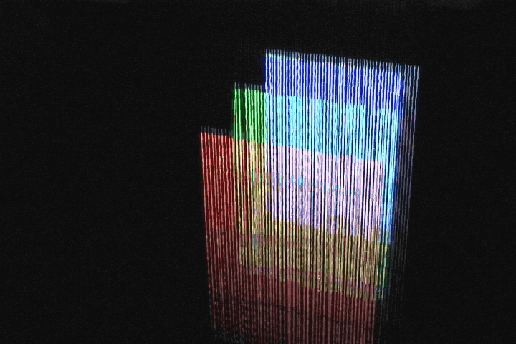
Red-Green-Blue
Notes:
12:15
You may think, “bah, solid colors, that’s boring.” But no, this is the hardest example! Any minor error is very evident in this example. The horizontal lines an breaking are due to the discrete camera capture time, and are not seen by a human observer. The vertical errors are real.

Slide 26
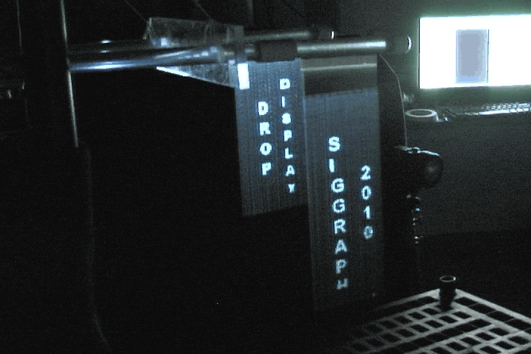
Close-up
Notes:
13:00
The drops oscillate as they fall, causing them to look like wiggles.

Slide 27
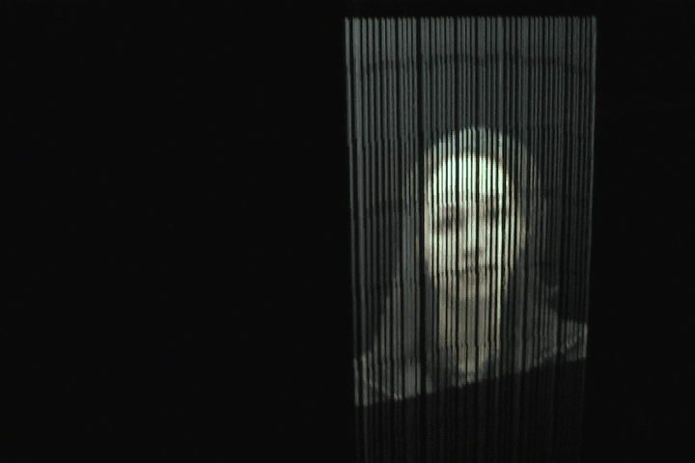
Wide Viewing-Angle
Notes:
13:45
The image on this side is due to the light refracting through the drops. The view on the opposite side is due to light reflecting off the drops.

Slide 28
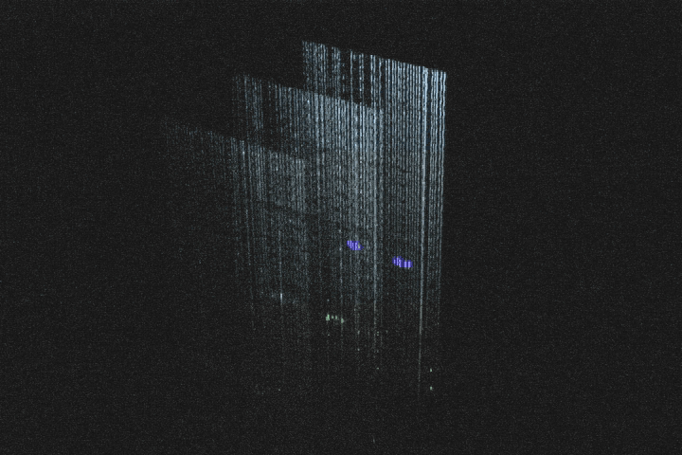
2.5D Tetris
Notes:
14:30
This multi-layer version of Tetris is like normal Tetris, in that you can move and rotate the pieces. But you can also switch a piece to any layer you want.

Slide 29
Summary and Future Work
Step 1:
Create
layers of drops
Step 2:
Find the
drops
Step 3:
Project
on the drops
Notes:
15:30
In summary, use these multiple linear manifolds, camera, and projector. How can we improve this? Forget the camera for now, but

Slide 30
Summary and Future Work
Step 1:
Create more
layers of drops
Step 2:
Find the
drops
Step 3:
Project
on the drops
Notes:
16:00
We can emit drops MORE precisely and MORE accurately.

Slide 31
Summary and Future Work
Step 1:
Create more
layers of drops
Step 2:
Find the
drops
Step 3:
Project faster
on the drops
Notes:
16:30
And as shown in paper, with a faster projector, we could show 17 layers, which would bridge the gap between 2.5D and 3D.

Slide 32
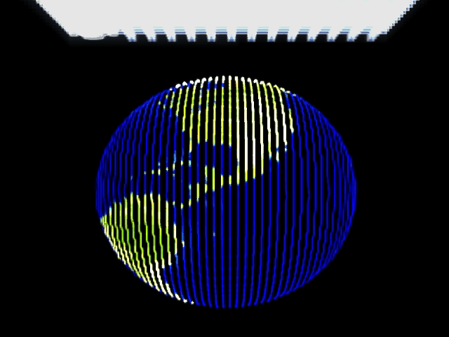
The Dream: Touchable 3D Models
Notes:
16:45
This is the dream, a touchable 3D model. This example shows a globe projected onto 17 layers of 50 drops apiece. And what I think is really cool about this is that there’s no separation between the person and the object. In most 3D displays, the use has to wear special glasses, or else the apparent 3D object is in a glass box. But water drops allow for a unique experience. You can run your hand through the oceans and see yourself touching them. And if you included hand tracking, you could move the continents around and create you own world. No mouse required, no artificial stereoscopy. Just you and your world.

Slide 33
Acknowledgements
Shelley Anna
Larry Hayhurst
Scott Satkin
Yaser Sheikh
Prasanna Velagapudi
Lynn Walker
Lee Weiss
CMU and Georgia Tech graphics groups
Notes:
17:45
And to conclude, I would like to thank these people, for discussions, advice, and encouragement. And thank you.

Slide 34
Drop on Demand

Slide 35
Drop on Demand

Slide 36
Drop on Demand

Slide 37
Water Drop Display 101

Slide 38
Water Drop Display 101

Slide 39
Drop on Demand With a Linear Manifold

