Slide 1
(De) Focusing on Global Illumination for Active Scene Recovery
Mohit Gupta¹
Srinivasa Narasimhan¹
Yuandong Tian¹
Li Zhang²
¹Carnegie Mellon University
²University of Wisconsin-Madison
CVPR 2009
Notes:
Hello everybody. The title of my talk is Defocusing on global illumination for active scene recovery.
In this work, we have studied the inter-relationship between defocused illumination and global illumination.
This is joint work with Yuandong Tian and Srinivasa Narasimhan at the Carnegie Mellon University, and Li Jhang at the University of Wisconsin Madison.
Let’s begin by understanding what is defocused illumination and global illumination.
<<Correct Broken Fonts – use Palatino Linotype – or remove animations>>

Slide 2
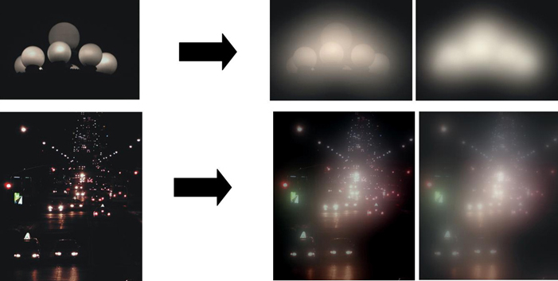
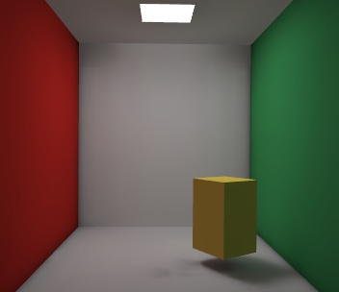

Global Illumination
Volumetric Scattering
Inter-reflections
Direct Illumination
Sub-surface scattering
Light Source
Scene
Notes:
Here is a scene and a light source. In the simplest case, light travels in a straight line from the source to the viewer. This is direct illumination.
However, light can get reflected from other parts of the scene – this is called inter-reflections. If the surface is translucent, light will permeate *BENEATH* the surface – this is called sub-surface scattering. Finally, in the presence of media such as dust, smoke and water, light will get scattered – this is called volumetric scattering.
All these complex and interesting effects are collectively called global illumination or global light transport.

Slide 3
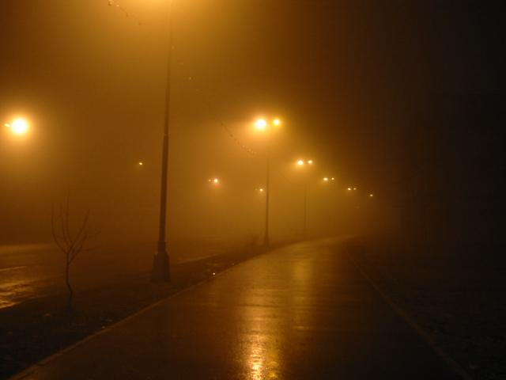




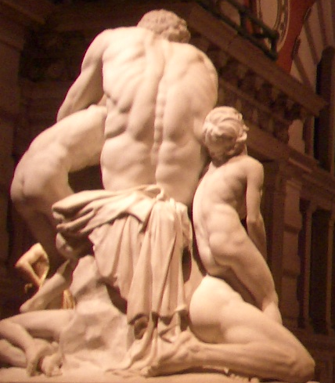


Global Illumination in the world around us
Notes:
We come across global light transport everywhere – infact, it is almost impossible to find a real-world scene without any global illumination.
Despite this, most current computer vision algorithms make the simplifying assumption that light travels in a straight light from the source to the scene and to then to the viewer. As a result, these algorithms suffer in *real world situations*, where there is global illumination.
Now, let’s keep this thought aside for a bit, and look at defocused illumination.

Slide 4
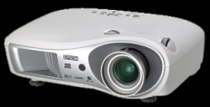





Defocused Illumination
Focal Plane
Image Plane
Defocus
Projector
Lens
Scene
Slide adapted from Zhang et al
Notes:
Now, let’s take the same scene and illuminate it with a limited depth of field device, such as a projector. For example this projector here. Projectors are designed to project a focused image on a single flat screen. However, if the projector focal plane is not on the scene, the image will be blurred or defocused. This is called defocused illumination.
Now these are two completely different physical effects – global illumination is an intrinsic property of the scene, and depends on material properties and scene geometry. On the other hand, defocused illumination is a property of the illumination device. So, one is a property of the scene, the other a property of illumination. Then why is it that we are interested in studying them together?

Slide 5
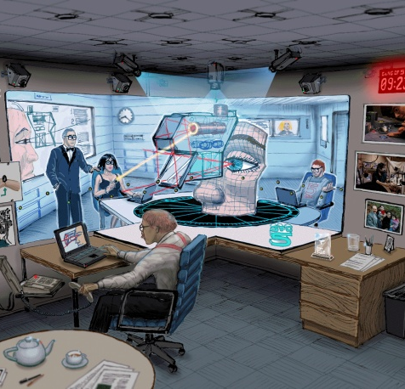

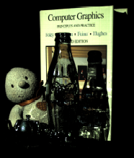
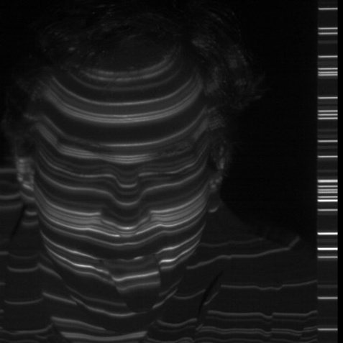

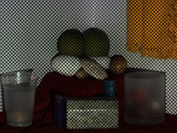
Projectors as Programmable Illumination
Office of the Future [Raskar et al]
Dual Photography [Sen et al]
High-speed Vision [Narasimhan et al]
Direct-global Separation [Nayar et al]
Notes:
Projectors are used as programmable illumination for a variety of applications in vision, graphics and virtual reality. In all these applications - they interact not just with a flat screen, but with complex real world objects around us. Because of this, there is an interplay between both global illumination and defocused illumination.

Slide 6
Interplay of Defocused and Global Illumination
Depth from Projector Defocus [Zhang and Nayar]
Does not account for global illumination
Direct-Global Separation [Nayar et al]
Does not account for projector defocus
Notes:
For example, recently projector defocus analysis was used to compute scene depths – however, this technique does not account for global illumination. On the other hand, the recent technique to separate the direct and global methods does not account for defocus.
Because of this interplay, because these two effects co-exist –we should really study them together. It might be hard – because physically, these are two different effects. But let’s see how different they really are?

Slide 7
Defocused Illumination: Low Pass Filter
With Defocus
No Defocus
Global Illumination: Low Pass Filter
No Global Illumination
With Global Illumination
Notes:
The first key observation that we make is that *BOTH* these effects manifest themselves as low pass filters on the incident illumination.
We saw that defocus results in blurring of the projected image.
Interestingly, global illumination has a similar effect as well. For example, we notice a glow around street lights in foggy conditions, which is like a blur.
So – both these effects **essentially ** result ** in ** blurring ** of ** the incident illumination!
Now, this is something interesting – let’s investigate this a bit further. Let’s consider a scenario where both these effects occur together.

Slide 8
Defocused Illumination + Global Illumination
Focal Plane
A
Projector
B
Temporal Radiance Profile at A
Temporal Radiance Profile at B
Global Illumination Blur Kernel
=
*
Time
Time
Notes:
Here is a toy scene consisting of a wax candle. We covered the top and bottom parts of the candle with diffuse paper – so that only the middle portion is translucent.
Now, let’s project a stripes pattern on this candle with a projector. This is illustrated with this ray-diagram here. Since the projector is focused on the background wall –the candle receives defocused illumination. Additionally, **ONLY** the middle portion of the candle receives global illumination in the form of sub-surface scattering.
By shifting the illumination pattern one pixel at a time – we record the temporal brightness profiles at the scene points A and B.
Clearly, Profile at A is more blurred than Profile at B due to the effect of global illumination. We can state this fact as a convolution with a global illumination blur kernel. The profile at B is a convolution of the input pattern with the defocus blur kernel.
8

Slide 9
Defocused Illumination + Global Illumination
Focal Plane
A
Projector
B
Temporal Radiance Profile at A
Input Pattern
Defocus Blur Kernel
Global Illumination Blur Kernel
=
*
*
Time
Time
Combined Blur Kernel
Notes:
Now , this is nice - By expressing both these effects as blur kernels, we now no longer have to worry about explicitly modeling them – especially global illumination, which can be extremely hard. We can straightaway borrow tools from signal processing literature and analyze them.
For example, we might want to analyze these two effects separately. What we observe though is a combined blur – the convolution of both these kernels – so, we need to separate them. Fortunately, we can modulate the defocus by changing the projector focus setting. What about the global illumination blur? How does that depend on focus setting?
9

Slide 10
Global Illumination vs. Projector Defocus
Focal Plane
A
Projector
B
Defocus + Global Illumination (A)
Only Defocus (B)
Focal Plane Position
Notes:
To study this, we record the intensity profiles at A and B at different projector focus settings. By deconvolving these profiles, we can compute the global illumination blur kernels for each of this setting.
10

Slide 11
Global Illumination vs. Projector Defocus
Focal Plane
A
Projector
B
Global Illumination Blur Kernels:
Defocus Blur Kernels:
Focal Plane Position
Global Illumination Blur is independent of Focal Plane Position
Notes:
If we put them together, we observe that the global illumination blur kernel is almost invariant to the focus setting! On the other hand, as expected, the defocus blur kernels vary a lot.
Let’s think about this for a moment – let’s see what is happening here. The global illumination blur kernel at a point is due to light coming from other scene points. When we change the focus setting, the individual contributions might change, but the sum remains nearly invariant.
Okay – so far, we have looked at sub-surface scattering. Let’s look at inter-reflections now.
11

Slide 12
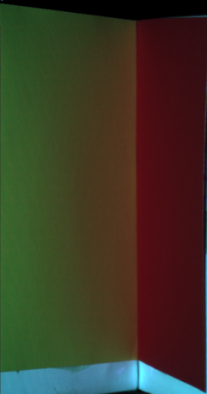
Global Illumination vs. Projector Defocus
V-Groove
Single Plane
Receives Global Illumination (Inter-reflections)
No Global Illumination
A
A
Global Illumination Blur Kernels:
Defocus Blur Kernels:
Global Illumination Blur is independent of Focal Plane Position
Notes:
This time, we made a V-groove made of two planes – so that point A receives inter-reflections. If we remove one of the planes from the V-groove, A does not receive inter-reflections now.
As before, we compute the global illumination blur kernels. They might be different from what we had before, but the important thing is that they are still invariant to the focal plane position.
This is a very nice result which can be useful in any scenario where a projector is used to illuminate a real scene.

Slide 13

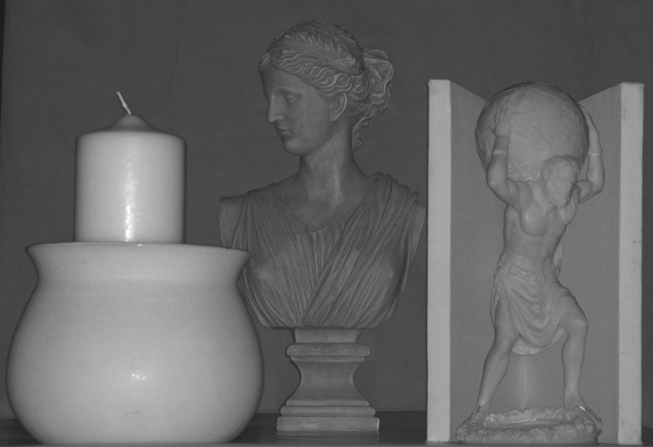
Depth Recovery using Projector Defocus
[Zhang and Nayar’ 06]
Sub-surface scattering
Wax Candle
Sub-surface scattering
Polyresin Bust
Marble Statue
Inter-reflections
Clay Pot
V-groove
Notes:
For example, as we mentioned earlier, projector defocus analysis was used to compute scene depths. The idea is to project a high frequency stripes pattern on the scene – the depths are computed by measuring the amount of defocus blur in the intensity profiles. However, due to the additional global illumination blur, this technique gets confused producing incorrect depths. Let’s consider this scene. We have a wax candle inside a clay pot, a marble statue….
This is the depth map from projector defocus. The brighter a scene point, the farther it is. In the correct depth map, the candle and the clay pot should have similar depths – which is not the case here due to the additional global illumination.

Slide 14
Depth Recovery in the presence of Global Illumination
Notes:
Let’s see how can we get the correct depths. Basically, we have two unknowns: global illumination and defocus. So, intuitively, with two focal plane positions, we should be able to separate the two.

Slide 15
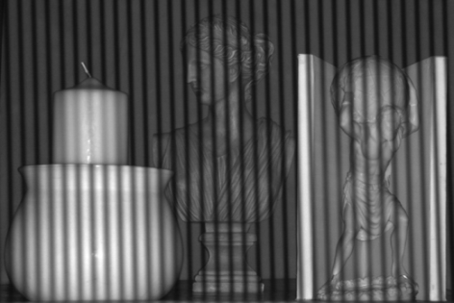
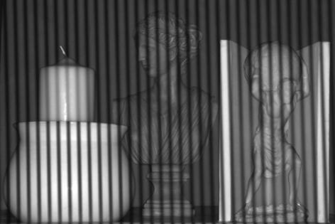
Depth using Two Focal Plane Positions
Input
Discrete Fourier Transform:
A
=
*
*
Intensity Profile
Input Pattern
Defocus Kernel
Global Illumination
Focal Plane Position 1
Frequency
Ω is invariant to Global Illumination
Ratio of DFT Coefficients:
A
=
*
*
Intensity Profile
Input Pattern
Defocus Kernel
Global Illumination
Focal Plane Position 2
Notes:
Here are two example sequences – in the first, the projector is focus behind the scene and in the second, it is focused in front of the scene.
Consider the radiance profiles at scene point A for the two focus settings. The profiles are a convolution of the input pattern, the defocus blur kernel and the global illumination blur kernel. We now use the fact that the global illumination kernel is the same across different focus settings.
So, we take the discrete fourier transform of the two profiles and take their ratio to cancel the g-term. The ratio omega is a depth measure which is invariant to global illumination!
To get real depths --- we do a one time calibration step.

Slide 16
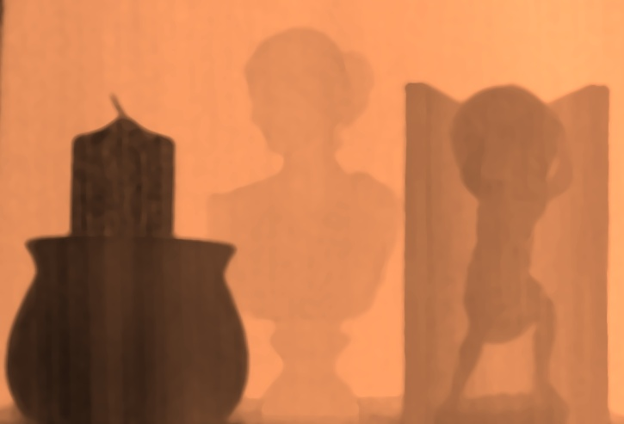
Depth map using Two Focal Plane Positions
Notes:
Here is the depth map of the scene computed using the two focal planes algorithm. The errors due to global illumination are significantly reduced – notice that the candle and the clay-pot have approximately the same depths.

Slide 17
Depth map using One Focal Plane Position
[Zhang and Nayar’ 06]
Incorrect Depths
Notes:
Compare this to the previous result – we call it the single focal plane algorithm because it requires capturing images at a single focus setting. We can see incorrect results wherever there is global illumination - on the candle – on the marble statue, in the V-groove - due to inter-reflections.

Slide 18
Depth map using Two Focal Plane Positions
Notes:
Here is our result one more time.
For more robustness, we can use multiple focal plane positions. Here is the depth map if we use multiple focal plane positions.

Slide 19

Depth map using Multiple Focal Plane Positions
Notes:
There is less noise then before – although we require more images. Interestingly, this algorithm can be thought of as dual to shape from camera focus – instead of changing the camera focal plane, we change the projector focal plane.

Slide 20
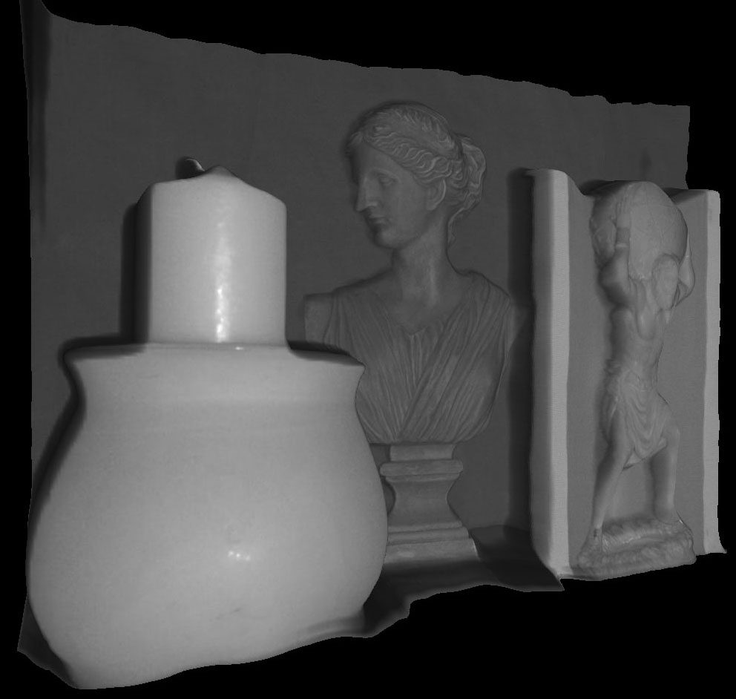
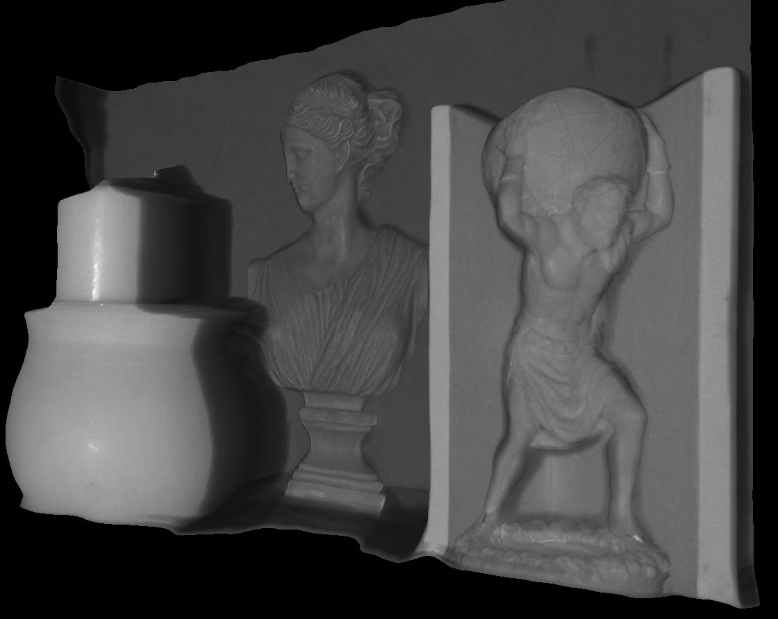
Renderings from different view-points
Notes:
Here are a couple of renderings of the scene from different view points.

Slide 21
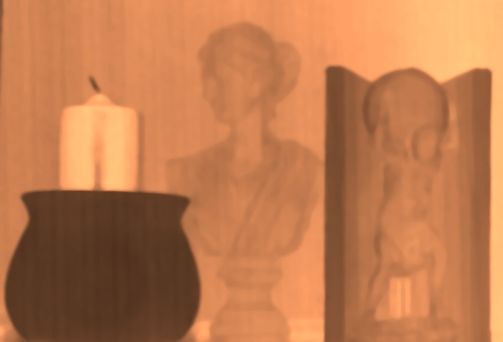
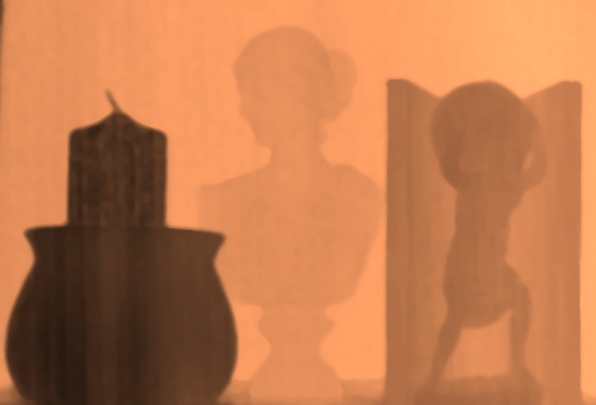

Comparison
Scene
One Focal Plane [Zhang et al]
Two Focal Planes [This Paper]
Multiple Focal Planes [This Paper]
Notes:
Here is a comparison. Top right is the previous technique – the bottom row is our results – with two and multiple focal planes. Looking at this comparison, it becomes clear that one has to account for global illumination for accurate depth recovery – and we have shown that this can be done by modeling both defocus and global illumination as blur kernels and then separating them.
Let’s look at some more results.

Slide 22
Scene with complex BRDF and textures
Metal
Wood
Velvet
Metal
Clay
Fur
Velvet
Sea-shells

Slide 23
Depth Recovery
Scene
One Focal Plane [Zhang et al]
Two Focal Planes [This Paper]
Multiple Focal Planes [This Paper]
Notes:
Look at the base of the objects – because of inter-reflections, the previous technique produces incorrect results. In the correct depth map, there should be a smooooooth transition in depths – which is the case with our results. <Pause>

Slide 24
‘Real vs. Fake’ Scene
Notes:
Try to guess which of these is real and which is fake.

Slide 25
Depth Recovery
Scene
One Focal Plane [Zhang et al]
Two Focal Planes [This Paper]
Multiple Focal Planes [This Paper]
Notes:
Now – because real and fake objects have different amount of translucencies, the previous method produces different depths for them. For example, look at the milk glasses. Interestingly, this can be used to measure how translucent a material is – in this case, the glass on the right with fat free milk is more translucent than regular milk.
In the correct depth map – these should have the same depths – which is the case with our techniques.
Now, so far we have considered global illumination as noise – something which needs to be eliminated. What if we actually want to measure the global component of an image. The reason we would want to do that is because the global component provides a lot of useful information about the scene.

Slide 26
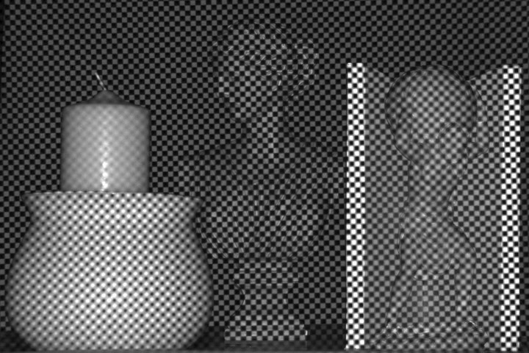
Separation of Direct and Global Components
[Nayar et al’ 06]
S
S
S
Checker-board pattern projected on the scene
Notes:
Recently Nayar et al proposed a technique for separating the direct and global components of light transport using high-frequency illumination. For example, we can use a checker-board pattern with half the pixels on and the other half off.
Consider the scene point S. If it is getting directly lit, it is receiving the direct component and HALF the global component – since only half the pixels are on. We call this emax. If it is not getting directly lit, it receives only half the global component. This is emin.
By shifting the pattern – we can compute the pixel wise emax and emin. From these, we can solve for the direct and global components.
This technique, however, does not account for defocus. Let’s see how does defocus affect separation.

Slide 27
How does Defocus affect Direct-Global Separation?
Defocus Blur
S
S
Projector
Focal Plane Position (f)
Checker-board pattern projected on the scene
Depend on defocus blur
Notes:
Consider this scene point. The pattern is blurred here due to defocus. The separation equations have to be modified in this manner to account for defocus. This point receives only a fraction of the direct component. This fraction depends on the focal plane position – when the point is in focus, it is 1. Since global illumination is a low frequency effect, we assume that S still receives half the global component. Similarly, for the emin image, the scene point receives a fraction of the direct component. This fraction is zero when it is in focus.

Slide 28
How does Defocus affect Direct-Global Separation?
Direct Component
Global Component
Focal plane moving from the front to the back
Notes:
If we do not account for defocus, we will get different separations for different focal plane positions – which is not right, because direct and global components are inherent to the scene – they should not be changing with the focus setting of the projector.

Slide 29
Direct-Global Separation in the presence of Projector Defocus
Notes:
To get the correct separation in the presence of defocus – let’s think about the source of error – defocus. Defocus is a depth dependent effect. So, in principle, if we have a depth map of the scene – we can remove the defocus effects. The depth map can be computed from any of the techniques discussed earlier.

Slide 30
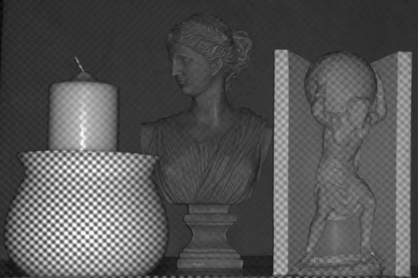
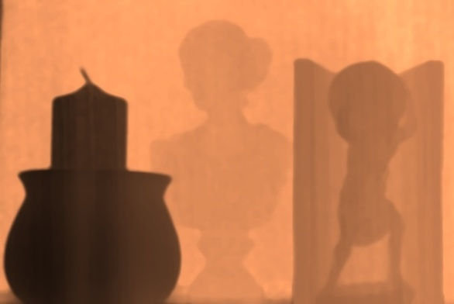
Separation using One Focal Plane + Depth map
Input
Max Intensity:
Min Intensity:
S
Direct Component:
Global Component:
Depth Map
Notes:
Let’s see how we do this.
Once again, let’s consider the scene point S – and compute emax and emin: the maximum and the minimum intensity.
Now here are two equations and 4 unknowns: eglobal, edirect, alpha-max and alpha-min. But, alpha-max and alpha-min depend ONLY on the defocus, and can be computed given the depth map of the scene.
So, we can take the difference of these two equations to eliminate the global component, and compute the direct component. Alpha-max and Alpha-min are computed from the depth map.
The global component is then computed simply by subtracting the direct image from the total image.
Here are the resulting direct and global components.

Slide 31
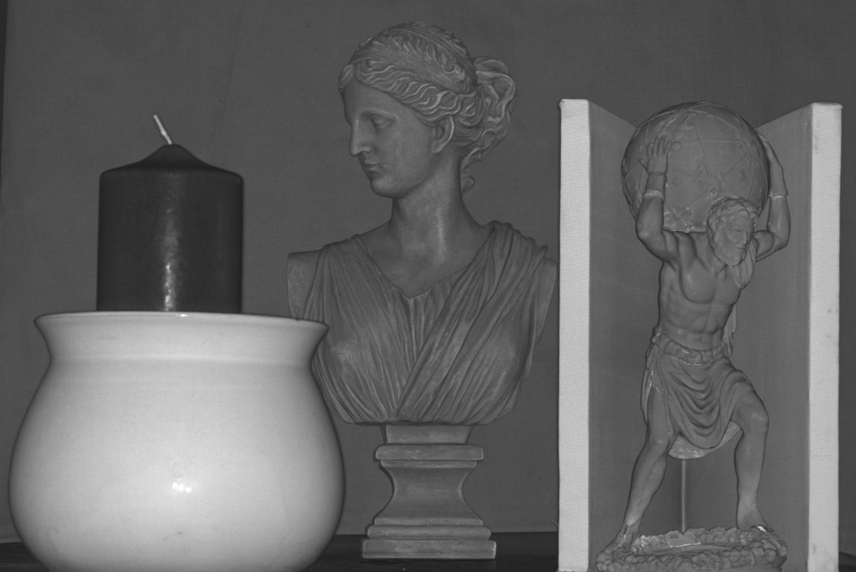
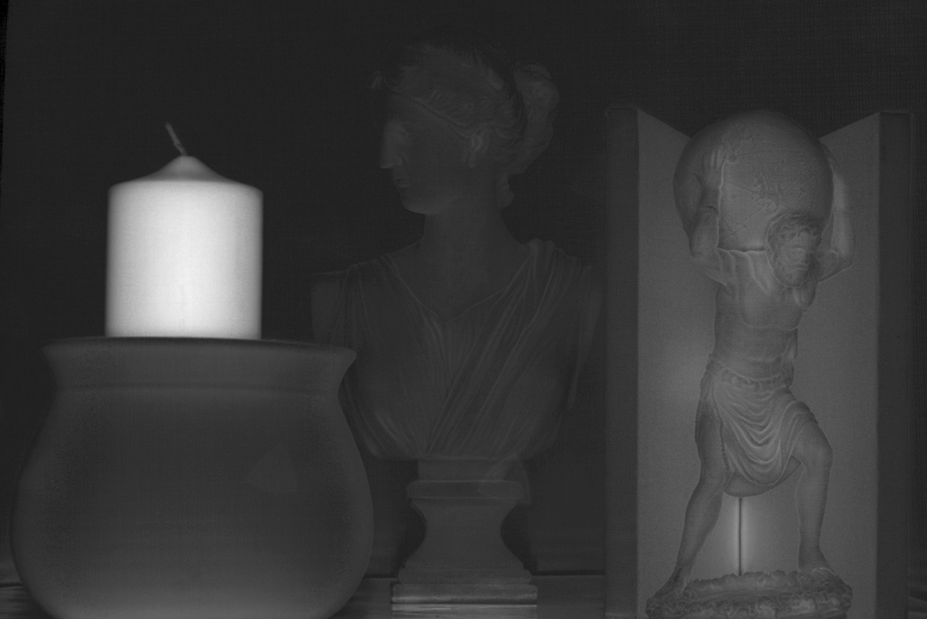
Separation using a Single Focal Plane + Depth Map
Direct Component
Global Component
Notes:
Notice the high global component due to sub-surface scattering on the candle, in the concavity and on the marble statue. The background wall and the clay pot have low amounts of global component.
It’s interesting to note the duality between the two applications: Earlier we were removing global illumination to get the correct depths – now we are removing defocus to get the correct global illumination.
Let’s look at some more results.

Slide 32
Organic Scene
Notes:
Now, I will show the results of our techniques on another scene composed of a variety of organic material, such as plants, flowers, peppers, pumpkins and eggs. We have a wide variety of BRDF’s, translucencies and complex shapes in this scene.

Slide 33
Separation using a Single focal plane [Nayar et al]
Direct Component
Global Component
Focal plane moving from the front to the back
Notes:
If we do not account for defocus, we will get a different separation for different focal plane positions – which is not right, because direct and global components are inherent to the scene – they should not be changing with the focus setting of the projector.

Slide 34
Separation using a Single Focal Plane + Depth Map
Direct Component
Global Component
Notes:
This is the separation using our multiple focal plane algorithms. The color of the pepper is mostly due to sub-surface scattering, and the translucency in the flower.

Slide 35
‘Real vs. Fake’ Scene
Direct Component
Global Component

Slide 36
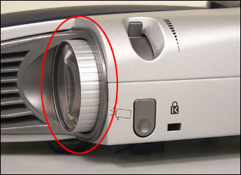
Illumination Defocus using an area light source
Scene
Area Light Source
Mask
Aperture
Focal Plane
Sun for Outdoor Scene Recovery
Notes:
Now, so far, we have associated projectors with illumination defocus – when it is really a more general effect. We have observed that we can simulate defocus using an area light source and a mask –the mask acts as the focal plane and the area source acts as the aperture. We can change the focus setting by either moving the mask or changing the size of the source. One big criticism we get is that all these techniques are good for table-top objects. With this analysis, we can use sun for recovering scene properties even for outdoor scenes.

Slide 37
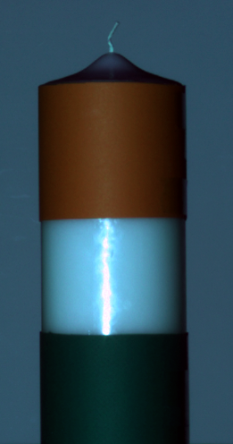



Defocused Illumination vs. Global Illumination
Scene Recovery in the presence of Global Illumination and Defocus
Area Light Source
Scene
Mask
Sun for Outdoor Scene Recovery
Dynamic Scenes
Notes:
For future work, we are planning to extend our techniques for outdoor, as well as dynamic scenes.
So, hopefully, in this talk, I have been able to shed some illumination on global light transport, albeit in a slightly defocused manner. Thank you all for listening, and I will be happy to take any questions.

